Slide 1
Sales Analysis
Timothy Yip

Slide 2
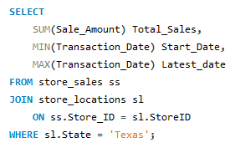
Total Revenue
Start date: 01/01/2022
End date: 12/31/2025
Total sales: $3,417,850.01

Slide 3
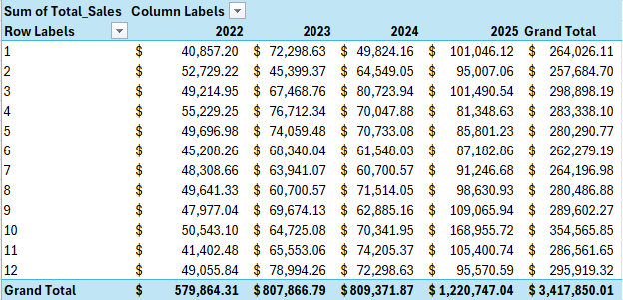
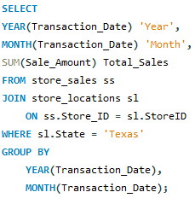
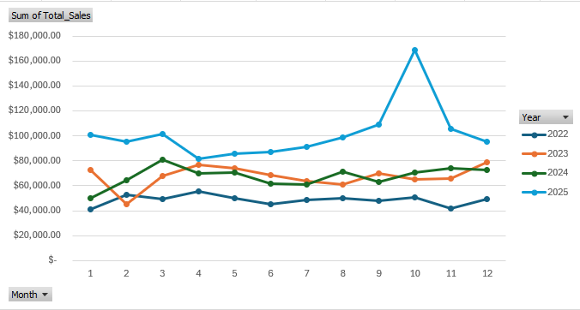
Yearly and Monthly Sales

Slide 4
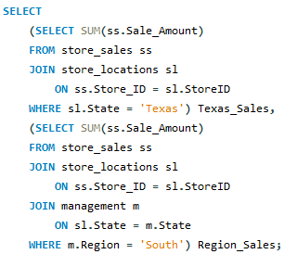
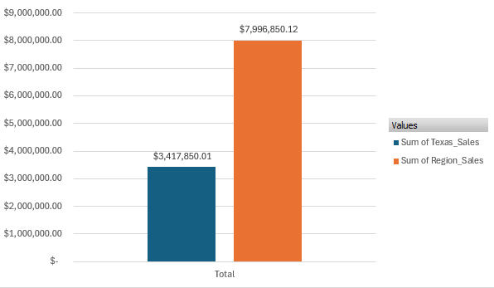
Texas vs. South Region Total Sales
South Region: $7, 996,850.12
Texas: $3,417,850.01
Difference: $4,579,000.11
Texas percentage: 42.74%

Slide 5
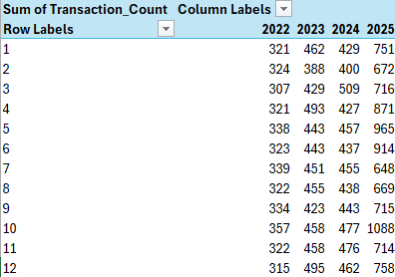
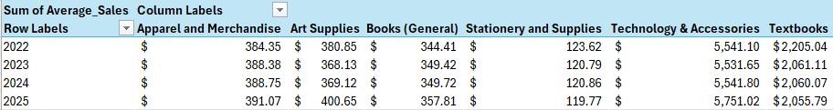
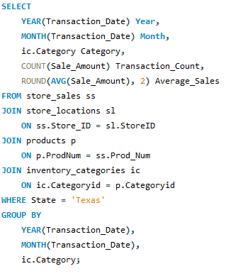
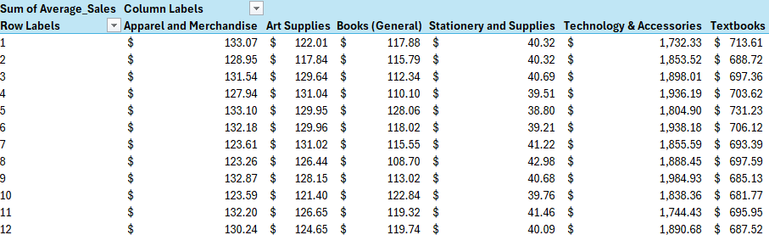
Average Sales Amount and Count
Per Month and Year

Slide 6
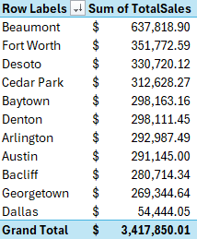
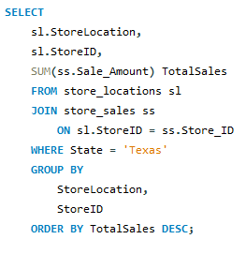
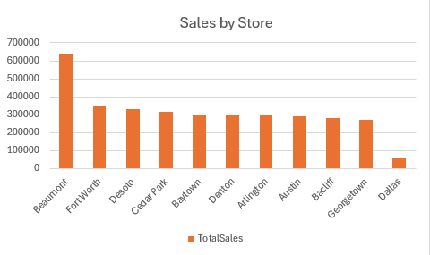
Store Ranking
Highest: Beaumont - $637,818.90
Lowest: Dallas - $54,444.05
Average: $310,713.64

Slide 7
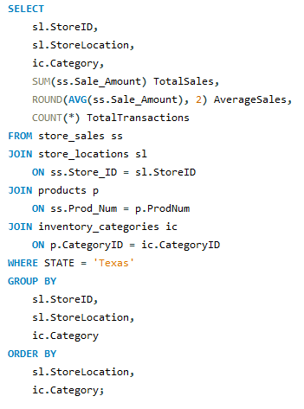
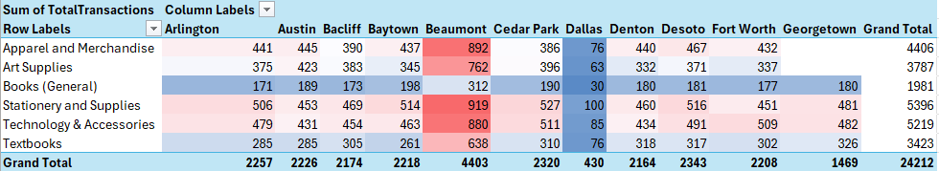
Focus Areas
Dallas low on sales
Georgetown missing categories

