Slide 1
MANAGEMENT BRIEFING · TEXT MINING · OCTOBER 2026
What 22,641 customer reviews tell us
A text mining analysis of women's apparel reviews: what customers talk about, what drives bad ratings, and where to act
Tim Vetter · Lisa-Marie Schwarz · Batuhan Aras · Max Tenz · Daniele Demerji
Text Mining / Text Analytics · Hochschule Ludwigshafen · Python & Jupyter Notebook
Notes:
We analysed the free text of the reviews with text mining methods from the course, not just the star ratings. All numbers come from the Jupyter notebook customer_review_text_mining.ipynb.

Slide 2
EXECUTIVE SUMMARY
Customers are satisfied, but fit, cut and fabric drive the bad reviews
82%
20%
44%
recommend the item · average 4.18★ · only 10% of reviews are negative (1–2★)
of all reviews report a size mismatch (“runs large”, “size down”…), even 19% of the happy ones
of critical (1–3★) reviews are about cut & shape (24%) or sizing (20%) – found by LDA topic modeling
Where to act
1 · Fit guidance
per-item size advice from review text
2 · Cut & silhouette
feed "unflattering" reviews back to design
3 · Fabric & workmanship
opacity, weight and seam checks
4 · Product pages
photos and specs that match reality
Source: clothing_reviews.xlsx · 22,641 reviews with text · analysis: customer_review_text_mining.ipynb
2
Notes:
Three numbers to remember: satisfaction is high; one in five reviews mentions a size problem; and the topic model shows what unhappy customers complain about.

Slide 3
OUR APPROACH
From 22,641 free-text reviews to numbers management can act on
1
2
3
4
5
6
7
Corpus
Text metrics
Preprocessing
Frequencies
TF-IDF
Sentiment
Topic model
Title + review text
22,641 documents
1.36 M tokens
Length, word length,
vocabulary, Flesch
readability
Tokenization, stop-
words, lemmatization
(NLTK)
Words, n-grams,
word clouds,
co-occurrence
Document-term matrix,
terms that separate
bad from good
VADER lexicon score
validated against
star rating
LDA on 5,193
critical reviews,
8 themes
Reading the results: negative = 1–2★, neutral = 3★, positive = 4–5★. Shares are “% of reviews that mention it”. Topic names are our interpretation of the words the algorithm grouped together.
Methods from the course: Text Mining · Information Retrieval · Natural Language Processing
3
Notes:
This is the pipeline from the first lecture. Each step is a section in the notebook. Key point: we did not define keyword lists in advance – the topics were discovered by the LDA algorithm.

Slide 4
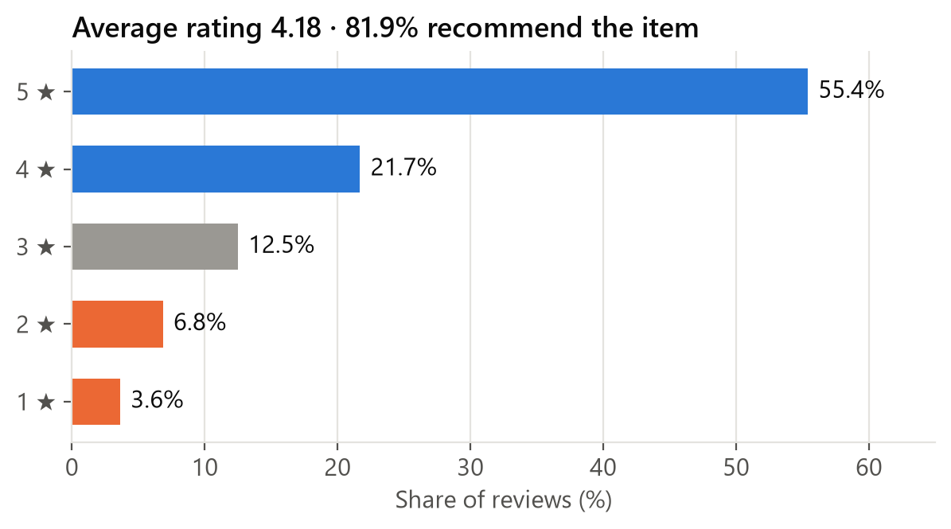
OVERALL PICTURE
Most customers give five stars – the 3★ group is the one to win
4.18★
average rating
82%
would recommend the item
Only 41% of 3★ reviewers recommend
2,823 lukewarm customers – their texts show what holds them back.
Source: clothing_reviews.xlsx · 22,641 reviews with text · analysis: customer_review_text_mining.ipynb · rating and recommendation columns
4
Notes:
Before mining the text: the structured data. 3-star reviewers are split – only about 4 in 10 still recommend.

Slide 5
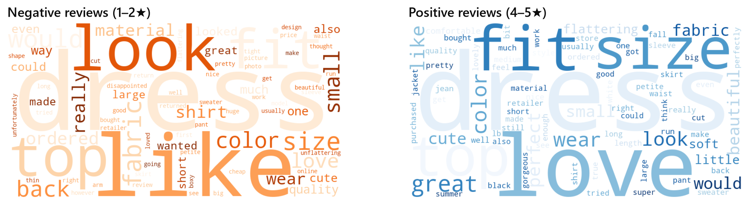
WORD FREQUENCIES
Happy and unhappy customers use the same words
Frequency alone is not enough: dress, fit, size, fabric and color dominate both sides. Positive adds love, perfect, flattering, soft; negative adds back (“sending it back”), material, quality.
Text as numbers: 60 words per review on average, 4.0 letters per word, Flesch reading ease 82 (“easy”), vocabulary of 14,219 distinct words. 3‑4★ reviews are the longest – customers explain trade-offs.
Source: clothing_reviews.xlsx · 22,641 reviews with text · analysis: customer_review_text_mining.ipynb · after stop-word removal and lemmatization
5
Notes:
Word clouds show what customers talk about: dress, fit, size, fabric, colour in both groups. To see what separates good from bad, we need TF-IDF / log-odds (next slide).

Slide 6
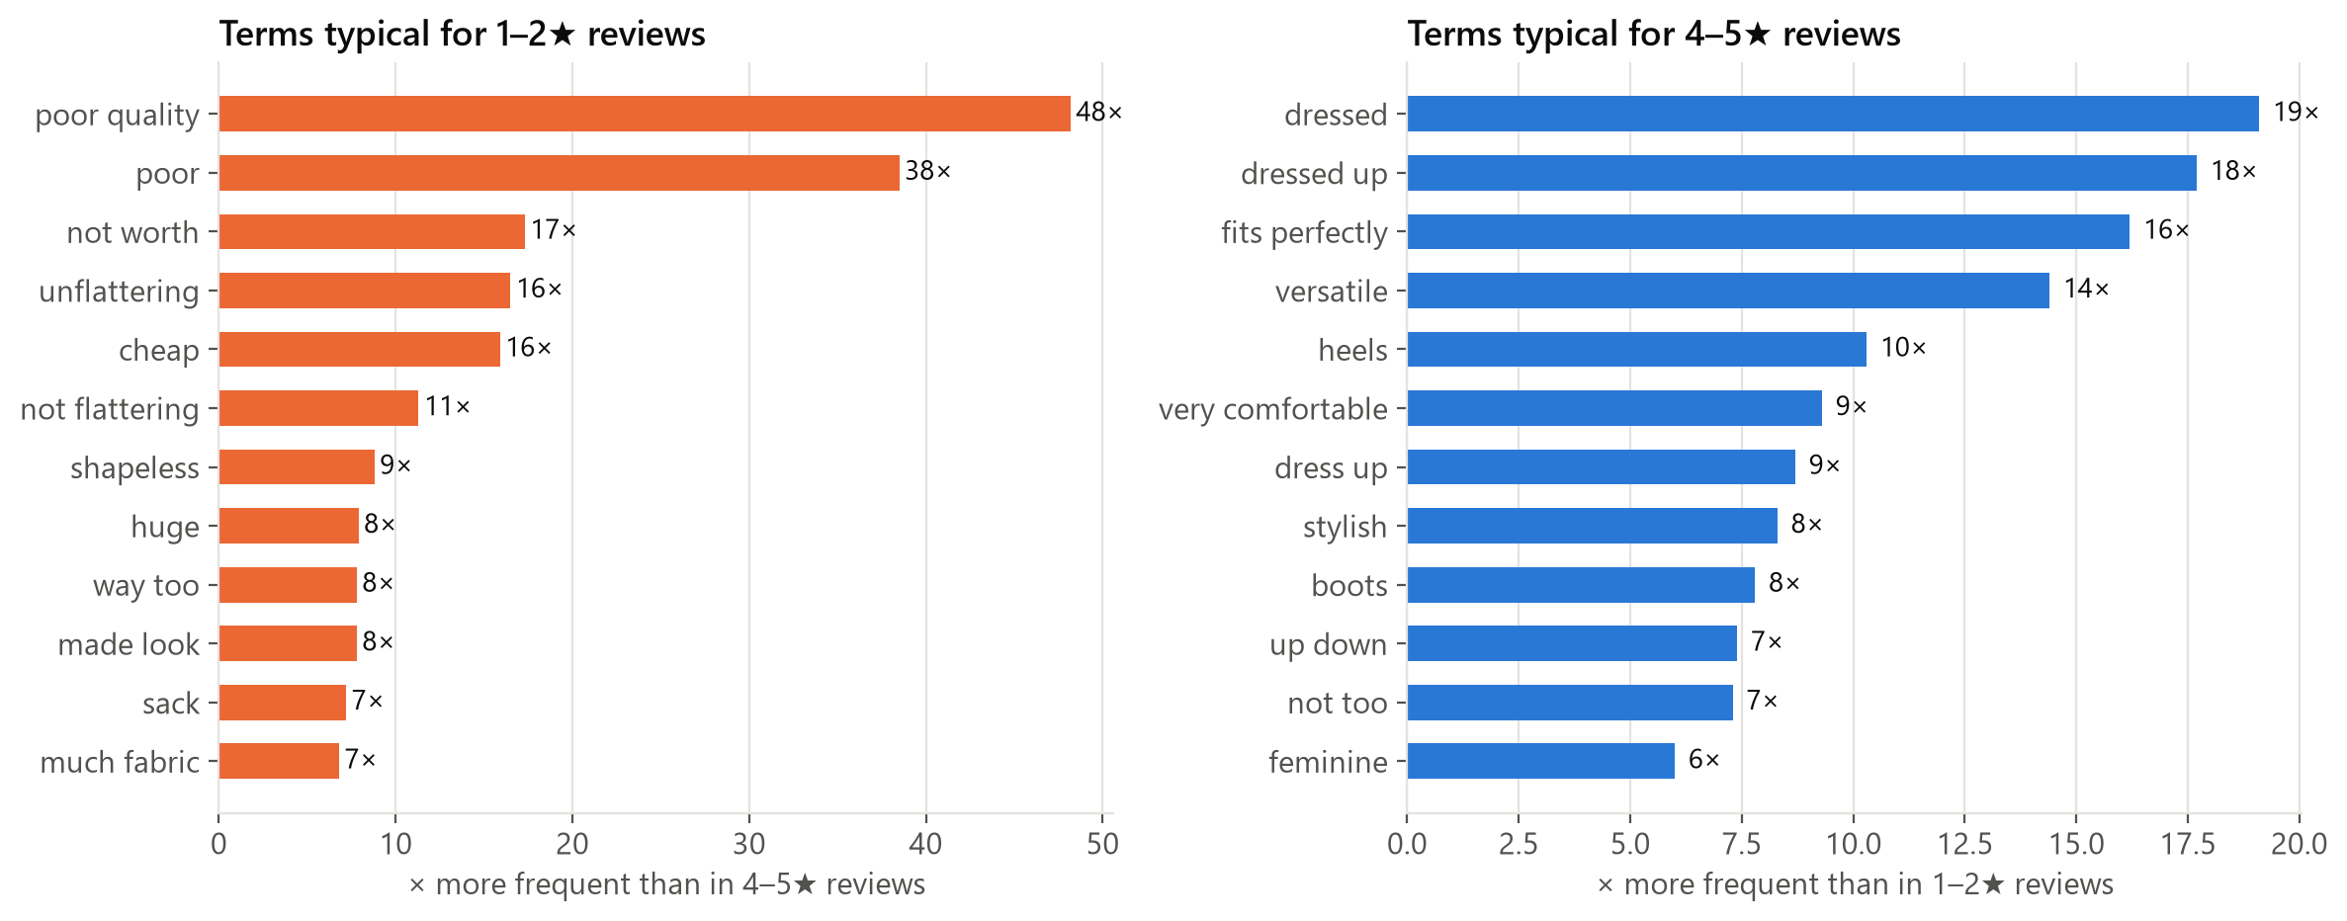
TF-IDF & LOG-ODDS
Bad reviews are about cheap quality and unflattering shapes
Quality
“poor quality” 48× and “cheap” 16× more frequent in bad reviews
Shape
“unflattering” in 7% of bad vs 0.4% of good reviews; “shapeless”, “huge”, “tent”
Source: clothing_reviews.xlsx · 22,641 reviews with text · analysis: customer_review_text_mining.ipynb · terms in ≥ 50 negative / ≥ 300 positive reviews; pure emotion words removed
6
Notes:
Each bar: how many times more often the term appears in a 1-2 star review than in a 4-5 star review. Purely emotional words like "disappointed" were removed so the chart shows product drivers.

Slide 7
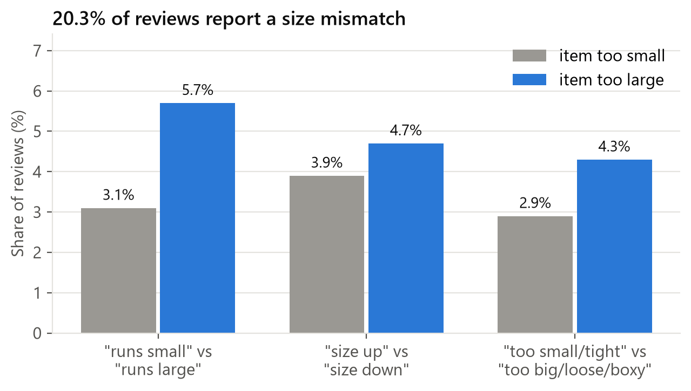
N-GRAM ANALYSIS: SIZING
One in five reviews reports a size mismatch – items run large
20%
of reviews mention a size mismatch
19%
of 4–5★ reviews still warn about the size
“true to size” only 8%
Customers need size advice – and they are already writing it for us.
Source: clothing_reviews.xlsx · 22,641 reviews with text · analysis: customer_review_text_mining.ipynb · bigram/trigram patterns such as “runs (a bit) large”, “size down”
7
Notes:
N-grams turn sizing language into a measurable signal. "Runs large" and "size down" clearly outnumber "runs small" and "size up". Even satisfied customers warn others about the size.

Slide 8
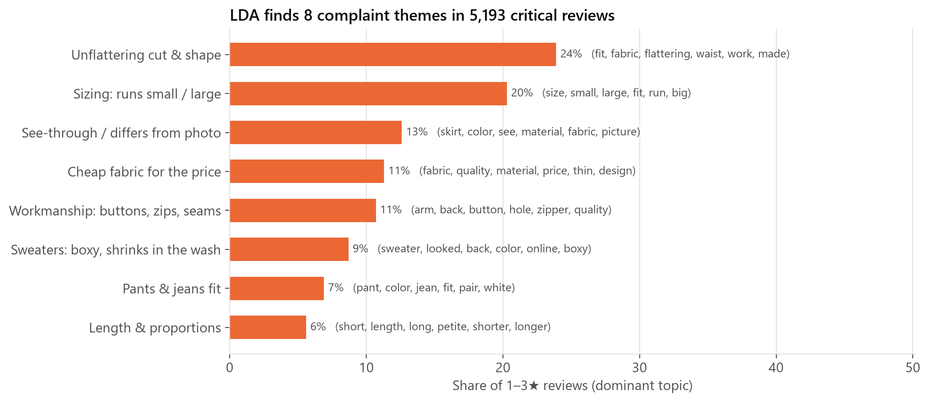
TOPIC MODELING (LDA)
The algorithm finds eight complaint themes – cut and sizing lead
LDA (scikit-learn), k = 8, on 5,193 reviews with 1–3★ · dominant topic per review · words in brackets = top terms
8
Notes:
LDA groups words that occur together into topics. We read the top words and example reviews and named each topic. Cut & shape and sizing together account for almost half of critical reviews.

Slide 9
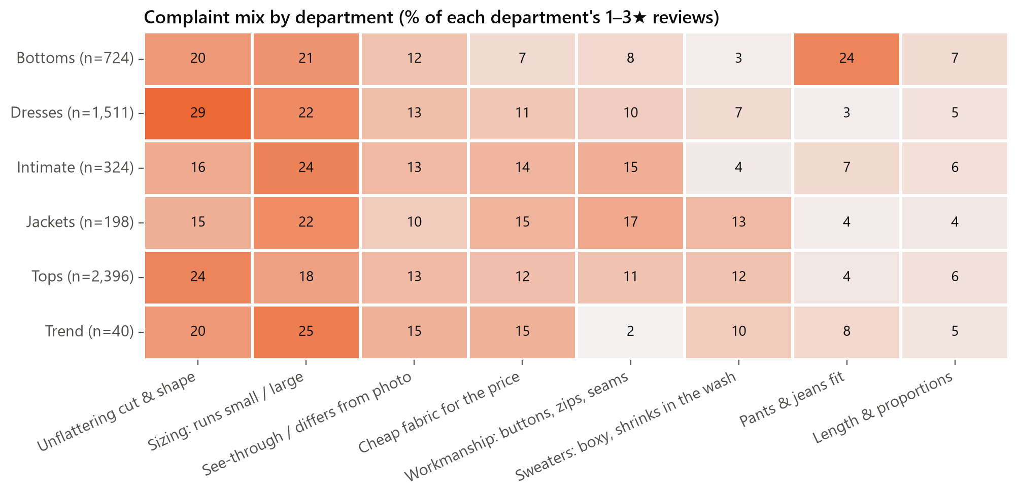
TOPICS BY DEPARTMENT
Beyond cut and sizing, each department has its own weak spot
Above-average topic
Dresses
cut & shape 29%
Bottoms
pants & jeans fit 24%
Jackets
workmanship 17%
Intimate
workmanship 15%, fabric 14%
Tops
sweaters & wash 12%, fabric 12%
Share of each department's 1–3★ reviews by dominant LDA topic (%) · Trend: small sample
9
Notes:
Read across a row: Dresses – the cut; Bottoms – pant and jeans fit; Jackets and Intimates – workmanship; Tops – washing and fabric. This tells each category team where to start.

Slide 10
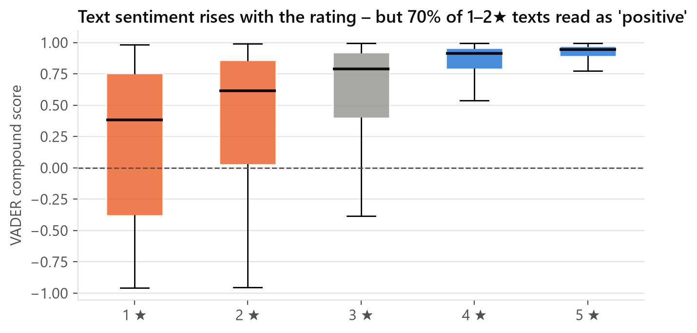
SENTIMENT ANALYSIS (VADER)
Text sentiment follows the stars – but cannot replace them
70%
of 1–2★ reviews are scored “positive” by VADER
“I wanted to love this…”
Unhappy customers praise colour and idea before the decisive “but it fits like a tent”. A general sentiment lexicon misses this – use topics and terms, not a sentiment score, for reporting.
Source: clothing_reviews.xlsx · 22,641 reviews with text · analysis: customer_review_text_mining.ipynb · VADER compound score; Spearman ρ with rating = 0.45
10
Notes:
VADER is a dictionary-based sentiment model. It rises with the rating, but it scores 70% of 1-2 star reviews as positive, because disappointed customers write "I wanted to love this, beautiful color, but...". Lesson: the value of the text is in WHY customers are unhappy, not in a sentiment score.

Slide 11
BY AGE GROUP
Satisfaction rises with age – the complaints are the same for everyone
Age | Share of reviewers | Avg ★ | Negative | Recommend
18-29 | 12% | 4.19 | 9.6% | 81%
30-39 | 32% | 4.15 | 10.9% | 81%
40-49 | 26% | 4.14 | 11.3% | 81%
50-59 | 17% | 4.23 | 9.8% | 84%
60+ | 12% | 4.29 | 9.3% | 85%
85%
of reviewers aged 60+ recommend – the highest group
Same problems at every age
Sizing is 20–21% of critical reviews in every age group. Cut & shape matters slightly more to younger customers (26% at 18–29 vs 21% at 60+).
Source: clothing_reviews.xlsx · 22,641 reviews with text · analysis: customer_review_text_mining.ipynb · age as stated by the reviewer
11
Notes:
All age groups name the same LDA topics in roughly the same proportions. So the fixes are product fixes, not age-specific campaigns.

Slide 12
RECOMMENDATIONS
Four actions – each with a KPI we can track from the review text
1
Fix fit guidance
2
Review cuts & silhouettes
Per-item fit notes (“runs large – size down”) and a size advisor fed by review n-grams. Start with Dresses and Tops.
Share the “unflattering / shapeless / boxy” reviews with design every season; rework repeat offenders.
KPI: size-mismatch reviews, today 20%
KPI: cut & shape topic, today 24% of critical reviews
3
Tighten fabric & workmanship checks
4
Make product pages match reality
Opacity, fabric weight, wash tests and seam/zip checks – especially Tops, Intimates, Jackets.
Show fabric, opacity, length and the model’s size; re-shoot items with “not like the picture” reviews.
KPI: fabric + workmanship + washing topics, today 31%
KPI: see-through / photo topic, today 13%
KPIs are measured with the same notebook – re-run it on each new review export
12
Notes:
Each recommendation links to a finding and a measurable KPI. Because the analysis is a notebook, these KPIs can be refreshed every quarter at no extra cost.

Slide 13
APPENDIX · METHOD AND LIMITS
How the analysis was done and what to keep in mind
Data & tools
clothing_reviews.xlsx: 23,490 rows → 23,486 rated → 22,641 with text (title + review = one document)
Python in Jupyter: pandas, NLTK (tokenization, stop-words, WordNet lemmatizer), scikit-learn (CountVectorizer, TF-IDF, LDA), vaderSentiment, textstat, wordcloud
Negations kept for n-grams (“not flattering”, “too big”)
LDA: 1,111-term vocabulary, k = 8 chosen for interpretability, fixed random seed
Limits
No review dates in the export – no trends over time yet
Review texts are cut at ~500 characters
One dominant topic per review for reporting; real reviews mix topics. Topic names are our interpretation
VADER is a general lexicon, not tuned to fashion language
Trend department (118 reviews with text) too small for firm conclusions
All code, outputs and charts: customer_review_text_mining.ipynb · github.com/Tim-vt22/MBA-Text-Mining
13
Notes:
For questions on method. The notebook is fully reproducible.

