Slide 1
Imagine this situation
(based on a true story)

Slide 2
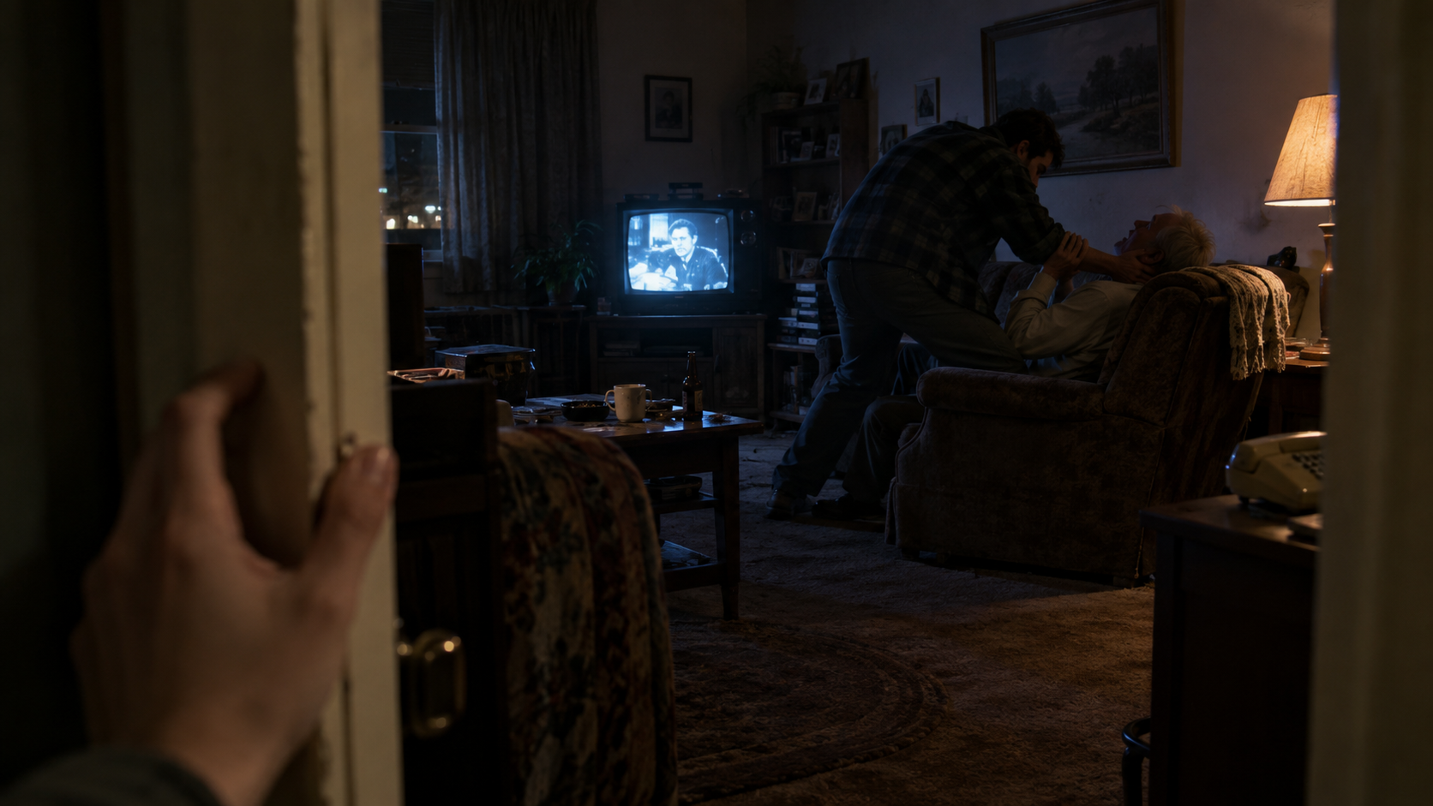

Slide 3
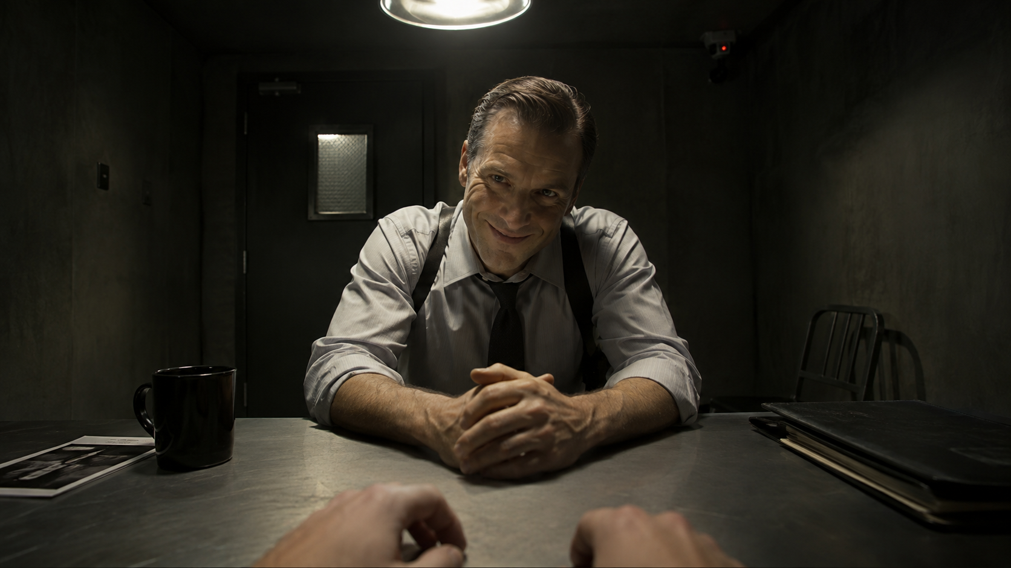

Slide 4
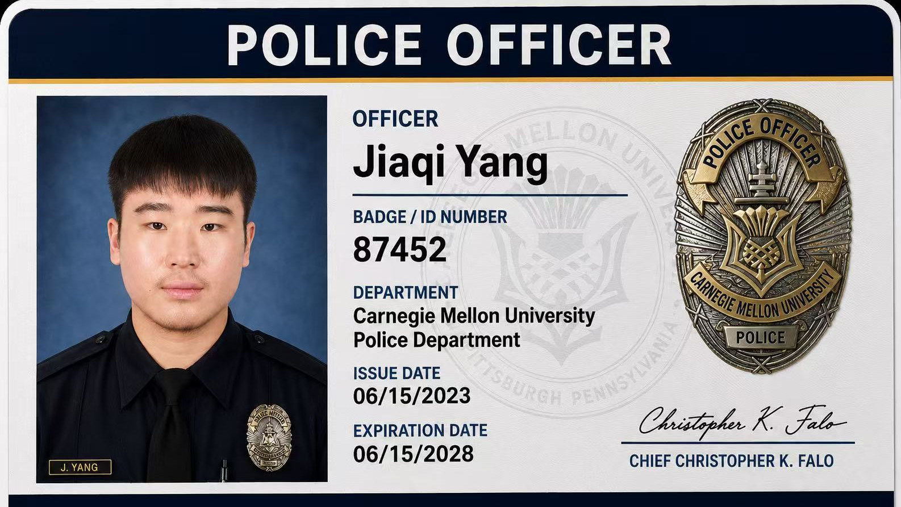

Slide 6
Neal was charged with the murder of Donald Collins

Slide 8
Purpose
Flag potential rights violations while intervention is still possible.

Slide 9

Voice
ElevenLabs Scribe v2
Eleven Flash v2.5

Slide 10

Reasoning
NVIDIA Nemotron 3.5 Lightning

Slide 11
Integration

Slide 12
“Lastly, we note that at any retrial, neither of defendant's two confessions will be admissible. Because each was involuntary, each is inadmissible for any purpose.”

