Slide 1
A True Story

Slide 2
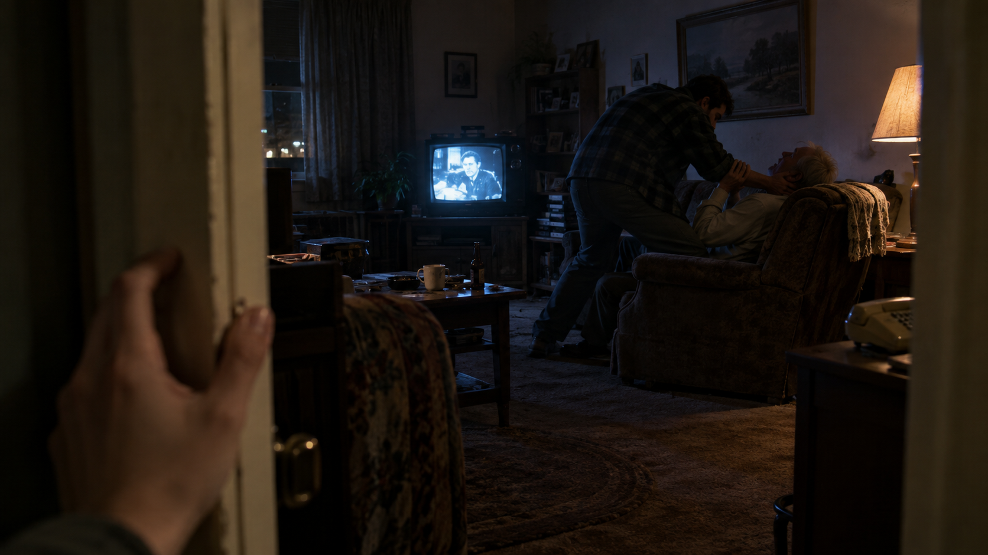

Slide 3
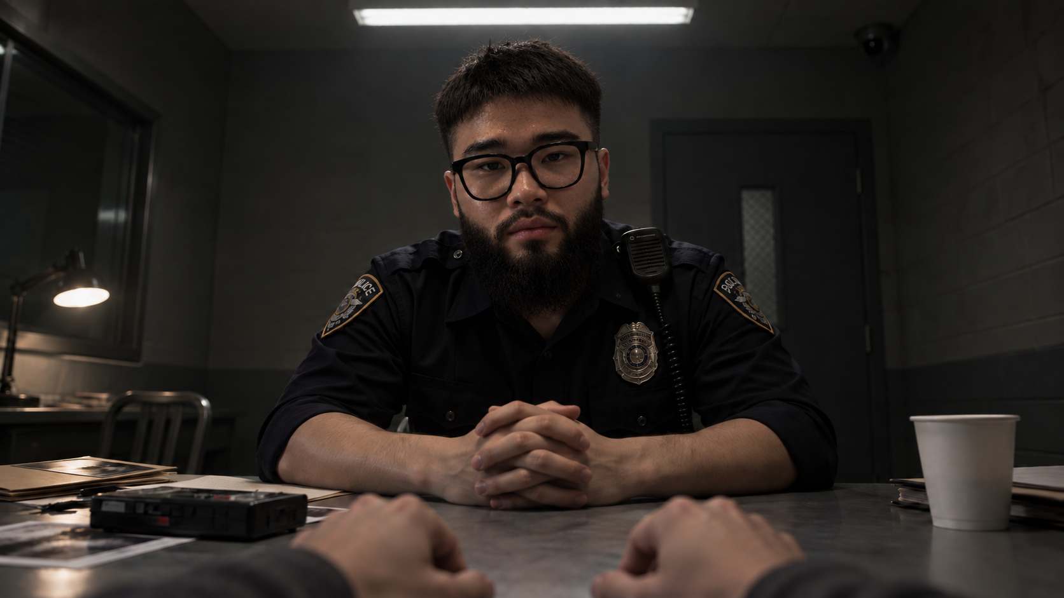

Slide 5
Neal was falsely charged with the murder of Donald Collins

Slide 6
Problem
Suspects are pressure to admit due to biased interrogation and threats
People’s rights can be violated
Without anyone recognizing the problem and intervening in time.

Slide 7
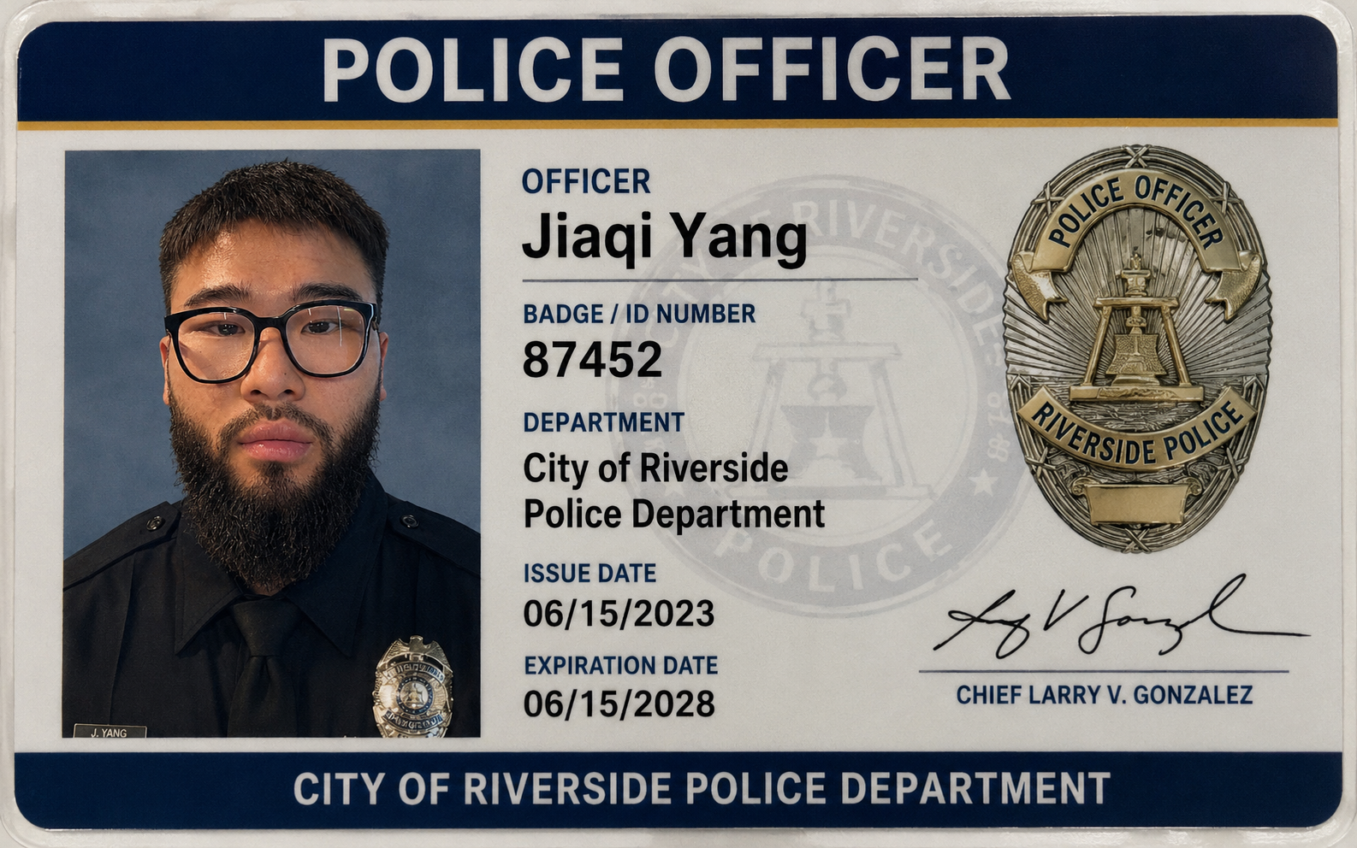
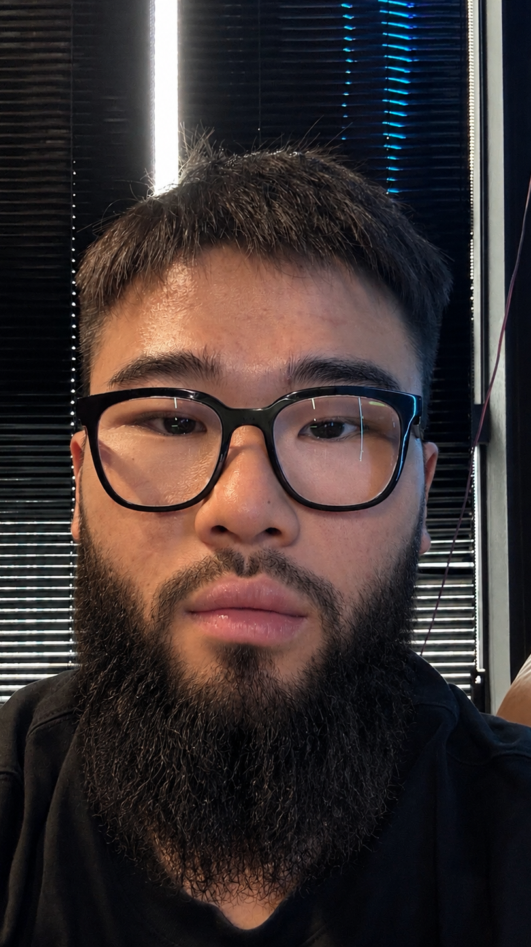

Slide 8
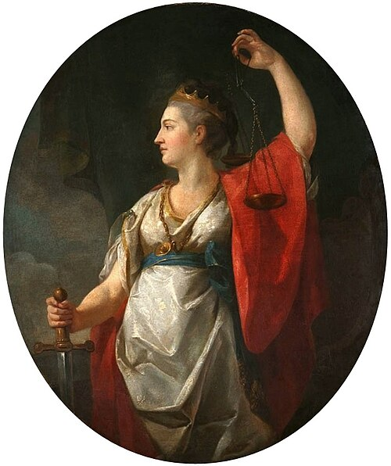
Themis
https://en.wikipedia.org/wiki/Themis
Notes:
Themis uses AI to flag potential rights violations during police interrogations and deliver spoken alerts, helping people recognize biased interrogation and threats and intervene before harm escalates.

Slide 9
User Interface Live Demonstration

Slide 10
Live Interrogation Monitor
Recording Starts
Audio input
Speech to Text
Transcribed Text
Analysis for violation of right
Text to Speech
Audio Output
ElevenLabs
Nemotron
ElevenLabs
Recording Ends
Saves session to archives

Slide 12
Reason for implementation
Higher accountability & credibility for police departments
Notes:
Reasons police departments would want ti implement this tool is because it gives them higher credibility, providing an objective reminder during questioning to prevent over biased questions and decisions, and it makes managing interrogations more convenient because of our archives tool

Slide 13

Voice
ElevenLabs Scribe v2
Eleven Flash v2.5
Notes:
How does our project fit in the track?
Why does speech beat text in this scenario?
Speech beats text in this scenario as it does a better job alerting the person of interest when a concern arises during interrogation.

Slide 14

Reasoning
NVIDIA Nemotron 3.5 Lightning
Notes:
talk about how we are using nemotron different from a chatbot
What does nemotron do in our project?
Some evidence that it works: an eval, comparison, benchmark, or even a failure you found.

Slide 15
Limitation
Accuracy -> human decision
Sensitive information

Slide 16
What did we learn?
Vibe Coding
Collaboration through GitHub
Developing and testing a usable product
Notes:
As beginners, we also learned about vibe coding and using GitHub to collaborate and manage changes.

Slide 17
Credit
Codex and Cursor for implementing the detailed plan and frameworks we decided
ChatGPT image for creating the scenes

