Slide 1
Progress update
Timothy Allen summer RA

Slide 2
Tinius Olsen
Familiarization with force decay measurements and equipment

Slide 3

MagMapper
Radial plots
Characteristics
Accuracy

Slide 4
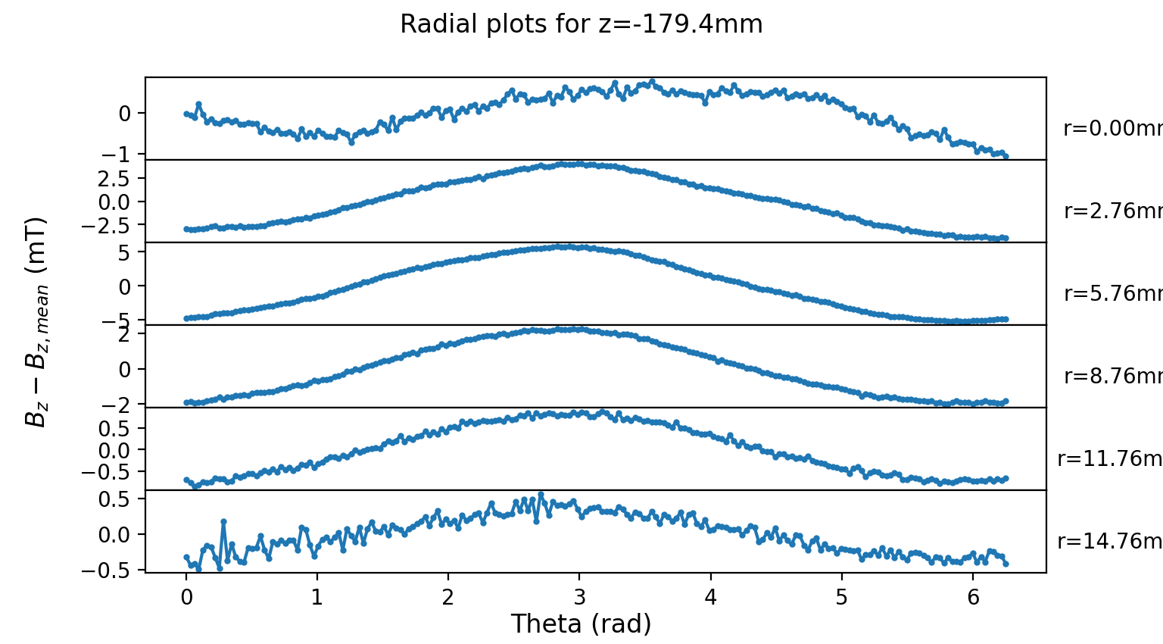
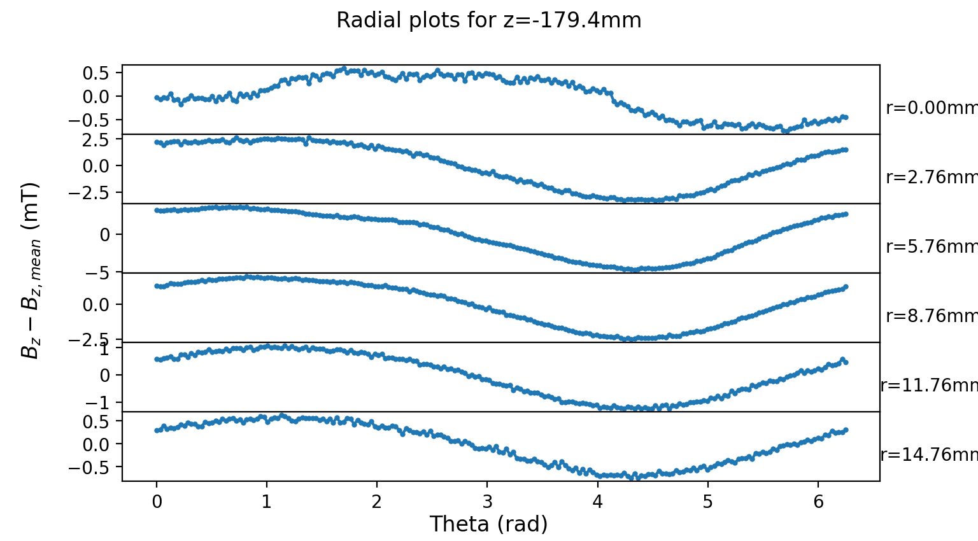
C350_12 with extra centering
C350_5

Slide 5
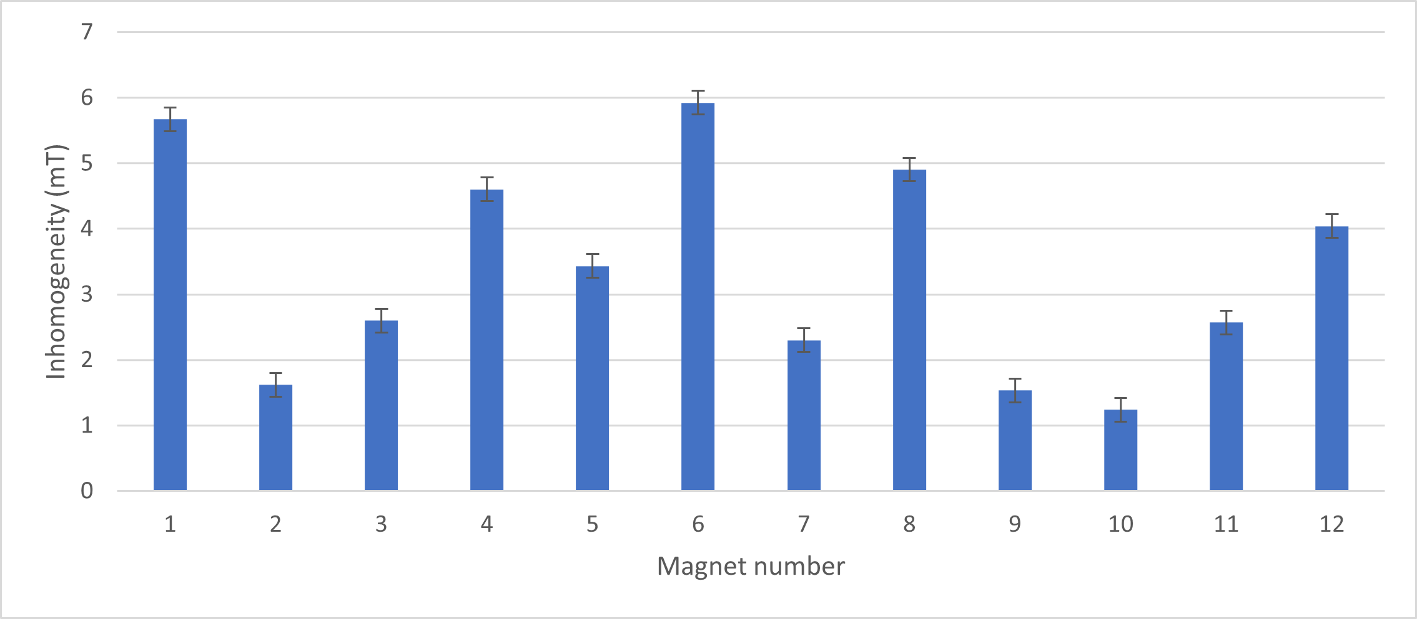
Inhomogeneity

Slide 6
Future work on accuracy
Little to no effect of day vs overnight measurements (<10% change in standard deviations)
Difference of more centered measurements appears small but not characterized
Duplicates within one measurement agree with standard deviation
Evaluate full duplicate measurements
Characterize fully centered data and compare

Slide 7
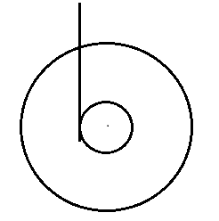


Centering
How measurements were taken
Observed changes
Missing data
Auto-centering with LabVIEW
Evaluation of severity
Exaggerated example of the effect

Slide 8
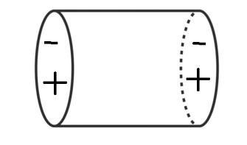
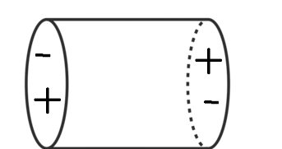
Further characterization
Aligning and comparing centres of magnetism
Aligned, offset motion
Oppositely aligned, twisting motion

Slide 9
Horizontal bearing setup
Familiarization

Slide 10
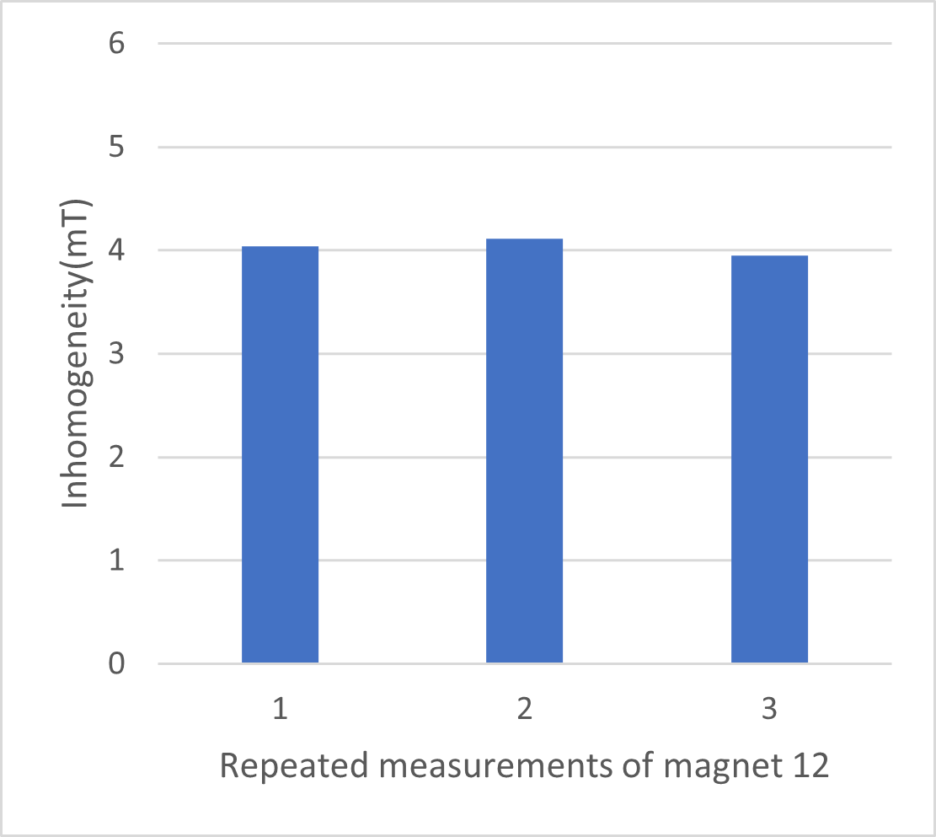

Slide 11
Inhomogeneity data
Magnet | Inhomogeneity (mT) | err
1 | 5.67 | 0.18
2 | 1.62 | 0.18
3 | 2.60 | 0.18
4 | 4.60 | 0.18
5 | 3.43 | 0.18
6 | 5.92 | 0.18
7 | 2.30 | 0.18
8 | 4.90 | 0.18
9 | 1.54 | 0.18
10 | 1.24 | 0.18
11 | 2.57 | 0.18
12 | 4.04 | 0.18
12 | 4.11 | 0.18
12 | 3.95 | 0.18

