Slide 1

Horizontal shaft update
Timothy Allen
25th Jan 2024

Slide 2
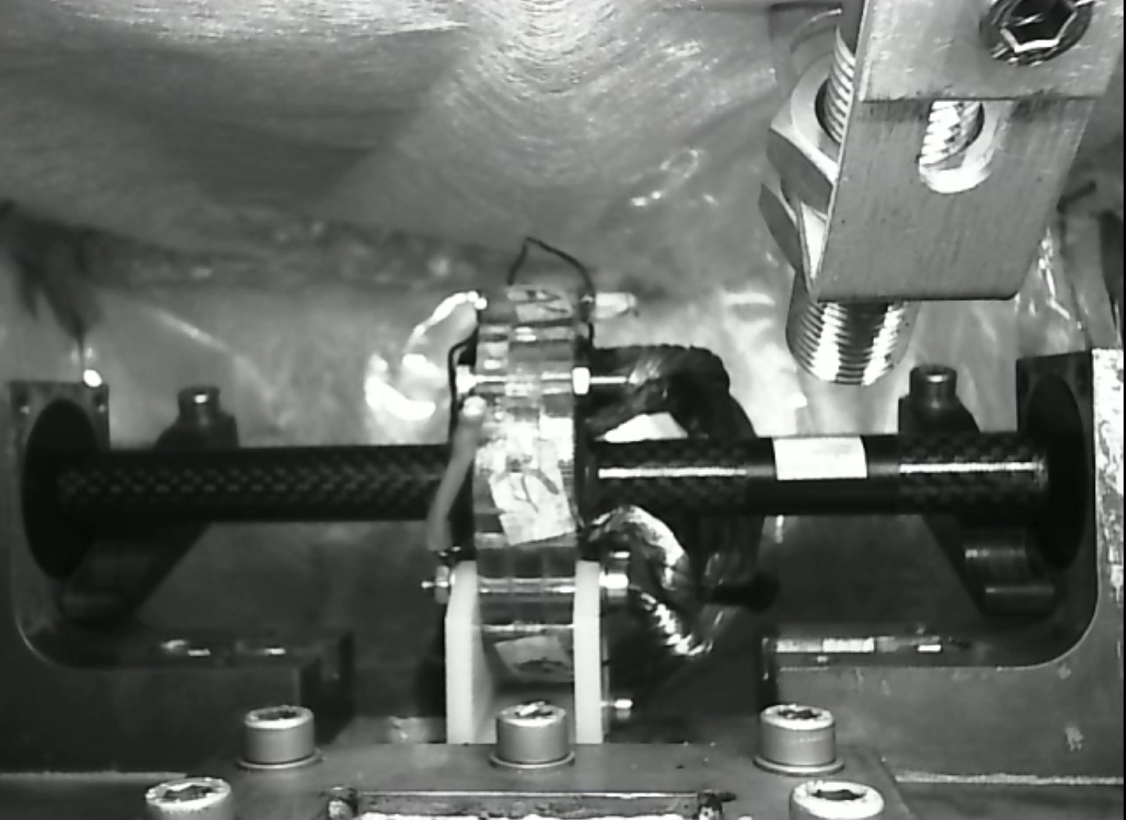
Overview
Design
Shaft
PLECs
LabVIEW
ADC accuracy to external mode

Slide 3
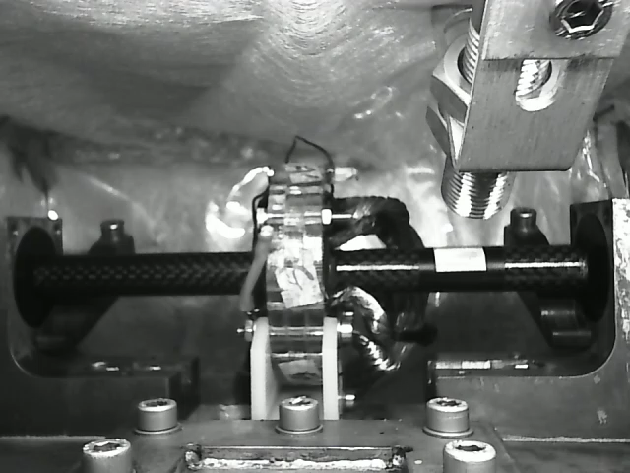
Roadblock
Ran at 1500Hz then stalls
Notes:
0, 1:05, 7:15

Slide 4
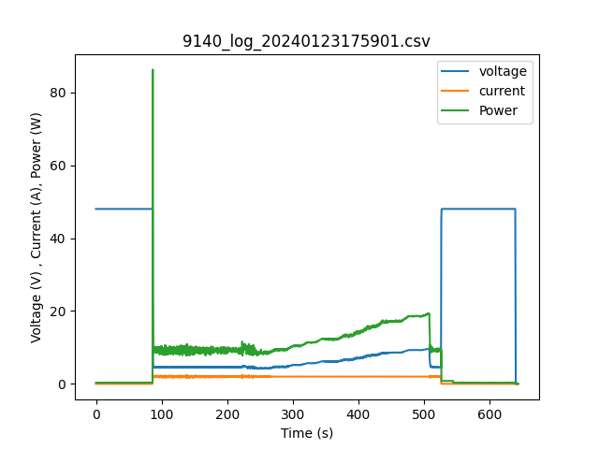
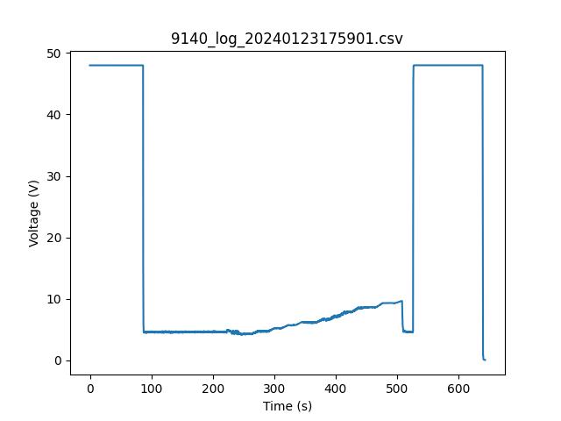
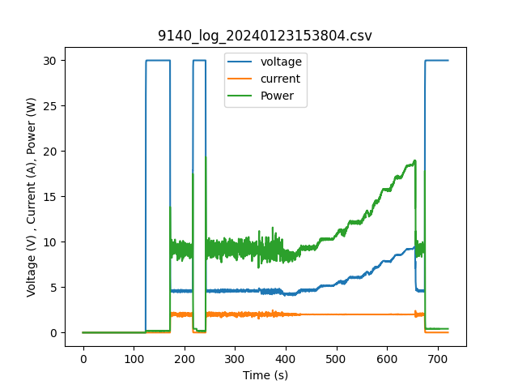
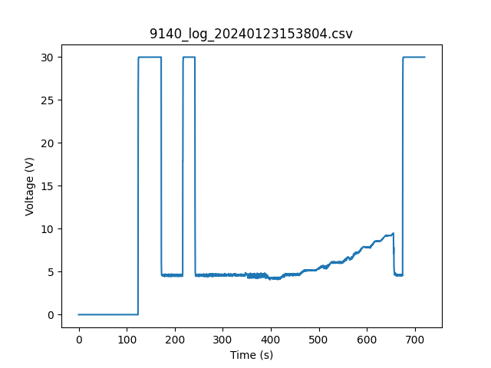
Power output
10V failure
Notes:
10V

Slide 5


