Slide 1
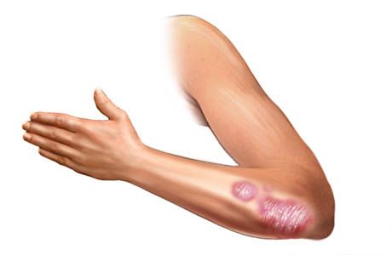
Statistical Analysis
Searching for relations between psoriasis/atopic dermatitis and gene expression

Slide 2
Contents
Data extraction
Feature Dimensionality
Clustering
Process relations
Cellular locations
Molecular relations
Gene trio
Psoriasis vs Atopic Dermatitis
A computational biololgy framework

Slide 3
Data extraction
NCBI information availability

Slide 4
Data Extraction
Data sets
  6 psoriasis
  3 atopic dermatitis
Values
  54675 genes
  Normal, Non-Lesional, Lesional
Focus
  Psoriasis
  Normal vs Non-Lesional?
  Non-Lesional vs Lesional (423)
Additional data
  Gene specific details
  Process, Cellular, Molecular information
A Computational Biology Framework

Slide 5
Feature Dimensionality
Removing features

Slide 6
Feature Dimensionality
Significance extraction
  T-test
  54675 -> 1768 significant genes
A Computational Biology Framework

Slide 7
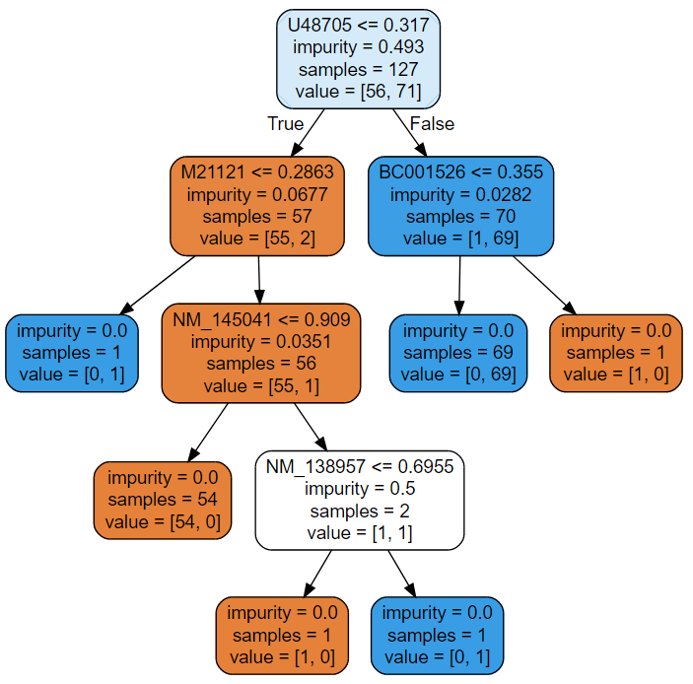
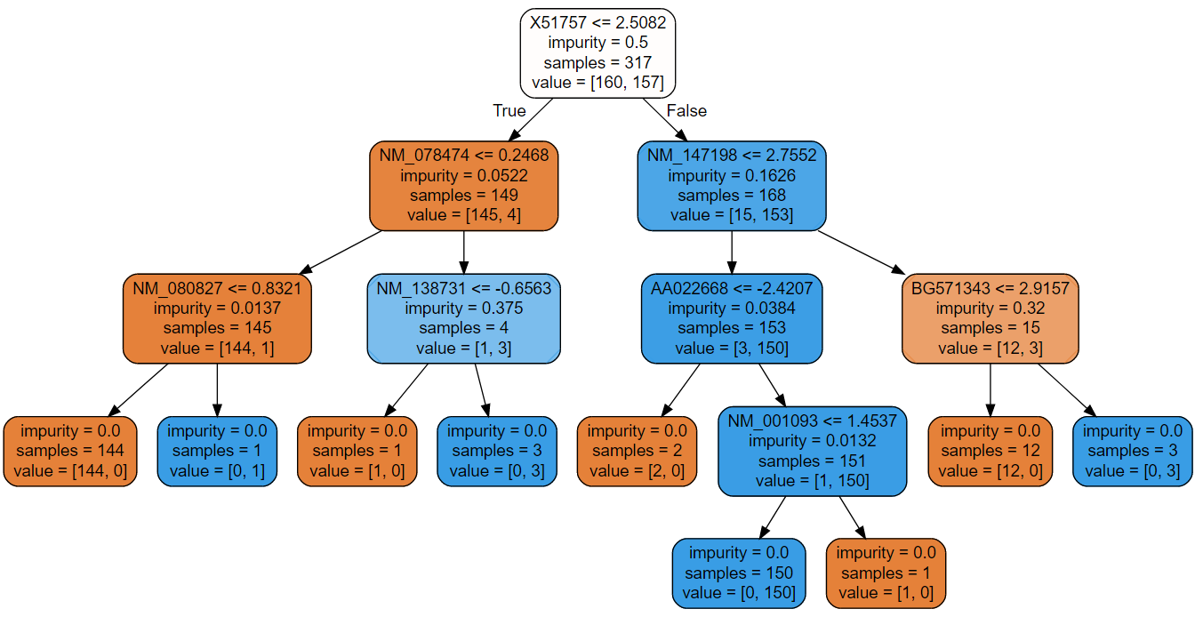
Feature Dimensionality
Correlation
  Memory issues
  Greedy multicollinearity testing
Score: 0.972
A Computational Biology Framework

Slide 8
Clustering
Finding relational genes

Slide 9
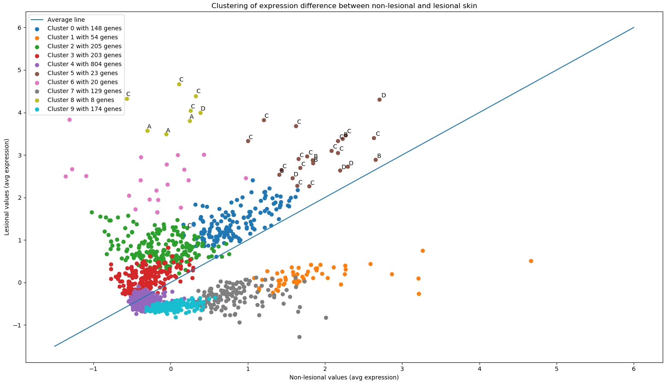
Clustering
Different types
  Agglomerative (hierarchical)
  K-means
  DBSCAN
Interesting clusters
  Cluster 5: Skin processes
  Cluster 8: Negative regulation
Labeled genes
  A: confirmed psoriasis markers
  B: known psoriasis linked genes
  C: known skin cell interesting genes
  D: unknown upregulated genes
A Computational Biology Framework

Slide 10
Process relations
Researching gene processes

Slide 11
Process
Relations
Check process significance
  Relational genes
  Many significant processes
Checked cluster 5 and 8 processes
  5: skin related processes
  8: (negative) regulation processes
A Computational Biology Framework

Slide 12
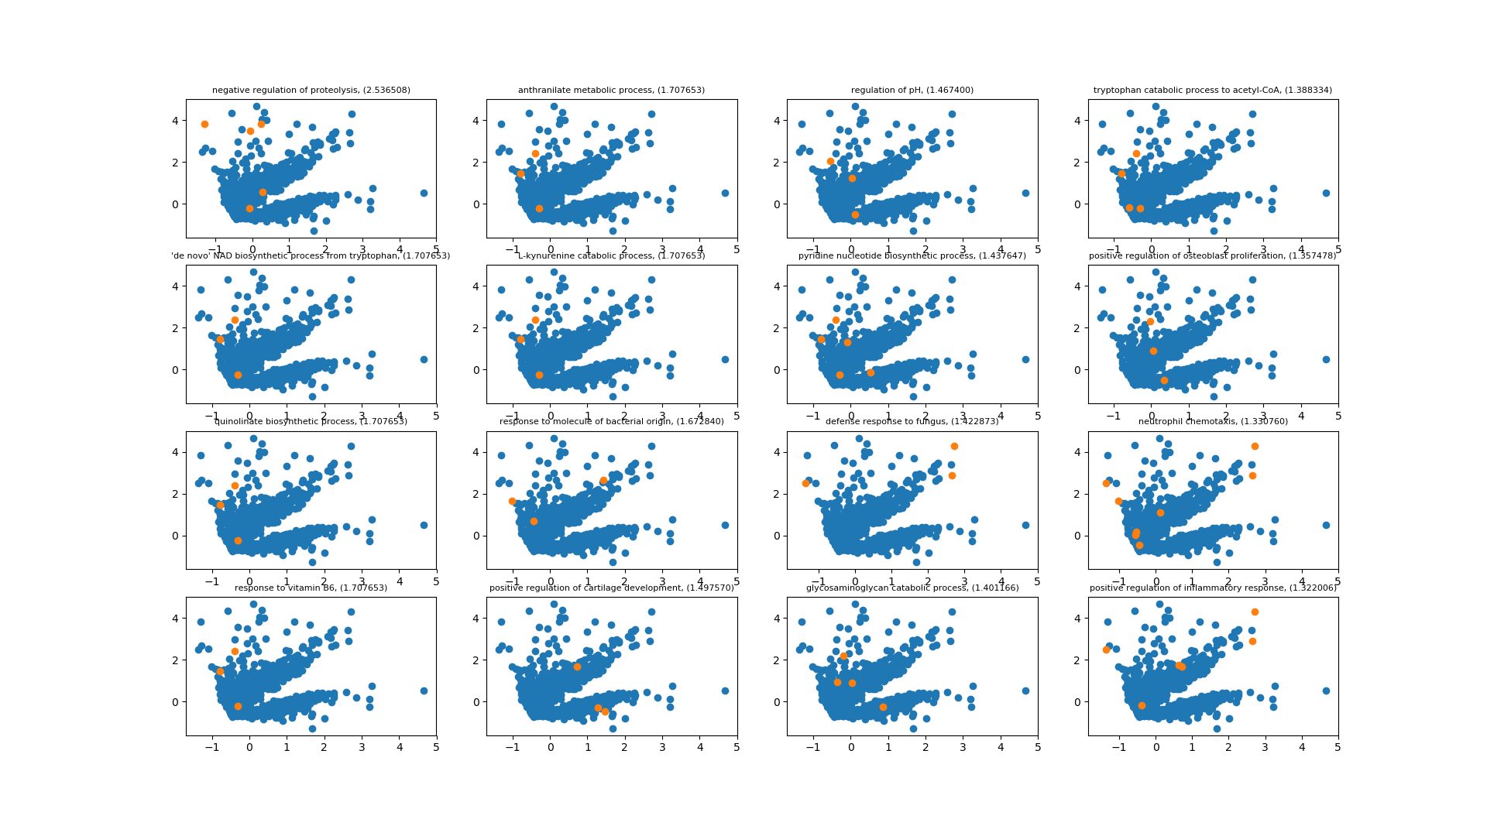
Process
Relations
A Computational Biology Framework

Slide 13
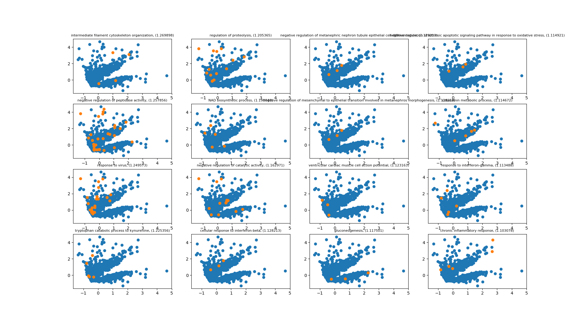
Process
Relations
A Computational Biology Framework

Slide 14
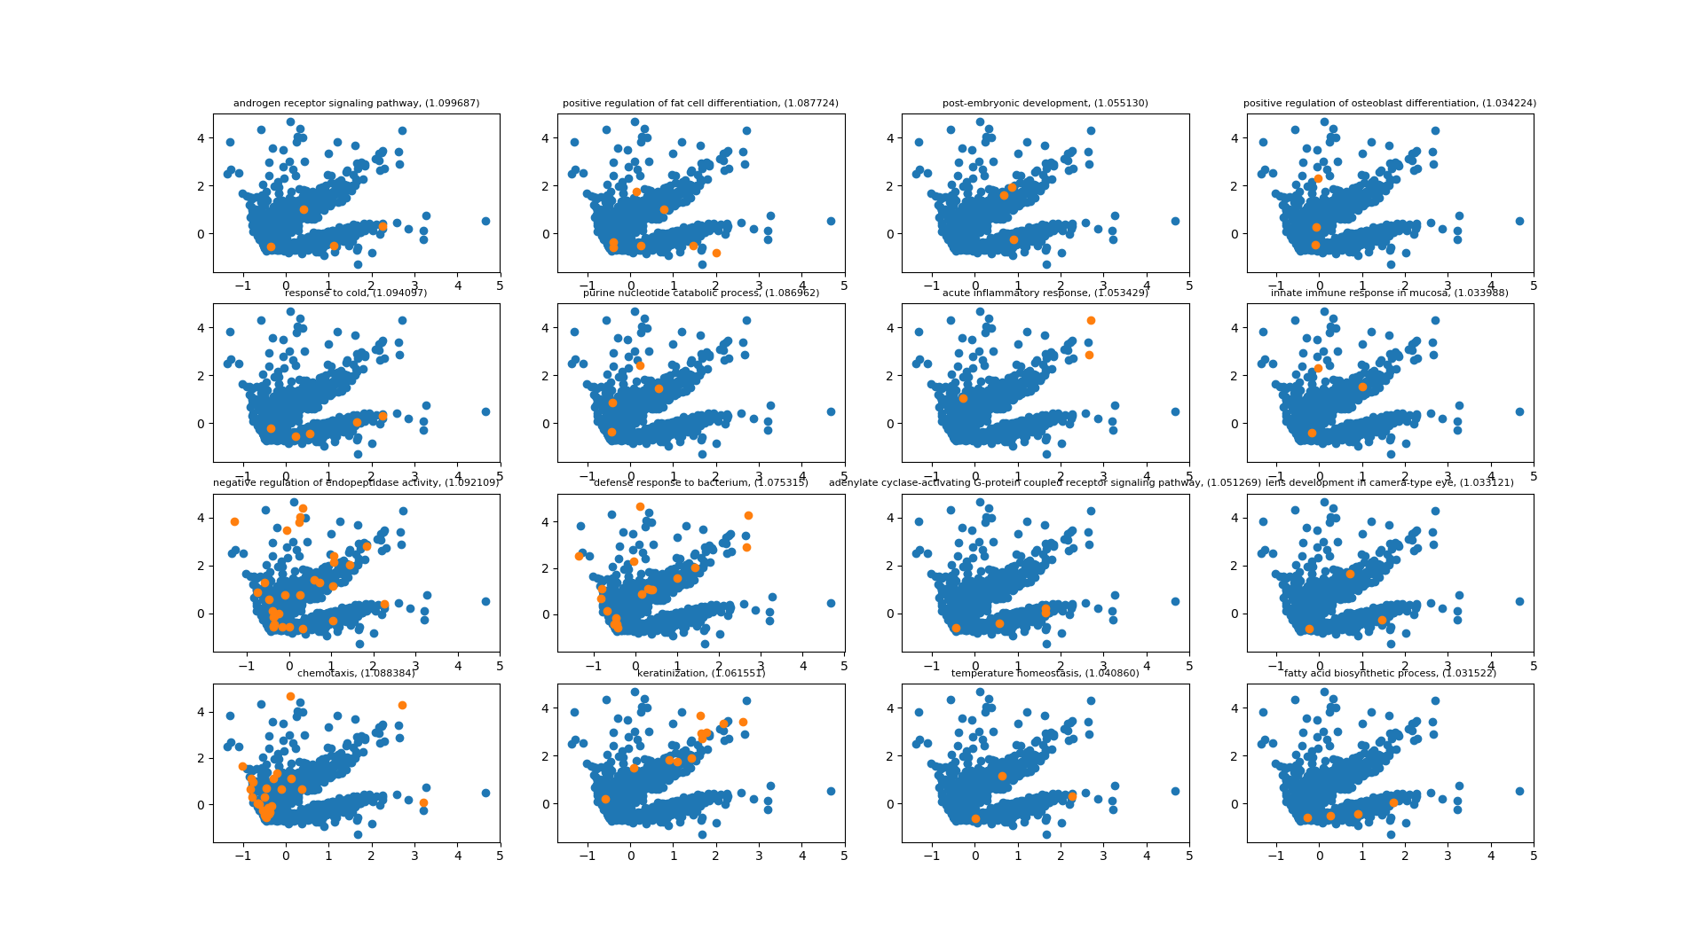
Process
Relations
A Computational Biology Framework

Slide 15
Cellular locations
Finding the gene organelles

Slide 16
Cellular
Locations
Check cellular location significance
  Relational genes
  Only a few significant locations (27)
  Many genes extracellular
Checked cluster 5 and 8 processes
  Most can be found in extracellular vesicular exonome
A Computational Biology Framework

Slide 17
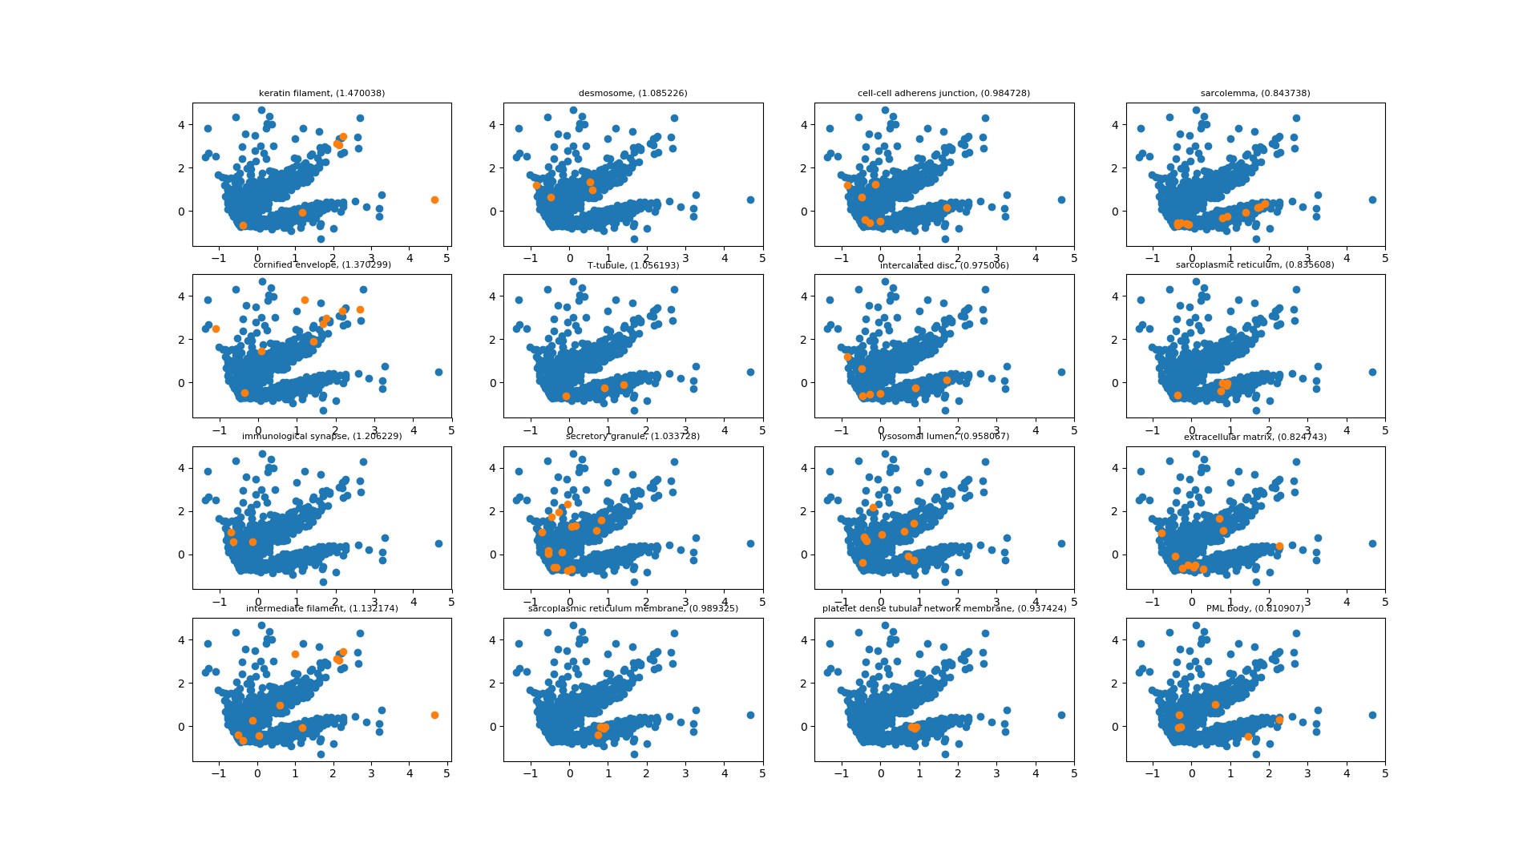
Cellular
Locations
A Computational Biology Framework

Slide 18
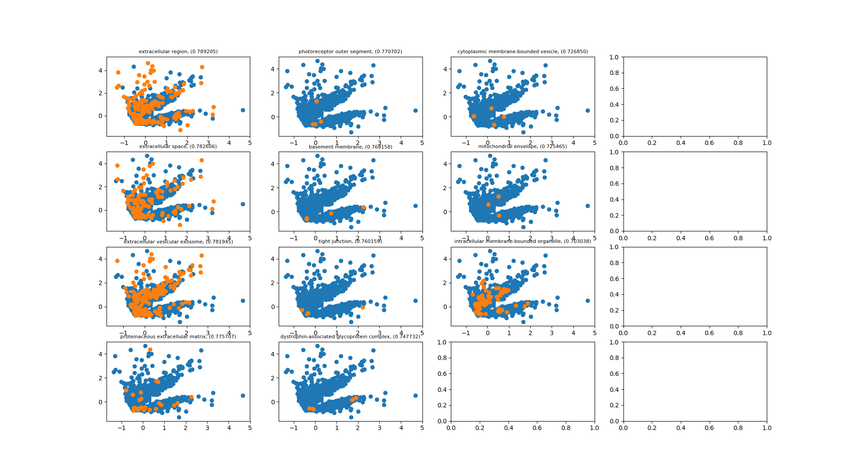
Cellular
Locations
A Computational Biology Framework

Slide 19
Molecular relations
Zooming in to the molecular level

Slide 20
Molecular
Relations
Check cellular location significance
  Relational genes
  Significant relations (56)
  Less clear results
A Computational Biology Framework

Slide 21
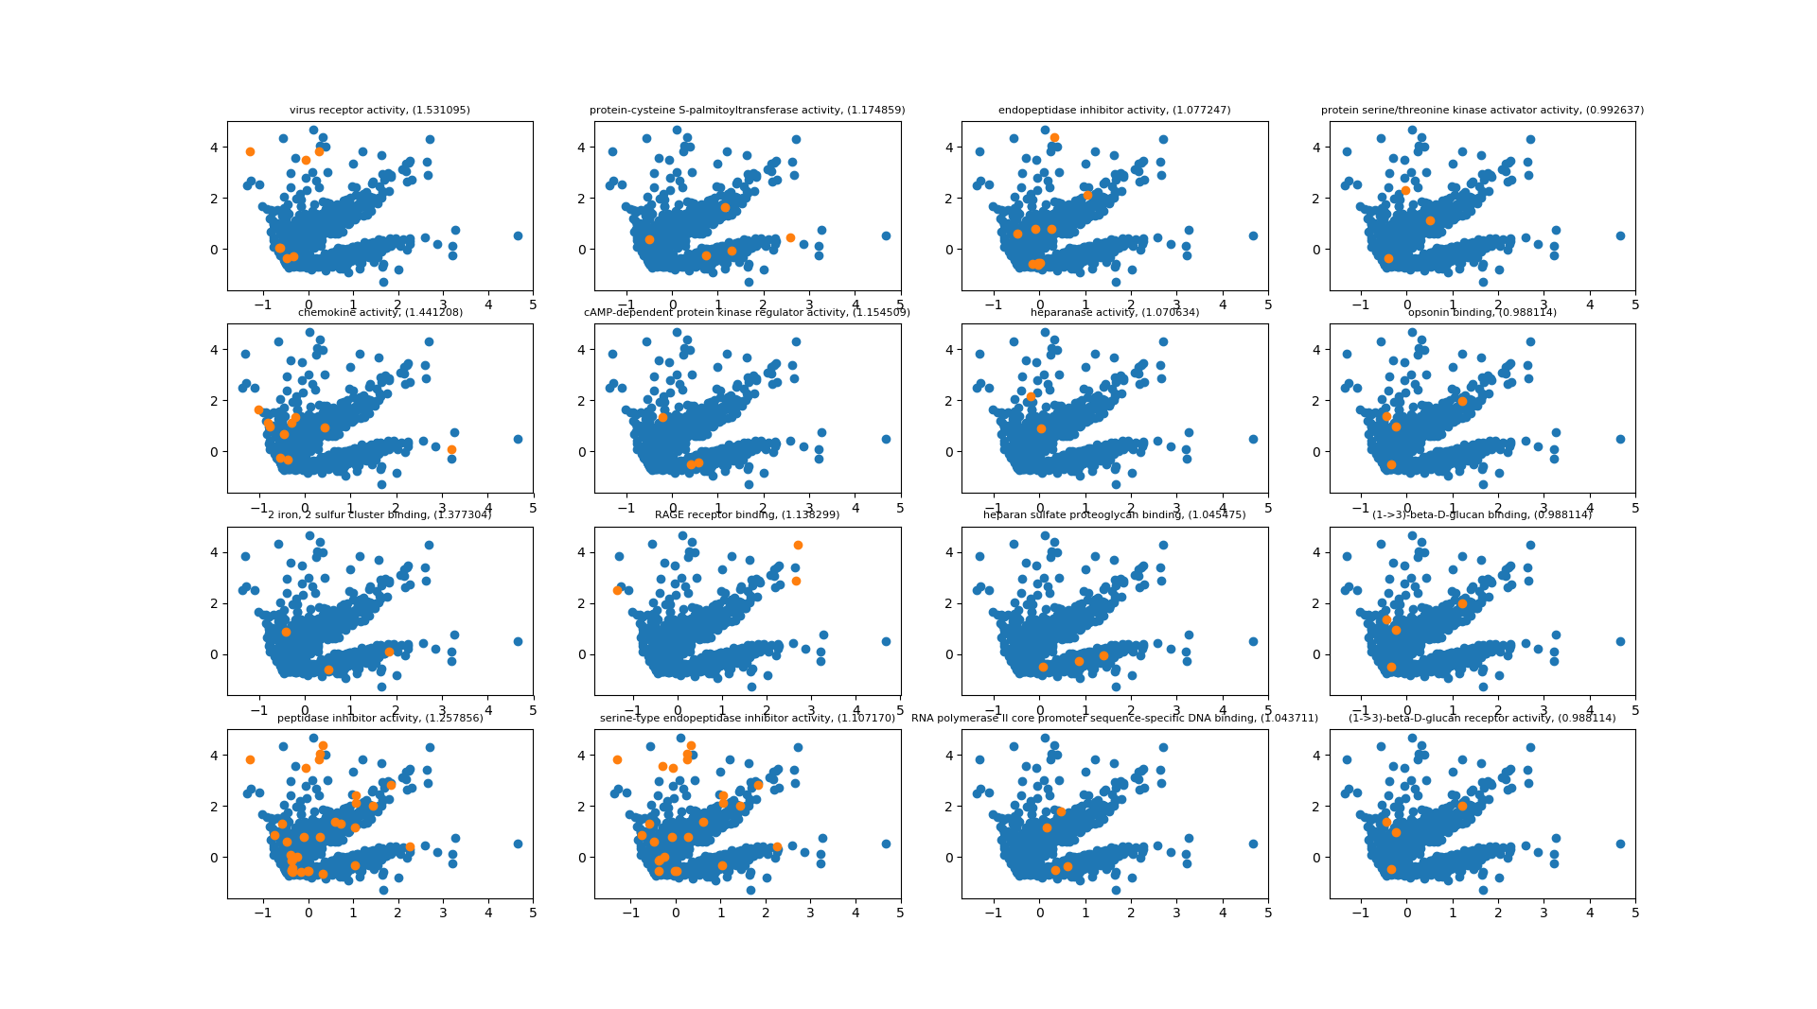
Molecular
Relations
A Computational Biology Framework

Slide 22
Gene trio
A relation of three genes

Slide 23
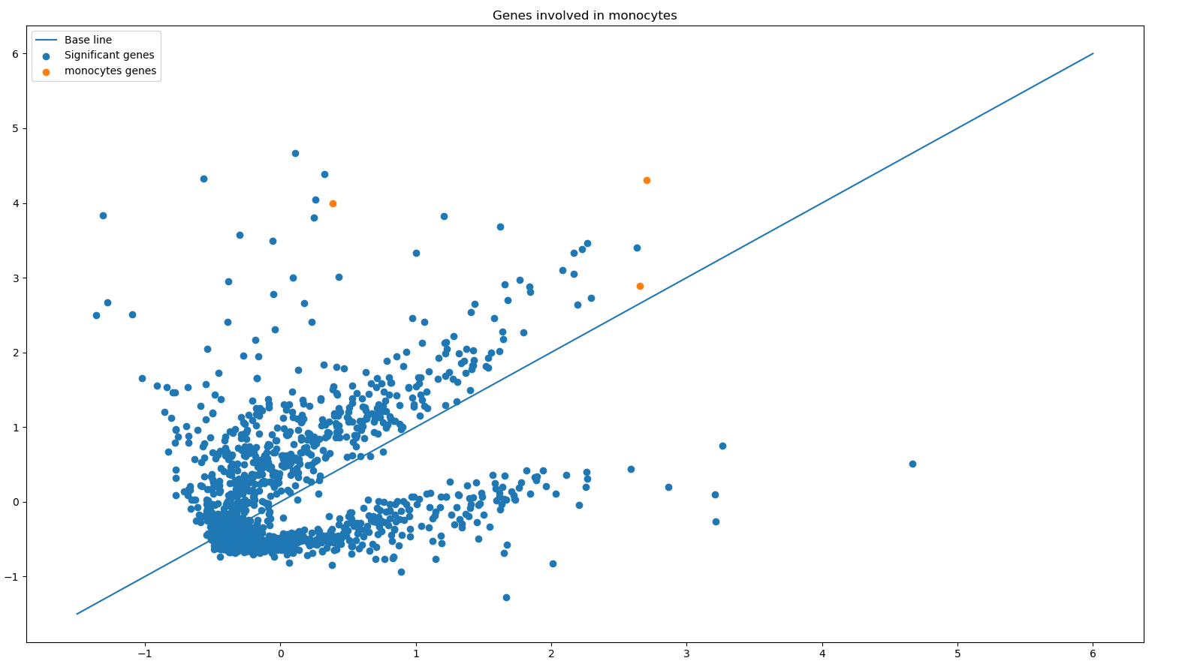
Gene Trio
Genes that show multiple relations
  AW238654: S100 calcium binding protein A8
  NM_002964: S100 calcium binding protein A8
  NM_002965: S100 calcium binding protein A9
27 process relations
A Computational Biology Framework

Slide 24
Psoriasis vs Atopic Dermatitis
Finding matches between the data

Slide 25
Psoriasis vs
Atopic Dermatitis
Psoriasis
423 samples
  209 non-lesional
  214 lesional
1768 significant genes
Atopic Dermatitis
58 samples
  28 non-lesional
  30 lesional
516 significant genes
Together
96 joint significant genes
145 processes
  Mainly cell proliferation/cell cycle focused
  Some immune system
  Some fat focused
A Computational Biology Framework

Slide 26
Psoriasis vs
Atopic Dermatitis
Processes
19 relations for process 'metabolic process'
13 relations for process 'small molecule metabolic process'
12 relations for process 'regulation of transcription, DNA-templated'
11 relations for process 'signal transduction'
11 relations for process 'transcription, DNA-templated'
8 relations for process 'cell cycle'
8 relations for process 'transport'
7 relations for process 'mitotic cell cycle'
7 relations for process 'positive regulation of transcription, DNA-templated'
7 relations for process 'lipid metabolic process'
A Computational Biology Framework

Slide 27
Results
What can be done with them

Slide 28
Results
Results
Separate genes
Clusters
Process/Cell/Molecular level
Future work
Link with literature/known data
Other ways to select features
A Computational Biology Framework

