Slide 1
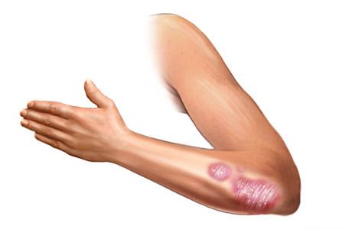
A Computational Biology Framework
Creating a platform for Biomedical Engineers to improve their data mining efficiency

Slide 2
Contents
Recap - Work done so far
  Literature Study
  Research Question
  Data Mining Seminar (case study)
Current work
  Working Issues
  Finishing up literature study
  Further insight case study
Graduation project outline
  Goal
  Topics
  Timetable

Slide 3
Recap
Work done so far

Slide 4
Recap
Literature study
Basic initial research
  Statistical analysis
  Machine Learning
Challenges based on biomedical data mining
  Data driven
  Target driven
  Tool driven
  Knowledge driven
Case study
  Bariatric data set
A Computational Biology Framework

Slide 5
Recap
Research Question
What aspects are of importance to include in a framework for Biomedical Engineers to increase data analysis efficiency?
Five different focuses:
  Data driven
  Goal driven
  Tool availability driven
  Tool extension driven
  Knowledge driven
A Computational Biology Framework

Slide 6


Recap
Data Mining Seminar
TPOT
  Optimization tool
  Machine learning
Skin disease data set
  High dimensionality
  Low data volume
  Data heterogeneity
A Computational Biology Framework

Slide 7
Current work
What am I doing now

Slide 8
Current work
Working issues
Trouble to focus
Talking with a student management advisor
A Computational Biology Framework

Slide 9
Current work
Finish parts
Literature research report
  About two days
Skin disease case study
  Only TPOT
  Statistical analysis?
A Computational Biology Framework

Slide 10
Future work
Planning the graduation project

Slide 11
Future work
Goal
What aspects are of importance to include in a framework for Biomedical Engineers to increase data analysis efficiency?
A framework that would help biomedical engineers in improving future data analysis efficiency
A Computational Biology Framework

Slide 12
Future work
Weeks | Focus
February 5th – February 16th | Finishing up current work Literature research Data Mining side (TPOT/Other data mining tools) Gathering live data analysis problems (surveys?)
February 19th – March 29th | Start focus on analysis high dimensional data (Psoriasis Data sets) More data set gathering (open source?) Trying out tools Possible tool extension
April 2nd – May 18th | Focus on analysis low quality data (error handling, missing value handling) Relevant data set gathering (open source?) Trying out tools Possible tool extension
May 21st – June 29th | Focus on low sample number data (Psoriasis data sets, sample generation) More data set gathering Trying out tools Possible tool extension
July 2nd – August 31th | Holidays (half a month) “Free time” Extension other aspects or starting new aspect
September 3rd – September 28th | Write and hand in report report (together/separate?)
October 1st – October 19th | Hand in report (together/separate?) Give presentations (together/separate?)
Topics and Timetable
Three data aspects
  High data dimensionality
  Low data quality
  Low data volume
  If possible, data heterogeneity
Answer aspects questions
per aspect
Four other phases
  Finishing up literature research
  “Free time”, reserved
  for better focus
  Report(s) writing
  Presentation(s)
A Computational Biology Framework

Slide 13
Future work
Discussion
Cooperation:
  Scheduling meetings
  Feedback
Final deadline:
  Mid October
Aimed grade:
  7.5
A Computational Biology Framework

