Slide 1


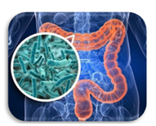
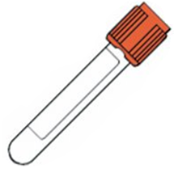
Applications of Canonical Correlation Analysis to microbial and metabolite data of individuals with metabolic syndrome
J.A. van der Stam
Daily supervisors:
E. Levin
N.A.W. van Riel
Committee members:
P.A.J. Hilbers
M. Nieuwdorp
M. Veta

Slide 2
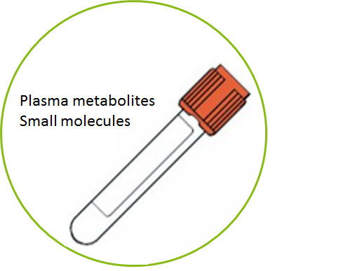
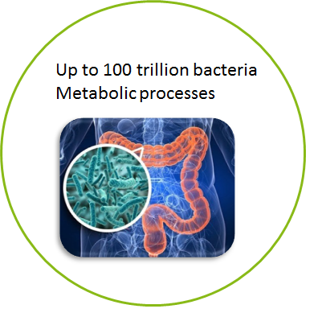

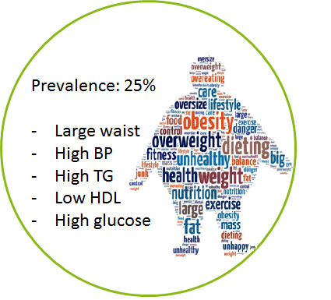
Applications of Canonical Correlation Analysis to microbial and metabolite data of individuals with metabolic syndrome
Applications of Canonical Correlation Analysis to microbial and metabolite data of individuals with metabolic syndrome
Applications of Canonical Correlation Analysis to microbial and metabolite data of individuals with metabolic syndrome
Applications of Canonical Correlation Analysis to microbial and metabolite data of individuals with metabolic syndrome
Applications of Canonical Correlation Analysis to microbial and metabolite data of individuals with metabolic syndrome

Slide 3
Contents
Dataset
Canonical Correlation Analysis
Extensions of CCA
Results
Discussion

Slide 4
Dataset:
Microbiome Features
Metabolite Features
Insulin sensitivity
Microbiome matrix X
Metabolite matrix Y
Patients
Patients
Patients
Nr of Patients | Nr of Features
28 | 1025
Nr of Patients | Nr of Features
28 | 82
Nr of Patients | Nr of Features
28 | 1

Slide 5
Dataset:
Microbiome Features
Microbiome matrix X
Patients
Small intestine biopsy microbiome
Microarray Hitchip data¹
Double columns removed
Nr of Patients | Nr of Features
28 | 1025
[1] Rajilić-Stojanović (2009)
Notes:
probes

Slide 6
Dataset:
Metabolite Features
Metabolite matrix Y
Mixed meal test: 616 kCal
61% fat, 33% carbohydrate and 6% protein.
Metabolites delta values
Relative difference between baseline and 2 hours after the meal
Patients
Nr of Patients | Nr of Features
28 | 82

Slide 7
Dataset:
Microbiome Features
Metabolite Features
Microbiome matrix X
Metabolitematrix Y
Patients
Patients
Nr of Patients | Nr of Features
28 | 1025
Nr of Patients | Nr of Features
28 | 82

Slide 8
Dataset preprocessing
Microbiome Features
Metabolite Features
Patients
Microbiome matrix X
Metabolite matrix Y
Patients
Nr of Patients | Nr of Features
28 | 1025
Filter based on highest variance
Nr of Patients | Nr of Features
28 | 82
Nr of Patients | Nr of Features
28 | 100

Slide 9
Dataset preprocessing
Normalisation:
Rescale all features to zero mean unit variance
Microbiome Features
Metabolite Features
Microbiome matrix X
Metabolitematrix Y
Patients
Patients
Nr of Patients | Nr of Features
28 | 100
Nr of Patients | Nr of Features
28 | 82

Slide 10
Canonical Correlation Analysis

Slide 11
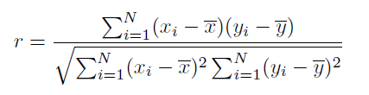
Univariate correlation:
1 Microbiome Feature
1 Metabolite Feature
Metabolite y
X
Y
Microbiome x
Patients
Patients

Slide 12
Multivariate correlation?
Microbiome Features
Metabolite Features
Microbiome matrix X
Metabolite matrix Y
Patients
Patients
Canonical Correlation Analysis (CCA) ²
[2] Hardoon (2004)

Slide 13
General Idea:
By definition of a weight vector (Wx) you can sum all microbiome values of a patient in a single number:
Microbiome Features
Wx
1 Patient
=
A
Microbiome 1 patient
Microbiome Features
X
*

Slide 14

Microbiome Features
Wx
For patient i and all metabolite features (1 to O):
1 Patient
=
A
Microbiome 1 patient
Microbiome Features
X
*

Slide 15
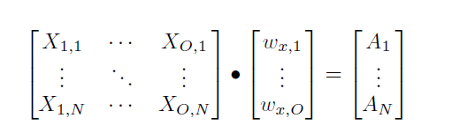
For all patients and again all microbiome features:
Microbiome Features
Microbiome matrix X
Wx
A
Patients
Patients
Microbiome Features
*
=

Slide 16
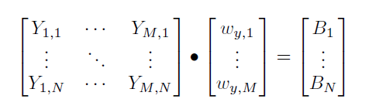
Similarly for all patients and all metabolite features:
We define weight vector Wy
Metabolite Features
Metabolite matrix Y
Wy
B
Patients
Patients
Metabolite Features
*
=

Slide 17

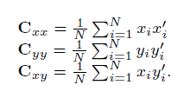
Maximal correlation gives best set of Wx and Wy
Microbiome Features
Metabolite Features
Wx
A
B
Wy
Metabolite matrix Y
Patients
Microbiome matrix X
Patients
*
=
Patients
Microbiome Features
=
*
Metabolite Features

Slide 18
A
B
Calculate Correlation between A & B
Maximal correlation gives best set of Wx and Wy
The features with high values in Wx and Wy then show a possible relationship
Patients

Slide 19

Maximal correlation between A and B
$W_{x} \& W_{y}$
Microbiome Features
Metabolite Features
Wx
A
B
Wy
Metabolite matrix Y
Patients
Microbiome matrix X
Patients
*
=
Patients
Microbiome Features
=
*
Metabolite Features

Slide 20
Dataset
Train (80 %)
Test (20%)
Perform CCA calculations
Weight vectors
Apply weight vectors to test set
Train correlation
Test Correlation
Repeat 1000 x

Slide 21

$W_{x} \& W_{y}$
Microbiome Features
Metabolite Features
Wx
A
B
Wy
Metabolite matrix Y
Patients
Microbiome matrix X
Patients
*
=
Patients
Microbiome Features
=
*
Metabolite Features
Nr of Patients | Nr of Features
28 | 100
Nr of Patients | Nr of Features
28 | 82
Risk of overfitting

Slide 22
Results Normal CCA
Regularization to avoid overfitting
Train Correlation | Test Correlation
Mean (SD) | Mean (SD)
0,997 (0,004) | 0,377 (0,218)

Slide 23

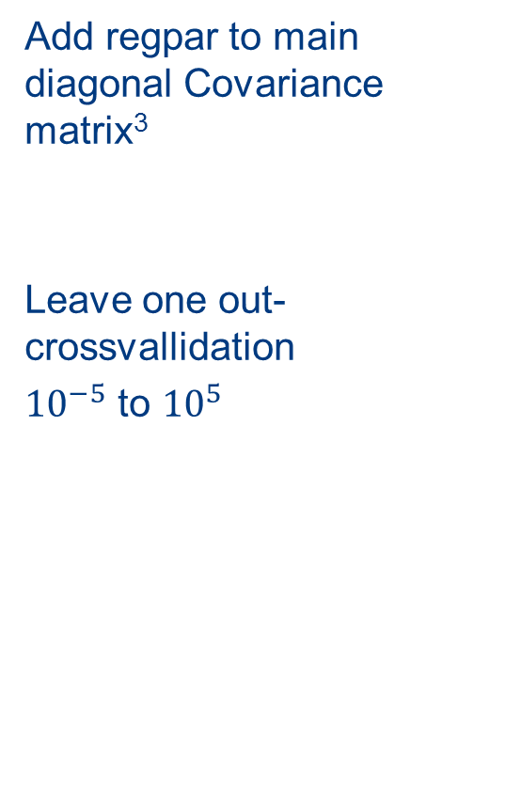
Dataset
Add regpar to main diagonal Covariance matrix$\text{3}$
Leave one out- crossvallidation
${10}^{−5}$ to ${10}^{5}$
N-1 patients
1 patient
Repeat
for every patient
Perform CCA calculations with regpar
Apply weight vectors to left out patient
Repeat
for every regpar
Calculate correlation between all left out patients
Select regpar
[3] Combes 2008

Slide 24
Dataset
Train (80 %)
Test (20%)
Perform CCA calculations
Weight vectors
Apply weight vectors to test set
Perform LOO
Crossval
Train correlation
Test Correlation
Repeat 1000 x

Slide 25
Expanding CCA algoritms

Slide 26
Including additional information in the CCA algorithm:
Cluster CCA
New proposed method: Rank preserving CCA

Slide 27
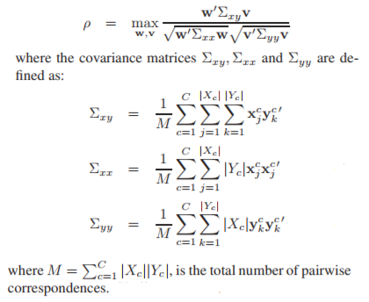
Including additional information in the CCA algorithm:
Cluster CCA includes clusters
of patients in the algorithm⁴
[4] Raswasia (2014)

Slide 28
Including additional information in the CCA algorithm
New proposed method: Rank preserving CCA can include additional information if the data matrices are ranked.
Microbiome Features
Metabolite Features
Microbiome matrix X
Metabolite matrix Y
Patients
Patients
Rank based on insulin sensitivity values
Insulin sensitivity
Patients

Slide 29
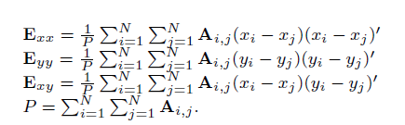

New proposed method: Rank preserving CCA can include additional information if the data matrices are ranked.
By altering the definition of the Covariance matrix:

Slide 30

New proposed method: Rank preserving CCA can include additional information if the data matrices are ranked.
By altering the definition of the Covariance matrix:
0 | 1 | … | 0 | 0
1 | 0 | … | 0 | 0
… | … | … | … | …
0 | 0 | … | 0 | 1
0 | 0 | … | 1 | 0
A=

Slide 31
Types of CCA:
Normal CCA
Regularized CCA
Cluster CCA
Rank Preserving CCA
Implemented with regularization

Slide 32
Results

Slide 33
 | Mean train correlation | Mean test correlation
N-CCA | 0,997 | 0,377
R-CCA | 0,926 | 0,345
C-CCA | 0,954 | 0,467
RP-CCA | 0,891 | 0,339

Slide 34
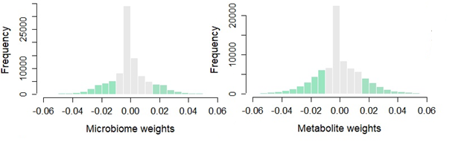

Slide 35
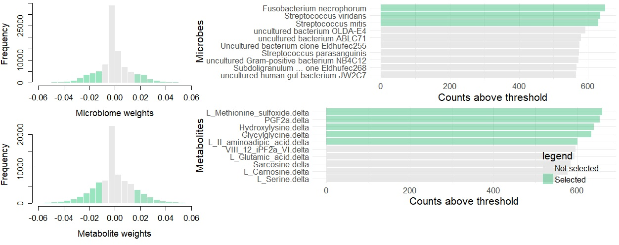

Slide 36


 | RP-CCA
Fusobacterium necrophorum
Lactobacillus kalixensis, lactobacillus utensis
Lactobacillus crispatus
Streptococcus viridans
Streptococcus mitis
Streptococcus pneumoniae
Uncultured bacterium ABL C71
Uncultured bacterium clode Eldhufec 225
Bacterium adhufec 13
 | RP-CCA
PGF2a.delta
Glycylglycine.delta
L Carnosine.delta
VIII 12 iPF2a VI.delta
L Methionine sulfoxide.delta
L methionine.delta
SDMA.delta
Homocysteine.delta
Homocitruline.delta
L II aminoadipic acid.delta
Hydroxylysine.delta

Slide 37
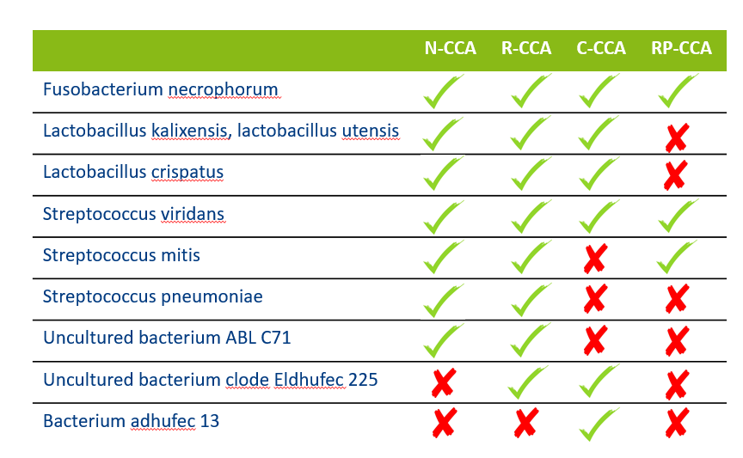
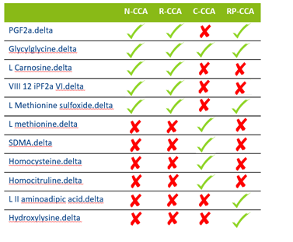

Slide 38
Discussion

Slide 39
 | N-CCA | R-CCA | C-CCA | RP-CCA
Fusobacterium necrophorum
Lactobacillus kalixensis, L. utensis
Lactobacillus crispatus
Streptococcus viridans
Streptococcus mitis
Streptococcus pneumoniae
Uncult. bacterium ABL C71
Uncult. bacterium clode Eldhufec 225
Bacterium adhufec 13
Produces butyrate
&
Forms propionate from lactate
Produce lactic acid
Closely related
99% similar sequence
Dominant species in duodenal part of small intestine

Slide 40
 | N-CCA | R-CCA | C-CCA | RP-CCA
PGF2a.delta
Glycylglycine.delta
L Carnosine.delta
VIII 12 iPF2a VI.delta
L Methionine sulfoxide.delta
L methionine.delta
SDMA.delta
Homocysteine.delta
Homocitruline.delta
L II aminoadipic acid.delta
Hydroxylysine.delta
Gastrointestinal motility
Oxidative stress
Methionine
Metabolism
Glycemic control
L-Cell Density⁵
[5] van Baar (2018)

Slide 41
Produces butyrate
&
Forms propionate from lactate
Gastrointestinal motility
Produce lactic acid
Oxidative stress
Closely related
99% similar sequence
Glycemic control
L-Cell Density
Dominant species in duodenal part of small intestine
Methionine
Metabolism

Slide 42
CCA based algorithms suitable
New method: RP-CCA
Small intestinal microbiome and mixed meal test delta values
Limitations dataset
Article

Slide 43
Questions?

