Slide 1
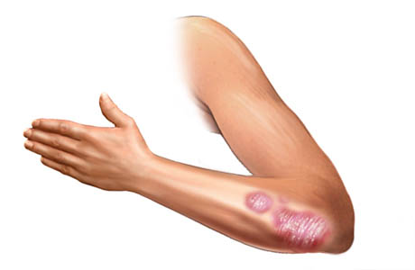
A Computational Biology Framework

Slide 2
Introduction
Feature selection
200 features rule of thumb - exploration
FS_Accuracy revisit
Pareto front feature selection methods
TPOT output
Missing values
Classification results
Data Exploration
Metafeatures
Schedules and deadlines
A Computational Biology Framework

Slide 3
Feature selection
Lookback and TPOT implementation

Slide 4
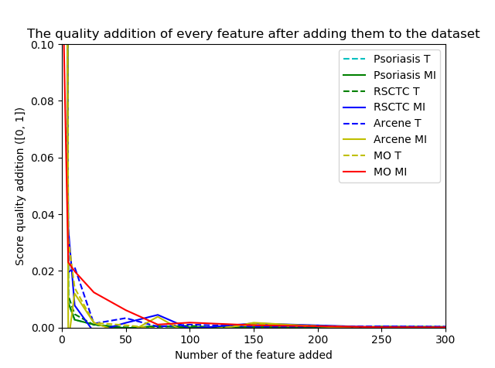
Feature selection
A Computational Biology Framework

Slide 5
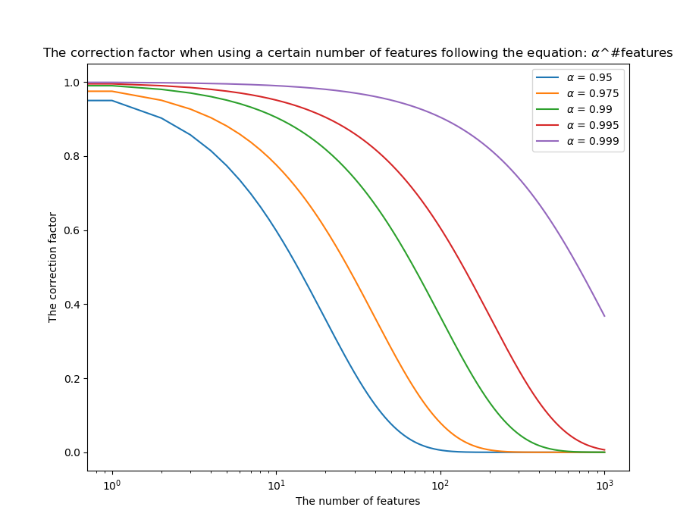
Feature
selection
New accuracy function:
FS_Accuracy = Accuracy(Pipeline) * Threshold ^ #features
A Computational Biology Framework

Slide 6
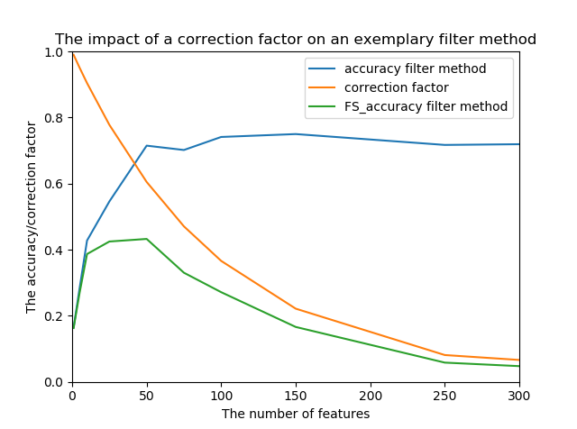
Feature
selection
New accuracy function:
FS_Accuracy = Accuracy(Pipeline) * Threshold ^ #features
Chosen threshold: 0.99
10 more features means 0.90 * accuracy (0.99 ^ 10 = 0.9)
A Computational Biology Framework

Slide 7
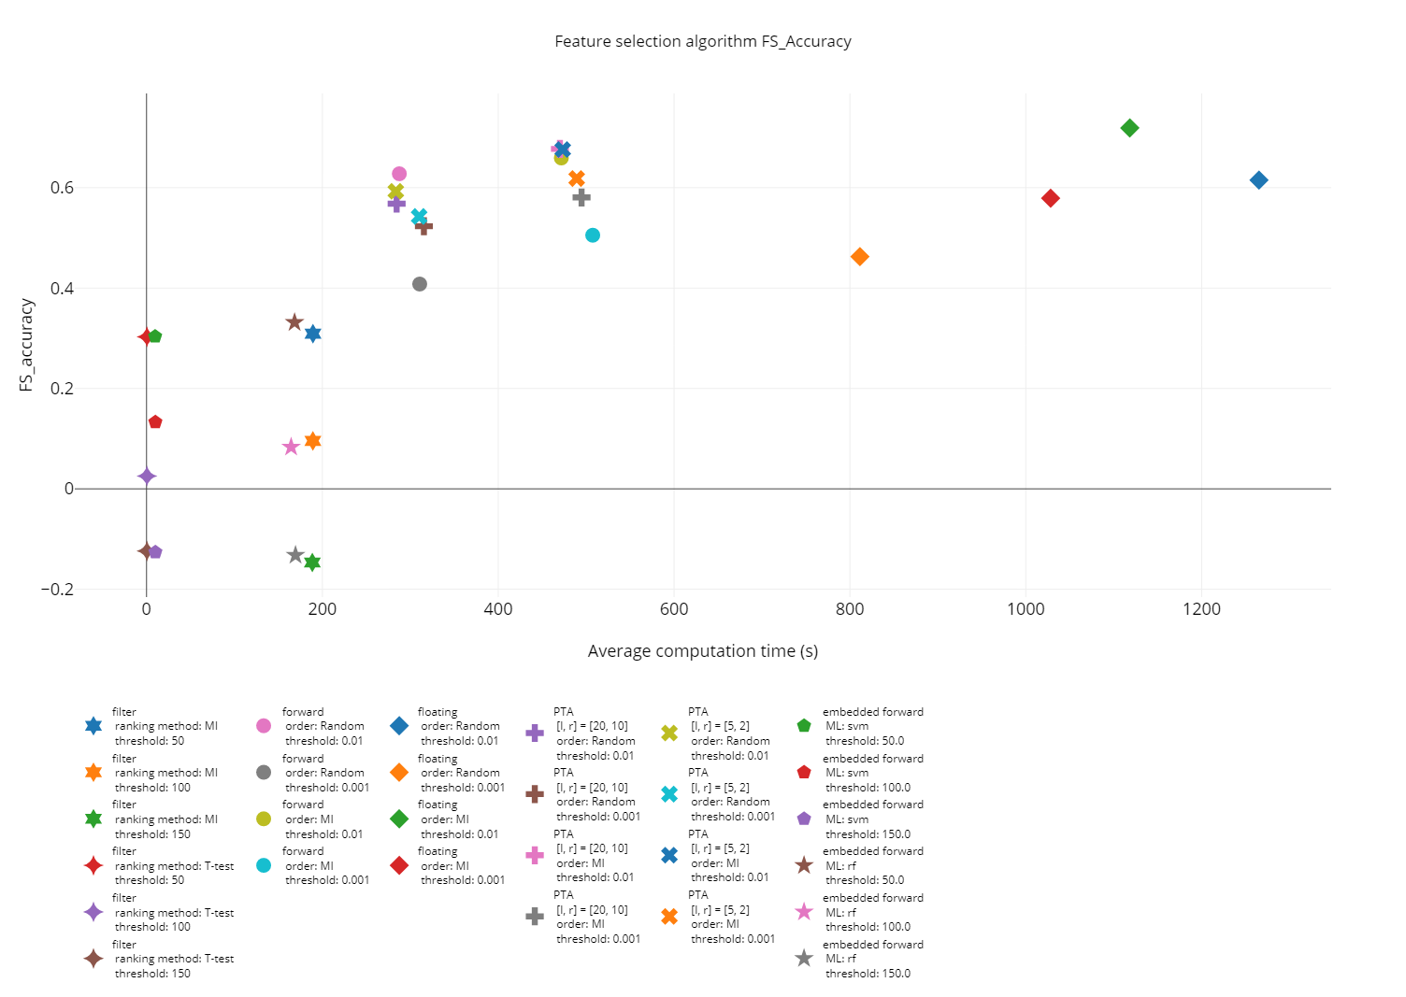
Feature selection
A Computational Biology Framework

Slide 8
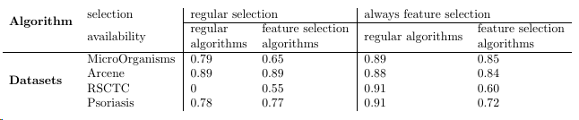
Feature
selection
Test changes TPOT
Use new FS_accuracy (threshold of 0.99)
Changes with last experiment:
Population of 20
Improved insert method
Starting with feature selection helps greatly
New pipelines have many steps (max found is 6)
FS algorithms underperform because of computation time issues
A Computational Biology Framework

Slide 9
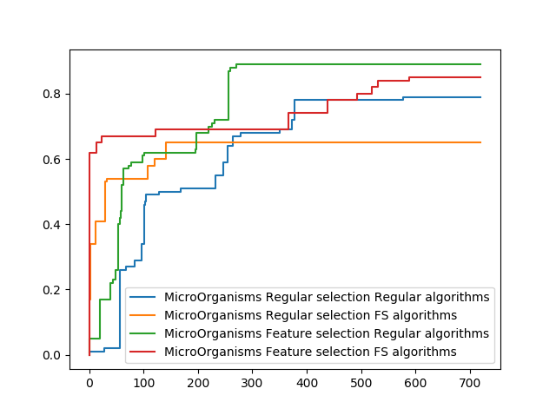
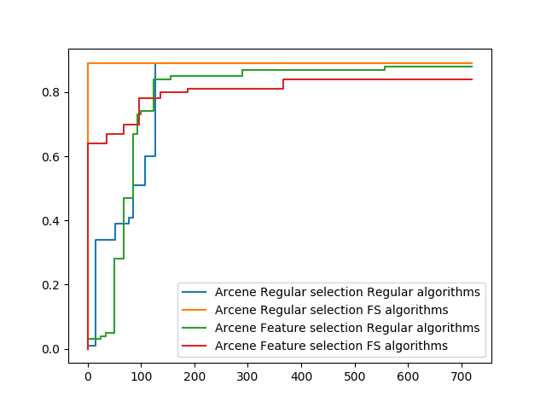
Feature
selection
Test changes TPOT
Use new FS_accuracy (threshold of 0.99)
Changes with last experiment:
Population of 20
Improved insert method
A Computational Biology Framework

Slide 10
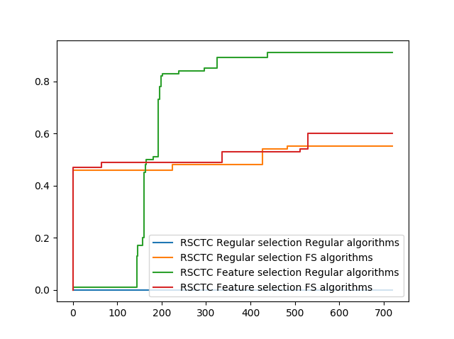
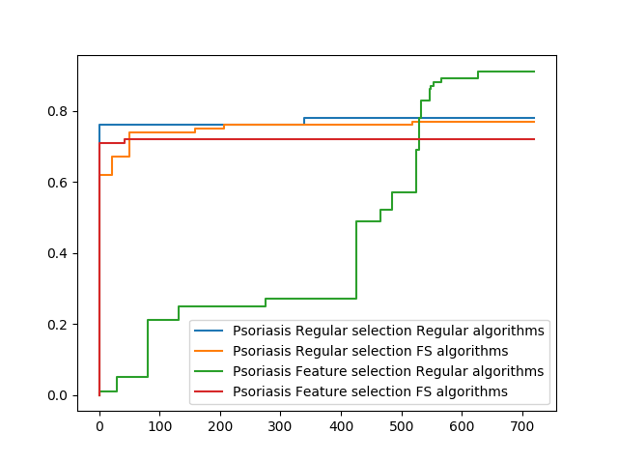
Feature
selection
Test changes TPOT
Use new FS_accuracy (threshold of 0.99)
Changes with last experiment:
Population of 20
Improved insert method
A Computational Biology Framework

Slide 11
Missing values
Theory and experiments

Slide 12
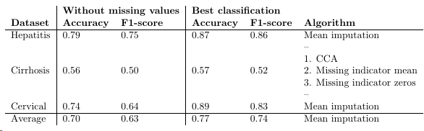
Missing values
Classification testing
Mean imputation performed best overall
Missing indicator shows additional information
A Computational Biology Framework

Slide 13
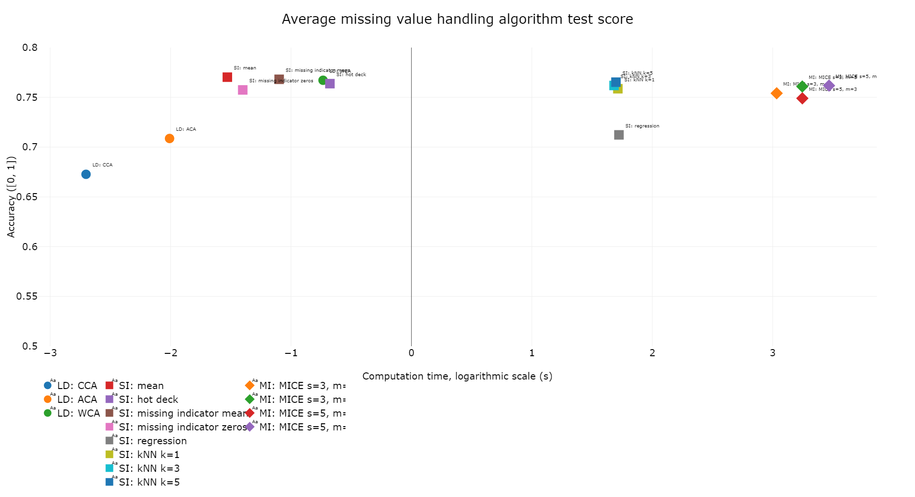
Missing
values
Classification quality (> 15% missing removed)
A Computational Biology Framework

Slide 14
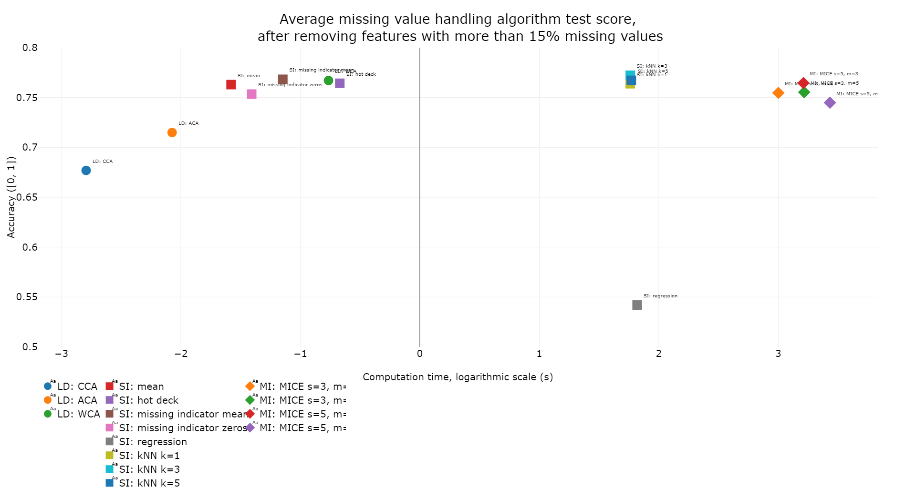
Missing
values
Classification quality (> 15% missing removed)
A Computational Biology Framework

Slide 15
Missing values
Conclusions
Mean imputation is best used in regular examples
Missing indicator good option for confirmed MAR/NMAR values
kNN, Regression and MICE not worth computation time in regular examples
A Computational Biology Framework

Slide 16
Metafeature exploration
Testing different initial values data

Slide 17
Metafeature
testing
Metafeature testing
Data shape (samples, features)
Data types (categorical, numerical)
Missing values (per sample/feature)
Output statistics (Class probabilities)
Entropies
Mutual information
Overall statistics
Possible outliers (3 best and worst)
A Computational Biology Framework

Slide 18
Planning
Future + final presentation

Slide 19
General information
Planning
Week | Topics
10 – 16 September | Feature exploration TPOT improvements Process remarks
17 – 23 September | Join separate reports Finish up where needed
DEADLINE 23 September | Draft 1 final report
24 – 30 September | Framework manual Framework methods Framework GUI
1 – 7 October | Process remarks report
DEADLINE 7 October | Draft 2 final report
8 – 14 October | Process remarks report
DEADLINE 14 October | Final report
15 – 21 October | Make final presentation
DEADLINE 23 October | Final presentations
A Computational Biology Framework

Slide 20
Presentation
Grade processing problem
Issue with processing ECTS
CSE wants to combine points (30 joint ECTS, 30 only BME ECTS)
BME wants to split points (30 only CSE ECTS, 60 only BME ECTS)
Separate presentation removes problem
Clash between studies (BME – EE is not a problem for example)
Solution?
A Computational Biology Framework

