Slide 1
Exponential Decay Analytics
Exponential decay
Moving window updates the analytic as new values received
Is there an alternative to moving windows?
Yes, exponential decay methods
Past values are exponentially down-weighted in time
Estimates of a statistic are updated with new observations
Computationally efficient
Memory efficient: do not need to store past observations!

Slide 2
Exponential Decay Analytics
Family of exponential smoothing algorithms
Family of algorithms known as the Holt-Winters methods
First order exponential smoother
Smooths random (white) noise
Acts as a low-pass filter
Second order model
Known as double exponential smoothing
Includes a trend term
Third order model
Known as triple exponential smoothing
Accounts for seasonal (periodic) component

Slide 3
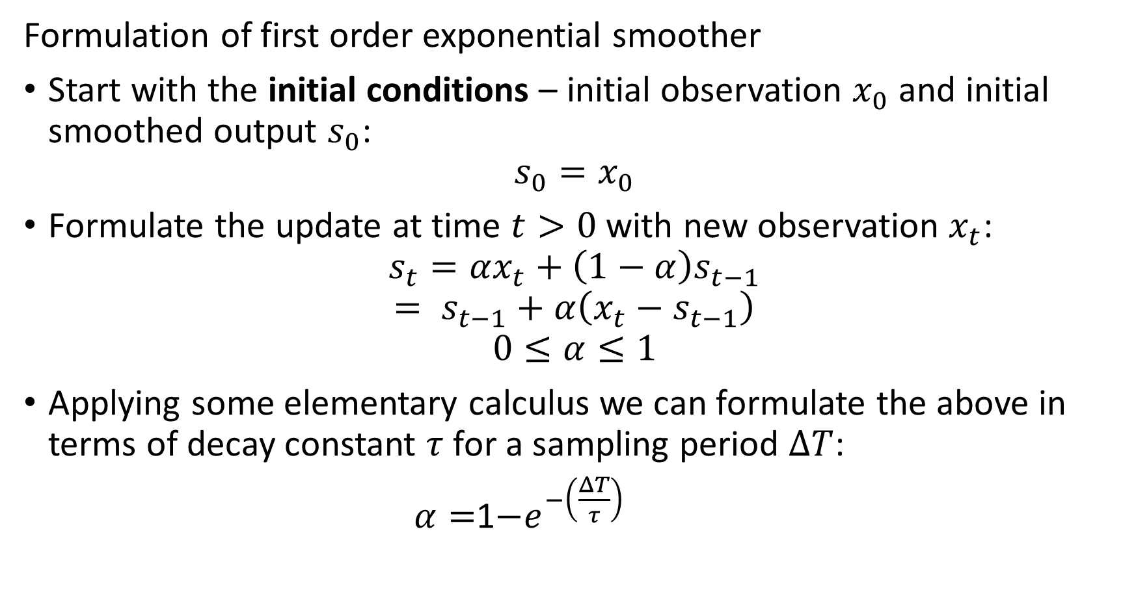
Exponential Decay Analytics
Formulation of first order exponential smoother
Start with the initial conditions – initial observation $x_{0}$ and initial smoothed output $s_{0}$:
$$s_{0}=x_{0}$$
Formulate the update at time $t>0$ with new observation $x_{t}$:
$$s_{t}=αx_{t}+\left(1−α\right)s_{t−1}$$
$$= s_{t−1}+α\left(x_{t}−s_{t−1}\right)$$
$$0≤α≤1$$
Applying some elementary calculus we can formulate the above in terms of decay constant $τ$ for a sampling period $ΔT$:
$α=$1$−e^{−\left(\frac{ΔT}{τ}\right)}$

Slide 4
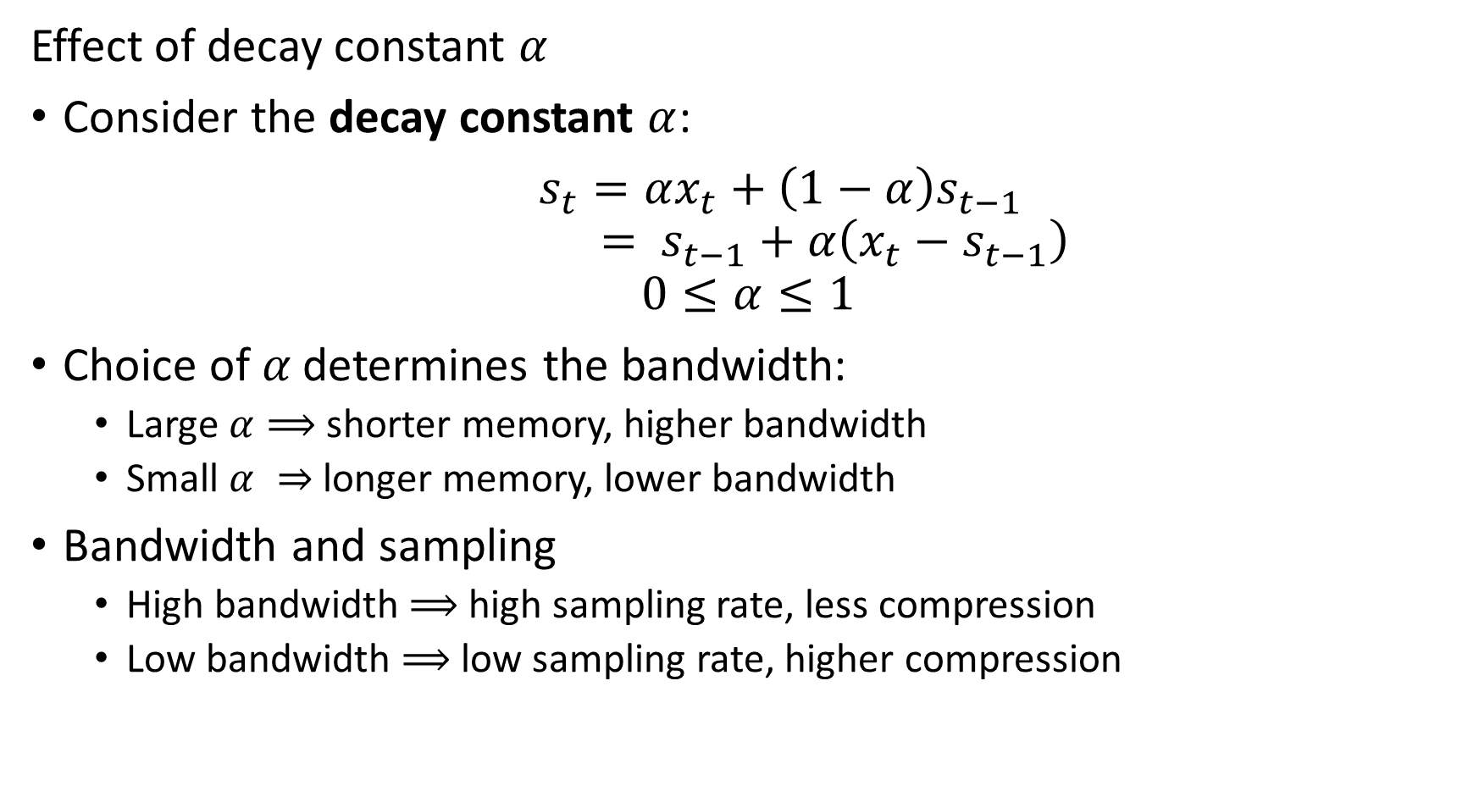
Exponential Decay Analytics
Effect of decay constant $α$
Consider the decay constant $α$:
$s_{t}=αx_{t}+\left(1−α\right)s_{t−1}$
$$= s_{t−1}+α\left(x_{t}−s_{t−1}\right)$$
$$0≤α≤1$$
Choice of$α$ determines the bandwidth:
Large $α⟹$ shorter memory, higher bandwidth
Small $α ⇒$ longer memory, lower bandwidth
Bandwidth and sampling
High bandwidth $⟹$ high sampling rate, less compression
Low bandwidth $⟹$ low sampling rate, higher compression

Slide 5
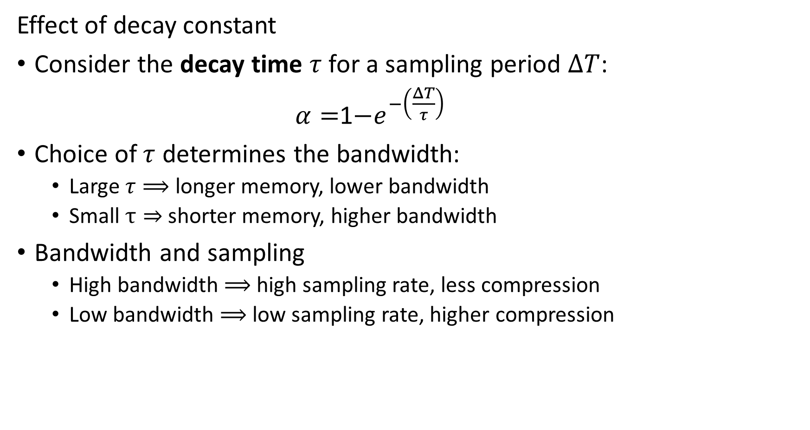
Exponential Decay Analytics
Effect of decay constant
Consider the decay time $τ$ for a sampling period $ΔT$:
$α=$1$−e^{−\left(\frac{ΔT}{τ}\right)}$
Choice of $τ$ determines the bandwidth:
Large $τ⟹$ longer memory, lower bandwidth
Small $τ⇒$ shorter memory, higher bandwidth
Bandwidth and sampling
High bandwidth $⟹$ high sampling rate, less compression
Low bandwidth $⟹$ low sampling rate, higher compression

Slide 6
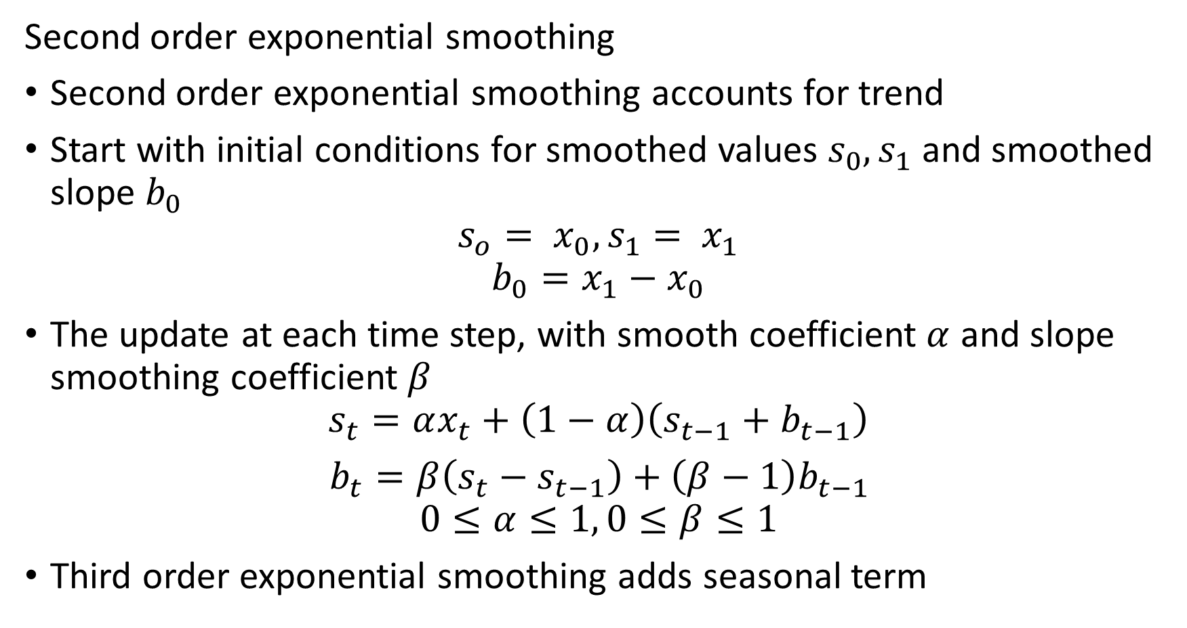
Exponential Decay Analytics
Second order exponential smoothing
Second order exponential smoothing accounts for trend
Start with initial conditions for smoothed values $s_{0},s_{1}$ and smoothed slope $b_{0}$
$$s_{o}= x_{0},s_{1}= x_{1}$$
$$b_{0}=x_{1}−x_{0}$$
The update at each time step, with smooth coefficient $α$ and slope smoothing coefficient $β$
$$s_{t}=αx_{t}+\left(1−α\right)\left(s_{t−1}+b_{t−1}\right)$$
$b_{t}=β\left(s_{t}−s_{t−1}\right)+\left(β−1\right)b_{t−1}$
$$0≤α≤1, 0≤β≤1$$
Third order exponential smoothing adds seasonal term

Slide 7
Exponential Decay Analytics
Exponential decay as an anomaly detector
Algorithm can be viewed as a forecast between of the next observation
When next observation arrives, compute difference
High difference between forecast and actual can indicate an unusual condition
High rates of change
Spikes or transient values

