Slide 1

CSCI E-96 Data Mining, Exploration and Discovery Introduction to Clustering Models Part 2
Steve Elston
Copyright 2020,2021, 2022, 2023, 2024, 2025, Stephen F Elston. All rights reserved.

Slide 2
Algorithms for Non-Euclidean Spaces
Euclidean spaces are optimal only for Normally distributed variables
Common examples of variables in non-Euclidean spaces
Categorical variables including NLP problems
Binary variables
Ordinal variables
Algorithms for non-Euclidian spaces
Tree-graph-based Agglomerative clustering
Graph-based affinity clustering
NN graph-based density algorithms
NN graph-based spectral clustering

Slide 3
K-Mediods and CLARA

Slide 4
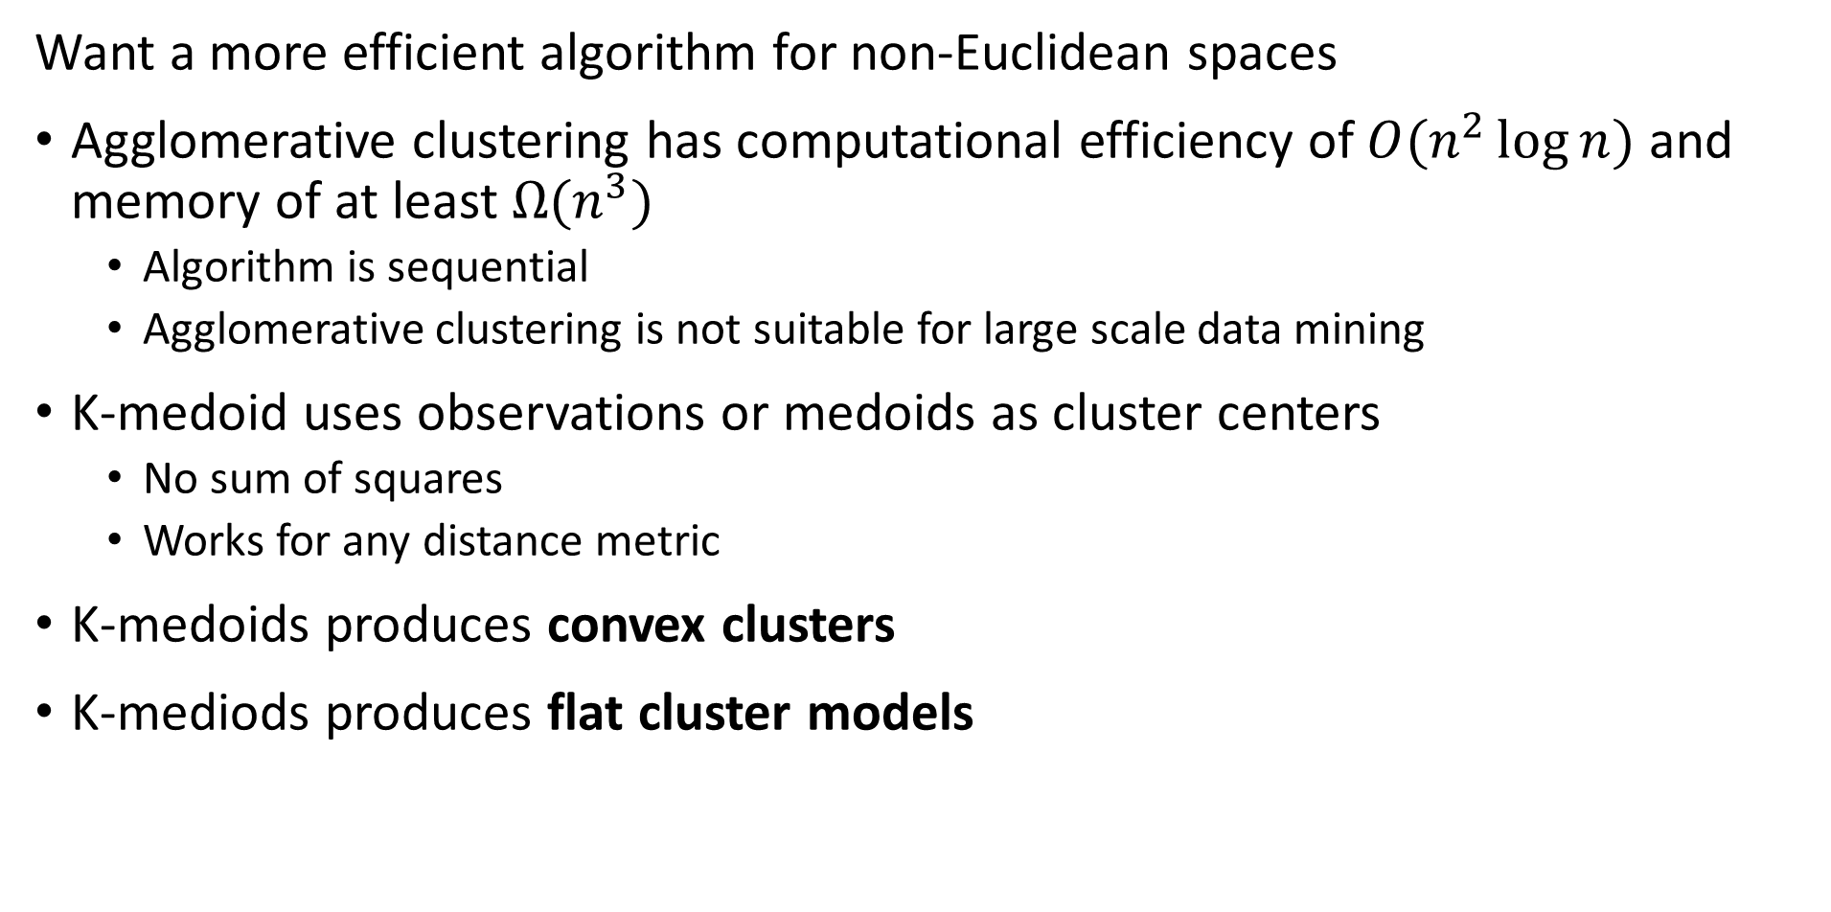
K-medoids Algorithm
Want a more efficient algorithm for non-Euclidean spaces
Agglomerative clustering has computational efficiency of $O(n^{2}\log{n})$ and memory of at least $Ω(n^{3})$
Algorithm is sequential
Agglomerative clustering is not suitable for large scale data mining
K-medoid uses observations or medoids as cluster centers
No sum of squares
Works for any distance metric
K-medoids produces convex clusters
K-mediods produces flat cluster models

Slide 5
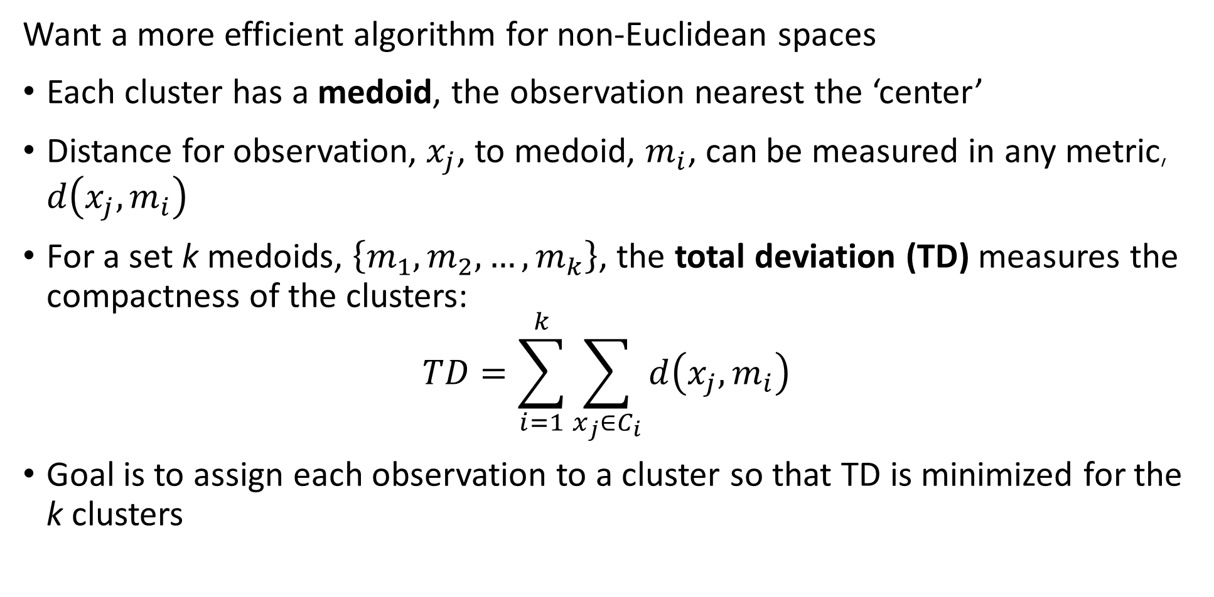
K-medoids Algorithm
Want a more efficient algorithm for non-Euclidean spaces
Each cluster has a medoid, the observation nearest the ‘center’
Distance for observation, $x_{j}$, to medoid, $m_{i}$, can be measured in any metric, $d\left(x_{j},m_{i}\right)$
For a set k medoids, $\left\{m_{1},m_{2},…,m_{k}\right\}$, the total deviation (TD) measures the compactness of the clusters:
$$TD=\sum_{i=1}^{k}{\sum_{x_{j}∈C_{i}}^{ }{d\left(x_{j},m_{i}\right)}}$$
Goal is to assign each observation to a cluster so that TD is minimized for the k clusters

Slide 6
K-medoids Algorithm
Many variations of the k-medoids have been developed
Partitioning Around Mediods (PAM) algorithm, was an early k-medoid algorithm
PAM algorithm has two steps:
Build step finds initial cluster assignments
Swap step improves cluster assignments

Slide 7
K-medoids Algorithm
Partitioning Around Mediods (PAM) algorithm was early k-medoid algorithm
Build step finds initial cluster assignments
# Find first medoid by greedy algorithm
Find a medoid observation with minimum total deviation (TD)
Assign as m1
# Sequentially find remaining medoids by greedy partitioning
For j in range(2,k):
find observation that partitions the observations with minimum TD
Assign as mj
Build is a greedy algorithm
Once an observation is assigned as a medoid the assignment is fixed
Build algorithm empirically superior to random starts for k-medoids

Slide 8
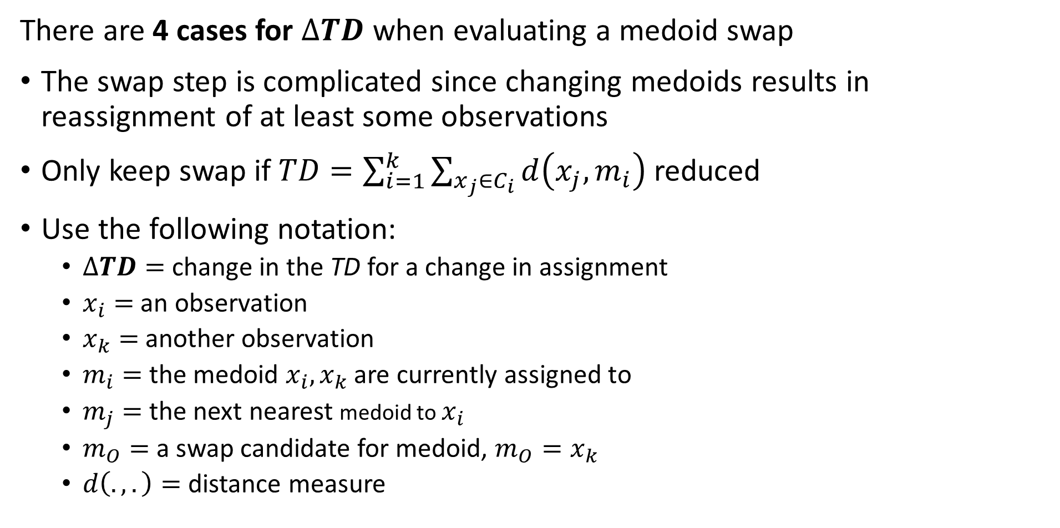
K-medoids Algorithm
There are 4 cases for $∆TD$ when evaluating a medoid swap
The swap step is complicated since changing medoids results in reassignment of at least some observations
Only keep swap if$TD=\sum_{i=1}^{k}{\sum_{x_{j}∈C_{i}}^{ }{d\left(x_{j},m_{i}\right)}}$ reduced
Use the following notation:
$∆TD=$ change in the TD for a change in assignment
$x_{i}=$ an observation
$x_{k}=$ another observation
$m_{i}=$ the medoid $x_{i},x_{k}$ are currently assigned to
$m_{j}=$ the next nearest medoid to $x_{i}$
$m_{O}=$ a swap candidate for medoid, $m_{O}=x_{k}$
$d\left(.,.\right)=$ distance measure

Slide 9
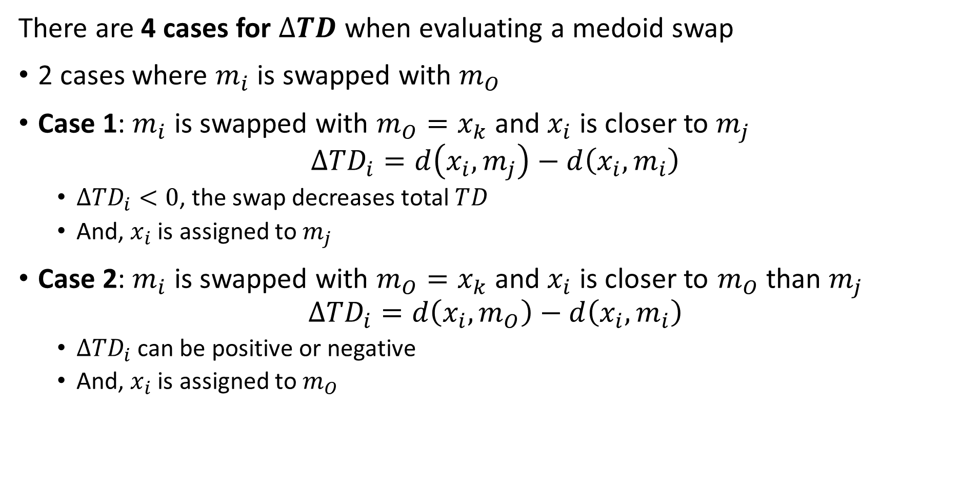
K-medoids Algorithm
There are 4 cases for $∆TD$ when evaluating a medoid swap
2 cases where $m_{i}$ is swapped with $m_{O}$
Case 1: $m_{i}$ is swapped with $m_{O}=x_{k}$ and $x_{i}$ is closer to $m_{j}$
$$∆TD_{i}=d\left(x_{i},m_{j}\right)−d\left(x_{i},m_{i}\right)$$
$∆TD_{i}<0$, the swap decreases total $TD_{ }$
And, $x_{i}$ is assigned to $m_{j}$
Case 2: $m_{i}$ is swapped with $m_{O}=x_{k}$ and $x_{i}$ is closer to $m_{O}$ than $m_{j}$
$$∆TD_{i}=d\left(x_{i},m_{O}\right)−d\left(x_{i},m_{i}\right)$$
$∆TD_{i}$ can be positive or negative
And, $x_{i}$ is assigned to $m_{O}$

Slide 10
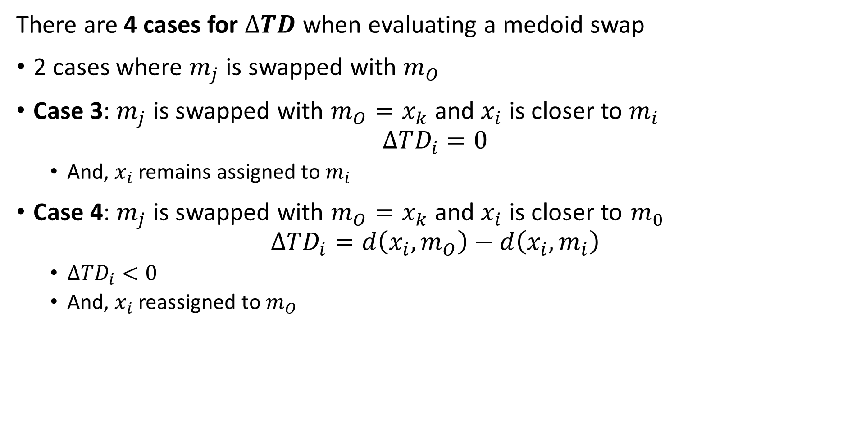
K-medoids Algorithm
There are 4 cases for $∆TD$ when evaluating a medoid swap
2 cases where $m_{j}$ is swapped with $m_{O}$
Case 3: $m_{j}$ is swapped with $m_{O}=x_{k}$ and $x_{i}$ is closer to $m_{i}$
$$∆TD_{i}=0$$
And, $x_{i}$ remains assigned to $m_{i}$
Case 4: $m_{j}$ is swapped with $m_{O}=x_{k}$ and $x_{i}$ is closer to $m_{0}$
$$∆TD_{i}=d\left(x_{i},m_{O}\right)−d\left(x_{i},m_{i}\right)$$
$∆TD_{i}<0$
And, $x_{i}$ reassigned to $m_{O}$

Slide 11
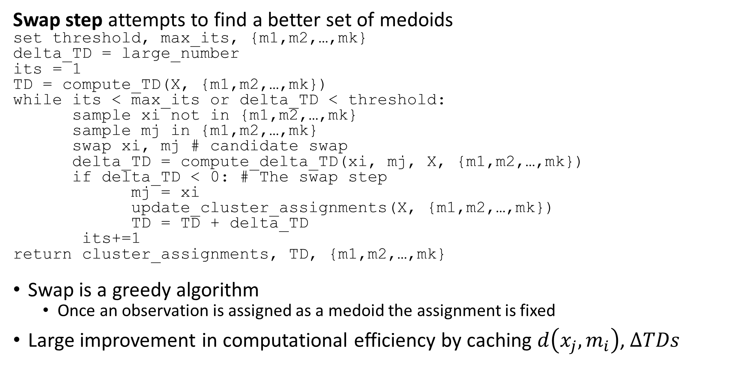
K-medoids Algorithm
Swap step attempts to find a better set of medoids
set threshold, max_its, {m1,m2,…,mk}
delta_TD = large_number
its = 1
TD = compute_TD(X, {m1,m2,…,mk})
while its < max_its or delta_TD < threshold:
sample xi not in {m1,m2,…,mk}
sample mj in {m1,m2,…,mk}
swap xi, mj # candidate swap
delta_TD = compute_delta_TD(xi, mj, X, {m1,m2,…,mk})
if delta_TD < 0: # The swap step
mj = xi
update_cluster_assignments(X, {m1,m2,…,mk})
TD = TD + delta_TD
its+=1
return cluster_assignments, TD, {m1,m2,…,mk}
Swap is a greedy algorithm
Once an observation is assigned as a medoid the assignment is fixed
Large improvement in computational efficiency by caching $d\left(x_{j},m_{i}\right)$, $∆TDs$

Slide 12
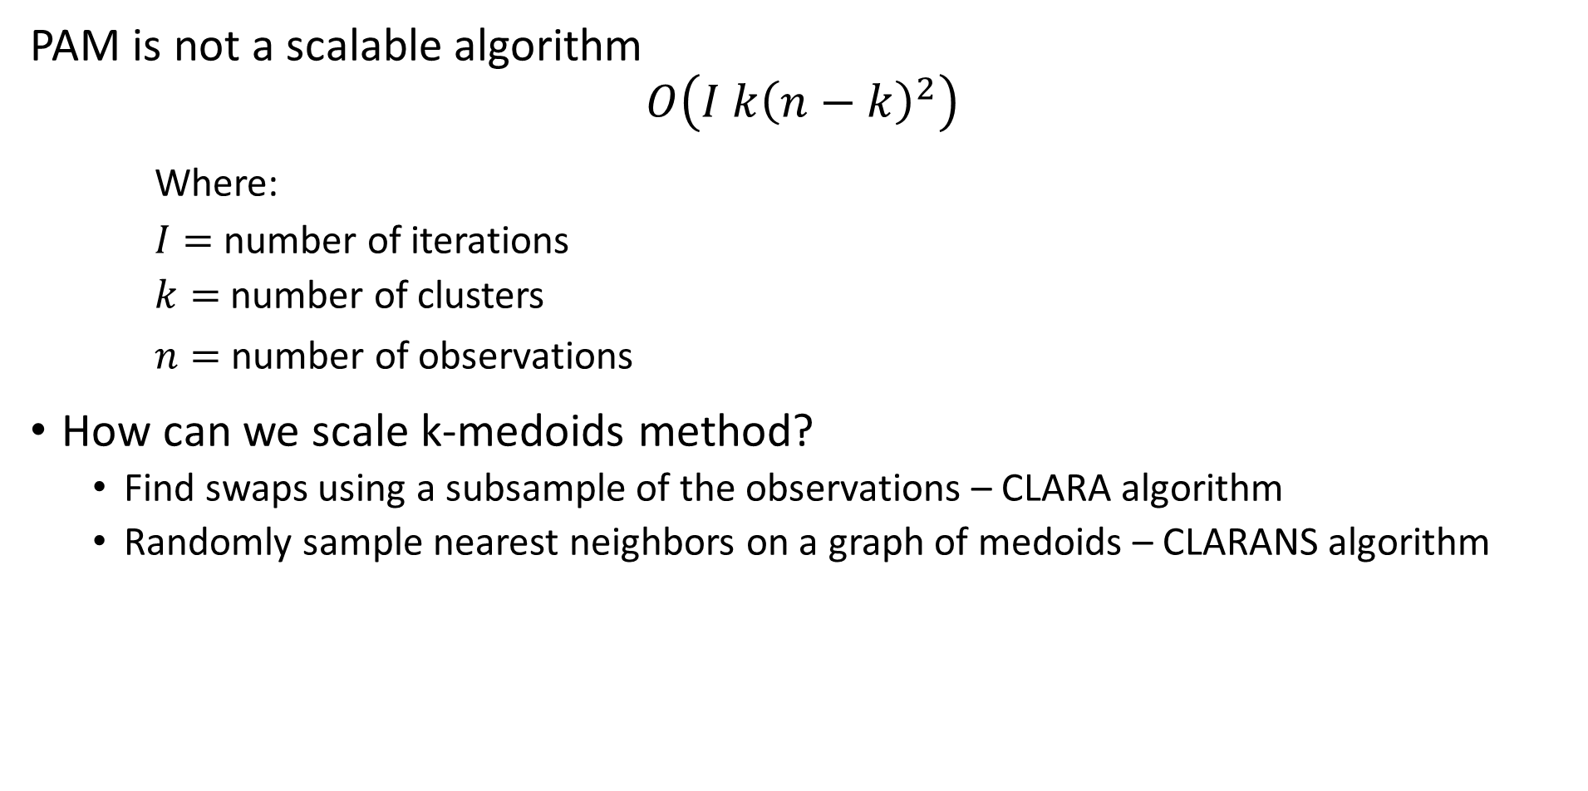
K-medoids Algorithm
PAM is not a scalable algorithm
$$O\left(I k{\left(n−k\right)}^{2}\right)$$
Where:
$I=$ number of iterations
$k=$ number of clusters
$n=$ number of observations
How can we scale k-medoids method?
Find swaps using a subsample of the observations – CLARA algorithm
Randomly sample nearest neighbors on a graph of medoids – CLARANS algorithm

Slide 13
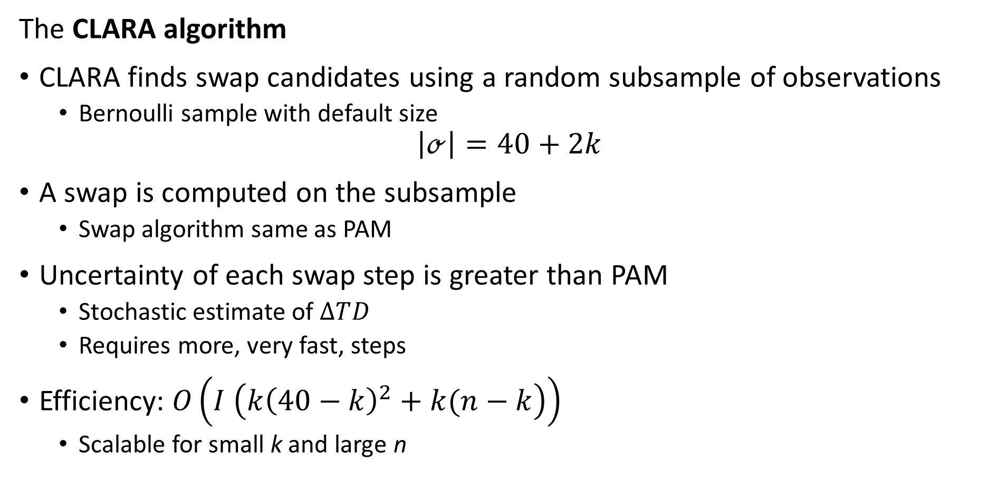
K-medoids Algorithm
The CLARA algorithm
CLARA finds swap candidates using a random subsample of observations
Bernoulli sample with default size
$$\left|ℴ\right|=40+2k$$
A swap is computed on the subsample
Swap algorithm same as PAM
Uncertainty of each swap step is greater than PAM
Stochastic estimate of $∆TD_{ }$
Requires more, very fast, steps
Efficiency: $O\left(I \left(k{\left(40−k\right)}^{2}+k(n−k\right)\right)$
Scalable for small k and large n

Slide 14
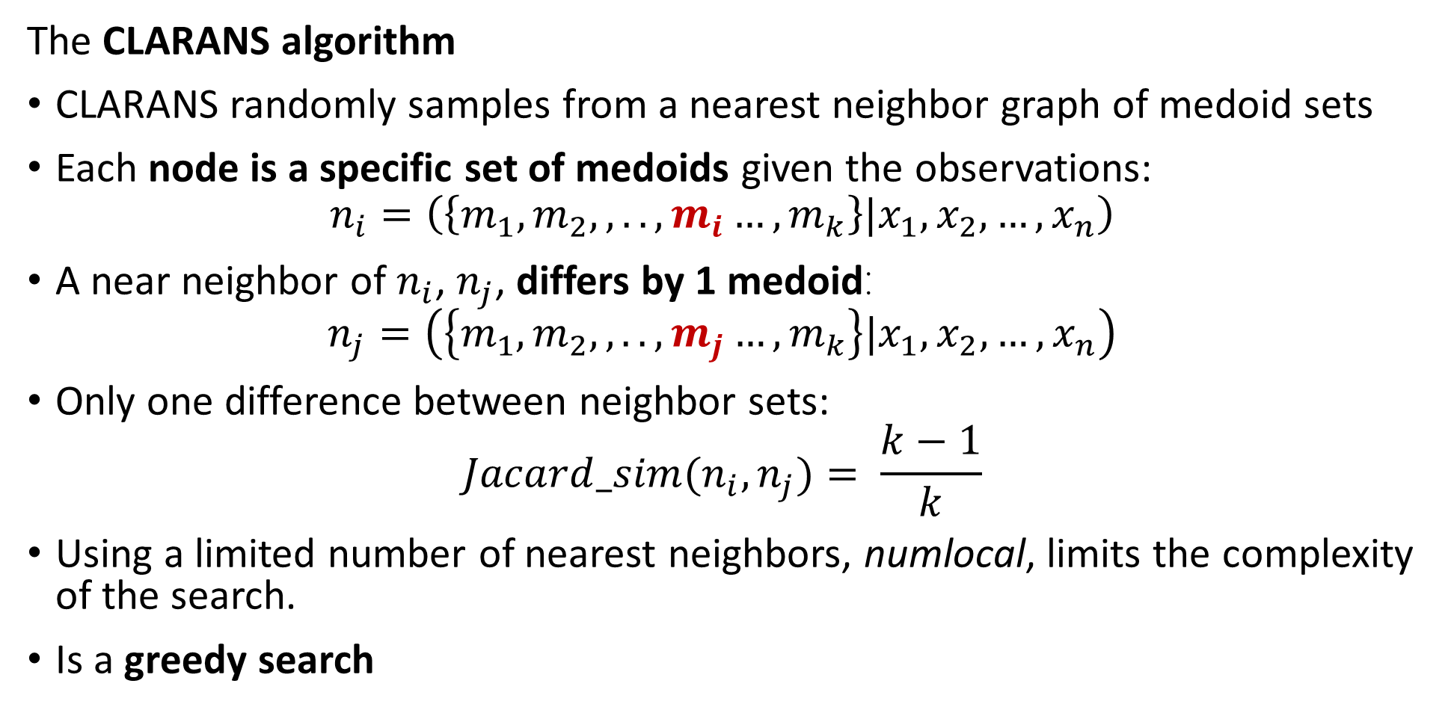
K-medoids Algorithm
The CLARANS algorithm
CLARANS randomly samples from a nearest neighbor graph of medoid sets
Each node is a specific set of medoids given the observations:
$$n_{i}=\left(\left\{m_{1},m_{2},,..,m_{i}…,m_{k}\right\}|x_{1},x_{2},…,x_{n}\right)$$
A near neighbor of $n_{i}$, $n_{j}$, differs by 1 medoid:
$$n_{j}=\left(\left\{m_{1},m_{2},,..,m_{j}…,m_{k}\right\}|x_{1},x_{2},…,x_{n}\right)$$
Only one difference between neighbor sets:
$$Jacard_sim(n_{i},n_{j})= \frac{k−1}{k}$$
Using a limited number of nearest neighbors, numlocal, limits the complexity of the search.
Is a greedy search

Slide 15
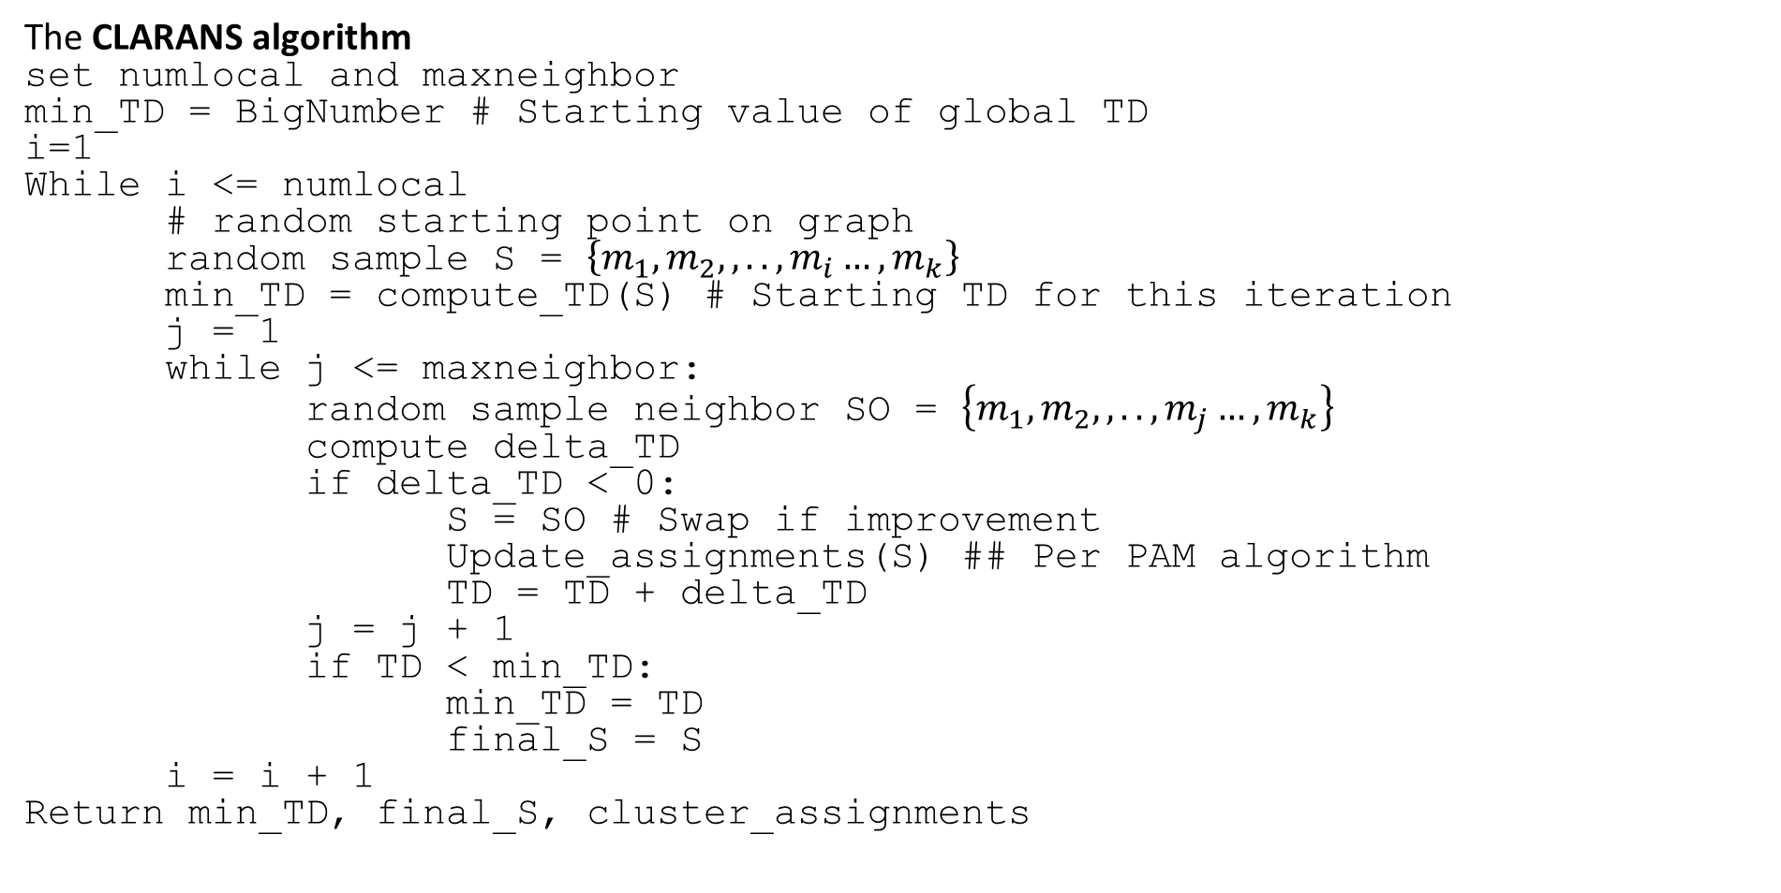
K-medoids Algorithm
The CLARANS algorithm
set numlocal and maxneighbor
min_TD = BigNumber # Starting value of global TD
i=1
While i <= numlocal
# random starting point on graph
random sample S = $\left\{m_{1},m_{2},,..,m_{i}…, m_{k}\right\}$
min_TD = compute_TD(S) # Starting TD for this iteration
j = 1
while j <= maxneighbor:
random sample neighbor SO = $\left\{m_{1},m_{2},,..,m_{j}…,m_{k}\right\}$
compute delta_TD
if delta_TD < 0:
S = SO # Swap if improvement
Update_assignments(S) ## Per PAM algorithm
TD = TD + delta_TD
j = j + 1
if TD < min_TD:
min_TD = TD
final_S = S
i = i + 1
Return min_TD, final_S, cluster_assignments

Slide 16
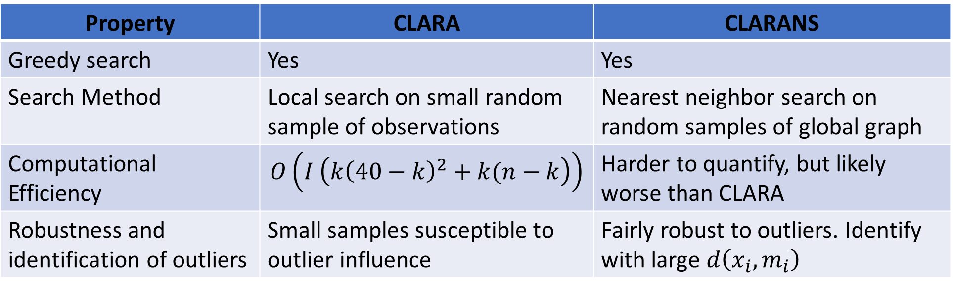
K-medoids Algorithm
Compare CLARA and CLARANS algorithms
Property | CLARA | CLARANS
Greedy search | Yes | Yes
Search Method | Local search on small random sample of observations | Nearest neighbor search on random samples of global graph
Computational Efficiency | $$O\left(I \left(k{\left(40−k\right)}^{2}+k(n−k\right)\right)$$ | Harder to quantify, but likely worse than CLARA
Robustness and identification of outliers | Small samples susceptible to outlier influence | Fairly robust to outliers. Identify with large $d\left(x_{i},m_{i}\right)$

Slide 17
K-medoids Algorithm
There is on-going research into scalable K-medoids algorithms
The original PAM algorithm was first published as Chapter 2 of Finding Groups in Data, Kaufmann and Rousseeuw, Wiley, 1990
The original CLARANS paper is behind paywalls, for a review of k-medoids methods including CLARANS: a method for clustering objects for spatial data, Ng and Hue, 2002
A recently developed algorithm to significantly improve the scalability of k-medoids algorithm can be found in Faster k-Medoids Clustering: Improving the PAM, CLARA, and CLARANS Algorithms, Schubert and Rousseeuw, 2019
For a reasonable up to date review and comparison of K-medoids algorithms see An Overview of Partitioning Algorithms in Clustering Techniques, Skaget and Pandya, 2016

Slide 18
K-medoids Algorithm
Python API software for K-medoids algorithms
The PAM and CLARA algorithms are implemented in Scikit-Extra package
Conforms to Scikit standards for API and good documentation
A versions of the PAM algorithm, CLARANS algorithm and several other clustering algorithms and utilities are implemented in the Pyclustering package
Unfortunately, this package has some rough edges and is not well documented

Slide 19
Affinity-Based Clustering Models

Slide 20
Affinity Clustering
Can we build a clustering algorithm using a mapping to a few prototypes or exemplar points?
Yes
Affinity clustering uses a message passing algorithm to find these responsible or exemplar points and create a graph of cluster members
Affinity clustering provides useful results in many situations
Document similarity
Computer vision
Computational genetics
Etc.

Slide 21
Affinity Clustering
Can we build a clustering algorithm using a relationship to a few prototypes or exemplar points?
The number of representative points, and clusters, are determined by the algorithms
No need to specify number of clusters apriori
The message passing algorithm iteratively determines
Responsibility, r(i,k), of sample k to be the exemplar of sample i
Availability, a(i,k), of sample k to be a member of cluster with exemplar i
Exemplar points are central nodes of a graph component, or cluster
Graph components have no edges between them
Samples in component are connected to the exemplars by undirected edges

Slide 22
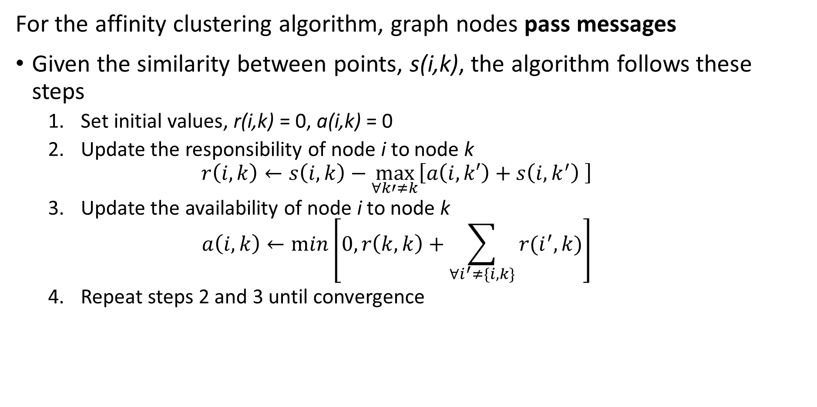
Affinity Clustering
For the affinity clustering algorithm, graph nodes pass messages
Given the similarity between points, s(i,k), the algorithm follows these steps
Set initial values, r(i,k) = 0, a(i,k) = 0
Update the responsibility of node i to node k
$$r\left(i,k\right)←s\left(i,k\right)−\max_{∀k′≠k}{⁡\left[a\left(i,k′\right)+s\left(i,k^{′}\right) \right]}$$
Update the availability of node i to node k
$$a\left(i,k\right)←min⁡\left[0,r\left(k,k\right)+\sum_{∀i^{′}≠\{i,k\}}^{ }{r(i^{′},k)}\right]$$
Repeat steps 2 and 3 until convergence

