Slide 1
Wollo University Komblocha
Institute of Technology
Department of Computer Science
Web-based mini-bus management system
for kombolcha mini-bus station

Slide 2
GROUP MEMBERS
NO NAME ID
1 ADEM YESUF…………………………..WOUR/1252/09
2 FOZIYA HUSSIEN……………………….WOUR/4662/09
3 KEMILA JEMAL…………………………..WOUR/1550/09
4AKLOGWOLIE……………………………..WOUR/1242/09
5 ALEMNESH BEGASHAW………………..WOUR/1510/09

Slide 3
Chapter One Introduction
The mini-bus management in the context of kombolcha mini-bus station has been carried out as a manual system as the station’s ticket man prepare the bill paper as of mini-bus exit request and deliver it to the driver’s assistant by receiving the appropriate bill which is pre-determined by the intended authority.
In order to solve problems of manual mini-bus management system in kombolcha mini-bus station, we will develop web based min-bus management.

Slide 4
Background of the Project
Kombolcha mini-bus station uses manual way to manage its all mini-bus and driver trip. This manual system has been used continuously for long time without improvement up to today.
In this mini-bus station, there is a need for automated method of keeping data which requires a greater need for a mini-bus management system.
By being initiated with all these unsuitable activities stated, we propose a web based mini-bus management system for kombolcha mini-bus station.

Slide 5
Statement of the Problem
The manual mini-bus management system in kombolcha station have number of problems like:
Requires a lot of resource stationary materials.
Drivers do not know their schedule easily.
Drivers do not register in online system.
Difficult to manage mini-bus.
Difficult to search records easily.
Redundancy and duplication of data records.

Slide 6
Objective of the Project
General objective
The general objective of this project is to develop web-based mini-bus management system for kombolcha mini-bus station
Specific objective
To Study the existing system and find out the problem.
To enable driver to easily access their schedules.
To calculate the total income generated per day.
To prepare feature that can generate incomes as a report
To implement and test the system.

Slide 7
Scope of the project
The Scope of the project are:
Calculate the total income of the station per week.
The operator can make Schedule to the mini-bus route.
The operator approve reservation based on their entry.
Show schedule of mini-bus in the system.
Request to cancel reservation.
Generate report.
Register new mini-bus.
Update schedule.
Users can update account.

Slide 8
Limitation of the project
The proposed system will not perform the following activities
The system will not support online payment
The system only give service for those drivers have already an account
The system will not allow the station to communicate with other mini-bus station.

Slide 9
Significance of the project
The significance of this project
Provides good services for the mini-bus station.
The system give response efficiently and effectively.
Drivers can easily view their schedule.
It increases customer satisfactions,
Reduces the required man power,
It reduces the wastage of time, money and energy

Slide 10
Methodology
Data Collection Methodology
Interview
Observation
Document analysis
System Implementation tools
Software requirement
Microsoft Visio
Hardware requirements
Computer
Programming Language
PHP language
Microsoft office word
flash
HTML
Systems Analysis and Design Methodology
Object-oriented analysis
Object-oriented Design

Slide 11
Feasibility study
Economic Feasibility.
Organizational feasibility.
Operational feasibility.
Tasks &Schedule Feasibility.
Technical feasibility.
Political and legal feasibility

Slide 12
Chapter 2 Description of the Existing System and Requirement Gathering
Players in the Existing System
Driver
Exit-cutter
Turn –taker
Manager

Slide 13
Major activities in the existing system
Some activities performed in the existing system includes:
Collect money from drivers for the trip.
Reserve the mini-bus turn.
Cut out exit ticket
Manage the mini-bus information
Collect money from the association of station.
Register mini-bus.

Slide 14
Bottlenecks of the existing system
Performance
It performs tedious and time consuming task.
Security and Controls
It is difficult to control and secure these manual records.
Efficiency
The current system inefficient while utilizing resources.
Data storage problem
Data redundancy that leads to inconsistency.

Slide 15
Proposed solution for the new system
The Proposed solution for the existing system are:-
Store information on the database.
Reduce wastage of time for preparing registration form.
Reduce wastage of cost.
Reduces the number of employees in the station.
Minimize the work load of employee.
Computerized form of information handling method.
Drivers get information about the schedule quickly.

Slide 16
Requirements of the Proposed System Functional requirements
Operator
Schedule the mini-bus route.
Manage the mini-bus
Post the schedule of mini-bus trip.
Approve reservation of mini-buses.
Send the notification.
Delete reservation of mini-bus
Generate the report.
Print the exit ticket.
Register payment
Exit-checker
Receive notification
Update his account
System Admin:
Manage operators
Manage exit-checkers
Driver
Can request for his trip.
Request to reserve his turn.
Can view their schedule.
Request to Cancel reservation

Slide 17
Nonfunctional requirements
The following are non functional requirement associated with the system:-
Performance
User friendly Interface
Security
Accuracy
Reliability
No Redundancy
Availability
Backup and recovery.

Slide 18
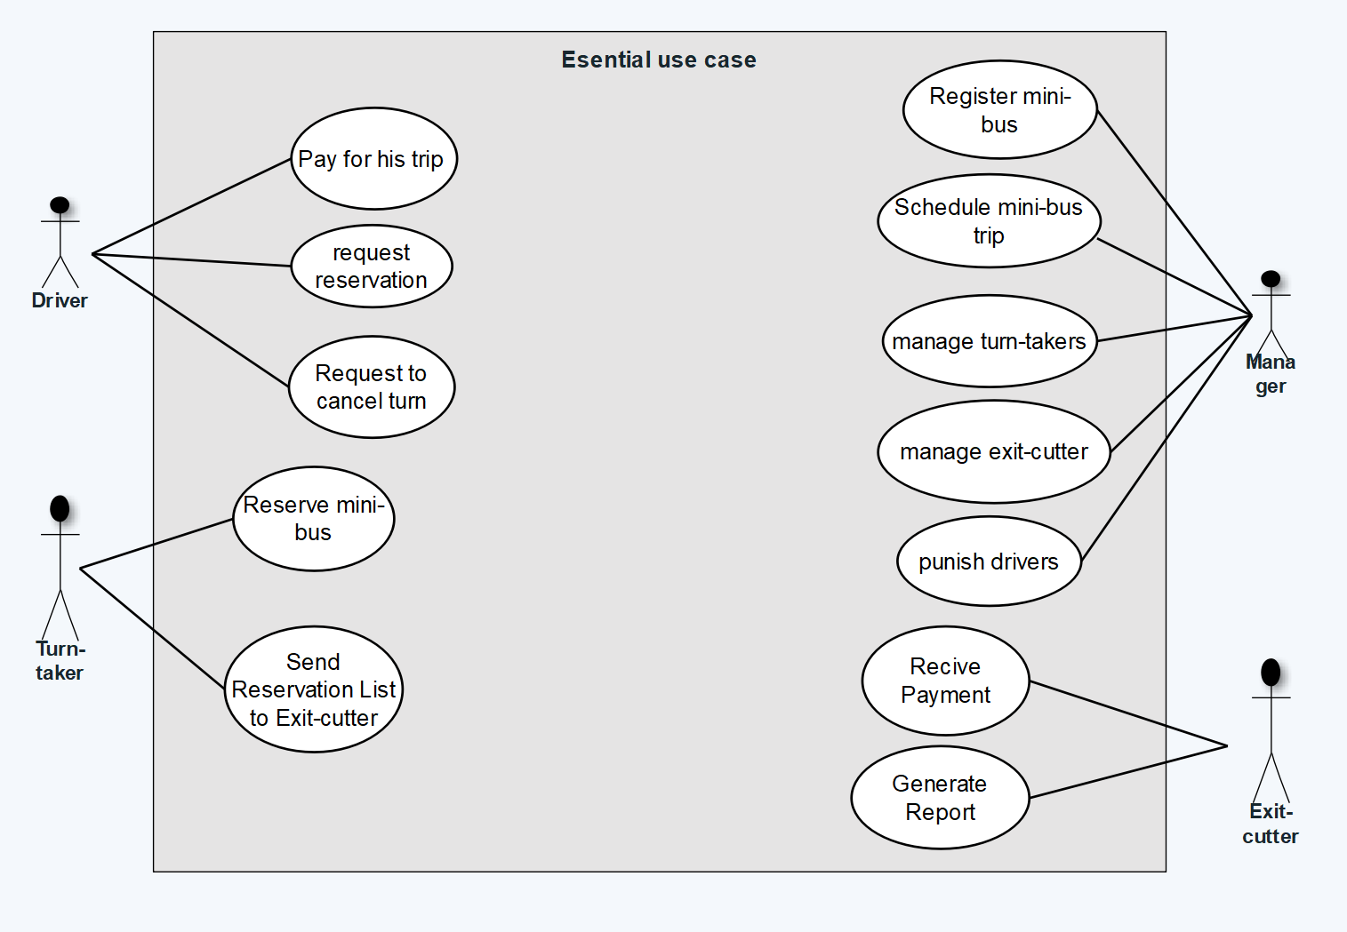
Modeling the existing systems Essential Use Case Modeling

Slide 19
Domain modeling with CRC
CRC is collection of standard index cards that have been divided in to three sections.
A class: represents a collection of similar objects.
A responsibility: is something that a class knows or does.
A collaborator: is another class that a class interacts with to fulfill its responsibilities.
Turn-taker
First Name Last Name Id Phone number | employee Approve reservation turn () send the reservation turn() delete reservation()
Manager
First Name Last name Id Phone number | manage Register mini-bus () schedule() manage mini-bus() post schedule()

Slide 20
CHAPTER THREE System Analysis
System analysis is a process of collecting and interpreting facts, identifying the problems, and decomposition of a system into its components.
Modeling proposed systems
System use case diagrams
System use case diagram display the relationship between the actor and use case
Actors that are already identified for the new systems are: -
System admin
Operator
Exit-checker
Driver

Slide 21
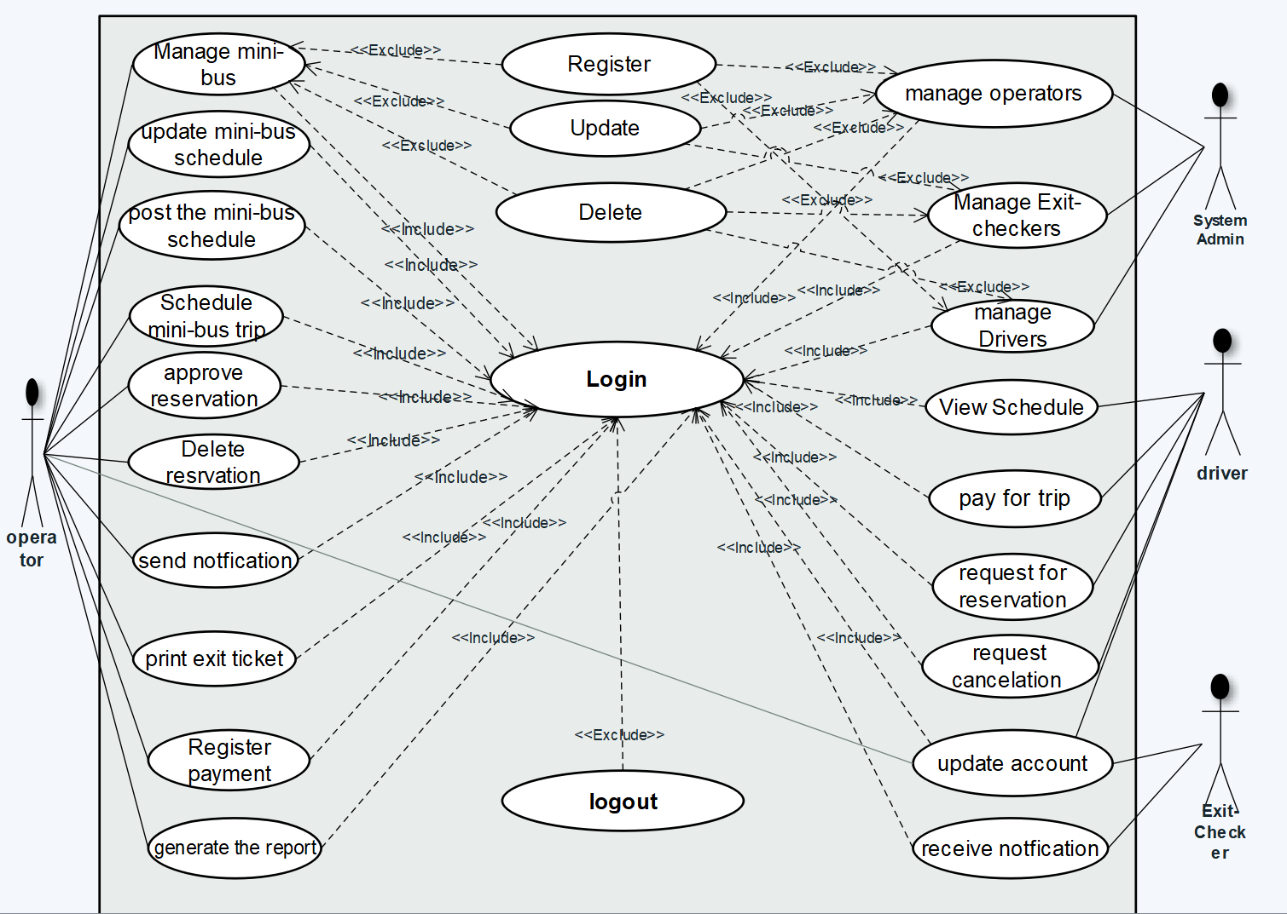
Cont…

Slide 22
Use case Documentation
Use case name | Request to reservation
Identifier | UC6
Actor | Driver
Description | Driver will request the operator to reserve his turn.
Precondition | The Driver must be a username and password.
Basic course of action | The driver: | System
 | 1.Open the homepage 2.login 4.Enter user name and password 6. Select request to reserve from the home page. 8. The driver inserts his trip and click request to turn. 10.logout 11. End use case. | 3.The system display login form 5. System validate user name and password 7. The system display reservation form page. 9. The system responses message his reservation sent or not (fault tolerance).
Alternate course of action | 1 if username and password is invalid return to step4 2 If the driver enters invalid data, the system displays “invalid data” message and return to basic course of action 8.
Post condition | The driver will ask his trip reservation to the operator, after approve his request the diver will wait his turn.

Slide 23
Use case name | approve the mini-bus reservation
Identifier | UC7
Actor | Operator
Description | Operator approves the turn request of drivers.
Precondition | The driver must be request for the trip reservation.
Basic course of action | The operator: | System
 | 1.Open the homepage 2.login 4.Enter user name and password 6. Select approve reservation from the home page. 8. The operator approves the reservation based on the request time. 10.logout 11. End use case. | 3.The system display login form 5. System validate user name and password 7. The system display approval page. 9. The system responses message his approve successful sent or not (fault tolerance).
Alternate course of action | 1 if username and password is invalid return to step4 2 If the operator approves the mini-bus that is lately come the turn-taker will return to 8.
Post condition | The operator approve the request of driver based on their request.

Slide 24
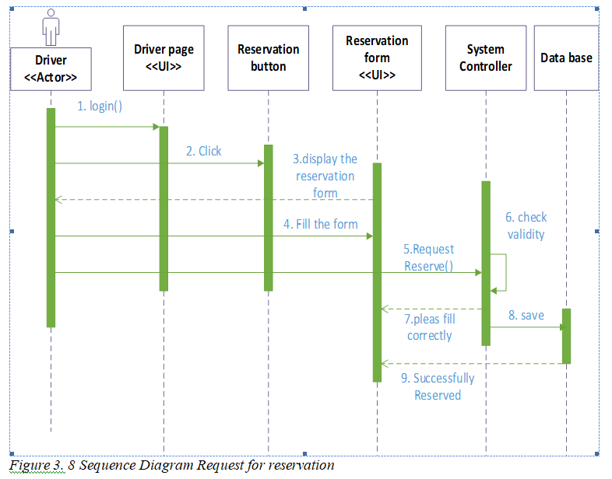
Sequence Diagram

Slide 25
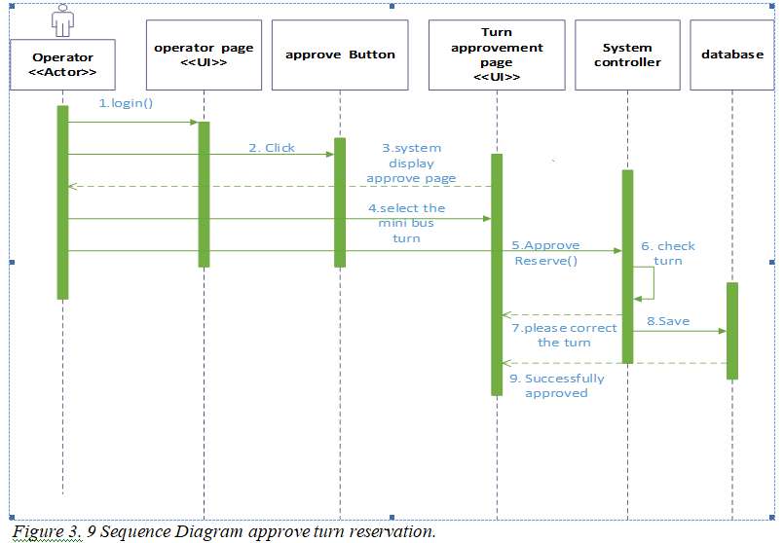

Slide 26
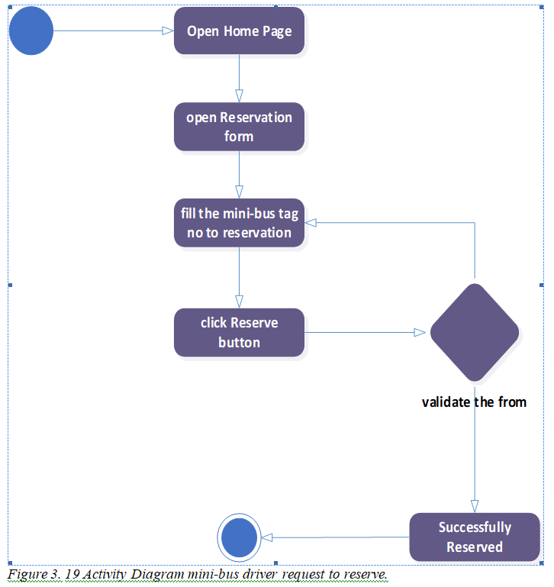
Activity Diagram

Slide 27
Analysis level class diagram

Slide 28
CHAPTER FOUR SYSTEM DESIGN
4.1 Introduction
System design is the transformation of the analysis model into a system design model. Up to now we were in the problem domain. System design is the first part to get into the solution into the design model that takes into n domain in a software development. This chapter focuses on transforming the analysis model account the non-functional requirements and constraints described in the problem statement and requirement analysis sections discussed earlier.

Slide 29
Design Goals
The new system is considered to be successful if it meets the following sets of criteria’s.
User Interface Documentation Performance Availability Security Modifiable

Slide 30

Class Modeling Diagram
It shows static nature of how the software is built. In object-oriented system Analysis, Real world concepts are modeled into objects. Conceptual modeling allows us to model these concepts which later involve in to a full-fledged class models.

Slide 31
Class Modeling Diagram

Slide 32
Stat chart Modeling
A state represents a particular set of values for an object. It has initial and final states and used to describe the states of different objects in its life cycle.

Slide 33
Collaboration Diagram for schedule
It represents the structural organization of a system and the messages sent/received and its purpose is to visualize the organization of objects and their interaction.

Slide 34
Component Modeling
Component modeling represents the software organizations and dependencies among a set of components and used to describe the physical aspects of a system.

Slide 35
Deployment Modeling
UML deployment diagram show physical view of system, taking software into real world by showing how software gets assigned to hardware and how communicates.

Slide 36
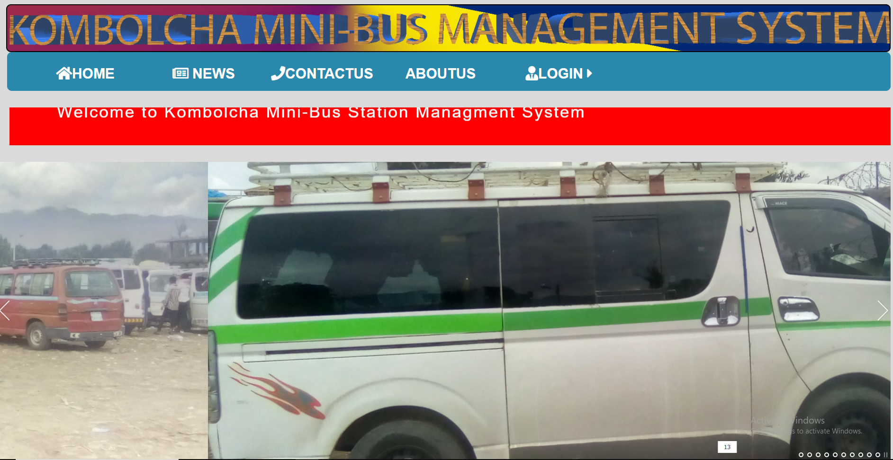
User interface Design

Slide 37
CHAPTER FIVE
IMPLEMENTATION AND TESTING
Unit testing Every module of the System is separately tested.
Integrated testing In this testing part, all the modules will be combined together and tested for their combinability with each other and with the systems functionality.
System testing: In this testing, the team performs over all functional testing by checking whether it meets the required target or not.

Slide 38
Hardware Software Acquisitions
Hardware
Printer
Server
Hard Disk
RAM
Software
Mysql
PHP
HTML5
Java script
CSS(cascading style sheet)

Slide 39
CHAPTER SIX
COCLUSION &RECOMMENDATION
Recommendation
There are some minor features that we cannot implement on top of this web-application. For example, cannot support online payment, GPS access of mini-bus so we recommend the next developers to perform their action from this angle.

Slide 40
Conclusion
In general, our system solves problems that exist in kombolcha mini-bus station problem. During the various phases of the project, we have learnt a lot in multidisciplinary technologies required to be embedding with this project and these technologies would be useful in our future techno-economic career. We have adopted the real cracks of web developing concepts so that the quality and standards can be achieved optimally.

Slide 41
Thank You!!!

