Slide 1
Wollo University Komblocha
Institute of Technology
Department of Computer Science
Web-based transport management system
for kombolcha city bus station

Slide 2
GROUP MEMBERS
NO NAME ID
1.Ahmed Hussen 0521/10
2. Amare Degu 0527/10
3. Gedefaye Melkie 0558/10
4. Meseret Teferi 1448/09
5. Seada Mohammed 1443/09

Slide 3
Chapter One Introduction
This proposal is about Kombolcha Bus Station transport management system. It is aimed to make the activities involved in the bus station computerized. The current system is being undergone manually and even if it is able to do its task well, its tasks are tedious and time consuming to be performed by human beings.
In order to solve problems of manual transport management system in kombolcha bus station, we will develop web based transport management system .

Slide 4
Background of the Project
The current system is being undergone manually and even if it is able to do its task well, its tasks are tedious and time consuming to be performed by human beings.
Under Kombolcha city administration, there is a government structure called the Road Transport Development Administration which has a part named Transport Supply and Cooperation Major Team.
By being initiated with all these unsuitable activities stated, we propose a web based transport management system for kombolcha bus station.

Slide 5
Statement of the Problem
The manual tranport management system in kombolcha bus station have number of problems like:
They are assigning turns and destination places manually.
They are recording information about buses and Associations (Mahiberat) manually in paper documents.
There is no means for the passengers to know which bus is going to be the turn owner currently easily.
Redundancy and duplication of data records.
The manual system does not allow Associations (Mahiberat) to view all the available working areas.

Slide 6
Objective of the Project
General objective
The general objective of this project is to develop Web based transport management system for Kombolcha city Bus Station.
Specific objective
To Study the existing system and find out the problem.
To design and model transport management system.
To Record all data related to buses and Associations.
To Design new proposed system .
To Implementing the proposed system.

Slide 7
Scope of the project
The Scope of the project are:
Involves data registration of vehicles and manipulation of these data.
Passengers can view available bus with their level.
Adjusting turns/schedules for the vehicles.
Checking maintenance record of vehicles.
Recorded bus order based on their arrival time.
Assign the work place timetable(Merhagbr) for each bus.
Register new bus in bus station.
Update schedule.

Slide 8
Limitation of the project
There are some limitations within the proposed system those are listed below.
➢Cars provide cargo service is no entertained.
➢The system will not allow the station to communicate with other bus station.

Slide 9
Significance of the project
The significance of this project
For Kombolcha bus Station workers:
this project allow them to perform their activities easily.
For the passengers:
passengers can easily get the information.
For Associations (Mahiberat):
this project allows them view these better and unoccupied areas through simple DBMS techniques.

Slide 10
Feasibility study
Economic feasibility
The proposed system is not expensive
Operational feasibility
It performs the basic functionalities that planned to use.
Technical Feasibility
The system which we developed will be technically feasible.

Slide 11
Methodology
Requirement gathering methods
Interview
Observation
Questionaires
System Implementation tools
Software requirement
Microsoft Visio
Hardware requirements
Computer
Programming Language
PHP language
Microsoft office word
flash
HTML
Systems Analysis and Design Methodology
Object-oriented analysis
Object-oriented Design

Slide 12
Analysis and design Methodology
Object Oriented Approach:
These techniques have a reusability feature.
Development Approach
In our team we select iterative model approach.

Slide 13
Implementation Methodology
We use the following programming tools:
Edraw Max uml 8.0 tool
Visual Paradigm 14.0
MYSQL server
HTML
PHP
JAVASCRIPT
Notepad++
Webserver: apache 4.1.14

Slide 14
Chapter 2 Description of the Existing System and Requirement Gathering
Players in the Existing System
Passenger
Distributer Employee
Operator
Dev’t Process manager
Association Manager

Slide 15
Major activities in the existing system
Some activities performed in the existing system includes:
Post the schedule of bus
Reserve the bus turn.
Manage the bus information
Formed associations
Register bus and association.

Slide 16
Bottlenecks of the existing system
Performance
It performs tedious and time consuming task.
Security and Controls
It is difficult to control and secure these manual records.
Efficiency
The current system inefficient while utilizing resources.
Data storage problem
Data redundancy that leads to inconsistency.

Slide 17
Proposed solution for the new system
The Proposed solution for the existing system are:-
Store information on the database.
Reduce wastage of time for preparing registration form.
Reduce wastage of cost.
Reduces the number of employees in the station.
Minimize the work load of employee.
Computerized form of information handling method.
Operator get information about the schedule quickly.

Slide 18
Requirements of the Proposed System Functional requirements
➢
Functional requirements are statement of capability that the system must generate for addressing the business needs that the system must satisfies.
User Account Management
➢Login and logout into the system.
➢Some system users can search different information
➢Registering new buses and Associations (Mahiberat)
➢Accept requests from the client
➢View different information user’s requests
➢

Slide 19
Cont…
Record available buses and related information
➢Accepting and approving of the membership request.
➢Reply request and form members.
➢Prepare schedule and update it
➢
➢
➢

Slide 20
Nonfunctional requirements
The following are non functional requirement associated with the system:-
Performance
User friendly Interface
Security
Accuracy
Reliability
No Redundancy
Availability
Backup and recovery.

Slide 21
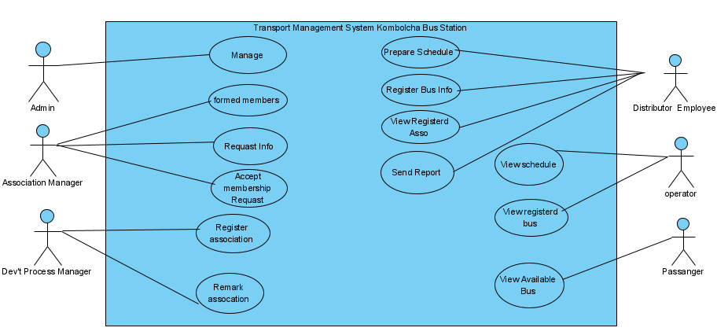
Modeling the existing systems Essential Use Case Modeling

Slide 22
Domain modeling with CRC
CRC is collection of standard index cards that have been divided in to three sections.
A class: represents a collection of similar objects.
A responsibility: is something that a class knows or does.
A collaborator: is another class that a class interacts with to fulfill its responsibilities.
Association Manager
First Name Last Name Id Accept request() View report() Generate report() Formed association() | Operator Dev’t process manager
Operator
First Name Last Name Id View his schedule() View available bus info() View association() | Association manager Passenger

Slide 23
CHAPTER THREE System Analysis
System analysis is a process of collecting and interpreting facts, identifying the problems, and decomposition of a system into its components.
Modeling proposed systems
System use case diagrams
System use case diagram display the relationship between the actor and use case.Actors that are already identified for the new systems are: -
System admin Distribute employee manager
Operator Association Manager
Passenger Dev’t Process Manager

Slide 24
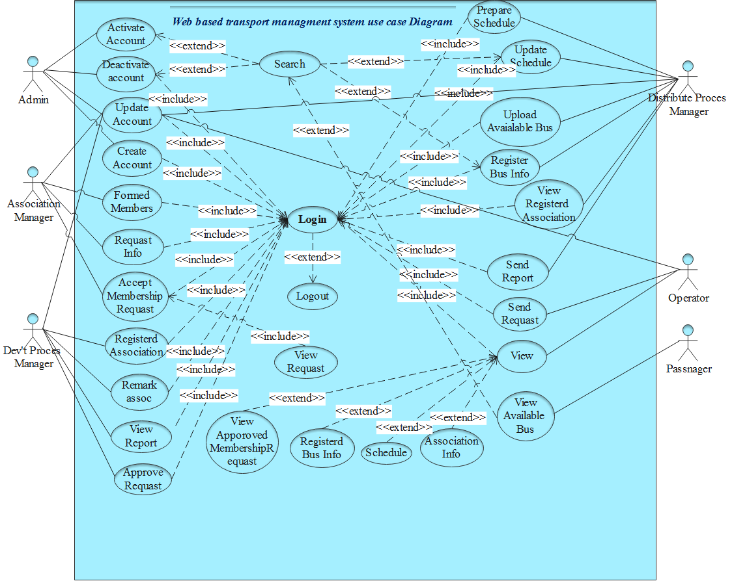
Cont…

Slide 25
Use case Documentation
Use case Name | View Registered Association
Use case ID: | UC 16
Actor: | Distributer employee manager
Description: | Distributer employee manager view registered association.
Pre-condition: | The distributer employee manager must login to the system.
Post condition : | View registered association.
Extends: | UC 05
Includes: | UC 01
Basic course of action: | The distributer employee manager must login to the system. The click view button The system display information Use case end.
Alternative course of Actions: | If the system is not display information. A1. The distributer employee manager going to step 2 and try again.

Slide 26
Use case Documentation
Use case Name | Prepare schedule
Use case ID: | UC 12
Actor: | Distributer employee manager
Description: | Distributer employee manager can prepare schedule.
Pre-condition: | The distributer employee must login to the system.
Post condition : | To prepare schedule.
Extends: | -----------
Includes: | UC 01
Basic course of action: | The distributer employee manager must login to the system. The click schedule button The system display schedule form The manager enter necessary information. System autonticate the entered information. Use case end.
Alternative course of Actions: | If the entered information is invalid. A1. The system display error message. A2. The distributer employee manager prepare again.

Slide 27
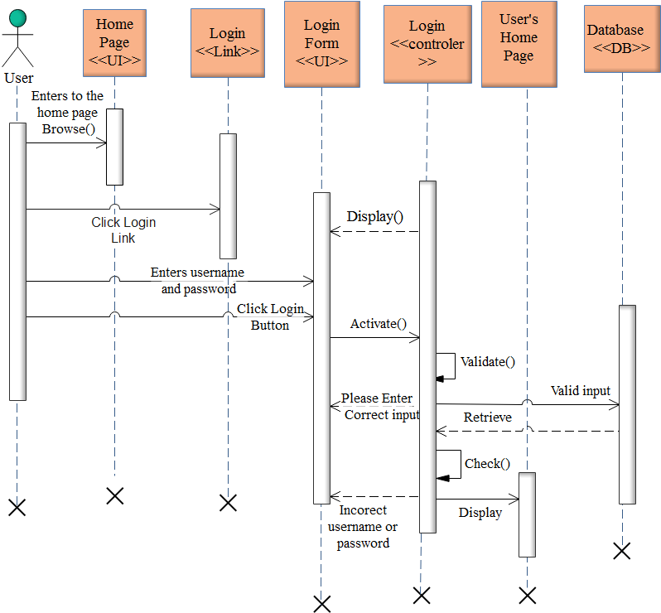
Sequence Diagram
Sequence diagram is one kind of interaction diagrams, which shows an interaction among a set of objects and their relationships.
Figure 3.2 Login sequence diagram

Slide 28
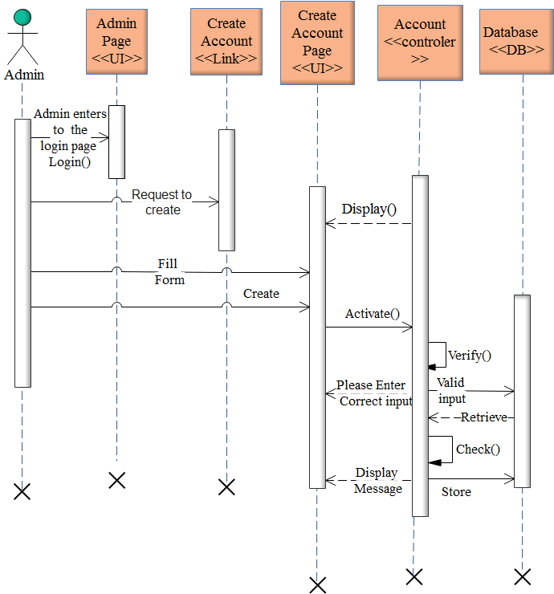
Cont…
Figure 3.3 Create an Account sequence diagram

Slide 29
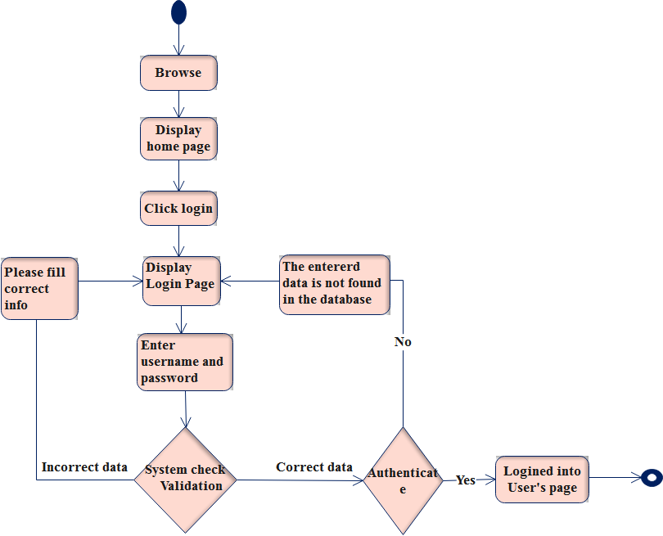
Activity Diagram

Slide 30
Analysis level class diagram
Class diagram is a static diagram. It represents the static view of an application.
Class diagram is not only used for visualizing, describing, and documenting different aspects of a system but also for constructing executable code of the software application.
Class diagram describes the attributes and operations of a class and also the constraints imposed on the system.

Slide 31
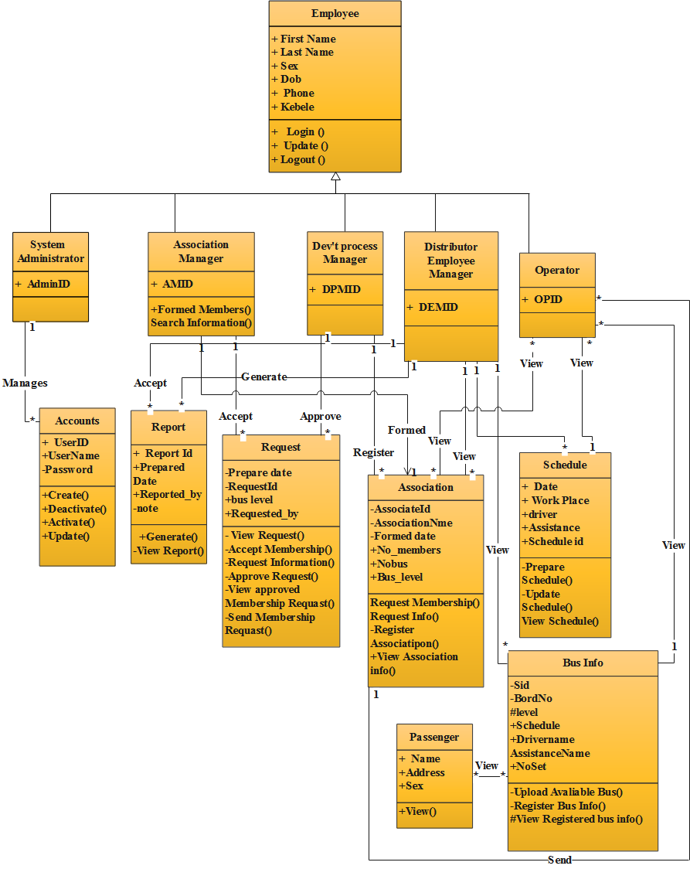

Slide 32
CHAPTER FOUR SYSTEM DESIGN
4.1 Introduction
System design is the transformation of the analysis model into a system design model. Up to now we were in the problem domain. System design is the first part to get into the solution into the design model that takes into n domain in a software development. This chapter focuses on transforming the analysis model account the non-functional requirements and constraints described in the problem statement and requirement analysis sections discussed earlier.

Slide 33
Design Goals
The new system is considered to be successful if it meets the following sets of criteria’s.
User Interface Documentation Performance Availability Security Modifiable

Slide 34

Class Modeling Diagram
It shows static nature of how the software is built. In object-oriented system Analysis, Real world concepts are modeled into objects. Conceptual modeling allows us to model these concepts fullwhich later involve in to a -fledged class models.

Slide 35
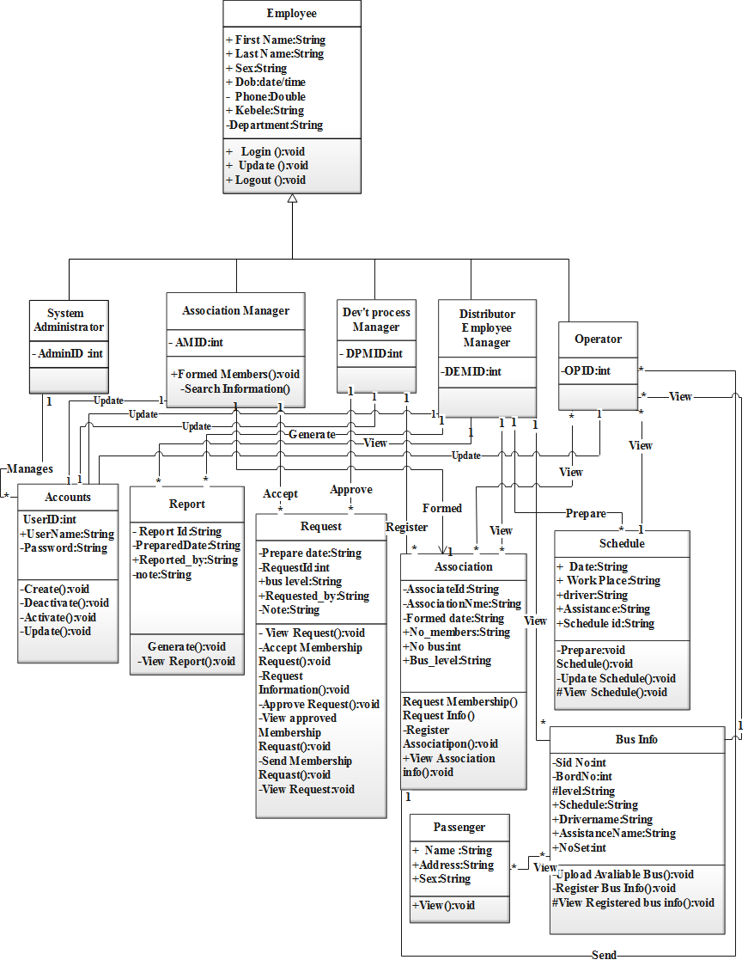

Slide 36
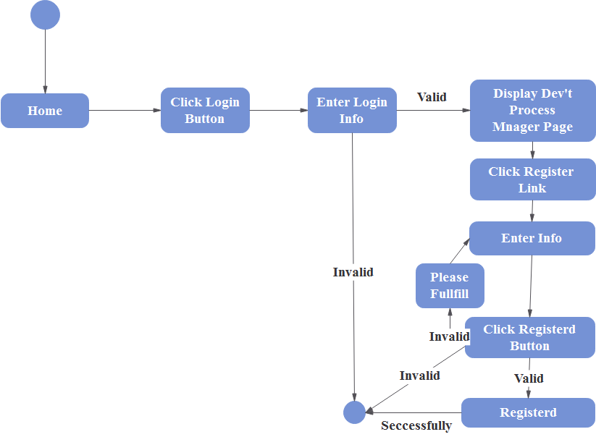
Stat chart Modeling
A state represents a particular set of values for an object. It has initial and final states and used to describe the states of different objects in its life cycle.

Slide 37
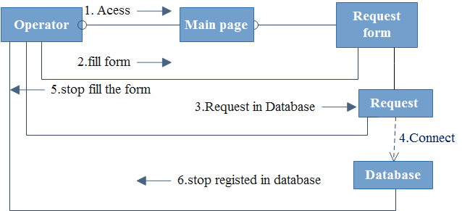
Collaboration Diagram for schedule
It represents the structural organization of a system and the messages sent/received and its purpose is to visualize the organization of objects and their interaction.

Slide 38
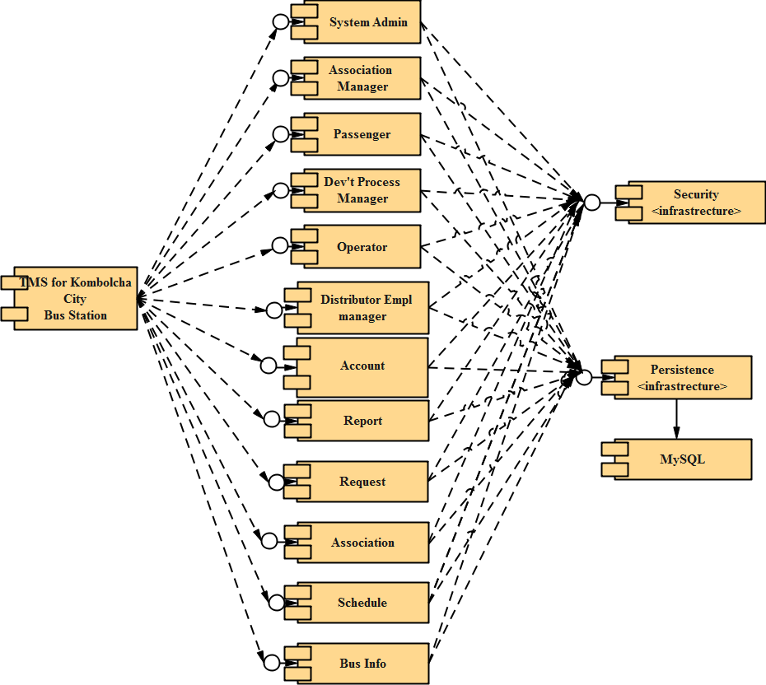
Component Modeling
Component modeling represents the software organizations and dependencies among a set of components and used to describe the physical aspects of a system.

Slide 39
Deployment Modeling
UML deployment diagram show physical view of system, taking software into real world by showing how software gets assigned to hardware and how communicates.

Slide 40
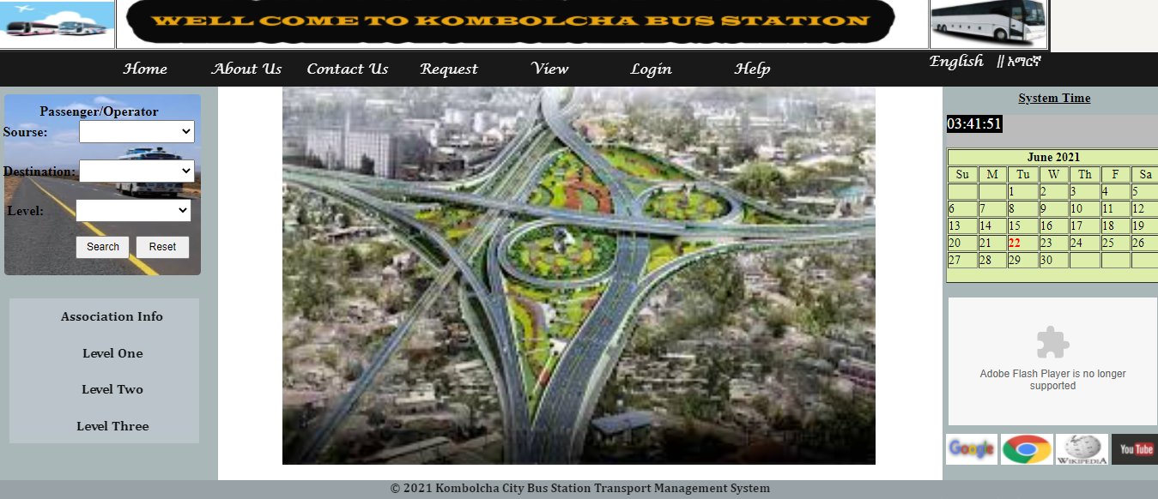
User interface Design

Slide 41
CHAPTER FIVE
IMPLEMENTATION AND TESTING
Unit testing Every module of the System is separately tested.
Integrated testing In this testing part, all the modules will be combined together and tested for their combinability with each other and with the systems functionality.
System testing: In this testing, the team performs over all functional testing by checking whether it meets the required target or not.

Slide 42
Hardware Software Acquisitions
Hardware
Printer
Server
Hard Disk
RAM
Software
Mysql
PHP
HTML5
Java script
CSS(cascading style sheet)

Slide 43
CHAPTER SIX
COCLUSION &RECOMMENDATION
Recommendation
There are some minor features that we cannot implement on top of this web-application. For example, cannot supportlike security issue for notify client , tariff formation and communication with other bus station, GPS access of bus so we recommend the next developers to perform their action from this angle.

Slide 44
Conclusion
In general, our system solves problems that exist in kombolcha bus station problem. During the various phases of the project, we have learnt a lot in multidisciplinary technologies required to be embedding with this project and these technologies would be useful in our future techno-economic career. We have adopted the real cracks of web developing concepts so that the quality and standards can be achieved optimally.

Slide 45
Thank You!!!

