Slide 1
Artificial Feeding Birds
Metaheuristic for TSP and SOP
Vorname Nachname des Referenten, Datum

Slide 2
Inhaltsverzeichnis
Kapitel 1 Kapitel 2 | Motivation From birds to TSP Algorithm | Seite x Seite y

Slide 3
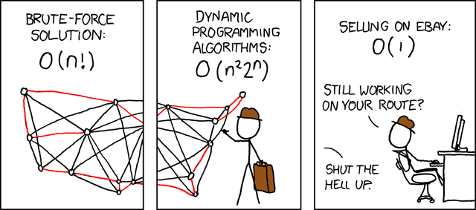

Motivation
TSP and SOP (TSP variant) are NP-complete
Enumeration of all solutions not feasible for configurations with a lot of nodes
Use a Metaheuristic inspired by nature
Source: https://www.explainxkcd.com/wiki/index.php/399:_Travelling_Salesman_Problem
Notes:
How can we help the poor guy?

Slide 4
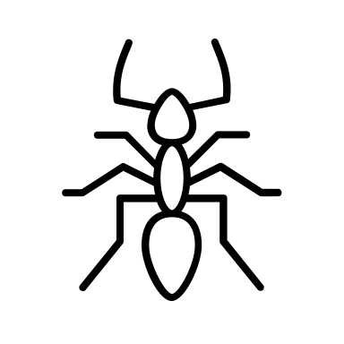
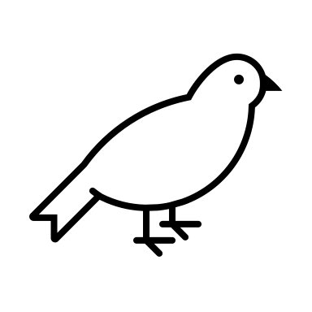
Motivation
Swarm intelligence is particular interesting
Allows a search of the solution space with simple strategies
Can yield complex behavior for multiple agents (e.g. ants)
Inspiration for Artificial Feeding Birds: Pigeons searching for food
Each pigeon (agent) can have the following behavior:
Walk a small distance
Fly to an arbitrary position
Return to a food source
Join another bird

Slide 5
Inhaltsverzeichnis
Kapitel 1 Kapitel 2 | Motivation From birds to TSP Algorithm | Seite x Seite y

Slide 6
From Birds to TSP
Each Birds represents one possible solution (one tour)
Each operation performed by a bird, alters its respective solutions

Slide 7
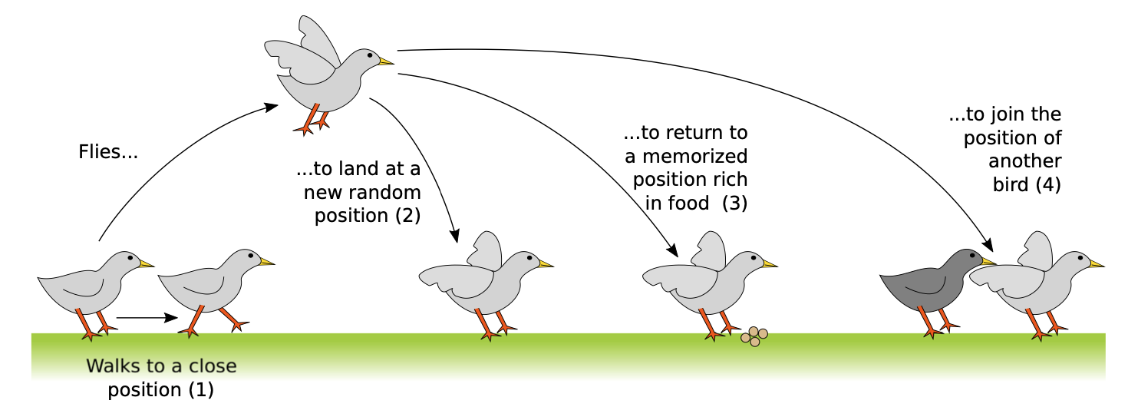
From Birds to TSP

Slide 8
From Birds to TSP
Each action of a bird corresponds to a change of its own solution
Each solution is valid
The number of candidate solutions does not change
(1) Walk
(2) Fly

Slide 9
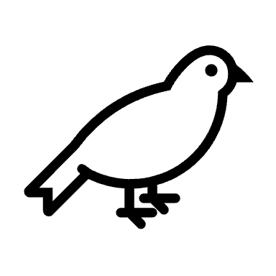
From Birds to TSP
(3) Return
(4) Join
Notes:
The current best solution of a bird = Food source
=> Return to a food source = Return to current best solution!

Slide 10
Inhaltsverzeichnis
Kapitel 1 Kapitel 2 | Motivation From birds to TSP Algorithm | Seite x Seite y

Slide 11
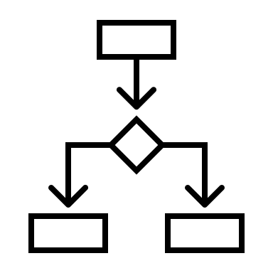
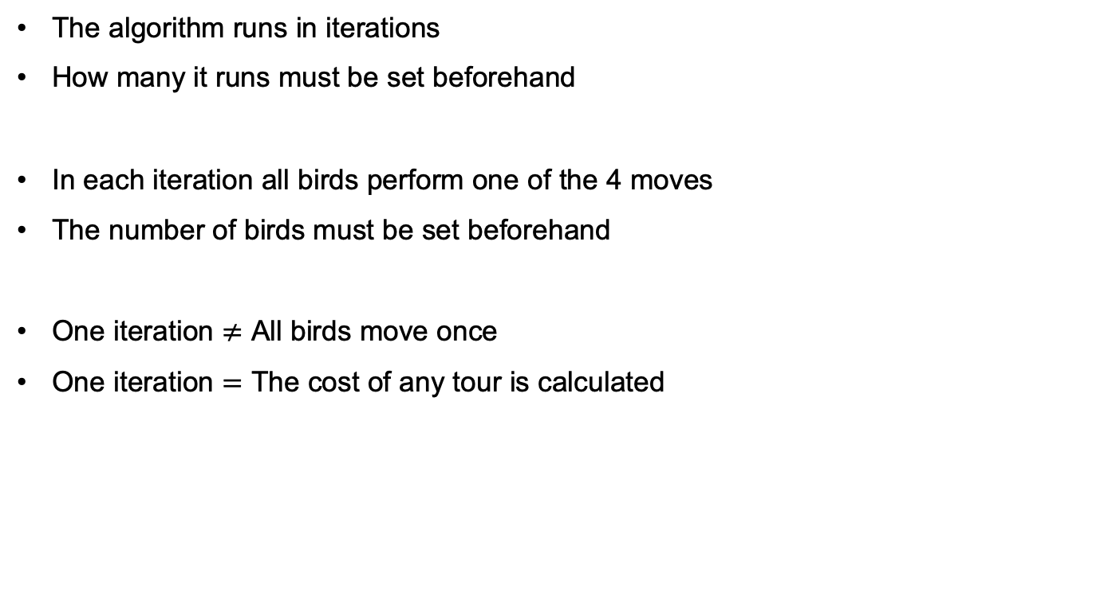
Algorithm Preconditions
The algorithm runs in iterations
How many it runs must be set beforehand
In each iteration all birds perform one of the 4 moves
The number of birds must be set beforehand
One iteration $≠$ All birds move once
One iteration $=$ The cost of any tour is calculated

Slide 12
Algorithm Preconditions
There are ”big” and “small” birds
Only a big bird can join a small bird
Which action an agent (bird) performs depends on the probability of the move
The probability for a move is a hyperparameter
If a bird hasn’t walked in the previous iteration, he walks!

Slide 13
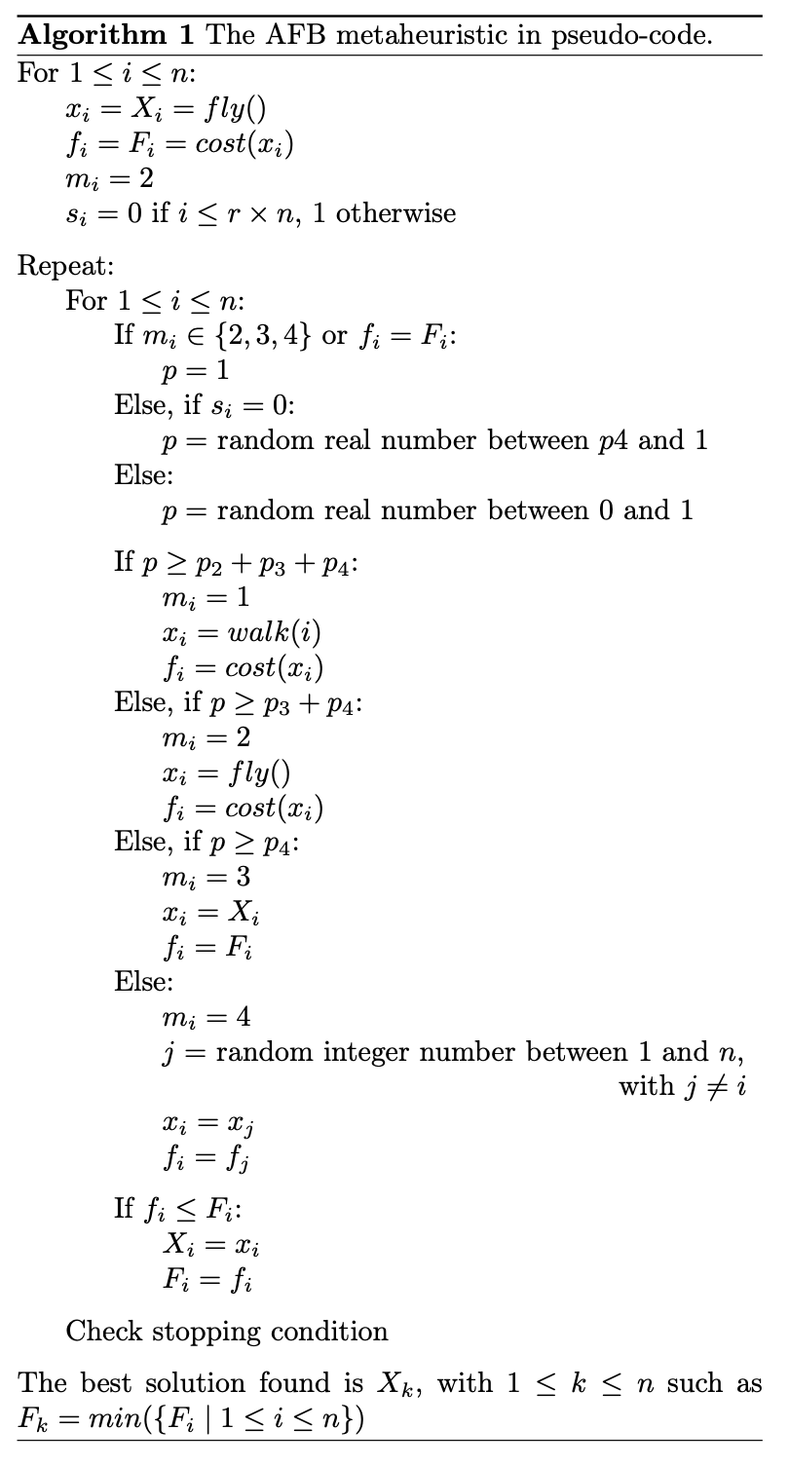
Algorithm
Variable | Meaning
x | Current tour
f | Cost of current tour
X | Best tour
F | Cost of best tour
s | Big bird?
m | Previous move

Slide 14
Algorithm
Variable | Meaning
x | Current tour
f | Cost of current tour
X | Best tour
F | Cost of best tour
s | Big bird?
m | Previous move

Slide 15
Vielen Dank für Ihre Aufmerksamkeit!

