Slide 1
Improvements on AFB
Advancing the Metaheuristic for TSP
Pit Hüne; Tim Cares, 19.12.2023

Slide 2
Inhaltsverzeichnis
Chapter 1 Chapter 2 Chapter 3 Chapter 4 Chapter 5 Chapter 5 Chapter 6 Chapter 7 Chapter 8 | Recap Methodology Top-b Join 3-Opt Delegating Responsibility Nearest-neighbor Initialization Early Stopping Optimization Behavior Metabirds | Page 4 Page 9 Page 11 Page 14 Page 17 Page 20 Page 23 Page 26 Page 29

Slide 3
Inhaltsverzeichnis
Chapter 1 Chapter 2 Chapter 3 Chapter 4 Chapter 5 Chapter 5 Chapter 6 Chapter 7 Chapter 8 | Recap Methodology Top-b Join 3-Opt Delegating Responsibility Nearest-neighbor Initialization Early Stopping Optimization Behavior Metabirds | Page 4 Page 9 Page 11 Page 14 Page 17 Page 20 Page 23 Page 26 Page 29

Slide 4

Recap
Each Birds represents one possible solution (one tour)
Each operation performed by a bird, alters its respective solutions

Slide 5
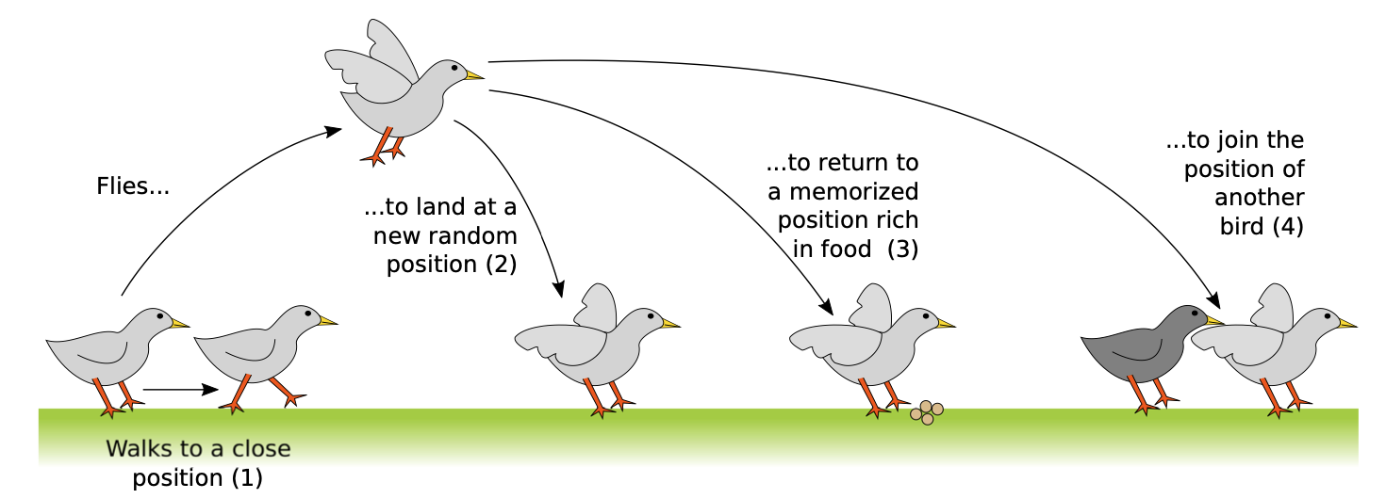
Recap

Slide 6
Recap
Each action of a bird corresponds to a change of its own solution
Each solution is valid
The number of candidate solutions (or agents respectively) does not change (currently)
(1) Walk
(2) Fly

Slide 7

Recap
(3) Return
(4) Join
Notes:
The current best solution of a bird = Food source
=> Return to a food source = Return to current best solution!

Slide 8
Inhaltsverzeichnis
Chapter 1 Chapter 2 Chapter 3 Chapter 4 Chapter 5 Chapter 5 Chapter 6 Chapter 7 Chapter 8 | Recap Methodology Top-b Join 3-Opt Delegating Responsibility Nearest-neighbor Initialization Early Stopping Optimization Behavior Metabirds | Page 4 Page 9 Page 11 Page 14 Page 17 Page 20 Page 23 Page 26 Page 29

Slide 9
Methodology
To benchmark our improvements, we select five feasible solutions from TSPLIB
Each problem has a different order of magnitude to account for the variety of different configurations possible
Each problem is run 10x, to account for the randomness (50 test in total)
We record the mean percentage error, and the mean time in seconds
Problems: eil101, pa561, pr1002, u2156, pr2392

Slide 10
Inhaltsverzeichnis
Chapter 1 Chapter 2 Chapter 3 Chapter 4 Chapter 5 Chapter 5 Chapter 6 Chapter 7 Chapter 8 | Recap Methodology Top-b Join 3-Opt Delegating Responsibility Nearest-neighbor Initialization Early Stopping Optimization Behavior Metabirds | Page 4 Page 9 Page 11 Page 14 Page 17 Page 20 Page 23 Page 26 Page 29

Slide 11
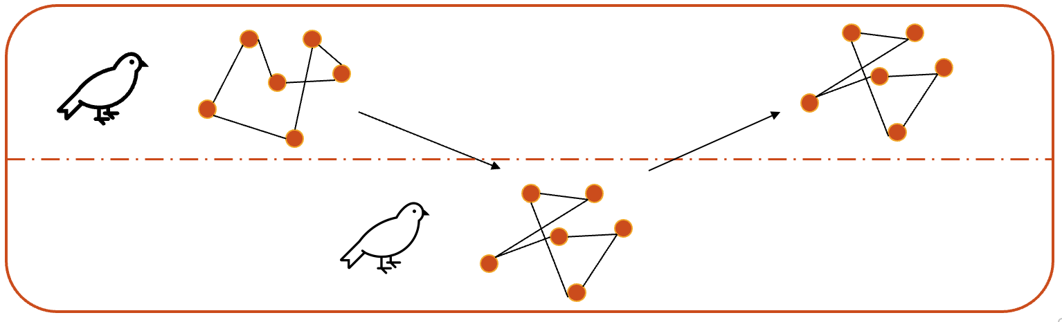

Top-b Join
Default behavior: If a big bird joins another, he chooses one randomly
Contradicts the idea that birds tend to join others, if they found a good food source
Good food source translates to a good solution
That is why we decide to allow a big bird to only join the top-b percent
Pick one of the top-b birds randomly
Means ordering the birds by their tour length after each iteration/phase
Increases runtime due to sorting complexity

Slide 12
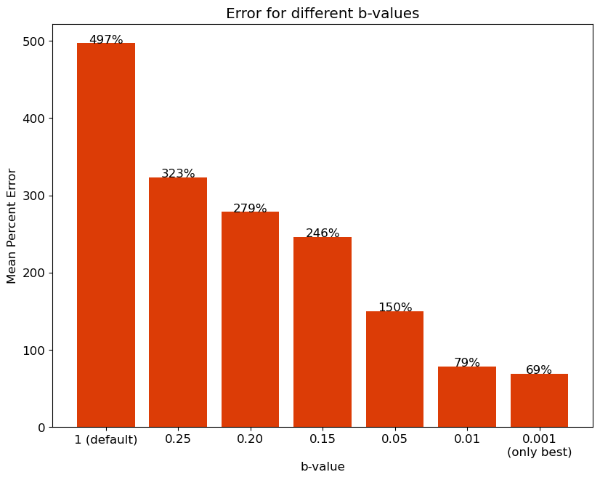
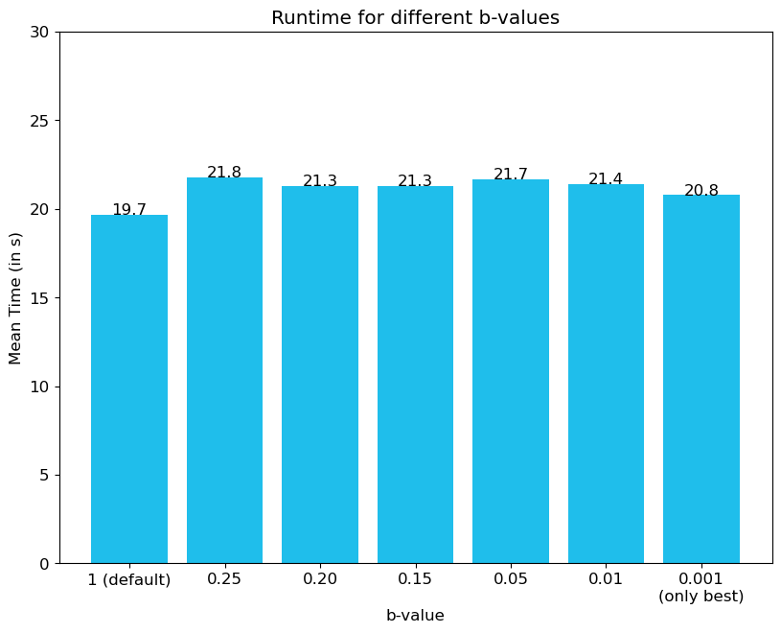
Top-b Join
Notes:
Unterschied nicht so riesig bei time -> ca. 2000 mal array der Länge 200 sortieren

Slide 13
Inhaltsverzeichnis
Chapter 1 Chapter 2 Chapter 3 Chapter 4 Chapter 5 Chapter 5 Chapter 6 Chapter 7 Chapter 8 | Recap Methodology Top-b Join 3-Opt Delegating Responsibility Nearest-neighbor Initialization Early Stopping Optimization Behavior Metabirds | Page 4 Page 9 Page 11 Page 14 Page 17 Page 20 Page 23 Page 26 Page 29

Slide 14
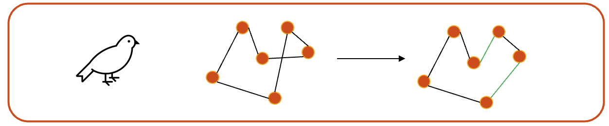
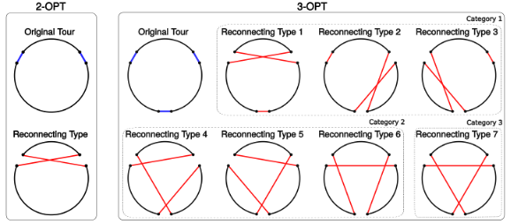
3-Opt
When performing the walk-operation, so the local search, a bird uses 2-opt to search for a potential better solution
Naturally, we also tested 3-opt as a more powerful alternative
Source: Jingyan Sui, Shizhe Ding, Ruizhi Liu, Liming Xu, Dongbo Bu. Learning 3-opt heuristics for traveling salesman problem via deep reinforcement learning. Proceedings of The 13th Asian Conference on Machine Learning, PMLR 157:1301-1316, 2021.

Slide 15
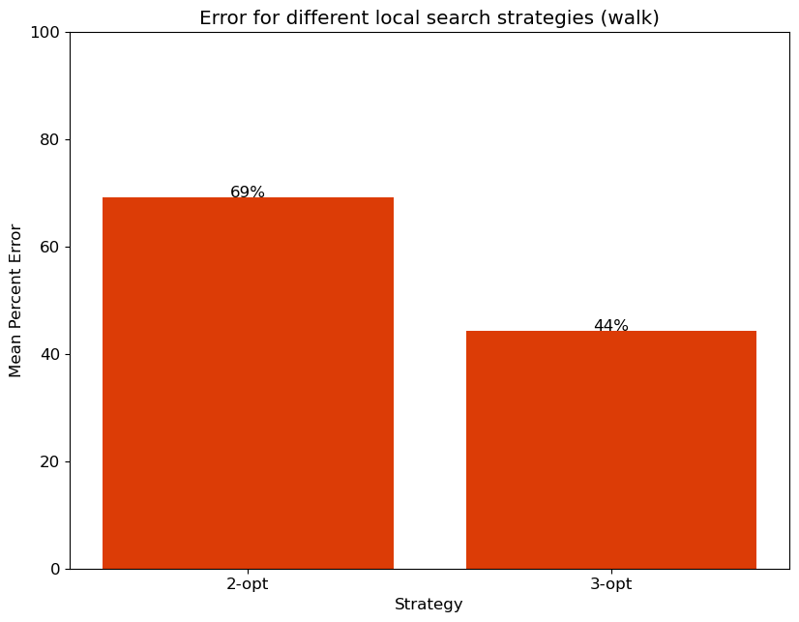
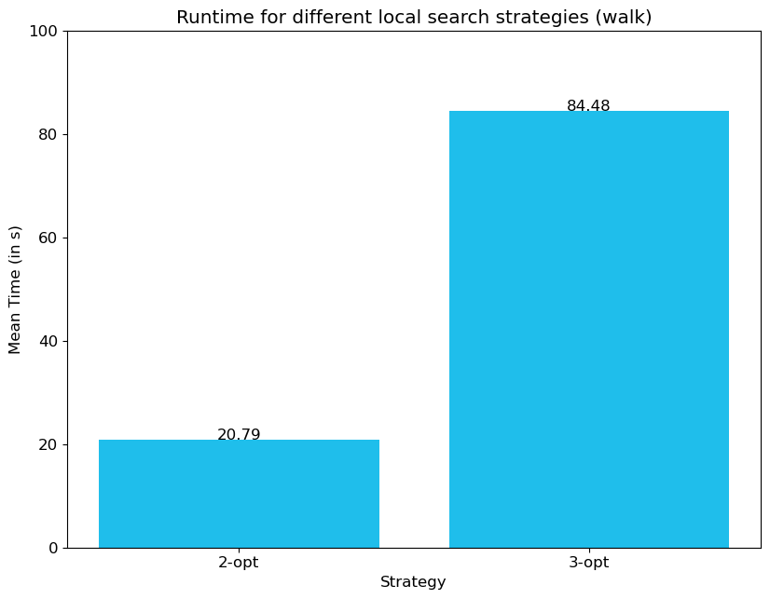
3-Opt

Slide 16
Inhaltsverzeichnis
Chapter 1 Chapter 2 Chapter 3 Chapter 4 Chapter 5 Chapter 5 Chapter 6 Chapter 7 Chapter 8 | Recap Methodology Top-b Join 3-Opt Delegating Responsibility Nearest-neighbor Initialization Early Stopping Optimization Behavior Metabirds | Page 4 Page 9 Page 11 Page 14 Page 17 Page 20 Page 23 Page 26 Page 29

Slide 17
Delegating Responsibility
Seen before: 3-opt (+ sorting for top-b join) yield very high computation effort
How can one make the algorithm faster while keeping the performance close to before?
Answer: Allow only big/small birds to perform 3-opt, the other 2-opt
Both were tested, but big birds make more sense regarding their “superiority”

Slide 18
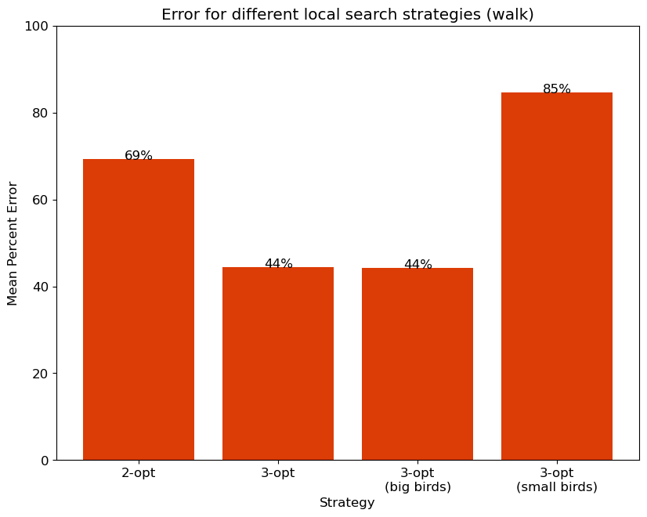
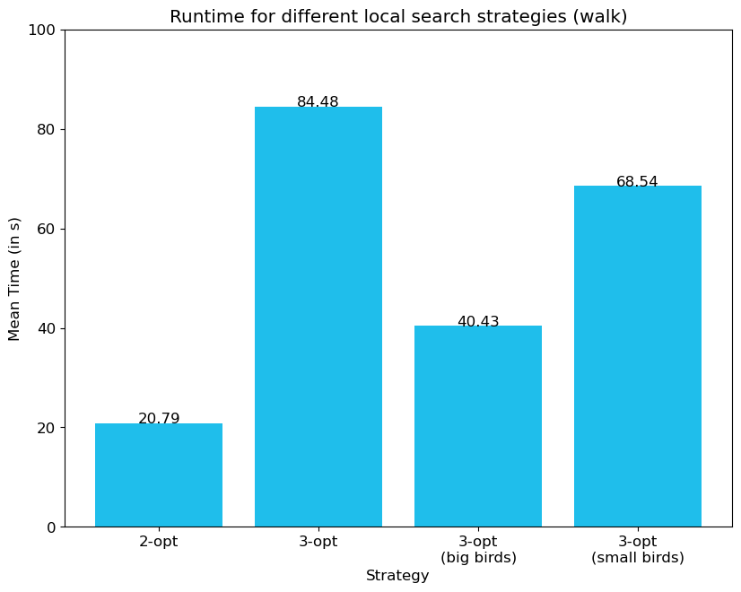
Delegating Responsibility

Slide 19
Inhaltsverzeichnis
Chapter 1 Chapter 2 Chapter 3 Chapter 4 Chapter 5 Chapter 5 Chapter 6 Chapter 7 Chapter 8 | Recap Methodology Top-b Join 3-Opt Delegating Responsibility Nearest-neighbor Initialization Early Stopping Optimization Behavior Metabirds | Page 4 Page 9 Page 11 Page 14 Page 17 Page 20 Page 23 Page 26 Page 29

Slide 20
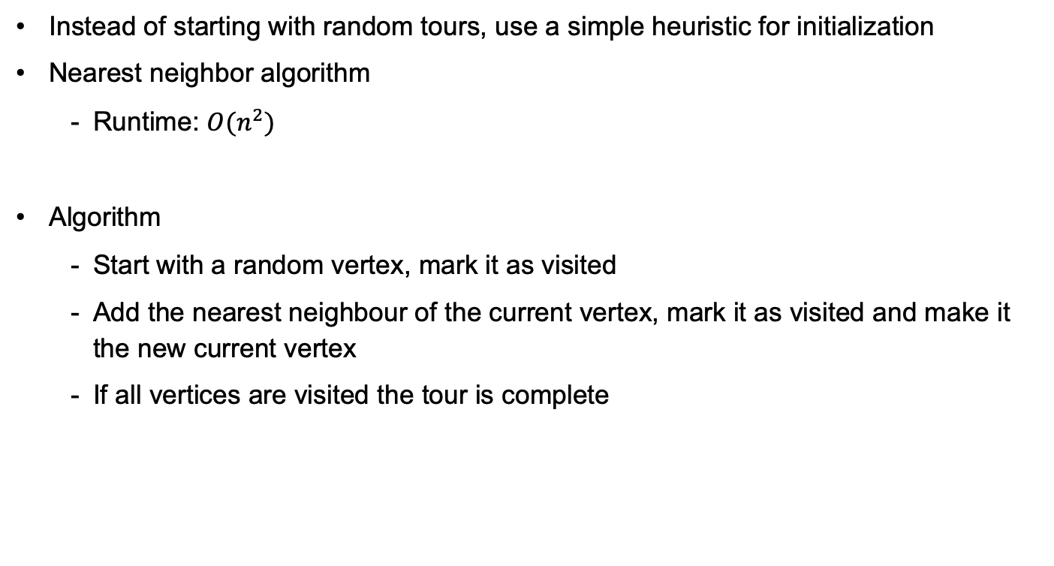
Nearest-Neighbor Initialization
Instead of starting with random tours, use a simple heuristic for initialization
Nearest neighbor algorithm
Runtime: $O(n^{2})$
Algorithm
Start with a random vertex, mark it as visited
Add the nearest neighbour of the current vertex, mark it as visited and make it the new current vertex
If all vertices are visited the tour is complete

Slide 21
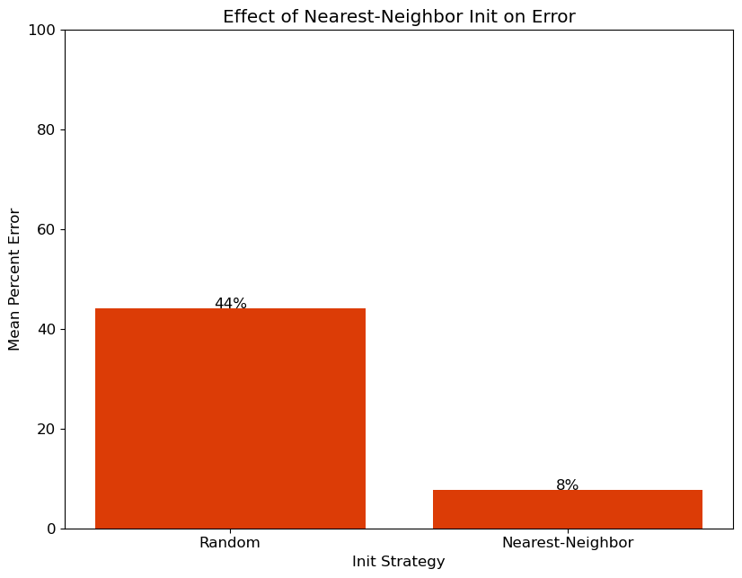
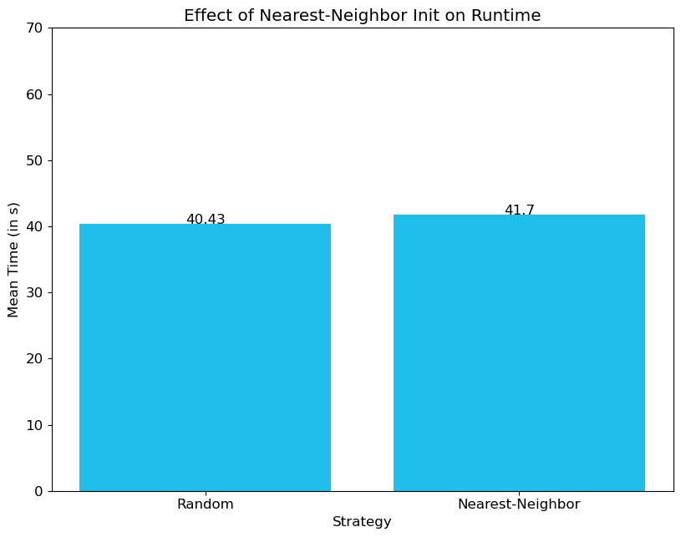
Nearest-Neighbor Initialization

Slide 22
Inhaltsverzeichnis
Chapter 1 Chapter 2 Chapter 3 Chapter 4 Chapter 5 Chapter 5 Chapter 6 Chapter 7 Chapter 8 | Recap Methodology Top-b Join 3-Opt Delegating Responsibility Nearest-neighbor Initialization Early Stopping Optimization Behavior Metabirds | Page 4 Page 9 Page 11 Page 14 Page 17 Page 20 Page 23 Page 26 Page 29

Slide 23


Early Stopping
Algorithm shows very fast convergence behavior
Especially for problems with a rather low number of cities
How many iterations are needed to achieve a good result for a given problem is difficult to estimate
Therefore, a predefined number of iterations yields unnecessary long computation times that do not improve the results
One solution is to stop the algorithm, if the current solution(s) do not improve

Slide 24
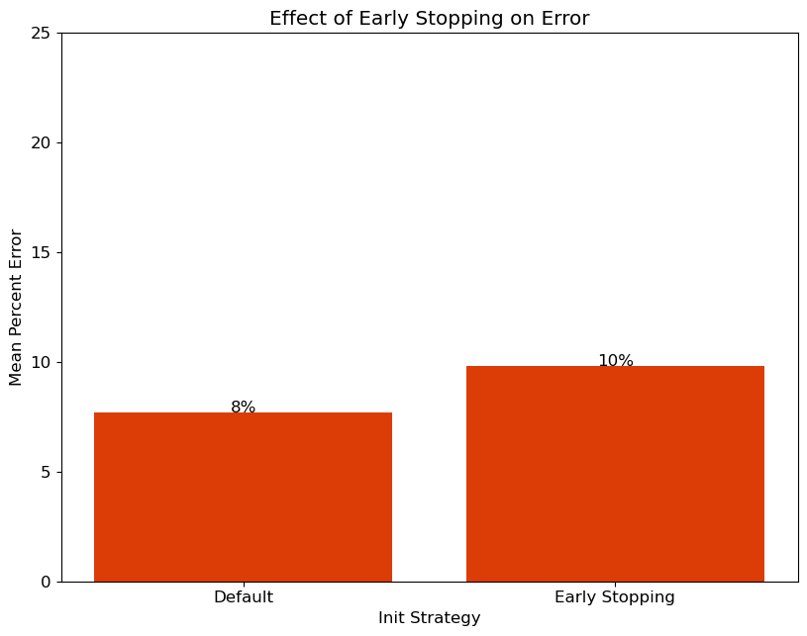
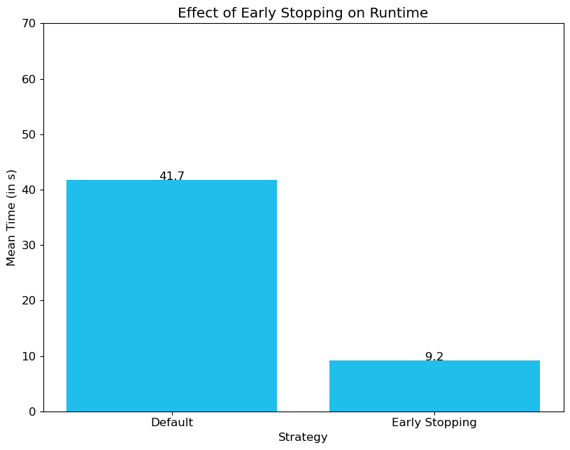
Early Stopping

Slide 25
Inhaltsverzeichnis
Chapter 1 Chapter 2 Chapter 3 Chapter 4 Chapter 5 Chapter 5 Chapter 6 Chapter 7 Chapter 8 | Recap Methodology Top-b Join 3-Opt Delegating Responsibility Nearest-neighbor Initialization Early Stopping Optimization Behavior Metabirds | Page 4 Page 9 Page 11 Page 14 Page 17 Page 20 Page 23 Page 26 Page 29

Slide 26
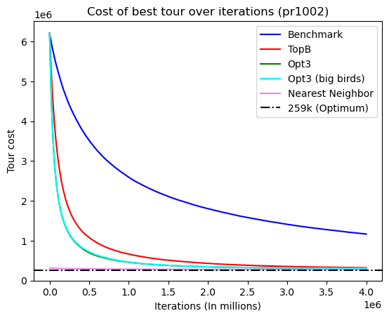
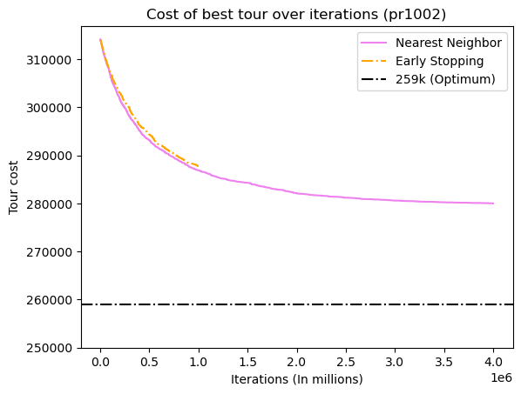
Optimization Behavior

Slide 27
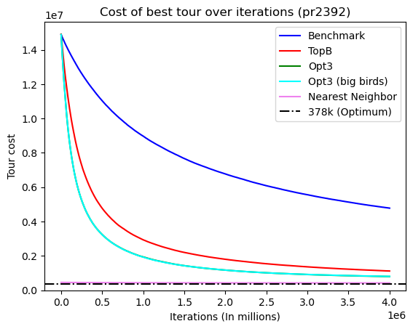
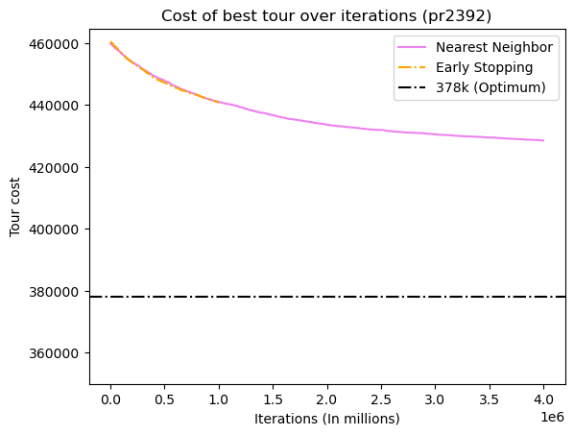
Optimization Behavior

Slide 28
Inhaltsverzeichnis
Chapter 1 Chapter 2 Chapter 3 Chapter 4 Chapter 5 Chapter 5 Chapter 6 Chapter 7 Chapter 8 | Recap Methodology Top-b Join 3-Opt Delegating Responsibility Nearest-neighbor Initialization Early Stopping Optimization Behavior Metabirds | Page 4 Page 9 Page 11 Page 14 Page 17 Page 20 Page 23 Page 26 Page 29

Slide 29

Metabirds
How do you choose hyperparameters like move probabilities or small bird ratio?
Apply an optimization algorithm to find optimal values
What optimization algorithm? Artificial Feeding Birds!
A Metabird’s position is a value for all probabilities, ratios, etc.
Flying generates a random position in the hyperparameter space
Walking adds or subtracts a random delta from each parameter
Calculating the fitness of a Metabird
A TSP solver is instantiated with the hyperparameters of the Metabird
Multiple runs solving a TSP are averaged to assess the performance with the current parameters.

Slide 30
Vielen Dank für Ihre Aufmerksamkeit!

Slide 31
Literature
Jean-Baptiste Lamy. Artificial Feeding Birds (AFB): a new metaheuristic inspired by the behavior of pigeons. Advances in nature-inspired computing and applications, 2019, 10.1007/978-3-319-96451- 5_3 . hal-02264232

