Slide 1
Artificial Feeding Birds
Metaheuristic for TSP and SOP
Pit Hüne; Tim Cares, 24.10.2023

Slide 2
Inhaltsverzeichnis
Chapter 1 Chapter 2 Chapter 3 | Motivation From Birds to TSP Algorithm | Page 4 Page 7 Page 12

Slide 3
Inhaltsverzeichnis
Chapter 1 Chapter 2 Chapter 3 | Motivation From Birds to TSP Algorithm | Page 4 Page 7 Page 12

Slide 4
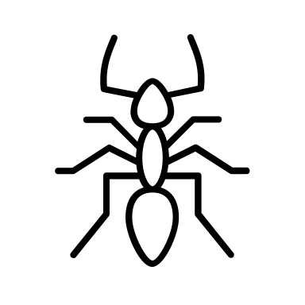
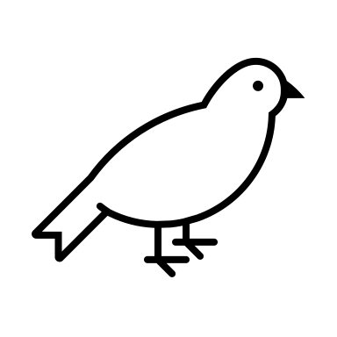
Motivation
Swarm intelligence
Allows a search of the solution space with simple strategies
Can yield complex behavior for multiple agents (e.g. ants)
Inspiration for Artificial Feeding Birds: Pigeons searching for food
Behaviors common in nature are more generally effective than rare ones
Each pigeon (agent) can have the following behavior:
Walk a small distance
Fly to an arbitrary position
Return to a food source
Join another bird

Slide 5
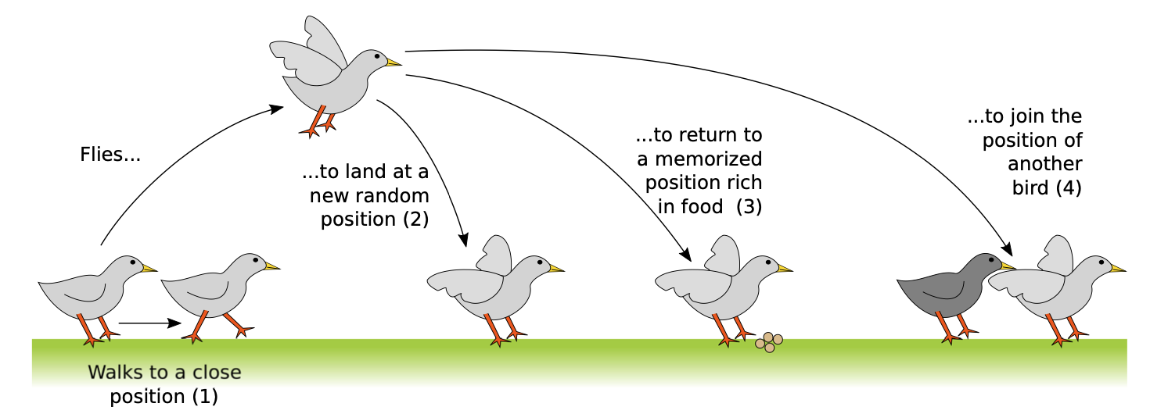
Motivation

Slide 6
Inhaltsverzeichnis
Chapter 1 Chapter 2 Chapter 3 | Motivation From Birds to TSP Algorithm | Page 4 Page 7 Page 12

Slide 7
From Birds to TSP
Each Birds represents one possible solution (one tour)
Each operation performed by a bird, alters its respective solutions

Slide 8
From Birds to TSP
Each action of a bird corresponds to a change of its own solution
Each solution is valid
The number of candidate solutions (or agents respectively) does not change (currently)
(1) Walk
(2) Fly

Slide 9
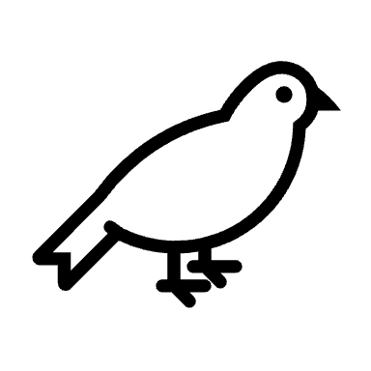
From Birds to TSP
(3) Return
(4) Join
Notes:
The current best solution of a bird = Food source
=> Return to a food source = Return to current best solution!

Slide 10
Inhaltsverzeichnis
Chapter 1 Chapter 2 Chapter 3 | Motivation From Birds to TSP Algorithm | Page 4 Page 7 Page 12

Slide 11
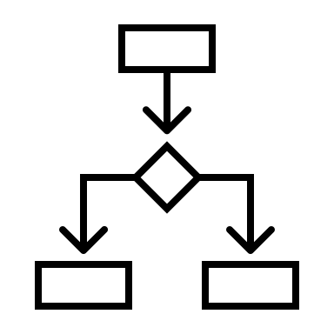
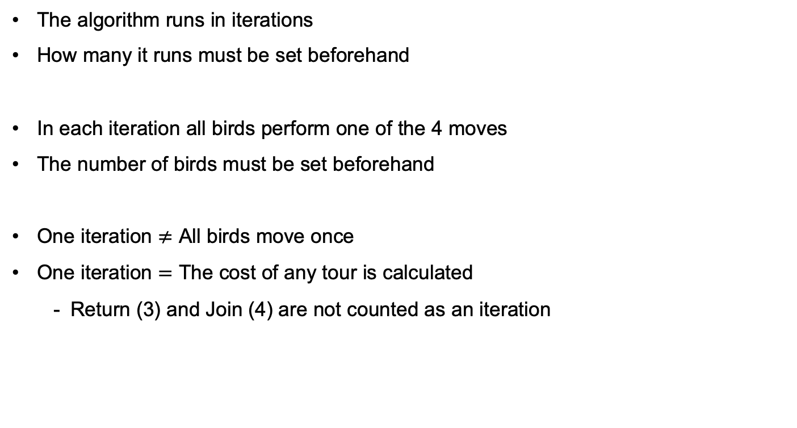
Algorithm Preconditions
The algorithm runs in iterations
How many it runs must be set beforehand
In each iteration all birds perform one of the 4 moves
The number of birds must be set beforehand
One iteration $≠$ All birds move once
One iteration $=$ The cost of any tour is calculated
Return (3) and Join (4) are not counted as an iteration

Slide 12
Algorithm Preconditions
There are ”big” and “small” birds
Ratio set beforehand
Only a big bird can join a small bird
Which action an agent (bird) performs depends on the probability of the move
The probability for a move is a hyperparameter
A bird walks, if
He currently resides at his best solution
If he flew beforehand
If the action ‘walk’ was randomly selected

Slide 13
Algorithm Initial Results

Slide 14
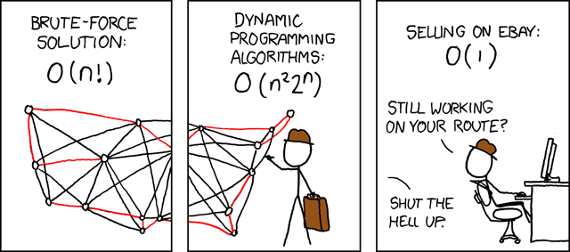
Vielen Dank für Ihre Aufmerksamkeit!
Source: https://www.explainxkcd.com/wiki/index.php/399:_Travelling_Salesman_Problem

Slide 15
Literature
Jean-Baptiste Lamy. Artificial Feeding Birds (AFB): a new metaheuristic inspired by the behavior of pigeons. Advances in nature-inspired computing and applications, 2019, 10.1007/978-3-319-96451- 5_3 . hal-02264232

Slide 16
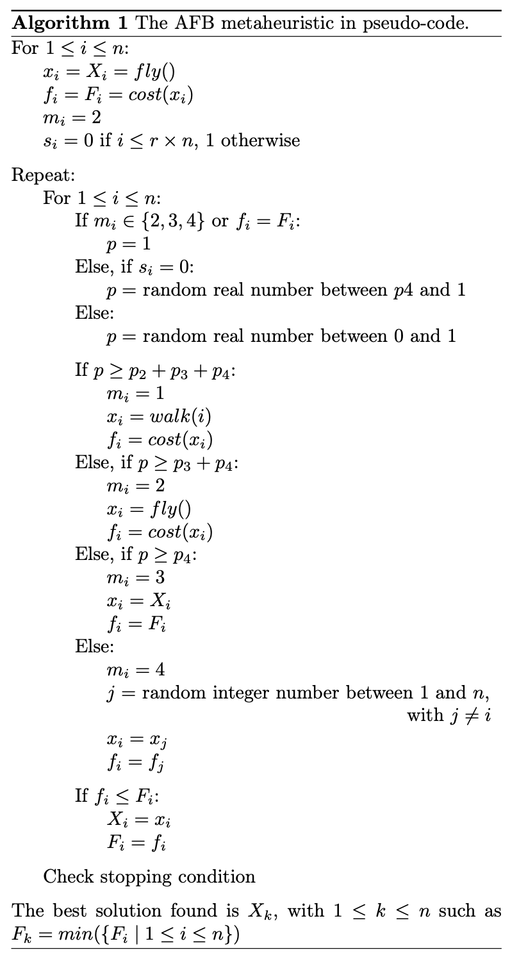
Algorithm
Variable | Meaning
x | Current tour
f | Cost of current tour
X | Best tour
F | Cost of best tour
s | Big bird?
m | Previous move

Slide 17
Algorithm
Variable | Meaning
x | Current tour
f | Cost of current tour
X | Best tour
F | Cost of best tour
s | Big bird?
m | Previous move

