Slide 1
Artificial Feeding Birds
Metaheuristic for TSP and SOP
Pit Hüne; Tim Cares, 24.10.2023

Slide 2
Inhaltsverzeichnis
Chapter 1 Chapter 2 Chapter 3 | Motivation From Birds to TSP Algorithm | Page 4 Page 7 Page 12

Slide 3
Inhaltsverzeichnis
Chapter 1 Chapter 2 Chapter 3 | Motivation From Birds to TSP Algorithm | Page 4 Page 7 Page 12

Slide 4
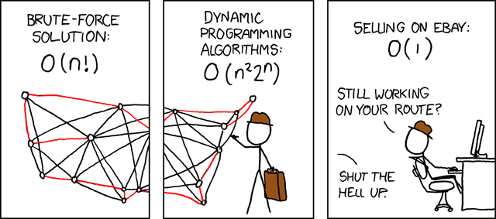

Motivation
TSP and SOP (TSP variant) are NP-complete
Enumeration of all solutions not feasible for configurations with a lot of nodes
Use a Metaheuristic inspired by nature
Source: https://www.explainxkcd.com/wiki/index.php/399:_Travelling_Salesman_Problem
Notes:
How can we help the poor guy?

Slide 5
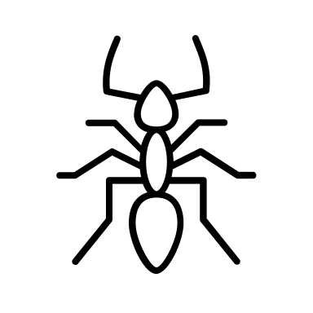
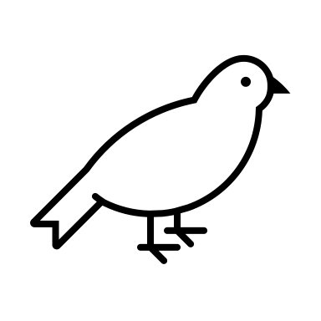
Motivation
Swarm intelligence is particularly interesting
Allows a search of the solution space with simple strategies
Can yield complex behavior for multiple agents (e.g. ants)
Inspiration for Artificial Feeding Birds: Pigeons searching for food
Each pigeon (agent) can have the following behavior:
Walk a small distance
Fly to an arbitrary position
Return to a food source
Join another bird

Slide 6
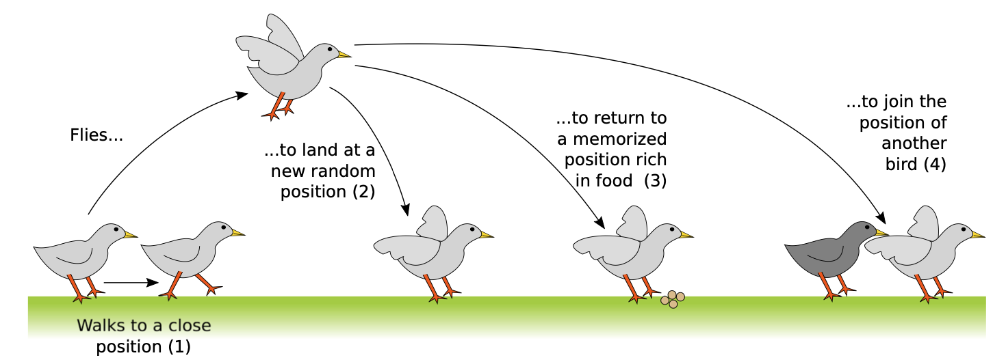
Motivation

Slide 7
Inhaltsverzeichnis
Chapter 1 Chapter 2 Chapter 3 | Motivation From Birds to TSP Algorithm | Page 4 Page 7 Page 12

Slide 8
From Birds to TSP
Each Birds represents one possible solution (one tour)
Each operation performed by a bird, alters its respective solutions

Slide 9
From Birds to TSP
Each action of a bird corresponds to a change of its own solution
Each solution is valid
The number of candidate solutions does not change
(1) Walk
(2) Fly

Slide 10
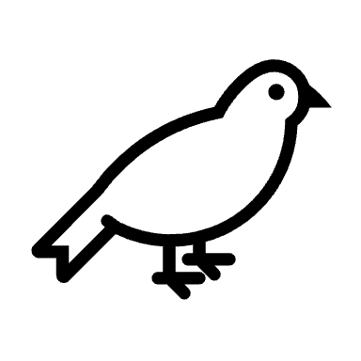
From Birds to TSP
(3) Return
(4) Join
Notes:
The current best solution of a bird = Food source
=> Return to a food source = Return to current best solution!

Slide 11
Inhaltsverzeichnis
Chapter 1 Chapter 2 Chapter 3 | Motivation From Birds to TSP Algorithm | Page 4 Page 7 Page 12

Slide 12
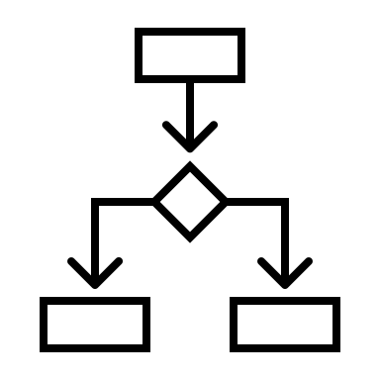
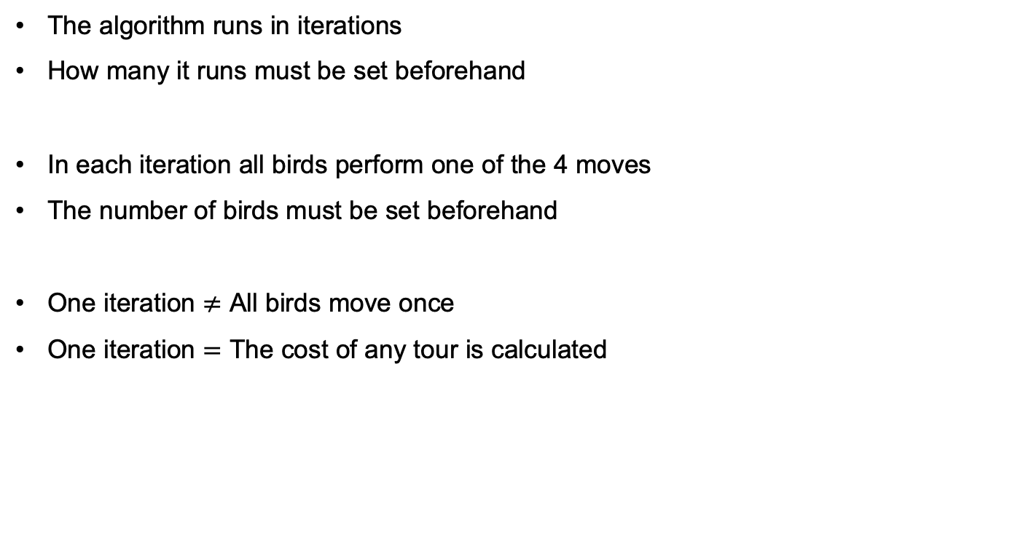
Algorithm Preconditions
The algorithm runs in iterations
How many it runs must be set beforehand
In each iteration all birds perform one of the 4 moves
The number of birds must be set beforehand
One iteration $≠$ All birds move once
One iteration $=$ The cost of any tour is calculated

Slide 13
Algorithm Preconditions
There are ”big” and “small” birds
Only a big bird can join a small bird
Which action an agent (bird) performs depends on the probability of the move
The probability for a move is a hyperparameter
A bird walks, if
He currently resides at his best solution
If he hasn’t walked beforehand

Slide 14
Vielen Dank für Ihre Aufmerksamkeit!

Slide 15
Literature
Jean-Baptiste Lamy. Artificial Feeding Birds (AFB): a new metaheuristic inspired by the behavior of pigeons. Advances in nature-inspired computing and applications, 2019, 10.1007/978-3-319-96451- 5_3 . hal-02264232

Slide 16
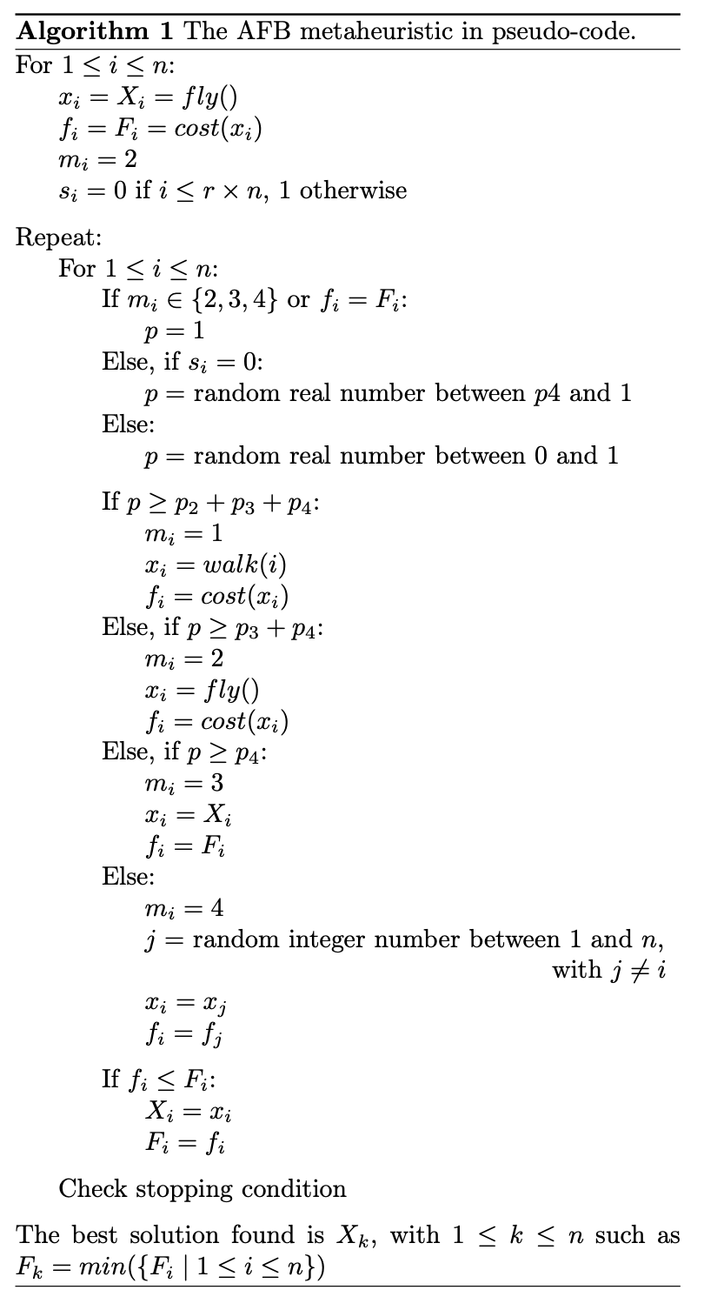
Algorithm
Variable | Meaning
x | Current tour
f | Cost of current tour
X | Best tour
F | Cost of best tour
s | Big bird?
m | Previous move

Slide 17
Algorithm
Variable | Meaning
x | Current tour
f | Cost of current tour
X | Best tour
F | Cost of best tour
s | Big bird?
m | Previous move

