Slide 1
Improvements on AFB
Advancing the Metaheuristic for TSP
Pit Hüne; Tim Cares, 24.10.2023

Slide 2
Inhaltsverzeichnis
Chapter 1 Chapter 2 Chapter 3 Chapter 4 Chapter 5 Chapter 5 | Recap Methodology Top-b Join 3-Opt Delegating Responsibility Nearest-neighbor Initialization | Page 4 Page 7 Page 11

Slide 3
Inhaltsverzeichnis
Chapter 1 Chapter 2 Chapter 3 | Motivation From Birds to TSP Algorithm Details | Page 4 Page 7 Page 11

Slide 4
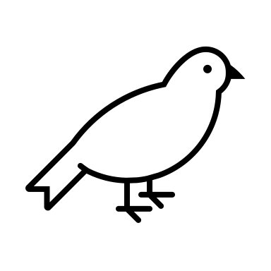
Recap
Each Birds represents one possible solution (one tour)
Each operation performed by a bird, alters its respective solutions

Slide 5
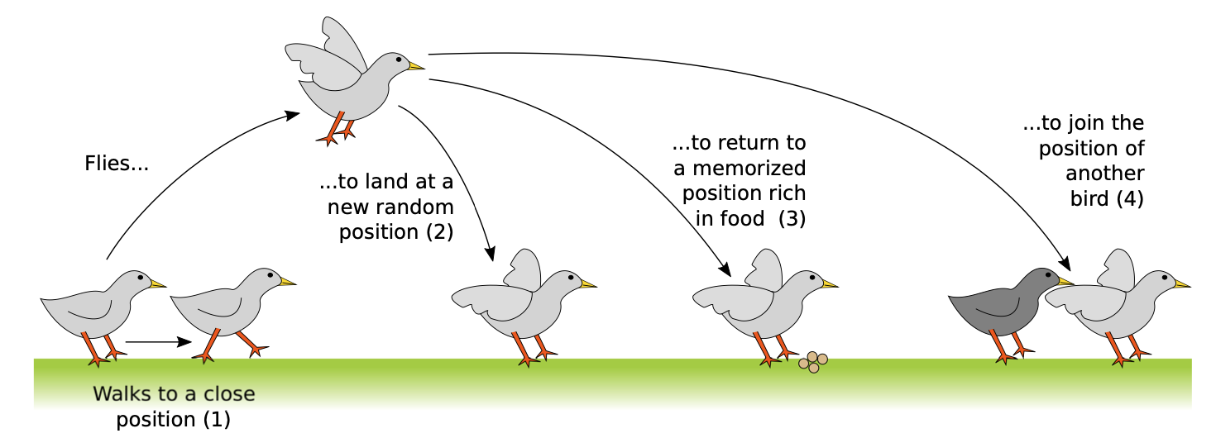
Recap

Slide 6
Recap
Each action of a bird corresponds to a change of its own solution
Each solution is valid
The number of candidate solutions (or agents respectively) does not change (currently)
(1) Walk
(2) Fly

Slide 7
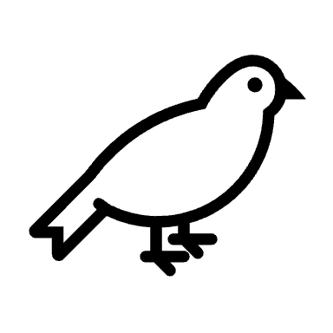
Recap
(3) Return
(4) Join
Notes:
The current best solution of a bird = Food source
=> Return to a food source = Return to current best solution!

Slide 8
Methodology
To benchmark our improvements, we select all feasible solutions from TSPLIB (86 problems)
Up to 6000 nodes
Each problem is run 10x, to account for the randomness (860 test in total)
We record the median percentage error, and the median time in seconds

Slide 9
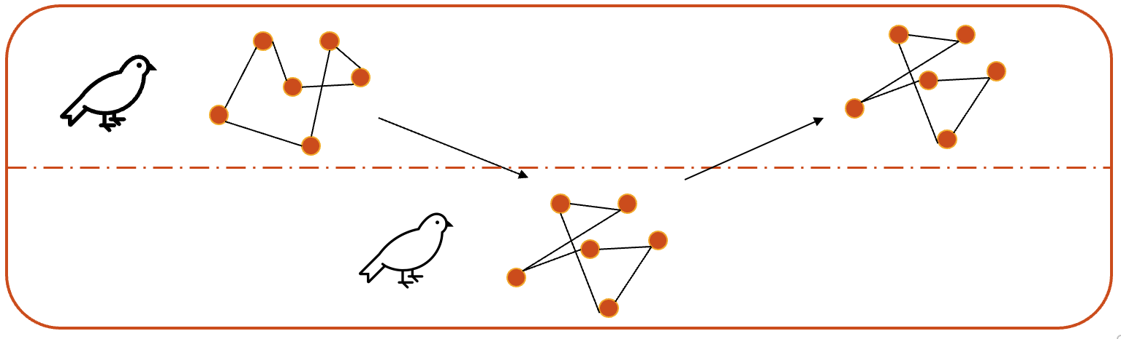

Top-b Join
Default behavior: If a big bird joins another, he chooses one randomly
Contradicts the idea that birds tend to join others, if they found a good food source
Good food source translates to a good solution
That is why we decide to allow a big bird to only join the top-b percent
Pick one of the top-b birds randomly
Means ordering the birds by their tour length after each iteration/phase
Increases runtime due to sorting complexity

Slide 10
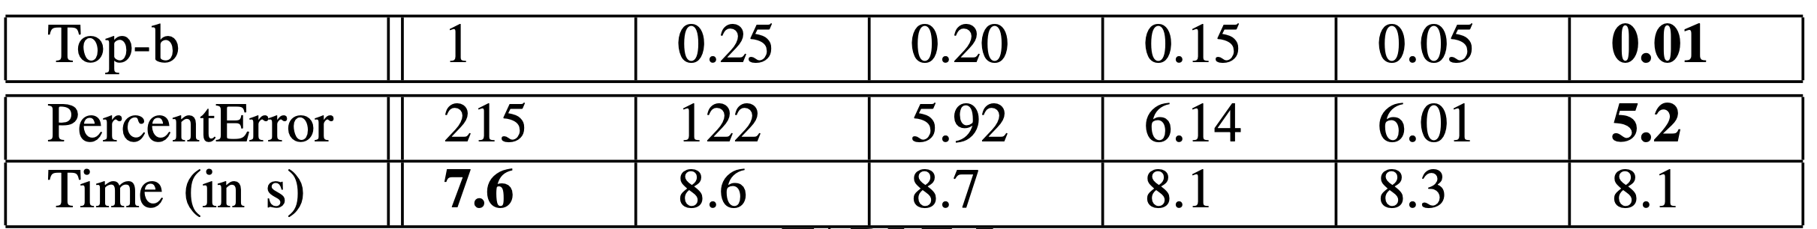
Top-b Join

Slide 11
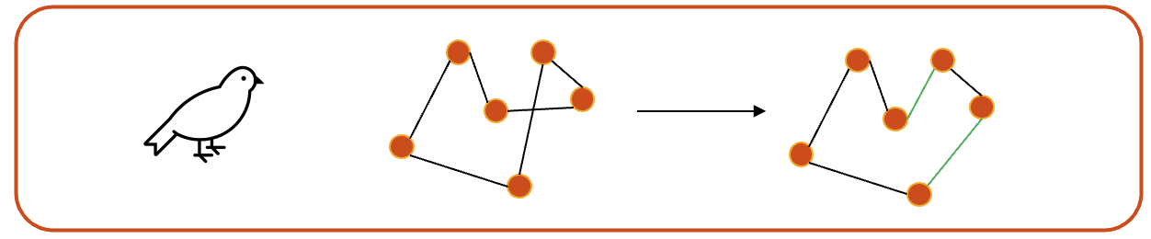
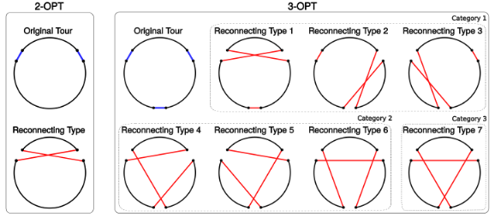
3-Opt
When performing the walk-operation, so the local search, a bird uses 2-opt to search for a potential better solution
Naturally, we also tested 3-opt as a more powerful alternative

Slide 12
3-Opt

Slide 13
Delegating Responsibility
Seen before: 3-opt (+ sorting for top-b join), yield very high computation effort
How can one make the algorithm faster while keeping the performance close to before?
Answer: Allow only big/small birds to perform 3-opt, the other 2-opt
Both were tested, but big birds make more sense regarding their “superiority”

Slide 14
Delegating Responsibility

Slide 15
Nearest-Neighbor Initialization

Slide 16
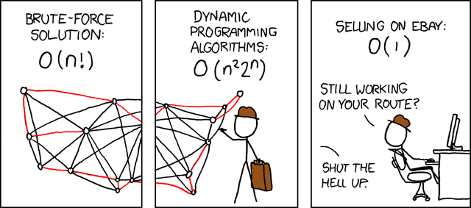
Vielen Dank für Ihre Aufmerksamkeit!
Source: https://www.explainxkcd.com/wiki/index.php/399:_Travelling_Salesman_Problem

Slide 17
Literature
Jean-Baptiste Lamy. Artificial Feeding Birds (AFB): a new metaheuristic inspired by the behavior of pigeons. Advances in nature-inspired computing and applications, 2019, 10.1007/978-3-319-96451- 5_3 . hal-02264232

