Slide 1
Emergency ‘landline’ telephone communications in PPE: A novel connector improves intelligibility
Rev 1.0 14-12-20
The following slides provide details for the connection of a throat microphone and bone conduction headset to an analogue land line telephone system with an RJ9 headset socket

Slide 2
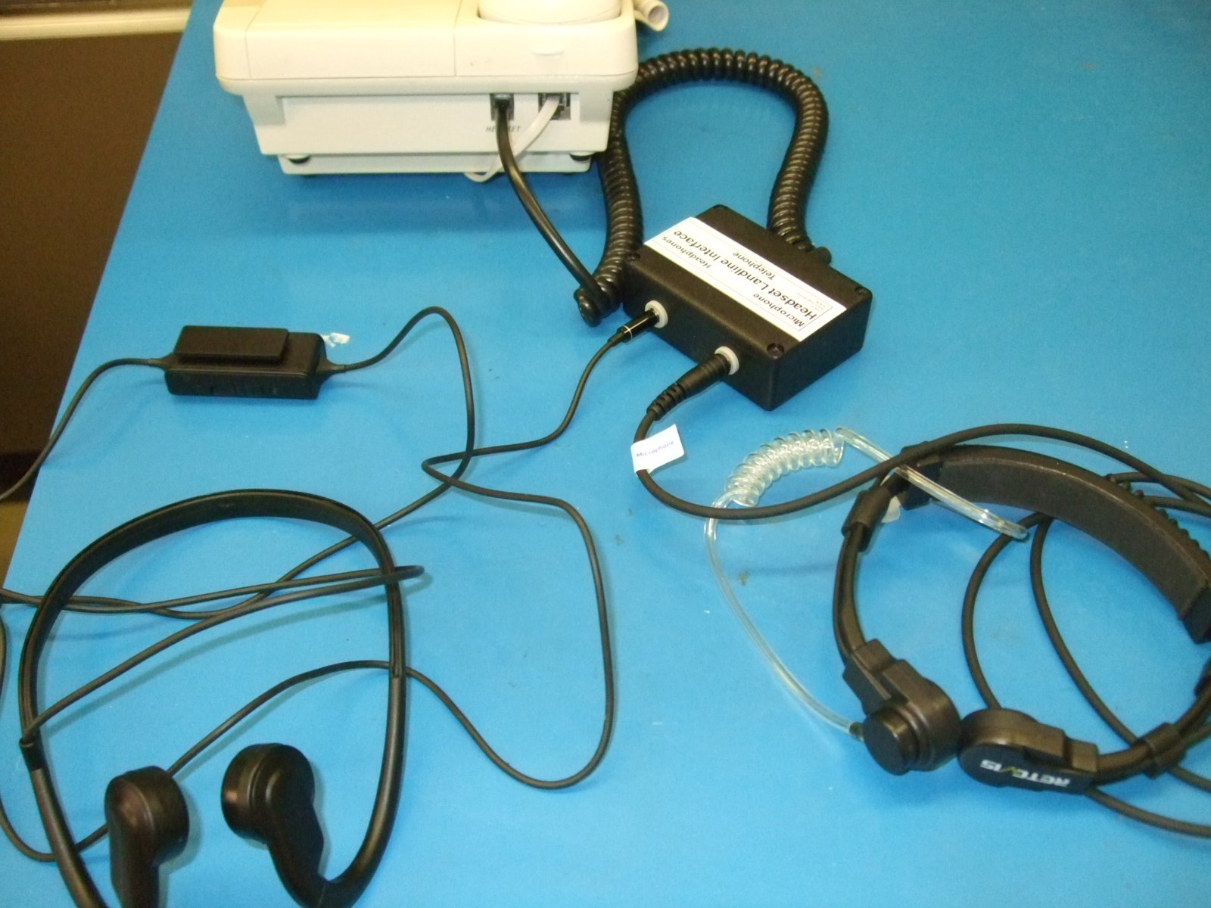
Telephone Connection
Telephone
RJ9
Interface
Enclosure
Volume Control
Bone Conduction
Headphones
Throat Microphone
(Earpiece Unused)

Slide 3
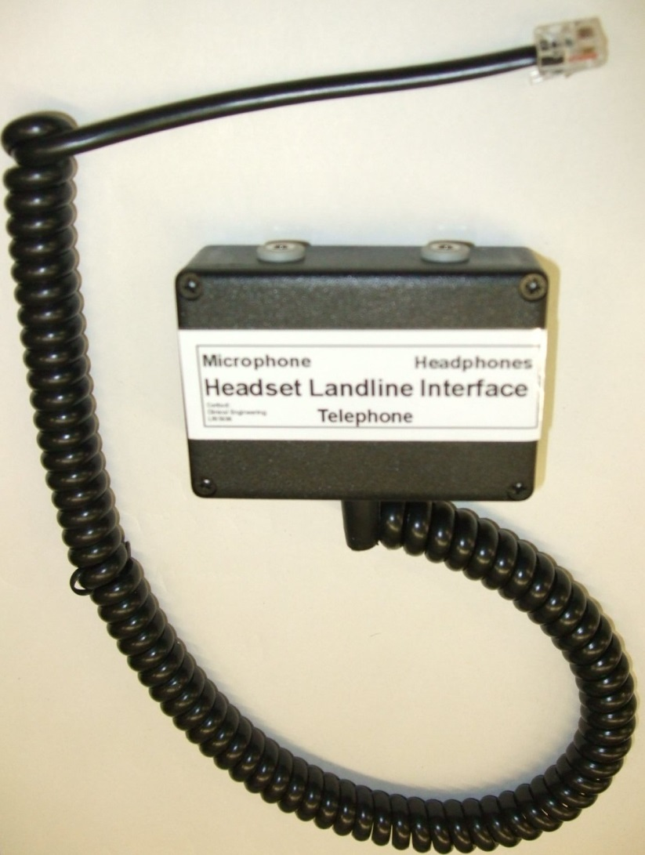
Headset Telephone Interface
74x54x26mm
ABS Enclosure

Slide 4
Landline
Telephone
Headset
RJ9/4PLC
Plug
4 Pole Jack Sockets 3.5mm
4-Yellow (T MIC)
Throat Microphone
1-Black (T MIC GND)
2-Red (HP R+L)
Headphones
3-Green (HP GND)
1 2 3 4
HP Headphones
Wiring diagram to connect separate throat microphone and headphones to a landline telephone.
Please check plug and socket wiring with your equipment supplier since there are pinout and wire colour variations between manufacturers

Slide 5
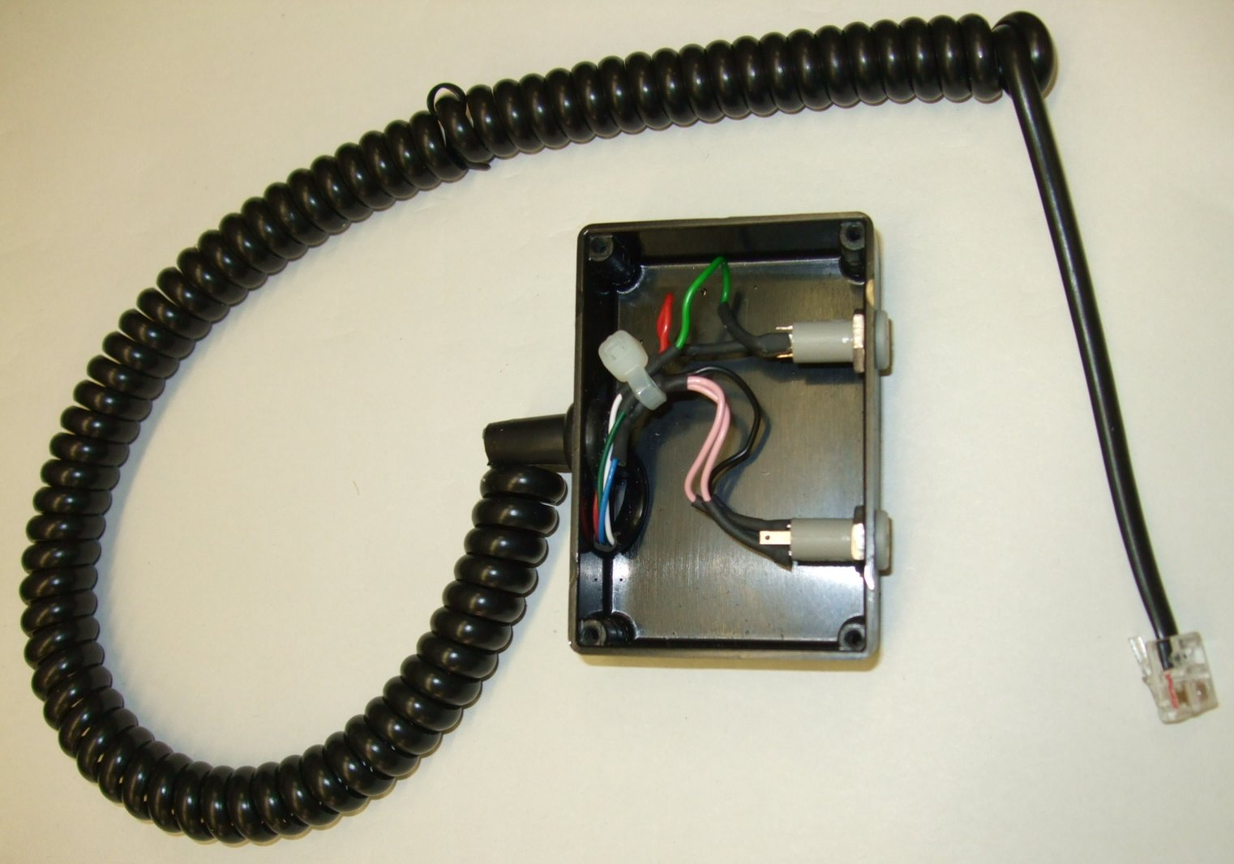
Headset Telephone Interface
RJ9 Telephone
Headset Plug
3.5 mm 4 Pole Sockets

Slide 6
3.5mm 4 pole Headset Jacks
Throat
Microphone
Headset
Bone
Conduction
Headset
Pin 4 RJ9
MIC
MIC (N/C)
Pin 1 RJ9
GND
GND
Pin 3 RJ9
RIGHT
(N/C)
Pin 2 RJ9
RIGHT
LEFT
(N/C)
LEFT
N/C No Connection
Please choose appropriate 3.5mm 4 pole sockets to match your headset jacks & enclosure

Slide 7
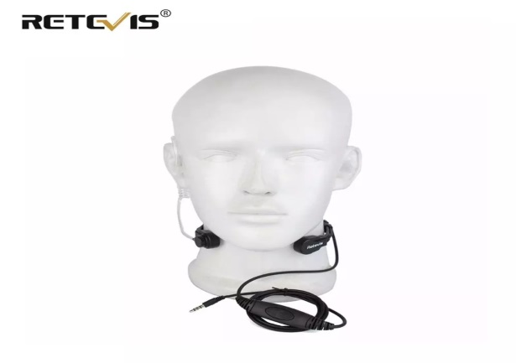
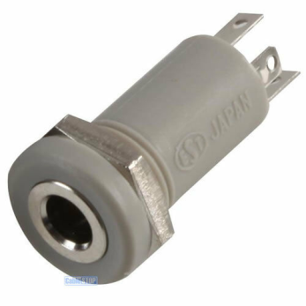
Suppliers
Throat Mic & Bone Conduction Headphones Manufactured by Retevis (Amazon)
3.5mm Mini Stereo Jack Chassis 4 POLE 4P Panel Mount Input Socket Connector Grey (eBay)

