Slide 1

Regional Sales Analysis
Tim Denby

Slide 2
Problem Statement
Sales teams often lack a clear, data-driven understanding of regional performance, making it difficult to identify growth opportunities and optimize resources. This project aims to analyse and visualize regional sales data to uncover trends, evaluate profitability, and support strategic decision-making.

Slide 3
Approach
I have conducted univariate and bivariate exploratory data analysis to uncover patterns and relationships in sales data.
I am using Python (pandas, seaborn, matplotlib) for data analysis and visualization.
Steps:
Extract sales data and join them into one data frame.
Perform data cleaning to handle missing values and inconsistencies.
Conduct univariate EDA to understand individual variable distributions.
Perform bivariate EDA to explore relationships between variables and profit.
Synthesize findings into actionable insights and recommendations.

Slide 4
Data Overview
The dataset includes 64105 sales records from 2014-2018, with variables such as channel, region, sales amount and cost.
Some of the data is in separate tabs and needs to be joined together on indexes into one big dataset.

Slide 5
Project Workflow
Data Collection & Cleaning – Join into one Dataframe.
Exploratory Data Analysis (Univariate and Bivariate)
Visualization of these Metrics
Insights and Key Findings
Recommendations

Slide 6
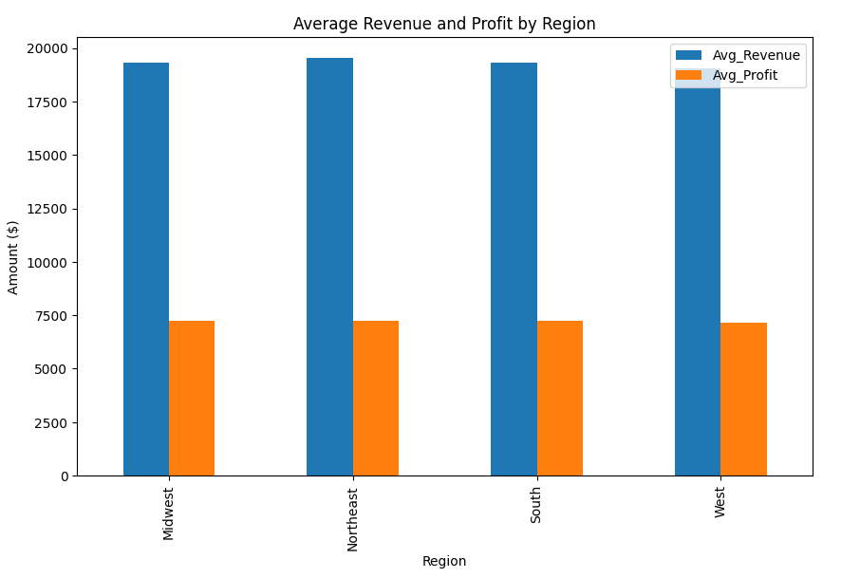
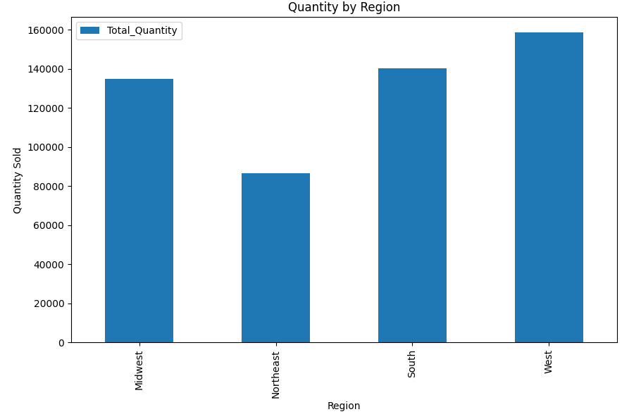
Exploratory Data Analysis
The average revenue and profit is equal across all regions.
Therefore, we can just look at the total quantity sold in each region.
The West Region is selling the most and the Northeast region is selling the least.

Slide 7
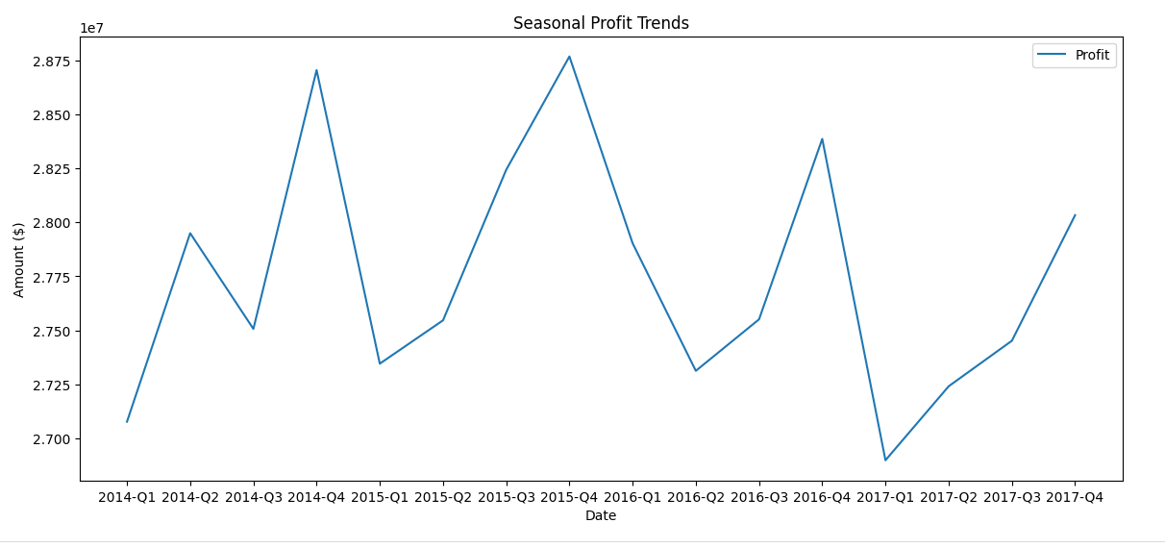
Seasonal Trends
If we look at the quarterly trends, we can see that profit increases throughout the year.
Quarter 1 being the least profitable and Quarter 4 being the most.

Slide 8
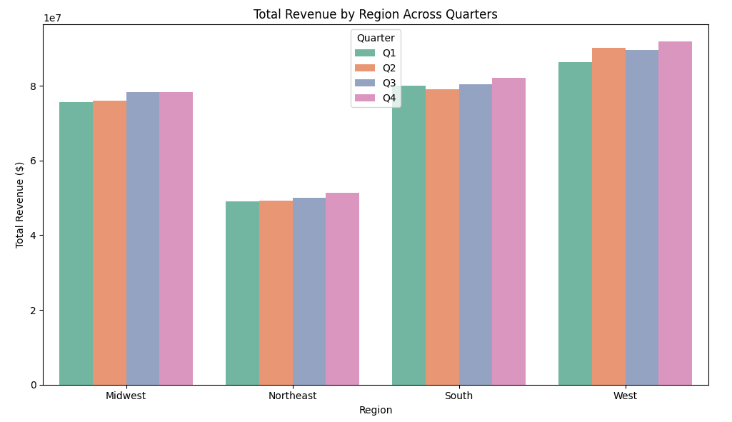
Bivariable Analysis
This is largely true when we look at each region by quarter.
Except there is a slight anomaly with the South in Quarter 1.

Slide 9
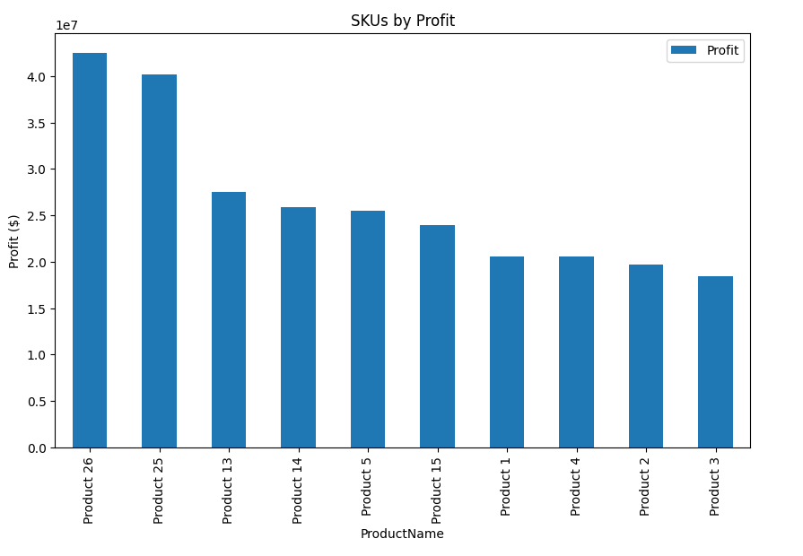
Products - Top SKUs
Products 25 and 26 are the most profitable.

Slide 10
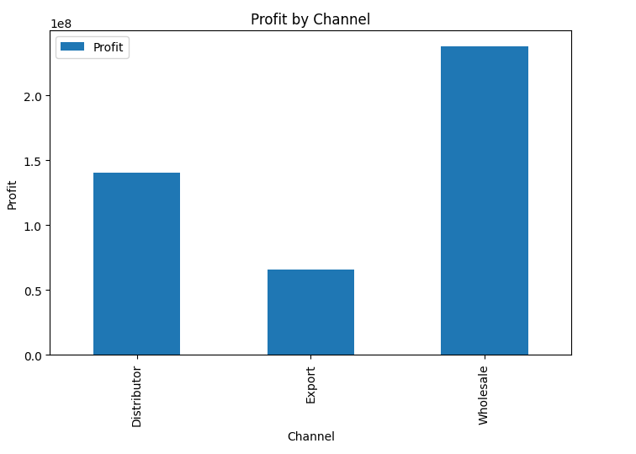
Channels
A large proportion of the sales are coming from wholesale orders.

Slide 11
Key Insights
West Region sells the most, Northeast Region sells the least
Profit increases throughout the year Q4 bringing the highest profits.
Product 25 and 26 are the most profitable.
The majority of sales are coming from Wholesale.

Slide 12
Recommendations
Target sales in the Northeast – even out the regional imbalance
Focus more on marketing Q1 to even out seasonal imbalance.
Push products 25 and 26 as these are the most popular products.

