Slide 1


Slide 2
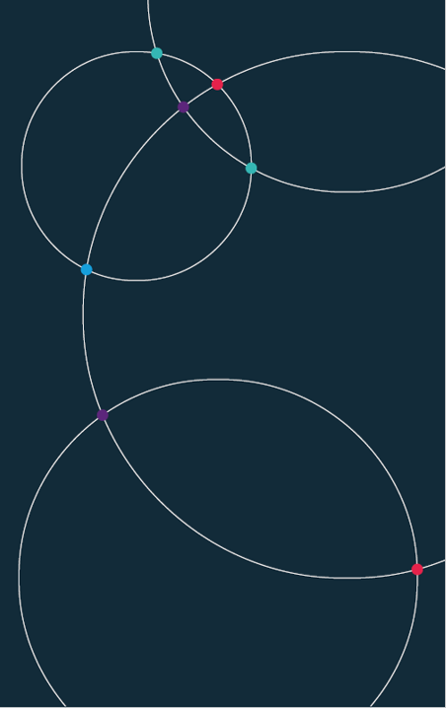
Data Science. Week 9. University of Bristol Autumn 2021

Slide 3
Office hours.
Richard. Monday, 17.00-18.00 (Zoom link)
Denes. Thursday, 15.00-16.00 (Zoom link)
Charlie. Friday, 15.30-16.30 (Zoom link)

Slide 4
Week 9.
Review of data skills so far.
Code-along:
Distributions.
Relationships. Estimations.
Regression. Classification.

Slide 5
Week 10.
Code-along:
Inference.
Resampling.
Hypothesis.
Clustering.

Slide 6
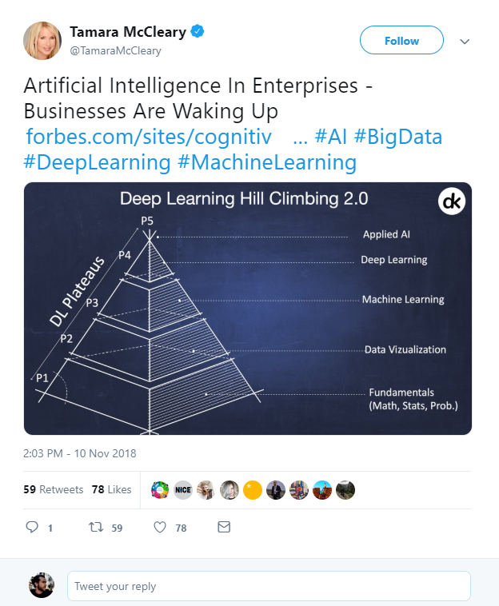
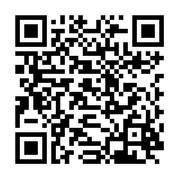
What is Data Science?
Artificial Intelligence?
Machine Learning?
Deep Learning?
Big Data?
https://twitter.com/TamaraMcCleary/status/1061197523610550272
Notes:
Tamara MCcleary – Tech Influencer
The data science pyramid
What do some of the more “fashionable” terms mean?
https://twitter.com/TamaraMcCleary/status/1061197523610550272

Slide 7

Data Science Handbook.
Jake VanderPlas.
UW | Google.
Introduction of Python.
Best introductory resource.
https://jakevdp.github.io/PythonDataScienceHandbook/
Notes:
http://vanderplas.com/
https://jakevdp.github.io/PythonDataScienceHandbook/
https://escience.washington.edu/people/jake-vanderplas/

Slide 8
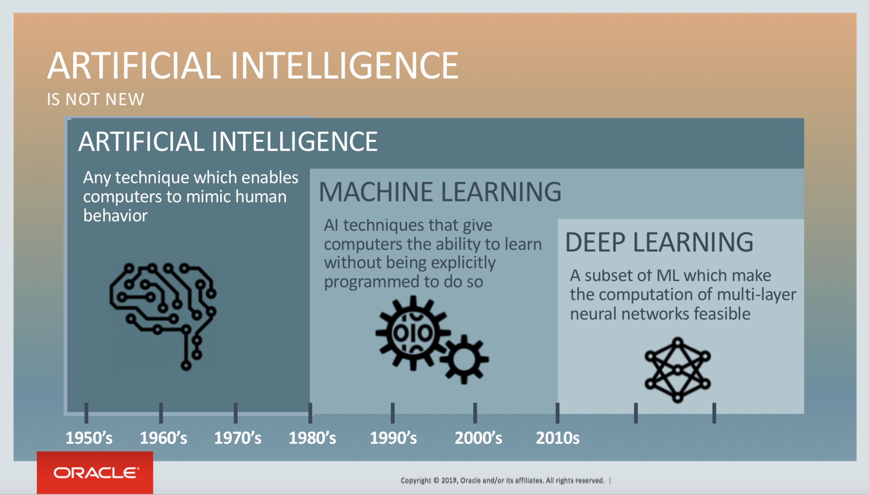
Notes:
https://blogs.oracle.com/bigdata/post/whatx27s-the-difference-between-ai-machine-learning-and-deep-learning

Slide 9
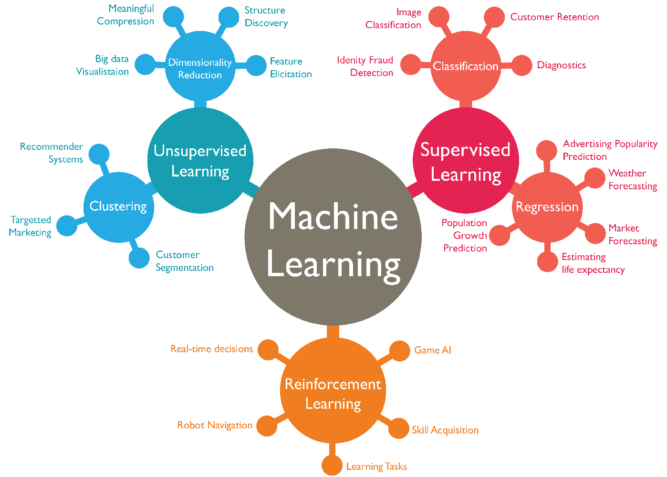

Slide 10
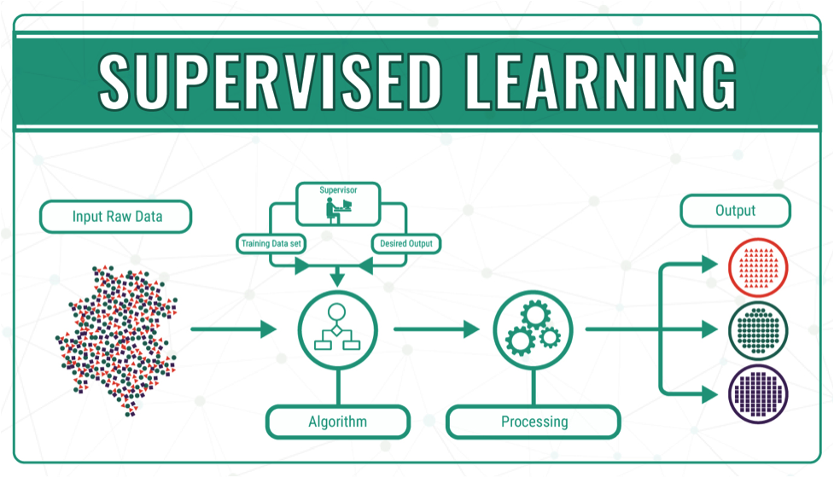
Notes:
https://bigdata-madesimple.com/machine-learning-explained-understanding-supervised-unsupervised-and-reinforcement-learning/

Slide 11
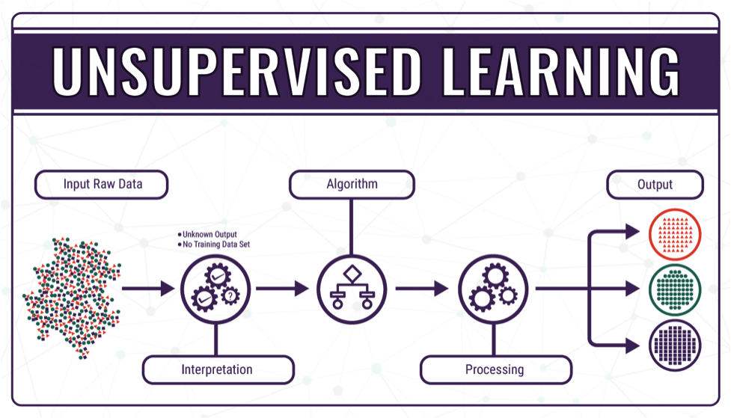
Notes:
https://bigdata-madesimple.com/machine-learning-explained-understanding-supervised-unsupervised-and-reinforcement-learning/

Slide 12
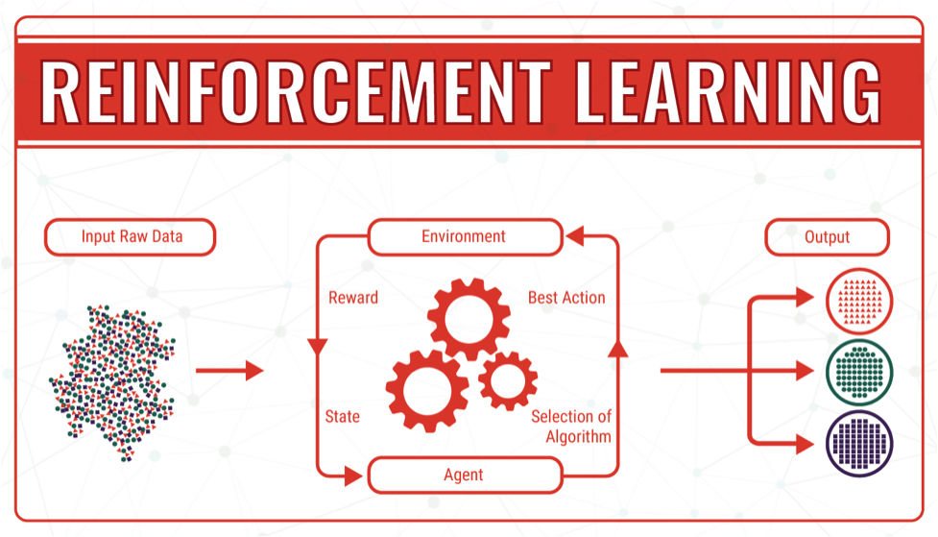
Notes:
https://bigdata-madesimple.com/machine-learning-explained-understanding-supervised-unsupervised-and-reinforcement-learning/

Slide 13
Homework Week 9.
Build a chart with data from two separate data sources.
Make a chart using any learnt data science technique.
Correlation.
Regression.
Classification.
Clustering.
Plenty of examples in the Week 9 and Week 10 folders.
This can be difficult. Ask if you hit a road block.

