Slide 1
1DV429 – IT Security
Introduction
Hüseyin Kayahan
The School of Computer Science,
Physics and Mathematics,
Linnaeus University.
E-mail: huseyin.kayahan@lnu.se

Slide 2
Course Outline
Course is tailored from IT Security into “Software Development security”
Will have 8 lectures generaly on Fridays 10:15-12:00
Will have roughly about 4-5 assignments
One project
Coursebook is Official (ISC)2® Guide to the CSSLP® CBK® 2nd edition
https://mymoodle.lnu.se/course/view.php?id=7795

Slide 3
Course Outline
Our primary focus will be on,
Secure software concepts
Secure software requirements & design
Secure software implementation & coding
Secure software testing
Software operations & maintenance

Slide 4
Plagiarism
Doing too much copy&paste from internet will only degrade the quality of your work and result in lower grade as long as you have proper referencing.
But a copy&paste from internet without referencing will be considered plagiarism

Slide 5
Secure software concepts
Lets start!

Slide 6
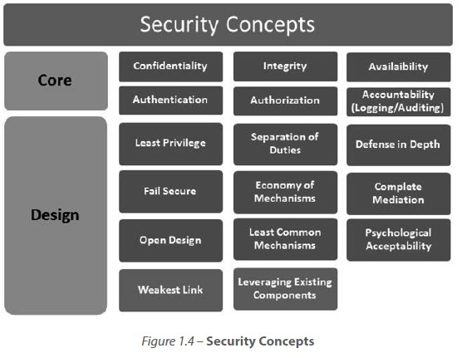
Secure Software Concepts
Core concepts

Slide 7
Secure Software Concepts
The well known CIA concept
Confidentiality: Ensure the data is seen by only the intended recipients.
Encryption
Integrity: Ensure the data is not corrupt or altered
Hashing
Availability: Ensure the data is available when necessary
Clustering, failover

Slide 8
Secure Software Concepts
The follows “triple A” (AAA)
Authentication: Ensure the identitiy of the entity (user, equipment, object etc)
Something that you know
Something that you have } Multifactor Authentication
Something that you “are”
Authorization: Ensure that the entitiy is restricted to its pre-defined rights and privileges
Accounting: Ensure non-repudiation
Auditing (Logging&Tracking)

Slide 9
Secure Software Concepts
Design concepts

Slide 10
Secure Software Concepts
Design security concepts
Least privilige: Ensure minimum level of access rights that is necessary
Seperation of Duties: Prevent “Jack of all trades”
Segregate power and privileges in order to minimize the impact of the absence or malicious intend of an entity
Defense in depth: Prevent “single point of complete compromise”
In old times, the boundaries of secure and unsecure networks were clearer

Slide 11
Secure Software Concepts
Design security concepts continued
Fail Secure: Maintain CIA in certain fail incidents
Imagine OTP server is down but authentication is still possible via one factor namely username&pass. Will you allow system use?
Economy of mechanisms: Keep it simple!
The more mechanisms, the more surface for user to interact with!
Reduce the “attack surface”
Open design: Security of the software should not rely on the obscurity of the design
Implemention and design should be independent

Slide 12
Secure Software Concepts
Design security concepts continued
Complete mediation: Every access to every object must be checked!
Time of check to Time of use issues (TOCTOU)
Race conditions
/* access returns 0 on success */
if (!access(file, W_OK)) {
f = fopen(file, "wb+");
write_to_file(f); }
else {
fprintf(stderr, "Permission denied when trying to open %s. ", file);
}

Slide 13
Secure Software Concepts
Design security concepts continued
Least common mechanisms: Ensures a mechanism, i.e a function is not allowed to be used by users or processes that have discrete priviliges
Psychological Acceptability: Ensures the users perceive the system as easy to use
Weakest Link: Entire software is as secure as its weakest surface!

Slide 14
RISK MANAGEMENT
Secure Software Concepts

Slide 15
Risk Management
Some terminology
Asset: Valuables of which the loss can potentially cause distruptions in opearational status of the corporate
Tangible or intangible
Vulnerability: A weakness or flaw that can either
Be triggered accidentally by a user or process
Or exploited intentionally by an attacker
Threat: The possibility of an unwanted or harmful event occuring. Vulnerabilities pose threat to assets!
Threat of disclosure
Alteration
Destruction

Slide 16
Risk Management
Some terminology
Threat Source/Agent: Any user, process or natural events that can materialize a threat.
Attack: An intentional action aiming to cause harm
Typical targets of attacks are the vulnerabilities
Mechanisms that take advantage of vulnerabilities are called exploits.
Probability: The chances that a threat can materialize
Not easy to measure, approaces are generally heuristic and qualitative.

Slide 17
Risk Management
Some terminology
Impact: The consequence of a materialized threat
Maybe temporal disruptions
Or can end up with revocation of compliant status
Exposure factor: Percentage of loss if a threat is materialized
If the 1.000.000 KR:- value of a house decreases to 250.000 KR:- after a fire, the exposure factor is %75
Controls: Mechanisms that aim to mitigate threats
Clipping levels for passwords
Input validation
Improper implementation of controls lead to threats

Slide 18
Risk Management
Now what is Risk?
Total Risk: The probability of a threat being materialized and impacting the business continuity, typically at the predicted exposure factors, “before” controls are in place.
The risk of developing cancer from smoking cigarettes could be expressed as "cigarette smokers are 12 times (for example) more likely to die of lung cancer than non-smokers“.
Residual Risk: The risk that still remains even “after” controls are in place.
Crucial on budget decisions for control mechanisms, if they worth investing or not.

Slide 19
Risk Management
Risk management for Software
Risk management for software is still maturing
Determination of software asset values are often subjective
Hard to collect data on exposure factor, impact and probability
Risk management is not an exact science!
“due to the closed nature of the industry, wherein the exact terms of software security breaches are not necessarily fully disclosed, one is left to speculate on what it would cost an organization should a similar breach occur within their own organization.”

Slide 20
Risk Management
Risk management for Software continued
Risks sourced from unsecure coding are relatively lower than the risks that can be sourced from humans
Wikileaks
Internal employees
Risks in outsourcing and “chinese wall” model
Published in 1989 to ensure fair competition*
Defines a wall and develops a set of rules that ensure that no subject access objects on the other side of the wall*
If a user access one company´s data, the competitor´s data can automatically be deemed "off limits“*

Slide 21
Risk Management
Handling Risk
Ignore the risk: Not handling the risk and leaving the software as is.
Avoid the risk: Discontinue or retire the software that is subject to risk
Preferred when mitigating is more costly compared to building a new software
Mitigate the risk: Implemention of security controls to reduce the risk.

Slide 22
Risk Management
Handling Risk
Accept the risk: Willingly and conciously deciding not to handle the risk.
When the cost of controls outweights the impact of the risk
Residual risks are tended to be accepted.
Transfer the risk: Transfering the “liability” to a 3rd party
Insurance
Outsourced security audit professionals or companies

Slide 23
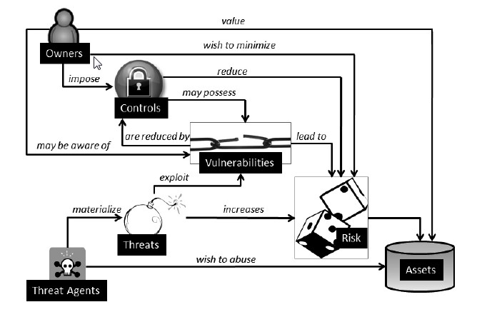
Risk Management
Risk Management Flow

Slide 24
Risk Management
Puting all into an example
You are an electroincs store with couple of shops in Sweden and you want to start sales on Internet.
In order to be able to process Credit cards, you should comply with PCI DSS
Your monthly income from shops is 10.000 KR:- whereas it is 20.000 KR:- over Internet
PCI DSS mandates that you can not transfer certain info such as PAN, CC holder name in clear text over unsecure networks
The cost of an IPSEC VPN solution between stores and payment gateway is around 90.000 KR:-
The impact of not implementing IPSEC VPN is revocation of PCI compliance which results in Internet sales termination
The exposure factor is %66 per month

Slide 25
Risk Management
Puting all into an example
You are an electroincs store with couple of shops in Sweden and you want to start sales on Internet.
The vulnerability is cleartext CC data flowing over internet
The threat is tapping the public network and capturing CC data
The attack is in man-in-the-middle form
The impact of materialization of this threat is revocation of PCI compliance which results in Internet sales termination.
The exposure factor is %66 per month (Internet sales is %66 of monthly income)
The probability is medium because your total income barely worths a hacker’s valuable time (for instance)
The control is an IPSEC VPN solution between stores and payment gateway.

