Slide 1
Secure software requirements
1DV429 – IT Security
Lecture 2
Hüseyin Kayahan

Slide 2
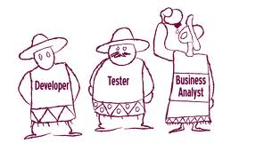
Secure Software Requirements
Requirements Engineering
What is a requirement?
“a requirement is a singular documented physical and functional need that a particular design, product or process must be able to perform.”
The entities that interact with the forms of requirements appear with various “roles”.

Slide 3
Secure Software Requirements
Requirements Engineering - Roles
Stakeholder
Typically is the group or individual that
Demands the software
Funds the software
Typically knows nothing about the development of it
Example: CIO in VEAB AB demands an ERP software
Developer
Typically is the group or individual that
Codes and implements the software
Example: You ☺

Slide 4
Secure Software Requirements
Requirements Engineering - Roles
From the developer’s standpoint, requirements of a Stakeholder can be seen abstract, vague and high level
This emerges the need for an intermediary role between Developer and Stakeholder
Analyst
Typicaly the group or individual that
Translates stakeholder’s and the users’ requirements into fine grained and elicited requirement language which a developer can follow.

Slide 5
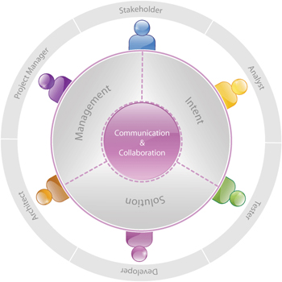
Secure Software Requirements
Requirements Engineering - Roles

Slide 6
Secure Software Requirements
The primary asset that we are concerned about is data
The security requirements eventually are raised for data itself.
Software (and hardware) are where the user interacts with data
Therefore the security of Software is the utmost concern. If it has a flaw, it gives way to data.
Software is typically where the implementation towards satisfying the requirement is performed.
Example:
Requirement: User passwords shall not be visible to any parties.
Data: User passwords
Software: MYSQL (Database)
Implementation: Password hashing
Security Requirements

Slide 7
Secure Software Requirements
Security Requirements – Understanding Data forms
If the aim is to understand Security Requirements that are eventually concerned with data, then we should first understand,
The forms of data:
Data in transit :
The state where the data is mobile, in flow from a source towards a destination
Data in processing:
Typcially the state where data is being worked on flowing through or staying on computer components (CPU,RAM etc.)
Data at rest:
The state where the data is stored/steady. (In a database, in a HDD)

Slide 8
Secure Software Requirements
Security Requirements – Data types and classification
Data types: A preliminary designation before the classification process
Structured Data: Data is organized in an identifiable structure.
Database (in tables as rows or columns)
Unstructured Data: Data has no identifiable structure
A shared folder where you have documents, images and other files

Slide 9
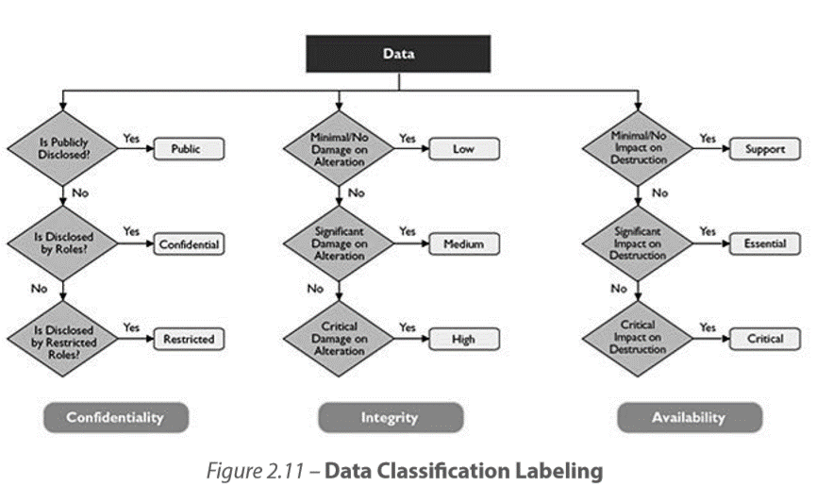
Secure Software Requirements
Security Requirements – Data types and classification
Data classification:
Labeling: “The conscious effort to assign labels, a level of sensitivity”

Slide 10
Secure Software Requirements
Security Requirements – Data types and classification
Data ownership and roles:
Who has access to what at what levels
Ownership
Read, Write
Owner:
“Define authorized list of users and access criteria based on information classification. This supports the Separation of Duties principle of secure design.”

Slide 11
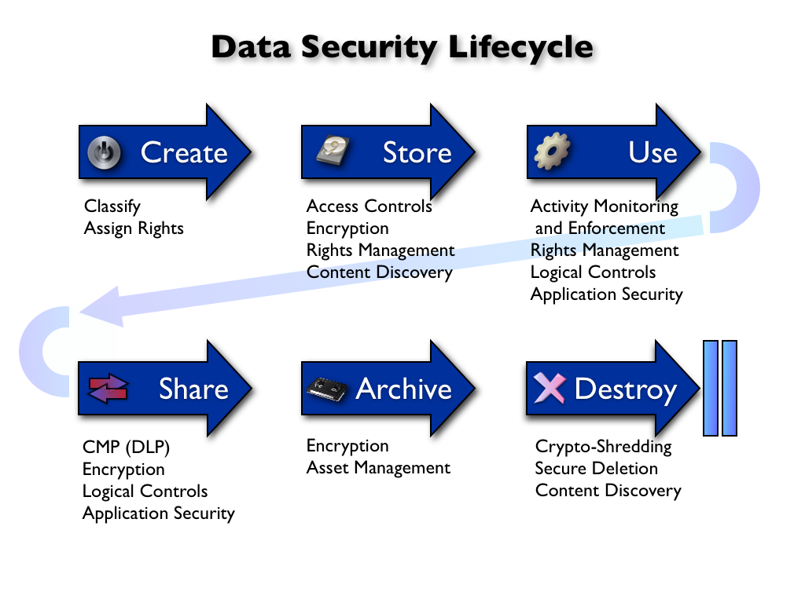
Secure Software Requirements
Security Requirements – Data types and classification
Data lifecycle management (DLM):
Is a policy-based approach to protect data throughout information lifecycle.

Slide 12
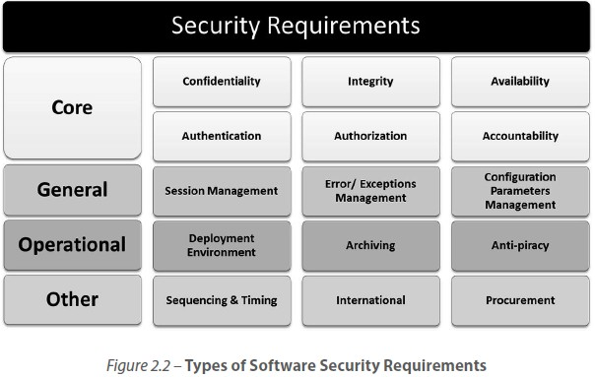
Secure Software Requirements
Security Requirements

Slide 13
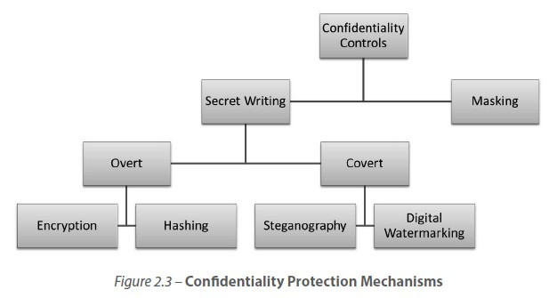
Secure Software Requirements
Security Requirements
Confidentiality requirement:
Requirements that aim to prevent unauthorized disclosure of classified data

Slide 14
Secure Software Requirements
Security Requirements
Integrity requirement:
Data Integrity:
Requirements that aim reliability by assuring that data is not altered by unauthorized entities
CRC checks and hashing
System Integrity:
Requirements that aim accuracy by assuring that the software that mainaints data is not altered by unauthorized entities
Input validation against injections

Slide 15
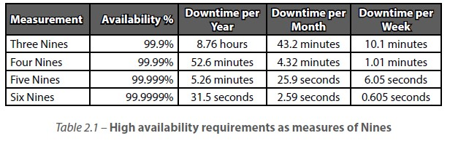
Secure Software Requirements
Security Requirements
Availability requirement:
Requirements that aim to maintain business continuity
Load-balancing, failover

Slide 16
Secure Software Requirements
Security Requirements
Authentication requirement:
Requirements that aim to validate entity identity
Multifactor (token, biometrics etc.), form-based, SSO
Authorization requirement:
Requirements that aim to ensure what can and can’t be done by an entitiy
RBAC, DAC, MAC
Accountability requirement:
Requirements that aim to provide historical records of entitiy interactions for auditing purposes.
Event logs

Slide 17
Secure Software Requirements
Identify the security requirement.
“Access to highly sensitive secret files will be restricted to users with secret or top secret clearance levels only.”
“A before and an after snapshot of the pricing data that changed when a user updates the pricing of a product must be tracked with the following auditable fields – identity, action, object and timestamp.”
“Log files must not store any sensitive information as defined by the business in humanly readable or easily decipherable form.”
“The number of users at any one given point of time who should be able to use the software can be up to 300 users.”
“All input forms and Querystring inputs need to be validated against a set of allowable inputs before the software accepts it for processing.”

Slide 18
Secure Software Requirements
Security Requirements

Slide 19
Secure Software Requirements
General Requirements
Session management:
Session hijacking protection
Error & Exception Management:
Exception handling,
Verbose exception information may lead to unnecessary information disclosure
Configuration parameter management:
Configuration parameters that software depends on to run
Setup.ini, web.xml
In development environment; pom.xml, hibernatecfg.xm

Slide 20
Secure Software Requirements
Identify the security requirement.
“All exceptions are to be explicitly handled using try, catch and finally blocks.”
“The user should not be required to provide user credential once authenticated within the Internet banking application.”
“The web application configuration file must encrypt sensitive database connections settings and other sensitive application settings.”

Slide 21
Secure Software Requirements
Deployment Environment Requirements:
Specifics regarding varying environments
Intranet or Extranet
Clustering among servers
Archiving Requirements:
Housekeeping of data over time
The location, the duration, the format
Storage decisions like media, speed, size
Retention period
Anti-Piracy Requirements:
Requirements aiming to cope with piracy
Code signing, licensing, IP check
Operational Requirements

Slide 22
Secure Software Requirements
Identify the security requirement.
“The server hosting the application shall be placed in DMZ and ports 1433 and 1434 must be reachable from inside network”
“The software must be digitally signed to protect against tampering and reverse engineering.”
“Data older than 1 year should be stored in an external NAS.”

Slide 23
Secure Software Requirements
Other Requirements
Sequencing and timing:
Software behavior at a lower level
TOCTOU
Race conditions
International (or External) Requirements:
Legal and technological sanctions and constraints
HIPAA, SOX, ISO
Character encoding, regional settings
Procurement Requirements:
Decisions regarding buying the software or a module of it rather than developing from scratch.
Does it make sense to develop card reader software for the authentication requirements of our software?

Slide 24
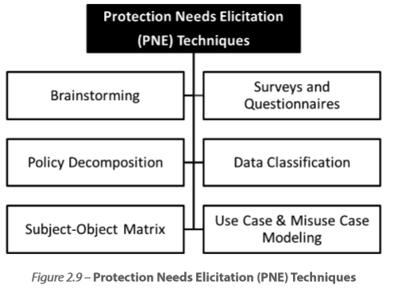
Secure Software Requirements
Now we have a better understanding of data and possible requirements for data or intermediaries towards data (software). Lets put it all together
Protection Needs Elicitation:
Determine the requirements on the assets (typically the data)
By strong communication with stakeholder and users
Protection Needs Elicitation (PNE)

Slide 25
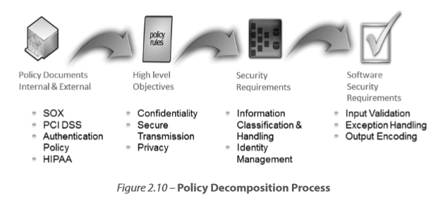
Secure Software Requirements
Brainstorming:
Fast and effective way for estimating a high level view of the picture
Surveys (Questionnaires and Interviews) :
Ask questions that aid you to elicit the requirement
“What is the maximum tolerable downtime for the software?”
Policy Decomposition
Convert abstract and general statements into high level specific objectives.
Protection Needs Elicitation (PNE)

Slide 26
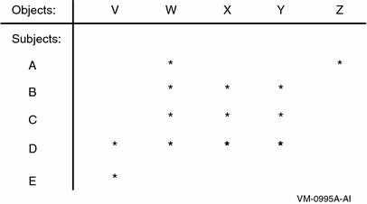
Secure Software Requirements
Subject/Object Matrix:
Define the interactions between subjects (roles) and objects
Data classification:
This subject is listed as a part of PNE, however it is a practice that should be carried on even before PNE. Therefore we covered this before PNE
Protection Needs Elicitation (PNE)

Slide 27
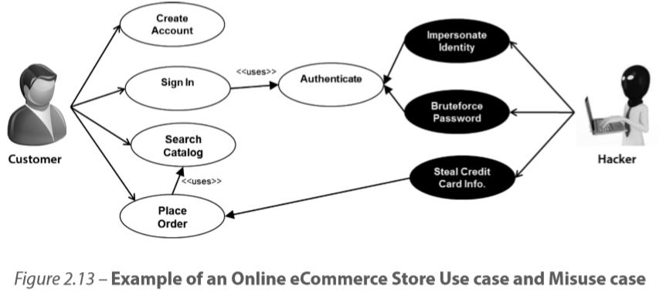
Secure Software Requirements
Use Case & Misuse Case Modeling:
Identify actors and the intended system behavior
Use cases focus on functional requirements whereas the aim of misuse cases is to elicit security requirements
Protection Needs Elicitation (PNE)

