Slide 1
Secure software DESIGN
1DV429 – IT Security
Lecture 3
Hüseyin Kayahan

Slide 2
Secure Software Design
The need for secure design
According to IBM’s research, it is nearly a hunderd times costlier to remediate security issues in production compared to handling security tight earlier at design phase
“Investing the time upfront in the SDLC to design security into the software supports the “build-in” motif of security, as opposed to trying to “bolt-it-on” at a later stage.”
As mentioned in earlier lectures, always generate a security requirement for a functional requirement during analysis and design.

Slide 3

Secure Software Design
The need for secure design
Security flaw vs Security bug
Security flaw: “Design and architectural defects which can result in errors that lead to security breaches”

Slide 4
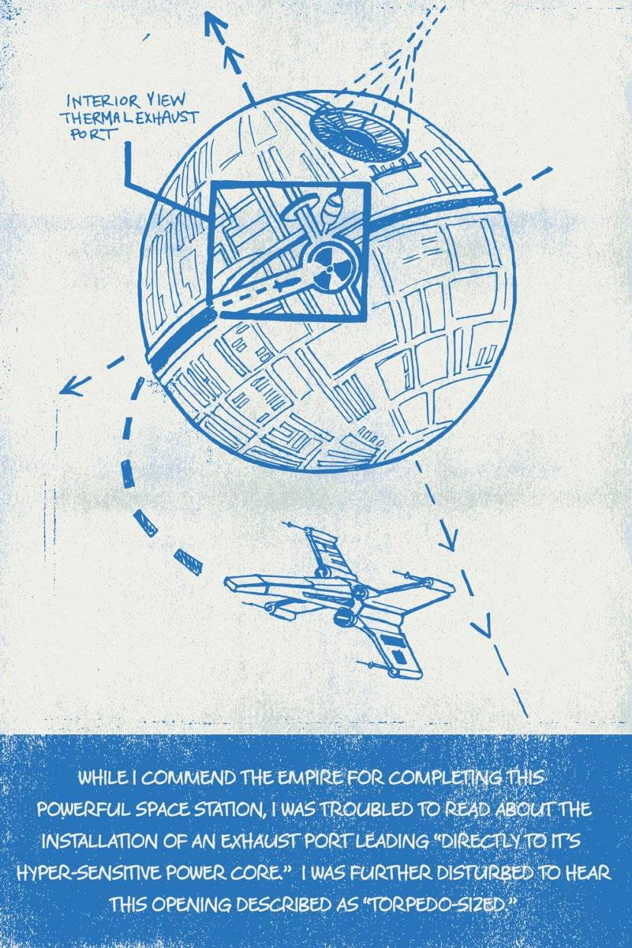
Secure Software Design
The need for secure design
Security flaw vs Security bug
DS-1 Orbital battle station
“aka Death Star”

Slide 5
Secure Software Design
The need for secure design
Security flaw vs Security bug
Security bug: “Implementation/coding defects which can result in errors that lead to security breaches”
http://www.youtube.com/watch?v=kYUrqdUyEpI

Slide 6
Secure Software Design
Architecting software with core security concepts
Some of the common, insecure design issues observed in software are the following:
improper implementation of least privilege,
software fails insecurely,
authentication mechanisms are easily bypassed,
security through obscurity,
improper error handling,
weak input validation.

Slide 7
Secure Software Design
Architecting software with core security concepts
Confidentiality design:
Cryptography
Symmetric algorithms
Same key used for encryption and decryption
Key distribution in a secure fashion is a concern
3DES, AES couple of examples
Assymetric algorithms
Different keys are used for enryption and decryption
Secure key distribution is not a concern
More CPU intensive compared to symmetric algorithms
RSA is the most common example

Slide 8
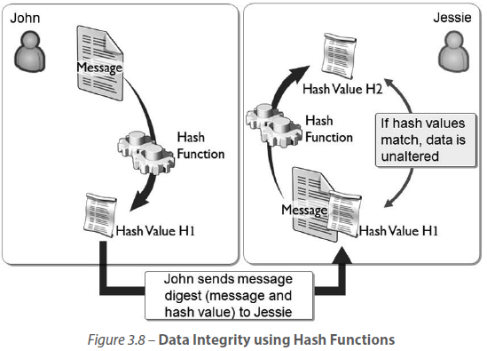
Secure Software Design
Architecting software with core security concepts
Integrity design:
Hashing:

Slide 9
Secure Software Design
Architecting software with core security concepts
Integrity design:
Referential Integrity:
Ensures that data is not left in an orphaned state when a referenced parent is deleted.
Resource Locking:
One of the concurrent operations locks that record from allowing any changes to it, until it completes its operation,

Slide 10
Secure Software Design
Architecting software with core security concepts
Availability design:
Replication:
By replicating data, databases and software across multiple computer systems, a degree of redundancy is made possible
Failover:
Failover refers to the automatic switching from an active transactional software, server, system, hardware component or network to a standby (or redundant) system
Scalability:
Is the ability of the system or software to handle increasing (or growing) amount of work without degradation in its functionality or performance
Vertical:
Supports adding resources such as disk or RAM
Horizontal:
Supports adding additional nodes such as more servers

Slide 11
Secure Software Design
The Design process
Attack surface evaluation:
Each accessible feature of the software is a potential attack vector.
Attack surface evaluation aims at determining the entry and exit points in the software that can lead to the exploitation of weaknesses
Relative attack surface quotient (RASQ)
Likely opportunities for attack against software in comparison to a baseline.

Slide 12
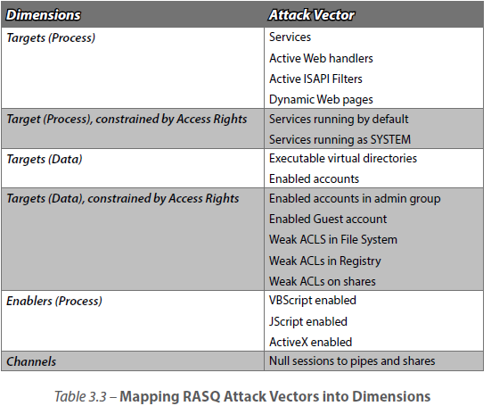
Secure Software Design
The Design process
Attack surface evaluation:
RASQ

Slide 13
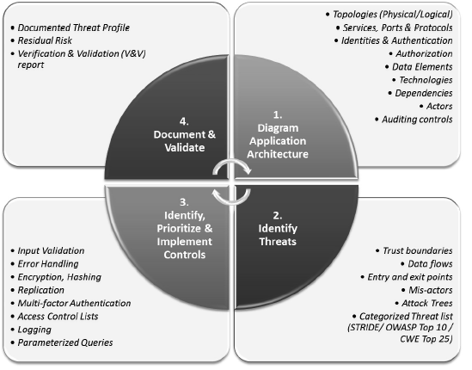
Secure Software Design
The Design process
Threat modeling:

Slide 14
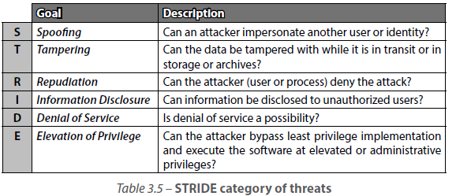
Secure Software Design
The Design process
Threat modeling:
Categorized threat lists:
NSA IAM, OWASP, STRIDE

Slide 15
Secure Software Design
Architectures
Mainframe arhitecture:
In the early days of mainframe, computing involved tightly coupled mainframe servers and dumb terminals
Terminals were merely interfaces to the functionality that existed on the high processing, backend servers
Distributed Computing:
Client/Server
The client is capable of processing and is essentially a program that requests service from a server program
Peer-to-Peer (P2P)
The client and the server programs each have the ability to initiate a transaction and act as peers

Slide 16
Secure Software Design
Architectures
Service Oriented Architecture (SOA):
Is a distributed computing architecture, which has the following characteristics:
Abstracted Business Functionality – the actual program, business logic, processes, and the database are abstracted into logical views, defined in terms of the business operations and exposed as services
Contract-Based Interfaces – Communication (messages) between the service providing unit (provider agent) and the consuming unit (requestor agent) is done using messages that are of a standardized format delivered through an interface

Slide 17
Secure Software Design
Architectures
Service Oriented Architecture (SOA):
Is a distributed computing architecture, which has the following characteristics continued:
Platform Neutrality - Messages in SOA are not only standardized but they are also sent in a platform-neutral format. Most use XML.
Discoverability - In order for the service to be available for use, it must be discoverable. The service’s discoverability and interface information are published so that requestor agents are made aware of what the service contract is and how to invoke it.
Examples of SOA:
RPC, COM, DCOM, CORBA, Web Services (SOAP, REST)

Slide 18
Secure Software Design
Architectures
Rich Internet Applications (RIA):
Some examples of RIA in use today are Facebook and Twitter.
A live connection (Internet Protocol) to the network and a client (browser, browser plug-in, or virtual machine) are often all that is necessary to run these applications
Some of the frameworks that are commonly used in RIA are AJAX, Abode Flash/Flex/AIR, Microsoft Silverlight, and JavaFX
With increased client (browser) side processing capabilities, the workload on the server side is reduced which is a primary benefit of RIA
RIA Security control mechanisms:
Same Origin Policy (SOP). The origin of a web application can be determined using the protocol (http/https), host name, and port (80/443) information.
Rich Internet Applications also run within the security sandbox of the browser and are restricted from accessing system resources

Slide 19
Secure Software Design
Architectures
Web Services:
Representational State Transfer (REST):
REST is a client/server model, in which the requests and responses are built around transition state of resources.
Has a unique Resource Address or Base URI (e.g., http://isc2.org/ resources/)
Supports media type of the data supported by the Web service (e.g., XML, JSON, etc.)
Uses HTTP Methods for its operations (e.g., GET, PUT, POST, or DELETE)
REST does not offer any built in security features and need to be implemented with complementing security technologies to assure secure operations.
For example, tokens for authentication and SSL (HTTPS) for encryption of data on the wire are necessary for incorporating security when using RESTful Web services

Slide 20
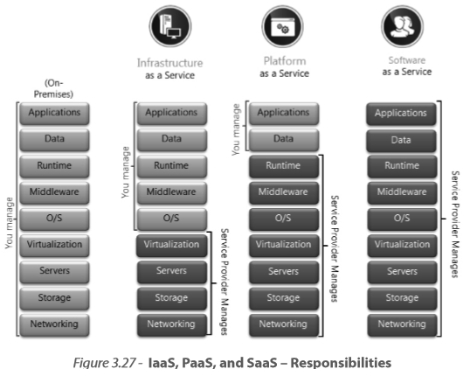
Secure Software Design
Architectures
Cloud Computing:
Service Models:
Some threats are
Data Disclosure or loss
Unauthorized Access
Man-in-the-Middle and Traffic Hijacking
Insecure and Proprietary API’s
Service Interruptions
Malicious Personnel (Insiders)
Cloud Abuse
Nefarious Use of Shared Computing/Technology Resources
Insufficient Due Diligence / Unknown Risk Profile

Slide 21
Secure Software Design
Technologies
Authentication and Identity management
Credential management (Certificates, SSO)
Flow Control (proxies, firewalls)
Audit (Syslog, IDS)
Data Protection (DLP, encryption)
Digital Rights Management (DRM)
Integrity (hashing, code signing)
Our focus will be on
Database Security
Programming language environment
Operating systems
Embedded systems

Slide 22
Secure Software Design
Technologies
Database Security:
Just as important as data design is for security is the design of the database for the reliability, resiliency and recoverability of software that depends on the data stored in the database.
Database is where the data is at rest
Subject to inference, aggregation and injection attacks

Slide 23
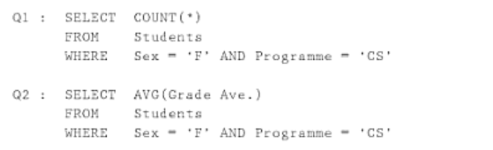
Secure Software Design
Technologies
Database Security:
Inference
Assume you are not allowed to directly query the average grade of a student by name (SELECT AVG FROM Student WHERE Name=‘Carol’).
For example sake, Q1 returns 1, so we know Carol is the only female student
Then Q2 will naturally reveal Carol’s average grade

Slide 24
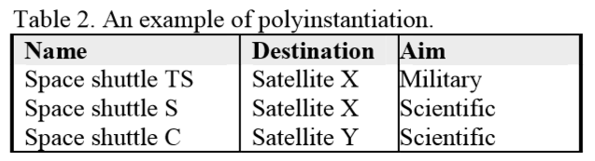
Secure Software Design
Technologies
Database Security:
Polyinstantiation:
Have multiple instances of the database instantiated according to a security level where users with given sec level is bound to specific instance
For a user with Top Secret clearance, either direct or indirect queries will return Destination Sat X and Aim is Military
Whereas a user with ordinary clearance will see that destination is Sat Y and purpose is scientific.

Slide 25
Secure Software Design
Technologies
Database Security:
Encryption:
Encrypt the database with cryptographic algorithms to provide confidentiality.
Encrypted database can only be read by parties that have the decryption key.
Some considerations are:
Where the data should be encrypted: at its point of origin in the application or in the database where it resides?
Where will the keys used for cryptography operations be stored?

Slide 26
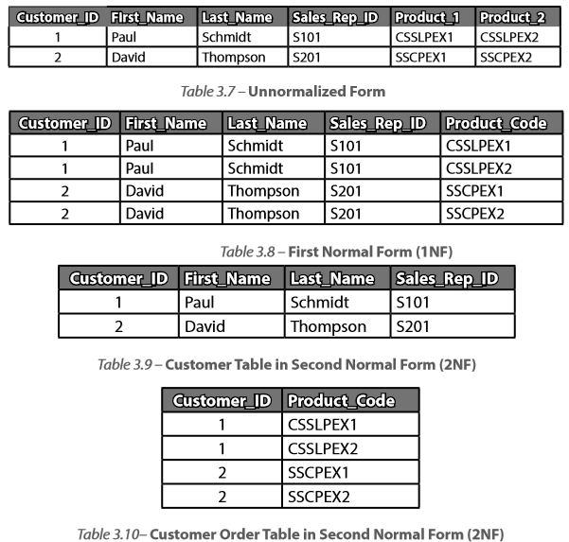
Secure Software Design
Technologies
Database Security:
Normalization:

Slide 27
Secure Software Design
Technologies
Database Security:
Normalization:
The maintainability and security of a database are directly proportional to its organization of data.
Properly organized data with few or no inconsistencies and redundancies provide a better handle on database security

Slide 28
Secure Software Design
Technologies
Programming language environment:
Types of programming languages:
Unmanaged code languages
Managed code languages

Slide 29
Secure Software Design
Technologies
Programming language environment:
Unmanaged code languages: The machine code that the compiler produces is directly reachable by OS.
Characteristics of unmanaged code languages:
“The execution of the code is not managed by any runtime execution environment but is directly executed by the operating system. This makes execution relatively faster.”
“Is compiled to native code, which will execute only on the processor architecture (X86 or X64) against which it is compiled.”

Slide 30
Secure Software Design
Technologies
Programming language environment:
Unmanaged code languages: The machine code that the compiler produces is directly reachable by OS.
Characteristics of unmanaged code languages continued:
“Memory allocation is not managed and pointers in memory addresses can be directly controlled, which makes these programming languages more susceptible to buffer overflows and format string vulnerabilities that can lead to arbitrary code execution by overriding memory pointers.”
“Requires developers to write routines to handle memory allocation, check array bounds, handle data type conversions explicitly, force garbage collection, etc., which makes it necessary for the developers to have more programming skills and technical capabilities.”

Slide 31
Secure Software Design
Technologies
Programming language environment:
Managed code languages: The machine code that the compiler produces is directly reachable by OS.
Characteristics of managed code languages:
“Execution of the code is not by the operating system directly, but instead, it is by a managed runtime environment.
Since the execution is managed by the runtime environment, security and non-security services such as memory management, exception handling, bounds checking, garbage collection.
Type safety checking can be leveraged from the runtime environment and security checks can be asserted before the code executes. These additional services can cause the code to execute considerably slower than the same code written in an unmanaged code programming language.”

Slide 32
Secure Software Design
Technologies
Programming language environment:
Managed code languages: The machine code that the compiler produces is directly reachable by OS.
Characteristics of managed code languages continued:
Is not directly compiled into native code but is compiled into an Common Intermediate Language (CIL) and/or bytecode prior to the creation of the executable. When the executable is run, the Just-in-Time (JIT) compilation transforms the CIL into native code that the computer will understand. This allows for platform independence, as the JIT compiler handles the compilation of the CIL or bytecode into native code that is processor architecture specific.

Slide 33
Secure Software Design
Technologies
Programming language environment:
Managed code languages: The machine code that the compiler produces is directly reachable by OS.
Characteristics of managed code languages continued:
“Since memory allocation is managed by the runtime environment, buffer overflows and format string vulnerabilities are mitigated considerably.”
“Time to develop software is relatively shorter since most memory management, exception handling, bounds checking, garbage collection, and type safety checking are automatically handled by the runtime environment.”

Slide 34
Secure Software Design
Technologies
Programming language environment:
Common Language Runtime (CLR):
The managed runtime environment for .NET
Microsoft’s implementation of Common Language Infrastructure (CLI)
Essentially is a virtual machine
During program execution, the CLR’s Just-In-Time (JIT) compiler transforms the CIL into machine instructions for execution by the processor

Slide 35
Secure Software Design
Technologies
Programming language environment:
Java Virtual Machine (JVM):
The managed runtime environment for Java is JRE
It is the JVM loads and executes Java programs and brings to Java, platform independence, mobility and security.
The JVM is an implementation of the Java Machine Specification, which has defined in it, some of the important aspects of the security of the JRE

Slide 36
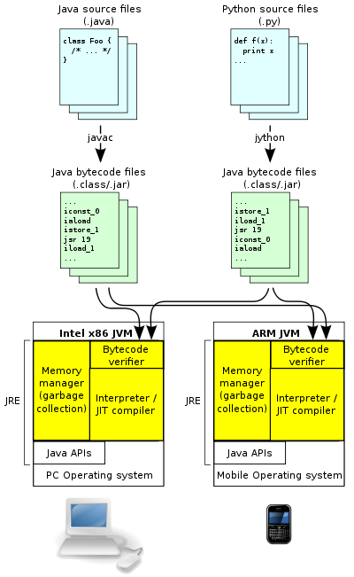
JRE & JVM Architecture
The Java APIs and JVM together make up the Java Runtime Environment (JRE).

Slide 37
Secure Software Design
Technologies
Programming language environment:
Compiler switches: Compiler based protection such as the /GS flag switch and StackGuard technology help in protection against memory corruption and mitigate buffer overflow
A function that causes buffer overflow tends to overwrite the argument on to the illegal returned address
/GS provides a cookie between susceptible argument and the return address
Function process the copy of the argument on the cookie. A possible overflow will destroy the cookie.
The argument will be written to the return address if cookie still exists!

Slide 38
Secure Software Design
Technologies
Programming language environment:
StackGuard: A compiler technique that provides code pointer integrity checking and protection of the return address in a function from being altered.
It works via inserting a known value (canary or canary word) prior to the return address on the stack.
In case of a buffer overflow, canary word will be overwritten
When the function exits, the code run to move the return address to its next instruction location (also known as the tear down code) checks to make sure that the canary word is not modified before jumping to the next return address.

Slide 39
Secure Software Design
Technologies
Operating Systems:
Address Space Layout Randomization (ASLR)
Due to the principle of locality (temporal primarily), processes and functions were observed to load in the same memory locations upon each run.
This made it easy for the attackers to discover the memory location and exploit the process or function by telling their payload exploit code the memory address of the process or function they wished to exploit
ASLR works by randomizing and moving the function entry points (addresses) in memory each time the program is run

Slide 40
Secure Software Design
Technologies
Operating Systems:
Data Execution Prevention (DEP)/Executable Space Protection (ESP)
Protects computers systems by monitoring software programs from accessing and manipulating memory in an unsafe manner
CPU initially marks the entire memory as non-executable. The memory allocation specified in the code allocates the memory clearing the NX flags.
Any process that tries to run instructions on NX flagged memory (sign of an injection) will be terminated

Slide 41
Secure Software Design
Technologies
Embedded Systems:
An embedded system is a computer system with a dedicated function either standalone or within a larger mechanical or electrical system.
Some examples are traffic lights, mp3 players, cars, TV, watches, insulin pump
The program instructions that are written for embedded systems are known as firmware and are usually stored in read-only chips or flash memory chips.
Not so easy to re-program or upgrade
Toyota is recalling 1.9 million Prius hybrid cars worldwide due to a software glitch that could cause the car to stop while driving, the AFP reports

