Slide 1
Secure software IMPLEMENTATION / CODING
1DV429 – IT Security
Lecture 4
Hüseyin Kayahan

Slide 2
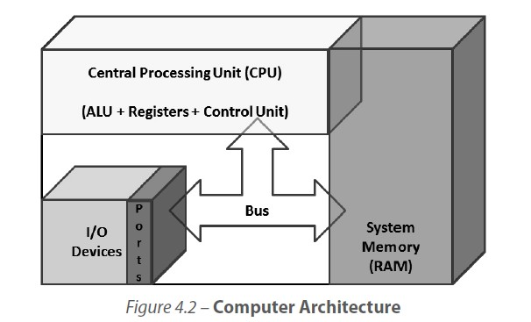
Secure Software Coding
Fundamental Concepts of programming

Slide 3
Secure Software Coding
Fundamental Concepts of programming
CPU
Arithmetic Logic Unit (ALU): A specialized circuit that performs mathematical and logical operations on the data.
Control: A mediator controlling process-
ing instructions.
The control unit itself does not
execute any instructions but instructs and directs other parts of the system such as the registers to do so.
Registers specialized internal memory holding spaces
within the processor itself.
These are temporary storage areas for instruction or data and they provide the advantage of speed.

Slide 4
Secure Software Coding
Fundamental Concepts of programming
CPU
Fetching:
The control unit gets the instruction from system memory.
The instruction pointer is used by the processor to keep track of which instruction codes have been processed and which ones are to be processed subsequently.
The data pointer keeps track of where the data area in stored in the computer memory
Decoding:
The control unit deciphers the instruction and directs the needed data to be moved from system memory onto the ALU.
Execution:
Control moves from the control unit to the ALU and the ALU performs the mathematical or logical operation on the data
Storing:
The ALU stores the result of the operation in memory or in a register
The control unit finally directs the memory to release the result to an output device or a secondary storage device.

Slide 5
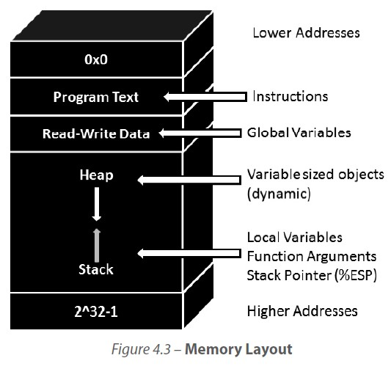
Secure Software Coding
Fundamental Concepts of programming
RAM

Slide 6
Secure Software Coding
Fundamental Concepts of programming
Evolution of programming languages
Recall from the previous lecture the managed and unmanaged code languages
Compiled languages
The source code that the programmer writes is converted into machine code.
The conversion itself is a two-step process as,
Compilation:
The process of converting textual source code written by the programmer into raw processor specific instruction codes
The output of the compilation process is called the object code
The object code itself cannot be executed by the machine unless it has all the necessary code files and dependencies provided to the machine
Linking:
The process of combining the necessary functions, variables and dependencies files and libraries required for the machine to run the program.
The output that results from the linking process is the executable program or machine code

Slide 7
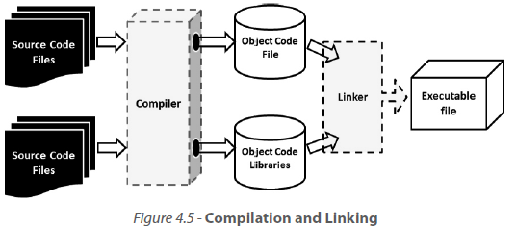
Secure Software Coding
Fundamental Concepts of programming
Evolution of programming languages
Recall from the previous lecture the managed and unmanaged code languages
Compiled languages

Slide 8
Secure Software Coding
Fundamental Concepts of programming
Evolution of programming languages
Recall from the previous lecture the managed and unmanaged code languages
Interpreted languages:
Have the need for an intermediary host program to read and execute each statement of instruction line by line
The source code is not compiled or converted into processor-specific instruction codes
Slower in execution speed but they provide the benefit of quicker changes because there is no need for re-compilation and re-linking
Examples include REXX, PostScript, Perl, Ruby and Python

Slide 9
Secure Software Coding
Fundamental Concepts of programming
Evolution of programming languages
Recall from the previous lecture the managed and unmanaged code languages
Hybrid languages:
The source code is compiled into an intermediate stage which resembles object code.
In Java, the intermediate stage code that results upon compilation of source code is known as the byte code
It requires an independent host program (JVM in Java and CIL in .Net) that runs on the computer to interpret the byte code.
At runtime, just in time compiler (JIT) converts the intermediary code into machine code, which is then executed by the machine

Slide 10
Secure Software Coding
Common Software Vulnerabilities and Controls
Buffer Overflow
“A buffer overflow is the condition that occurs when data that is being copied
into the buffer (contiguous allocated storage space in memory) is more than
what the buffer can handle”
This means that the length of the data being copied is equal to (in languages that need a byte for the NULL terminator) or is greater than the byte count of the buffer.
The two types of buffer overflows are:
Stack Overflow
Heap Overflow

Slide 11
Secure Software Coding
Common Software Vulnerabilities and Controls
Buffer Overflow

