Slide 1
Secure software IMPLEMENTATION/Coding
1DV429 – IT Security
Lecture 5
continued
Hüseyin Kayahan

Slide 2
Secure Software Coding
Common Software Vulnerabilities and Controls
Heap Overflow:
The large, dynamic data is stored in the heap
Such as arrays
Does not necessarily target the instructions itself, it is rather the data
In short, the data stored in memory is corrupted
As a consequence, the program may
Return errouneous data
Not be able to interpret properly and crash
Return the data of some other program/function
Likely to happen if you
Put the input from the user to the heap w/o checking its size
Access the heap with incorrect length
Improperly interpret indexes and array boundaries

Slide 3
Secure Software Coding
Common Software Vulnerabilities and Controls
Vulnerability databases are repositories of discovered and known vulnerabilities that have been observed to impact computer systems and softwareThe forms of data:
Some well-known vulnerability databases are
The National Vulnerability Database (NVD):
U.S. Government repository of vulnerabilities and vulnerability management data
Includes security checklists, security related software flaws, misconfigurations of products, products affected and impact metrics
US Computer Emergency Response Team (CERT) Vulnerability notes database:
CERT vulnerability analysis project aims at reducing security risks due to software vulnerabilities in both developed and deployed software
Open Source Vulnerability Database:
An independent and open source database that is created by and for the security community

Slide 4
Secure Software Coding
Common Software Vulnerabilities and Controls
Common Vulnerabilities and Exposures (CVE):
A dictionary of publicly known information security vulnerabilities and exposures
OWASP Top 10:
In addition to considering the most common application security issues from a weaknesses or vulnerabilities perspective
Common Weakness Enumeration (CWE™):
Provides a common language for describing architectural, design or coding software security weaknesses
Freely available for public use

Slide 5
Secure Software Coding
Common Software Vulnerabilities and Controls
Injection Flaws:
Considered to be one of the most prevalent software (or application) security weaknesses.
Occures when the user supplied data is not validated before being processed by an interpreter
The attacker supplies data that is accepted as is and interpreted as a command or part of a command, thus allowing the attacker to execute commands
Common injection flaws are
SQL injection
OS Command injection
LDAP injection
XML injection

Slide 6
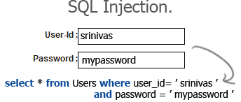
Secure Software Coding
Common Software Vulnerabilities and Controls
SQL Injection:
Attacker supplies an input to a legitimate inputbox (such as username box or password box) which if not sanitized or validated become part of the (Structured Query Language) query that the databases processes as a command.

Slide 7
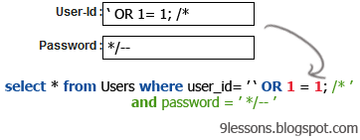
Secure Software Coding
Common Software Vulnerabilities and Controls
SQL Injection:
Attacker’s input is interpreted as a part of the code which comments out the password check as following

Slide 8
Secure Software Coding
Common Software Vulnerabilities and Controls
OS Command Injection:
Same injection principle; arguments are passed via a legitimate input method (inputbox, addressbar etc.)
This time the passed arguments invoke an OS command
http://www.mycompany.com/sensitive/cgi-bin/userData.pl?doc=%20%3B%20/bin/ls%20-l
%20 decodes to a space and %3B decodes to a ; and the command that is executed will be /bin/ls -l listing the contents of the program’s working directory.

Slide 9
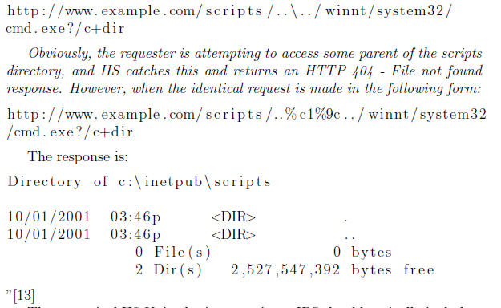
Secure Software Coding
Common Software Vulnerabilities and Controls
OS Command Injection:
IIS Unicode attack

Slide 10
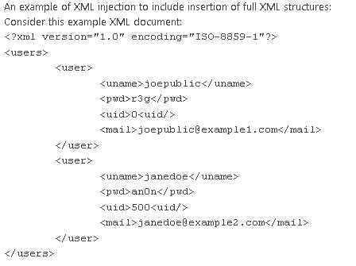
Secure Software Coding
Common Software Vulnerabilities and Controls
XML Injection:

Slide 11
Secure Software Coding
Common Software Vulnerabilities and Controls
XML Injection:
Attacker registers to this system using the following arguments

Slide 12
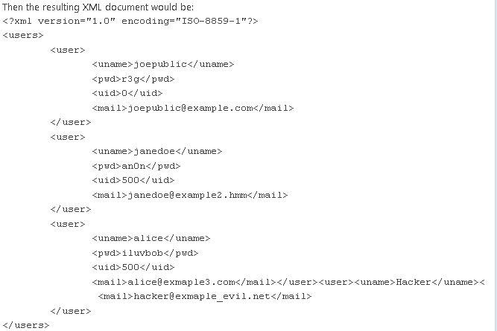
Secure Software Coding
Common Software Vulnerabilities and Controls
XML Injection:
“In this example a new user (Hacker) will be inserted into the table with user ID 0. In many cases with XML applications, the second user ID instance will override the first. This results in the injected new user 'Hacker' being logged in with userid=0 (which often is used as the administrator uid)” {webappspace.org}

Slide 13
Secure Software Coding
Common Software Vulnerabilities and Controls
Cross-Site Scripting (XSS):
XSS is the most prevalent web application security attack today
An application is said to be susceptible to XSS vulnerability when the user supplied input is sent back to the browser client without being properly validated
An attacker will provide a script instead of a legitimate value and that script if not escaped before being sent to the client, gets executed
The aim is typically stealing victim’s cookies
Thre common types are
Non-persistent or Reflected
Persistent or Stored
DOM Based

Slide 14
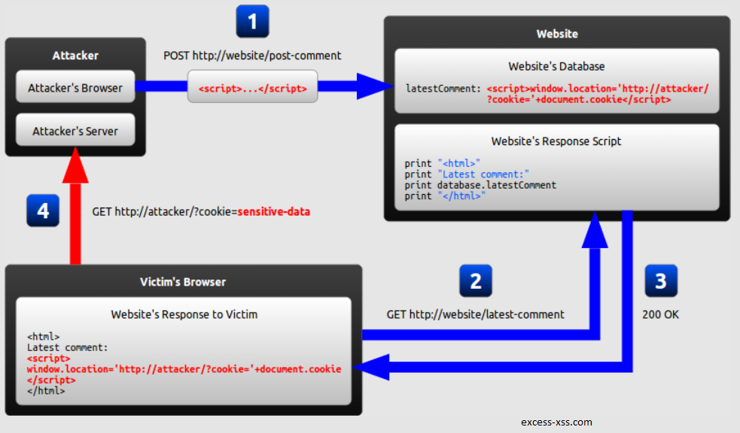
Secure Software Coding
Common Software Vulnerabilities and Controls
Persistent or Stored XSS
The malicious string originates from the website's database.

Slide 15
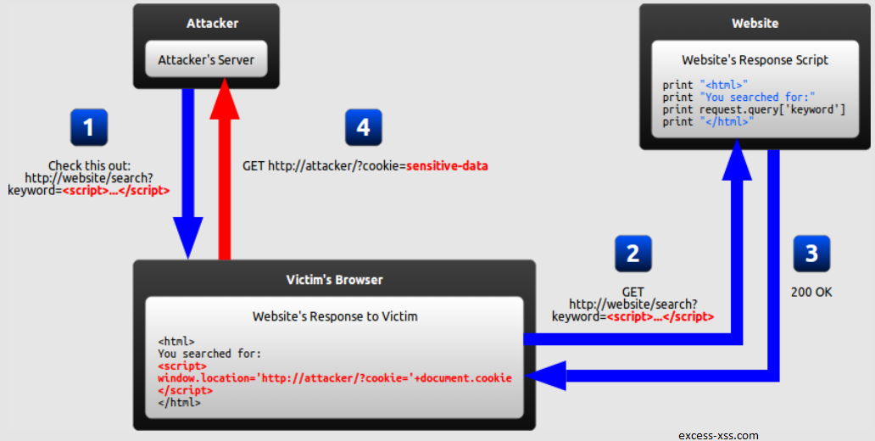
Secure Software Coding
Common Software Vulnerabilities and Controls
Non-persistent or Reflected XSS
The malicious string is part of the victim's request to the website.

Slide 16
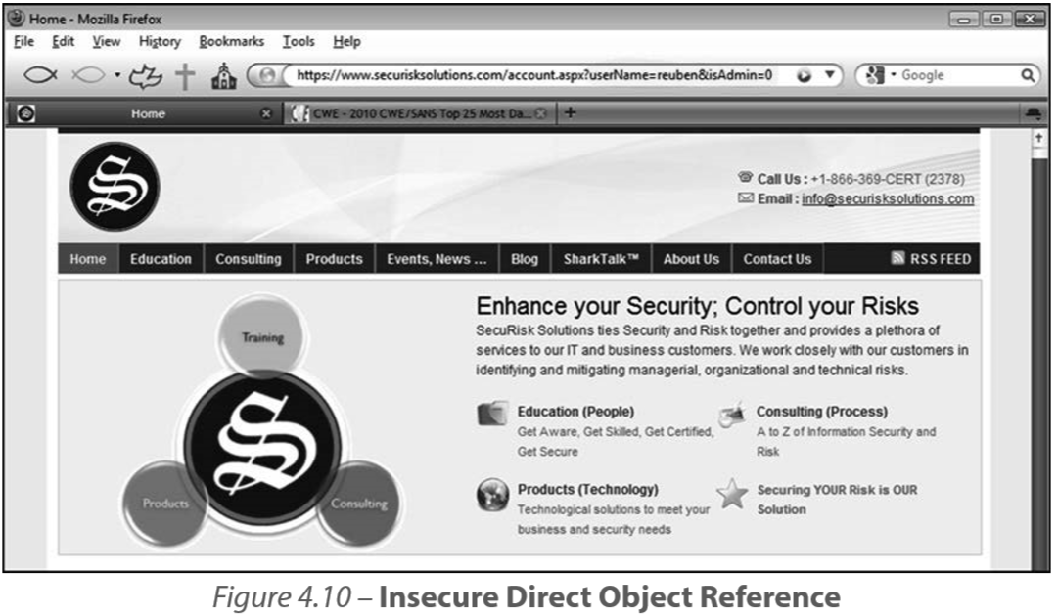
Secure Software Coding
Common Software Vulnerabilities and Controls
Insecure Direct Object References
User or process can invoke the internal functionality of the software by manipulating parameters and other object values that directly reference this functionality

Slide 17
Secure Software Coding
Common Software Vulnerabilities and Controls
Sensitive Data Exposure
Lack of appropriate confidentiality controls lead to data exposure
Common causes of data exposure are
Insufficient data-in-motion protection
Insufficient data-at-rest protection
Electronic social engineering

Slide 18
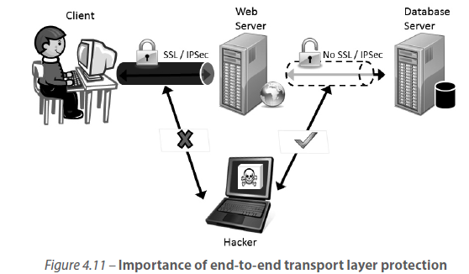
Secure Software Coding
Common Software Vulnerabilities and Controls
Insufficient Data-in-Motion Protection

Slide 19
Secure Software Coding
Common Software Vulnerabilities and Controls
Insufficient Data-in-Motion Protection
Man in the middle (MITM)
The situation where the attacker has an advantageous position between the server and the victim
Attacker can monitor unprotected data in transit
Once the attacker has control of a session (hijack) they can interject themselves in the middle, impersonating themselves as valid.
MITM applies for OSI Layer 2 and above, our focus will be L4+
Surf jacking & Side jacking:
Ways to divert victim from a secure connection (https) to unsecure (http) so that attacker can read the session cookie in cleartext

Slide 20
Secure Software Coding
Common Software Vulnerabilities and Controls
Insufficient Data-at-Rest Protection
The primary sources of insufficient data-at-rest protection include:
Local storage
Browser settings
Cache
Backups, logs and configuration files
Comments in code
Hardcoded secrets in code
Unhandled exceptions and error messages
Backend data stores

Slide 21
Secure Software Coding
Common Software Vulnerabilities and Controls
Insufficient Data-at-Rest Protection
Local storage:
Local storage usage has increased especially with HTML5.
Ability to keep more data clientside reduced the data marshalling between server and the client.
On the other hand, more data is now subject to be exposed once accessed via scripts.

Slide 22
Secure Software Coding
Common Software Vulnerabilities and Controls
Insufficient Data-at-Rest Protection
Browser settings:
Browser history can be stolen using Cascading Style Sheet (CSS) hacks
Information about sites that a user has visited can be stolen from a user.
Cache
Although cache can be used to significantly improve performance and user experience, sensitive information if cached can be disclosed, breaching confidentiality

Slide 23
Secure Software Coding
Common Software Vulnerabilities and Controls
Insufficient Data-at-Rest Protection
Backups, Logs and Configuration Files
These files can potentially have sensitive information that come in very handy for an attacker as they attempt to exploit the software.
Comments in Code:
Among the minority of security concerns.
Comments should not reveal sensitive information

Slide 24
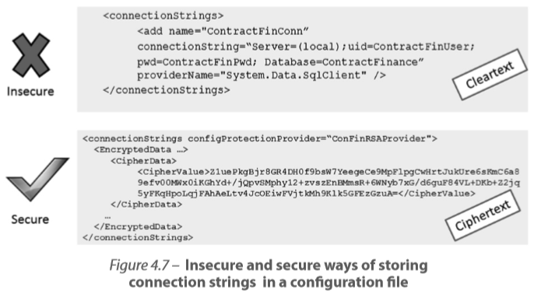
Secure Software Coding
Common Software Vulnerabilities and Controls
Insufficient Data-at-Rest Protection
Hardcoded Secrets in Code:
Passwords or keys in plaintext in the code

Slide 25
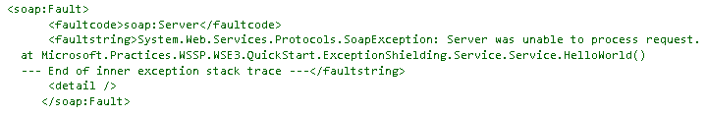
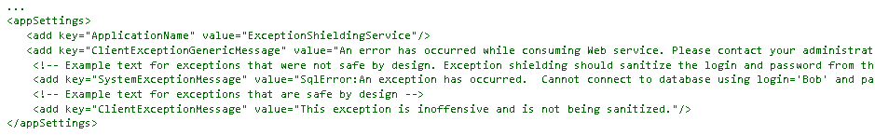
Secure Software Coding
Common Software Vulnerabilities and Controls
Insufficient Data-at-Rest Protection
Unhandled Exceptions and Error Messages
When exceptions are not handled properly, sensitive information including the internal structure of the software can be leaked to an attacker.Backend Data Stores
When shielded properly,

Slide 26
Secure Software Coding
Common Software Vulnerabilities and Controls
Insufficient Data-at-Rest Protection
Unhandled Exceptions and Error Messages
When exceptions are not handled properly, sensitive information including the internal structure of the software can be leaked to an attacker.Backend Data Stores
Backend Data Stores:
Satisfying confidentiality in data-at-transit is not enough!
Data in databases or folders has to be stored in a protected form.

Slide 27

Secure Software Coding
Common Software Vulnerabilities and Controls
Cross-Site Request Forgery (CSRF)
Classified within the top five application security attacks
User authenticates into a legitimate web site and receives the authentication token associated with that site
User is tricked into clicking a link that has a forged malicious HTTP request to be performed against the site that the user is already authenticated to.
Browser sends the malicious HTTP request while helping the request being authenticated using the auth token

Slide 28
Secure Software Coding
Common Software Vulnerabilities and Controls
Only when all of these conditions are fulfilled, does a race condition occur.
Race Conditions
Concurrency property
There must be at least two threads or control flows executing concurrently.
Shared object property
The threads executing concurrently are both accessing the same object
Change state property
At least one of the control flows must alter the state of the shared object

Slide 29
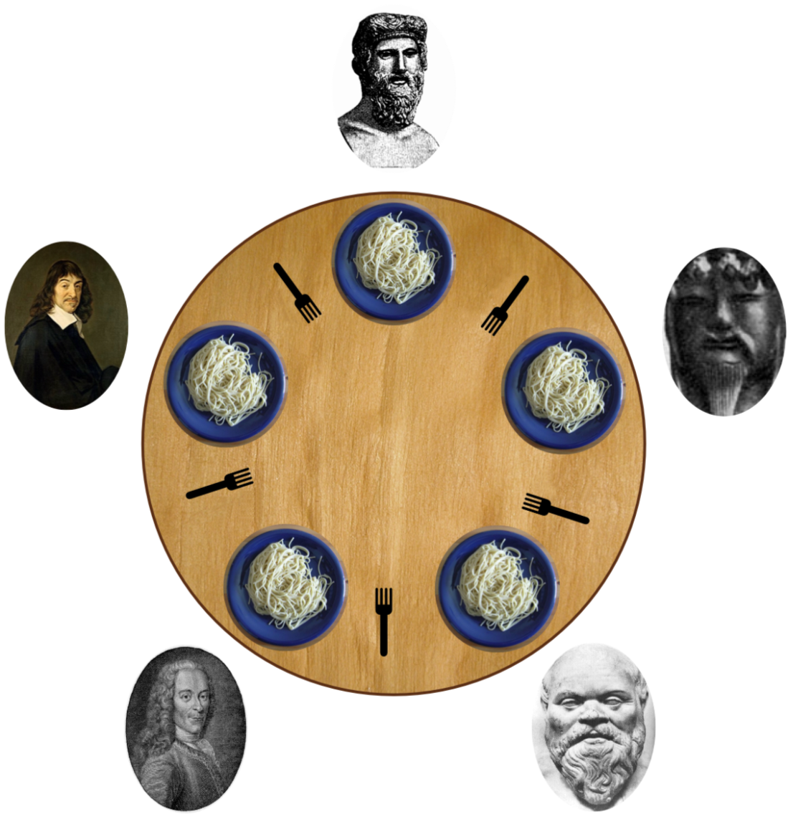
Secure Software Coding
Common Software Vulnerabilities and Controls
Race Conditions
Dining philosophers
http://www.cs.uiuc.edu/class/sp06/cs241/Animations/Dining2/philosophers.html

Slide 30
Secure Software Coding
Common Software Vulnerabilities and Controls
Side Channel Attacks
Timing attacks
Attacker measure how long each computational operation takes and uses that side channel information to discover other information about the internal makeup of the system
Power Analysis attacks
The attacker measures the varying degrees of power (peak power consumption can be interpreted that CPU is doing multiplication)
TEMPEST attacks
Attacker uses leaked electromagnetic radiations to reveal infomation
Acoustic Cryptanalysis attacks
Attacker analyses the sound produced during the computation of operations

Slide 31
Secure Software Coding
Common Software Vulnerabilities and Controls
Side Channel Attacks
Differential Fault Analysis attacks
Induce faults to reveal internal states
Distant Observation attacks
Someone can read over your shoulder
Cold Boot attacks
An attacker can extract secret information by freezing the data contents of memory chips and the booting up to recover the contents in memory.
In an improper shutdown incident (cold boot), critical information will be residing in RAM without being properly flushed.
It is discovered that considerable amount of data still stays in RAM without power, for a period of time.
Critical data like encryption keys can be extracted from memory content

