Slide 1
Secure software development/Coding
1DV429 – IT Security
Lecture 6
Hüseyin Kayahan

Slide 2
Secure Software Coding
Defensive Coding Practices – Concepts and Techniques
Defensive coding practices and techniques aims
Reducing the attack surface
Reducing the amount of code and services that are executed by default.
Reducing the volume of code that can be accessed by untrusted users
Limiting the damage when the code is exploited
And assuring the reliability, resiliency and recoverability of software.

Slide 3
Secure Software Coding
Defensive Coding Practices – Concepts and Techniques
Input Validation
Input validation is the verification process that ensures the data that is supplied:
for processing is of the correct data type and format
falls within the expected and allowed range of values
is not interpreted as code as is the case with injection attacks
does not masquerade in alternate forms that bypass security controls
How to validate?
Regular expressions (RegEx) can be used for validating input (filtering)
Filtering user input can be accomplished using either a whitelist or a blacklist
Blacklist examples include the single quote ( ‘ ), SQL comment ( - - ) or a pattern such as (1=1).

Slide 4
Secure Software Coding
Defensive Coding Practices – Concepts and Techniques
Input Validation
Where to validate?
Input can be validated on the client or on the server or on both
Minimally, server side validation must be performed. Validation on both is recommended
What to validate?
Data type, range, length, format
Alternate representations of a canonical form

Slide 5
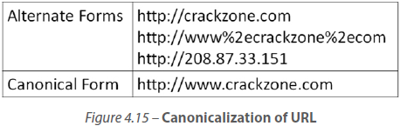
Secure Software Coding
Defensive Coding Practices – Concepts and Techniques
Canonicalization
Is the process of converting data that has more than one possible representation to conform to a standard canonical form.
A blacklist can be potentially bypassed when an alternate
representation of the canonical form is passed in.
It is recommended to canonicalize inputs into the internal
representation before performing validation to ensure that validation is not circumvented

Slide 6
Secure Software Coding
Defensive Coding Practices – Concepts and Techniques
Sanitization
Is the process of converting something that is considered dangerous into its innocuous form.
Both inputs and outputs can be sanitized.
Sanitization can be accomplished using,
Stripping: Removing harmful characters from user supplied input
<script>alert(‘XSS probe test’);</script> becomes scriptalertXSS probe testscript
Substitution: Replacing user supplied input with safer alternatives
‘ Or 1=1 – becomes “ Or 1=1 --

Slide 7
Secure Software Coding
Defensive Coding Practices – Concepts and Techniques
Sanitization
Literalization: Using properties that render the user supplied input to be treated as a literal form.
Conversion of the input into its innerText form, instead of its innerHTML form.
This renders the input to be non-executable
<div id="test">This is element <code>x</code>. It contains a <strong>strong</strong> an <em>em</em>.</div>
x.innerHTML // => "This is element <code>x</code>. It contains a <strong>strong</strong> an <em>em</em>."
x.innerText // => "This is element x. It contains a strong an em."

Slide 8
Secure Software Coding
Defensive Coding Practices – Concepts and Techniques
Error Handling
Input validation is the first step towards error handling since validated inputs are less likely for the software to expose sensitive information.
E.g Validate all input to prevent an attacker from forcing an error by using an input (type, value, range, length, etc.) that the software is not expecting.
Next comes error handling, the error messages must be non-verbose and explicitly specified in the software.
Use non-verbose or laconic equivalent such as ‘Login invalid’ rather than
‘User ID did not match’ or ‘Password is incorrect’
Additionally upon errors, the software is to fail to a more secure state
After 3 invalid login attempts, login is disabled for specific sourse for certain period
Shielding errors with GUIDs that are only understandable to developers
Error 0x805421b occurred, contact support

Slide 9
Secure Software Coding
Defensive Coding Practices – Concepts and Techniques
Safe APIs
APIs make the internal functionality of a software function accessible to external callers abstracting the internal structure of the software
Nefarious use of APIs is listed in top 10 threats in Cloud Computing
When confidentiality of sensitive information (usernames, passwords, connection string, keys) is required, CryptoAPI Next Generation (CNG) can be used.

Slide 10
Secure Software Coding
Defensive Coding Practices – Concepts and Techniques
Memory Management
We have covered the operations in memory and its weaknesses in early lectures
Some of the defensive concepts that you should be familiar for better
implementation of controls
Locality of Reference:
A.k.a “the principle of locality”
Is the principle that subsequent data locations that are referenced when a program is run are often predictable and in proximity to previous locations based on time or space
This is primarily to promote the reuse of recently used data and instructions

Slide 11
Secure Software Coding
Defensive Coding Practices – Concepts and Techniques
Memory Management
Locality of Reference (continued):
Temporal locality:
The same memory locations that are recently accessed are more likely to be referenced again in the near future.
Spatial locality:
The memory locations that are nearby recently accessed memory locations are more likely to be referenced in the near future.

Slide 12
Secure Software Coding
Defensive Coding Practices – Concepts and Techniques
Memory Management
Dangling pointers:
The pointers that reference to an object’s memory space where the referenced object had been removed but updating the pointer was forgotten
Garbage Collection:
The pointer that references to the memory space is lost. Data is in memory occupying space but unreachable.
Or software did not properly deallocate memory when it has to
Improper management of memory can lead to abnormal memory allocations that can eventually lead to a DoS attack
The main goal of garbage collection is to reduce memory leaks i.e., reclaiming unreachable memory objects
Although it is automatically enforced, it can be invoked in code by the programmer
Garbage collector can be subject to attack as well (slow death and fast death)

Slide 13
Secure Software Coding
Defensive Coding Practices – Concepts and Techniques
Memory Management
Type Safety:
Type safe code cannot access memory out of the range of memory address space that belongs to the object’s publicly exposed fields
Type-safe code cannot perform an operation on an object that is invalid for that object.
C# produces type-safe code, which is verified to be type-safe during JIT compilation.
In C++ it is easy to declare a variable and then check its value; whatever was in the memory address given to that variable would then be shown. The C# complier will notify you if you try to use a variable before you have initialized it to some valid value.
With C#, you can no longer just walk past the end of an array, as you have been able to do in C and C++. In C++ you could declare an array of three elements but still be able to examine the fourth element of that array and get the next chunk of memory.

Slide 14
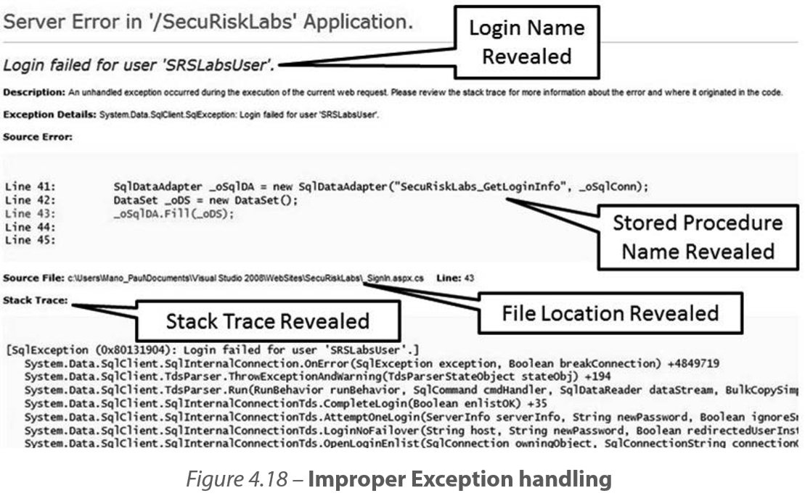
Secure Software Coding
Defensive Coding Practices – Concepts and Techniques
Exception Management

Slide 15
Secure Software Coding
Defensive Coding Practices – Concepts and Techniques
Exception Management
All exceptions must be explicitly handled. If the programming language allows for try-catch-finally constructs then there must be a catch all exception block.
An important exception management feature is to use the Safe Security Exception Handler (/SAFESEH) flag in systems that support it.
When the /SAFESEH flag is set, the linker will produce the executable’ s safe exception handlers table
This table is used to verify safe (or valid) exceptions by the OS.

Slide 16
Secure Software Coding
Defensive Coding Practices – Concepts and Techniques
Exception Management
/Safeseh example
extern "C" EXCEPTION_DISPOSITION __cdecl
MyExceptionFilter(
EXCEPTION_RECORD *pExceptionRecord,
EXCEPTION_REGISTRATION_RECORD *pEstablisherFrame,
CONTEXT *pContext,
void *DispatcherContext
)
{
...
return ExceptionContinueSearch;
}
Now you add a .asm file:
MyExceptionFilter proto
.safeseh MyExceptionFilter

Slide 17
Secure Software Coding
Defensive Coding Practices – Concepts and Techniques
Session Management
Identify and verify users at both the source as well as at the end of the communication channel to ensure that no malicious users have interjected themselves in between.
Always authenticate users only from an encrypted source (web page).
Do not expose session ID in URLs or accept preset or timed out session identifiers from the URL or HTTP Request.
Require the user to re-authenticate upon account update such as password changes and if feasible, generate a new session ID upon successful authentication or change in privilege level.

Slide 18
Secure Software Coding
Defensive Coding Practices – Concepts and Techniques
Configuration Parameters Management
Two main configurable parameters include,
Startup variables:
Usually during the bootstrapping process of the startup phase, environment variables and configuration parameters are initialized.
These variables and parameters need to be protected from disclosure, alteration or destruction threats.
Bootstrapping security will be covered in later lecture
Cryptographic keys:
What good is it to lock the doors and windows of your house when you leave the key under the mat on the front porch?

Slide 19
Secure Software Coding
Defensive Coding Practices – Concepts and Techniques
Cryptography
Suite of mathematical functions and operations where data is rendered to different forms to provide confidentiality
Cryptographic Encryption/Decryption
Symmetric Cryptography
Same key is used to ency/dec data
Faster compared to Asym
Key distribution is a concern
Several examples are DES, 3DES, AES
Asymmetric Cryptography
Different keys of a keypair is used for ency/dec
Can also achieve authentication
Example; SSL certificates (RSA algorithm for TLS)

Slide 20
Secure Software Coding
Defensive Coding Practices – Concepts and Techniques
Cryptography
Cryptographic Hashing
One way algorithms where a fixed length output (hash) is produced for an input.
Two different inputs should not output the same result
Hash should experience major change in minor changes in original input (Avalanche property)
Best practise for data-at-rest protection, hashes of the passwords should be stored in DB rather than the plain password.
Cryptographic agility: How flexible is it to change cryptographic methodologies
Avoid obsolete APIs and unsecure algorithms
Avoid use of DES
Stick with Crypto API Next-gen

Slide 21
Secure Software Coding
Defensive Coding Practices – Concepts and Techniques
Concurrency
Recall the dining philosophers
In order for race conditions to occur, there should be multiple threads operating concurrently against a shared object, and each thread attempting to change the state of that shared object
Concurrency (simultaneous operations) is a primary property in TOC/TOU attacks.
Some of the prevalent protection measures against race conditions or TOC/TOU attacks are:
Avoid race windows
Atomic operations
Mutual Exclusion (Mutex)

Slide 22
Secure Software Coding
Defensive Coding Practices – Concepts and Techniques
Concurrency
Avoid race windows:
A race window (aka critical section) is defined as the window of opportunity when two concurrent threads race against one another trying to alter the same object
The first step in avoiding race conditions is to identify race windows.
Upon identification of race windows, it is important to fix them in code or logic design to mitigate race conditions.

Slide 23
Secure Software Coding
Defensive Coding Practices – Concepts and Techniques
Concurrency
Atomic operations:
The entire process is completed using a single flow of control and that concurrent threads or control flow against the same object is disallowed.
Rest of the system percieves an atomic operation as an instantenous action.
“References and assignments are atomic in almost all systems. A=B will always get a good value for B, will always set a good value for A.” stanford

Slide 24
Secure Software Coding
Defensive Coding Practices – Concepts and Techniques
Concurrency
Mutual exclusion (Mutex):
Race conditions can also be eliminated by making two conflicting processes or race windows, mutually exclusive of each other.
Mutex can be accomplished by resource locking, wherein the object that is accessed is locked and does not allow any alteration until the first process or threat releases it

Slide 25
Secure Software Coding
Defensive Coding Practices – Concepts and Techniques
Concurrency
Mutual exclusion (Mutex):
Example:
Jack bids on a particular item and Jill who is also interested in that same item places a bid as well.
Both Jack and Jill’s bids should be mutually exclusive of one another and until Jack’s bid is processed entirely and committed to the backend database.
Jill bid’s operation should not be allowed. The backend record that holds the item information must be locked from any operations until Jack’s transaction commits successfully or is roll-backed in the case of an error.

Slide 26
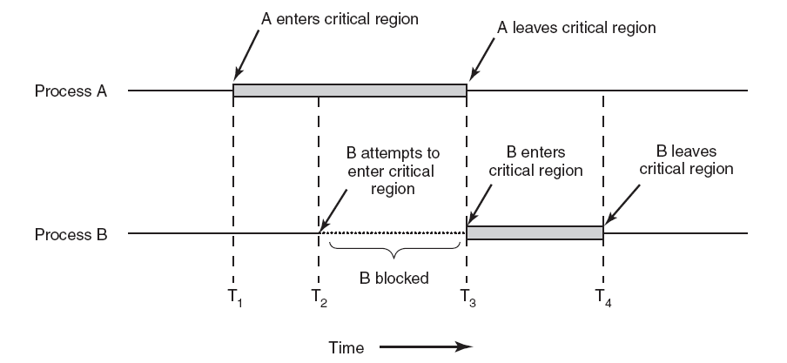
Secure Software Coding
Defensive Coding Practices – Concepts and Techniques
Concurrency
Mutual exclusion (Mutex):
Spot the mutex locks

Slide 27
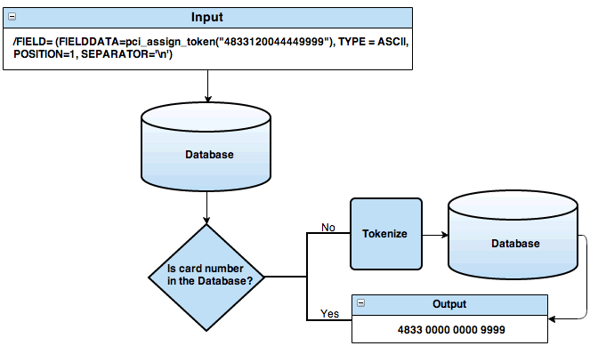
Secure Software Coding
Defensive Coding Practices – Concepts and Techniques
Tokenization
Is the process of replacing sensitive data with unique identification symbols
The needed information about the data is still retained without compromising its security

Slide 28
Secure Software Coding
Defensive Coding Practices – Concepts and Techniques
Sandboxing
Sandboxing refers to the security mechanism that prevents software running on a system from accessing the host operating system
Unless permissions are explicitly granted, the software program that is being sandboxed will have minimal to no access to the underlying operating system.
Consider a modular main application you coded that works with plugins coded either by you or others.
Sandboxing is achieved via “Application Domains” in C#

Slide 29
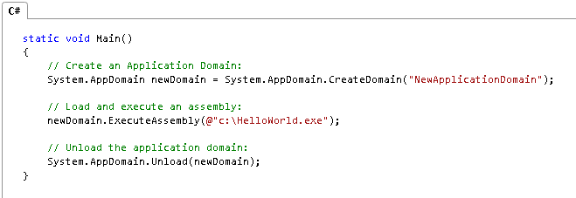
Secure Software Coding
Defensive Coding Practices – Concepts and Techniques
Sandboxing
Application domains:
Faults in one application domain cannot affect other code running in another application domain.
Individual applications can be stopped and code unloaded without stopping the entire process.

Slide 30
Secure Software Coding
Defensive Coding Practices – Concepts and Techniques
Anti-tampering
Assure integrity assurance and protection against unauthorized and malicious alterations of the software code and/or the data.
Several ways are
Obfuscation:
Is the process of making the code obscure and confusing using a special program called the obfuscator so that even if the source code is leaked to or stolen by an attacker, the source code is not easily readable and decipherable.
Code Signing:
Is the process of digitally signing the code (executables, scripts, etc.) with the digital signature of the code author

Slide 31
Secure Software Coding
Secure Software Processes
Version control(Configuration Management)
Not only ensures that the development team is working with the correct version of code, but also gives the ability to rollback to a previous version should there be a need to.
Provides the ability to track ownership and changes of code
Version control can reduce the incidences of regenerative bugs, where a previously fixed bug reappears.
Team Foundation Server, Subversion (SVN), Git are couple of examples.

Slide 32
Secure Software Coding
Secure Software Processes
Code Analysis
Is the process of inspecting the code for quality and weaknesses
Two types of analysis are Static and Dynamic

Slide 33
Secure Software Coding
Secure Software Processes
Code Analysis
Static analysis:
Involves the inspection of the code without executing the code.
Can be performed manually by what is called a code review or in an automated manner using tools.
Tools that are used to perform static source code analysis are commonly referred to as source code analyzers.
Uses pattern matching against a known list of vulnerability syntax and data flow/model analysis against known sets of data to detect vulnerabilities
Tools that are used to analyze intermediate bytecode are known as bytecode scanners
Tools used to analyze object code statically are referred to as binary analyzers or binary code scanners
Uses disassembly prior to pattern and data analysis against executable
It can detect vulnerabilities and code inefficiencies that have been introduced by the compiler

Slide 34
Secure Software Coding
Secure Software Processes
Code Analysis
Dynamic analysis:
Is the inspection of the code when it is being executed
Just because the code compiles without any errors does not mean that it will run without any errors
In order to accurately perform dynamic analysis, a simulated environment that mirrors the production environment where the code will be deployed is necessary
Tools used for dynamic code analysis are known as dynamic code analyzers and they can be used to determine how the program will run as it interacts with other processes and the operating system itself

Slide 35
Secure Software Coding
Secure Software Processes
Code/Peer Review
When peers from the development team are part of the code review process.
It is a systematic evaluation of the source code with the goal of finding out syntax issues and weaknesses in the code that can impact the performance and security of the software.
Semantic issues such as business logic and design flaws are usually not detected in a code review
Code reviews with security aim are generally concerned about,
Insecure Code
Inefficient Code

Slide 36
Secure Software Coding
Secure Software Processes
Code/Peer Review
Insecure Code: Code that has exploitable weaknesses in it.
Common insecure code implementations include:
Injection flaws
Lack of input validation or the dynamic construction of queries which accept user supplied data without proper validation or sanitization
Non-repudiation Mechanisms
Auditing is properly implemented and that the authenticity of the code and the user or system actions are not disputable
Spoofing Attacks
Session identifiers are not predictable, passwords are not hard-coded, credentials are not cached
Errors and Exception Handling
Errors don’t reveal more information than is necessary , software fails securely, check for the presence of try-catch-finally blocks, check objects created in code are destroyed in the finally blocks

Slide 37
Secure Software Coding
Secure Software Processes
Code/Peer Review
Insecure Code: Code that has exploitable weaknesses in it.
Common insecure code implementations include:
Cryptographic Strength
Non-standard algorithms must be avoided, use of Random Number Generators (RNG) and pseudo-Random Number Generators (PRNG) must be validated, keys must not be hard-coded
Unsafe and Unused Functions and Routines in Code
Banned APIs should be avoided, unused functions should be removed. Explicit checks for “Easter eggs” in code must be performed.
Reversible Code
Debugger detectors and any symbolic and textual information that can aid a reverse engineer revealing the internal state should be removed

Slide 38
Secure Software Coding
Secure Software Processes
Code/Peer Review
Insecure Code: Code that has exploitable weaknesses in it.
Common insecure code implementations include:
Privileged Code
Is code that violates the principle of least privilege, checks must be performed to ensure that code that requires administrative rights to execute are explicitly controlled and monitored
Maintenance Hooks
They are implanted to ease troubleshooting and better support. Can be used to impersonate a user who is experiencing issues with the software to recreate the issue as a way to troubleshoot the issue. Can also function as a back door and should be avoided in production.
Logic Bombs
A logic bomb can be triggered to go off to perform some malicious and unintended operation when that logic is met. Mostl of the timecan only be detected via a code review.

Slide 39
Secure Software Coding
Secure Software Processes
Code/Peer Review
Timing and Synchronization Implementations
The code is constructed to be executed in a mutually exclusive (Mutex) manner
Cyclomatic Complexity:
A measure of the number of linearly independent paths in a program
Is a metric that is used to find out the extent of decision logic within each module of the code.
It pertains to the design principle of economy of mechanisms and least common mechanisms

