Slide 1
Secure software TESTING,
1DV429 – IT Security
Lecture 8
Hüseyin Kayahan

Slide 2
Secure Software Testing
Testing Artifacts
Test Strategy:
outlines the testing approach that will be undertaken
includes information about the testing goals, methods, time needed, test environment configuration and needed resources
is high level in nature and is developed from conceptual design documents
Test Plan:
test plan is much more granular document that details the testing approach systematically
three primary components of a test plan includes: test requirements (or responsibility), test methods and test coverage.

Slide 3
Secure Software Testing
Test Case
A test case takes the test requirements from the test plan and defines measurable conditions to validate
a test case contains a unique identifier, a reference to the requirements specification that is being validated, any preconditions that need to be met, actions, test inputs and expected results
In addition to functional test cases, security test cases need to be defined as well
Test Script
the procedures that the tester will undertake to perform the test
developed using the test case, and for each test case, one or more test scripts need to be developed
Testing Artifacts

Slide 4
Secure Software Testing
Test Suite
groups and a collection of test cases makes up a test suite
usually organized logically by section, such as functional tests, performance tests
Test Harness
All the components that are necessary to conduct software testing are collectively referred to as a test harness
the testing tools, test data samples, testing configurations, test cases and test scripts
Testing Artifacts

Slide 5
Secure Software Testing
Types of Software QA Testing
Functional Testing:
Functional testing is also referred to as reliability testing.
We test to check if the software is reliable, a.k.a. is functioning as it is supposed to
Unit Testing:
performed during the implementation phase
is the first process to ensure that the software is functioning properly, according to specifications
It is performed by breaking the functionality of the software into smaller parts and each part is tested in isolation from the other parts
When there exists incomplete/unclear dependent modules, drivers and stubs programming come in handy

Slide 6
Secure Software Testing
Types of Software QA Testing
Functional Testing:
Logic Testing:
Unit testing validates the “what” whereas logic testing validates the “why”.
Integration Testing:
The security of the sum of all parts (the system) is tested.
An individual code units may successfully pass unit testing, but fail when they are integrated
Regression Testing:
Is performed to validate that the software did not break previous functionality or security and regress to a non- functional or insecure state when a new functionality is introduced
An example of this is that a menu option that was previously available to all users is no longer available upon the implementation of role based access control of menu options

Slide 7
Secure Software Testing
Types of Software QA Testing
Non-Functional Testing:
covers testing for the recoverability and environmental aspects of the software
are conducted to check if the software will be available when required
Performance Testing:
conducted to ensure that the software is performing to the SLA and expectations of the business
The implementation of secure features can have a significant impact on performance
Having smaller cache windows, complete mediation, and data replication are examples of security design and implementation features that can adversely impact performance
Results can be used to tune the software, bottlenecks can be reduced.

Slide 8
Secure Software Testing
Types of Software QA Testing
Non-Functional Testing:
Performance Testing:
Load testing:
is the process of subjecting the software to volumes of operating tasks or users until it cannot handle any more
also referred to as longevity or endurance or volume testing
Helps identifying the threshold limit at which the software no longer meets the business SLA
Stress testing
stress testing is taking load test one step further. It is mainly aimed to determine the breaking point of the software
Purpose is to find out if the software can recover gracefully upon failure, when the software breaks and if it fails securely.

Slide 9
Secure Software Testing
Types of Software QA Testing
Non-Functional Testing:
Scalability Testing:
identify the loads and bottlenecks that prevents software to scale to handle more load or changes
For instance a column ORDER_ID is type int16. How will the software react upon scaling this field up to int32?
Environment Testing:
testing of the security of the environment itself in which the software will operate (configurations, data etc.)
Trust boundaries demarcate one environment from another
Interoperability Testing:
Integration/Dependence of the system with other systems is tested
Disaster Recovery (DR) Testing:
testing the ability of the software to restore its operation after a disaster happens.

Slide 10
Secure Software Testing
Types of Software QA Testing
Non-Functional Testing:
Simulation Testing:
A common issue faced by software teams is that the software functions as desired in the development and test environments but fails in the production environment
A familiar and dangerous response to this situation is that the software is configured to run with administrative or elevated privileges.
By simulating the configuration settings between these environments, configuration mismatch issues can be determined
Other Testing:
Privacy Testing:
For software that handles personal data, privacy testing must be part of the test plan
Includes testing appropriateness of notices and disclaimers, point of disclosure in end-to-end communications

Slide 11
Secure Software Testing
Types of Software QA Testing
Non-Functional Testing:
Other Testing:
Privacy Testing:
For software that handles personal data, privacy testing must be part of the test plan
Includes testing appropriateness of notices and disclaimers, point of disclosure in end-to-end communications
User Acceptance Testing (UAT):
Conducted to assure end user that the software meets their specified requirements
it brings the benefit of extending software testing to the end users as they are the ones who perform the UAT before accepting it

Slide 12
Secure Software Testing
Security Testing Methods
Security Testing (Attack Surface Validation) :
While functional testing is done to make sure that the software does not fail during operations or under pressure, security testing is performed with the intent of trying to make the software fail.
It is testing that is performed to see if the software can be broken.
It is performed with a hostile user (attacker or blackhat) mindset.
Security testing begins with creating a test strategy of high risk items first, followed by low risk items.

Slide 13
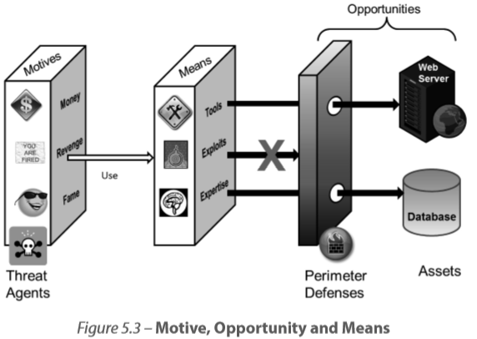
Secure Software Testing
Security Testing Methods
Security Testing (Attack Surface Validation) :
Motives, Opportunities and Means

Slide 14
Secure Software Testing
Security Testing Methods
Security Testing (Attack Surface Validation) :
Testing of Security Functionality versus Security Testing
Security testing is testing with an attacker perspective to validate the ability of the software to withstand attack (resiliency)
Whereas testing security functionality (authentication mechanisms, auditing capabilities, error handling, etc.) in software is meant to assure that the functionality of protection mechanisms are working properly

Slide 15
Secure Software Testing
Security Testing Methods
Security Testing (Attack Surface Validation) :
White-box testing:
is a security testing methodology that is performed based on the knowledge of how the software is designed and implemented.
It is broadly known as full knowledge assessment, because the tester has complete knowledge of the software
It can be used to test both the use case (intended behavior) as well as the misuse case (unintended behavior) of the software

Slide 16
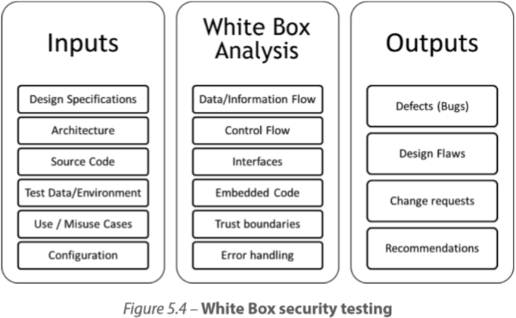
Secure Software Testing
Security Testing Methods
Security Testing (Attack Surface Validation) :
White-box testing:

Slide 17
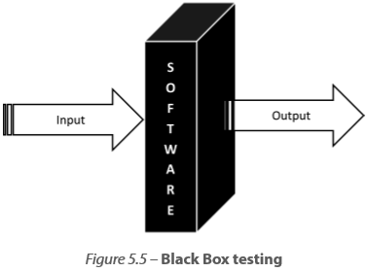
Secure Software Testing
Security Testing Methods
Security Testing (Attack Surface Validation) :
Black-box testing:
is broadly known as zero knowledge assessment, because the tester has very limited to no knowledge of the internal working of the software being tested

Slide 18
Secure Software Testing
Security Testing Methods
Security Testing (Attack Surface Validation) :
White Box vs Black Box:
white box testing may not cover code dependencies (services, libraries, etc.) or 3rd party components. It provides little insight into the exploitability of the vulnerability itself and so may not present an accurate risk picture.
On the other hand, black box testing can attest the exploitability of weaknesses in both simulated and actual production systems.

Slide 19
Secure Software Testing
Security Testing Methods
Security Testing (Attack Surface Validation) :
The following are different criteria that can be used to determine the type of approach to take when validating software security.
Root Cause Identification:
Root Cause Analysis (RCA) of software security is easier when the source code is available so that the exact line of code that causes the vulnerability can be determined and handled.
Extent of Code Coverage
white box testing requires access to source code and each line of code can be analyzed for security issues, it provides greater code coverage than does black box testing

Slide 20
Secure Software Testing
Security Testing Methods
Security Testing (Attack Surface Validation) :
The following are different criteria that can be used to determine the type of approach to take when validating software security.
Number of False Positives and False Negatives
When a vulnerability is reported and in reality it isn’t a true vulnerability, it is referred to as a false positive result of security testing.
On the other hand, when a vulnerability that exists goes undetected in the results of security testing, it is said to be a false negative.
The number of false positives and false negatives are relatively higher in black box testing than in white box testing because black box testing looks at the behavior

Slide 21
Secure Software Testing
Security Testing Methods
Security Testing (Attack Surface Validation) :
The following are different criteria that can be used to determine the type of approach to take when validating software security.
Logical Flaws Detection
implementation bugs are syntactic whereas logical flaws are design issues and semantic in nature
Easier to reveal via whitebox testing since other contextual artifacts such as the architectural and design documents, configuration information are present
Deployment Issues Determination
We have binaries and not the source code in deployment
The attestation of deployment environment resilience and discovery of actual configuration issues in the environment where the software will be deployed is possible with black box testing.

Slide 22
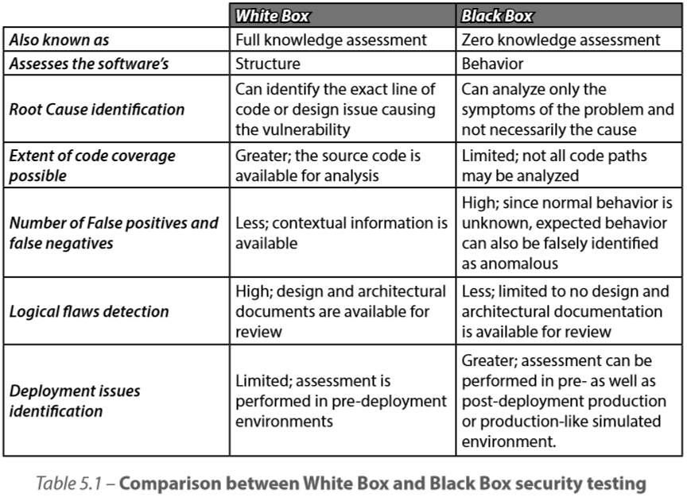
Secure Software Testing
Security Testing Methods
Security Testing (Attack Surface Validation) :

Slide 23
Secure Software Testing
Types of Security Testing
Cryptographic Validation Testing
Standards Conformance:
Confirmation that cryptographic modules conform to prescribed standards such as the Federal Information Processing Standards (FIPS) 140-2
Environment Validation:
The computing environment in which cryptographic operations occur must be tested as well.
The ISO/IEC 15408 Common Criteria (CC) evaluation can be used for this attestation.
Data Validation:
FIPS 140-2 testing considers data in unvalidated cryptographic systems and environments as data that is not protected at all, i.e., as unprotected cleartext

Slide 24
Secure Software Testing
Types of Security Testing
Cryptographic Validation Testing
Cryptographic Implementation
seed values needed for cryptographic algorithms should be checked so that they are random and not easily guessable
The uniqueness, randomness and strength of identifiers (such as Session ID) can be determined using phase space analysis and resource and time permitting, these tests need to be conducted
Scanning
Typically is the first step determining the service entry points
Devices, fingerprint operating system, identify active services

Slide 25
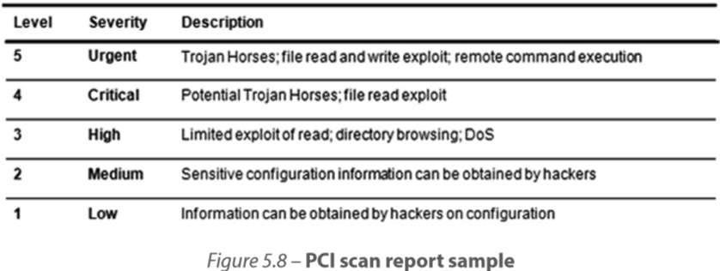
Secure Software Testing
Types of Security Testing
Scanning
Vulnerability Scanning:
When scanning is performed with the goal of detecting and identifying security flaws and weaknesses in the software and/or network, it is referred to as vulnerability scanning
The scan report should not only describe the type of vulnerability but also provide risk ratings and recommendations

Slide 26
Secure Software Testing
Types of Security Testing
Scanning
Content Scanning:
Content scanning technologies analyze the content within the document (web pages, files, etc.) for malicious content that can exploit unprotected systems
The Melissa macro-virus which packed within what seemed to be an innocuous Microsoft Word document a malicious script (macro), malware packed executables that can lead to malicious file execution attacks
Privacy Scanning
Helps in detecting potential issues that violate privacy policies and end-user trust.
It is essential to scan the software to attest the assurance of non-disclosure and privacy

Slide 27
Secure Software Testing
Types of Security Testing
Penetration Testing (Pen-Testing)
The main objective of penetration testing is to see if the network and software assets can be compromised by exploiting the vulnerabilities that were determined by the scans
(SP) 800-115 my NIST provides guidelines for pentesting
Reconnaissance (Enumeration and Discovery)
Fingerprinting, banner grabbing, port and services scans, vulnerability scanning, can be used to probe and discover the network layout and the internal workings of the software within that network.
Resiliency Attestation (Attack and Exploitation)
once potential vulnerabilities are discovered, the next step is to try to exploit those weaknesses

Slide 28
Secure Software Testing
Types of Security Testing
Penetration Testing (Pen-Testing)
Removal of Evidence (Cleanup activities) and Restoration
Not cleaning up and leaving behind accounts, services and tools created during pentest, and not restoring the system, leaves it with an increased attack surface and any subsequent attempts to exploit the software are made easy for the real attacker.
Reporting and Recommendations
This report should include not only technical vulnerabilities covering the network and software, but also include non-compliance with organization policy, and weaknesses in organizational processes and people know-how.

Slide 29
Secure Software Testing
Types of Security Testing
Fuzzing
Fuzzing, which is also known as fuzz testing or fault injection testing, is a brute force type of software testing in which faults (random and pseudo-random input data) are injected into the software and its behavior observed
The data that is used for fuzzing is commonly referred to as fuzz data or fuzzing oracle.
Generation-Based Fuzzing (Smart Fuzzing)
There is foreknowledge of the data format/protocol and the fuzz data is generated from scratch based on the specification/format
Mutation-Based Fuzzing (Dumb Fuzzing)
the fuzz data is created by corrupting (mutating) existing data samples (if they exist) by recursion or replacement.
This is done randomly and blindly and so mutated fuzzing is also referred to as dumb fuzzing.

Slide 30
Secure Software Testing
Software Security Testing
Testing for Input Validation
it is best recommended to perform the input validation tests for both the client and the server
Attributes of the input such as its range, format, data type, and values must all be tested
In order to perform input validation tests, it is first important to determine the sources of input and the events in which the software will connect to the backend store or command environment
These sources can range from authentication forms, search input fields, hidden fields in web pages, Querystrings in the URL address bar

Slide 31
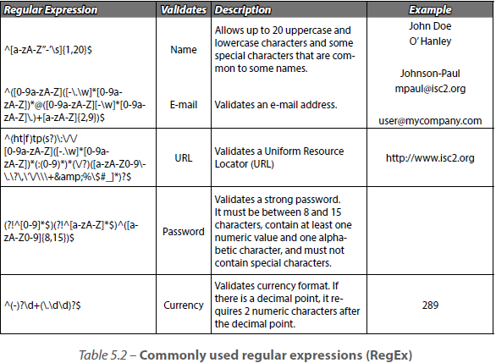
Secure Software Testing
Software Security Testing
Testing for Input Validation

Slide 32
Secure Software Testing
Software Security Testing
Testing for Injection Flaws Controls
parameterized queries that are not susceptible to injection themselves are used.
dynamic query construction is disallowed
Testing for Scripting Attacks Controls
Requests and inputs are validated using a current and contextually relevant whitelist that is updated with the latest script attack signatures and their alternate forms.
Scripts cannot be injected into input sources or the response.

Slide 33
Secure Software Testing
Software Security Testing
Other testings are
Testing for Non-repudiation Controls
Testing for Spoofing Controls
Failure Testing
Fail Secure (Fail safe)
Error and Exception Handling
Buffer Overflow Controls
Testing for Privileges Escalations Controls

Slide 34
Secure Software Testing
Tools for Security Testing
Fingerprinting tools
Sniffers / Protocol analyzers
Password crackers
Web security tools - Scanners, Proxies and Vulnerability Management
Wireless security tools
Reverse engineering tools (Assembler and Disassemblers, Debuggers and Decompilers)
Source code analyzers
Vulnerability exploitation tools
Security oriented Operating Systems
Privacy testing tools
See Appendix B in book

Slide 35
Secure software OPERATIONS, MAINTENANCE
1DV429 – IT Security
Lecture 8
Hüseyin Kayahan

Slide 36
Secure Software Operations, Maintenance
Installation and Deployment
Hardening:
Hardening includes the processes of locking down a system to the most restrictive level so that it is secure.
These minimum (or most restrictive) security levels are usually published as a baseline that all systems in the computing environment must comply to.
This baseline is commonly referred to as a Minimum Security Baseline (MSB).

Slide 37
Secure Software Operations, Maintenance
Installation and Deployment
Environment Configuration:
A common violation of least privilege that is observed is that in order for the software to function it is granted administrative rights when installed
Enabling disabled services, ports and protocols so that the software can be installed to run is an example of defense in depth violations
If one is lax about the security principles with which the software was designed and built, during the installation phase, then one must not be surprised when that software gets hacked.
Configuration issues are also evident in disparate platforms or when platforms are changed (x86 to x64).

Slide 38
Secure Software Operations, Maintenance
Installation and Deployment
Release Management:
the software when released should be released in a formal and controlled manner.
Release management is the process of ensuring that all changes that are made to the computing environment are planned, documented.
It is also important to ensure that the software is built for “release” and not for “debug”.
When software is compiled for debugging purposes, the debug information is usually stored in a separate file that is known as the program database file.
The program database (.pdb) file should not be deployed into the IT computing (production) environment as it holds debugging and project state information.
The ISO/IEC 15408 (Common Criteria) requirements mandates that the implementation, documentation, tests, project related documentation, tools including build tools are maintained in a configuration management system (CMS).

Slide 39
Secure Software Operations, Maintenance
Installation and Deployment
Bootstrapping and Secure Startup:
Secure startup refers to all the processes and mechanism that assure the environment’s TCB integrity when the system or software running on the system starts
The Trusted Platform Module (TPM) chip can be used for storing cryptographic keys
Startup events such as Application_OnStart or Session_OnStart events are used in web applications to provide software bootstrapping.
Malicious Software threat agents such as spyware and rootkits are known to interrupt the bootstrapping process and interject themselves as the program loads

Slide 40
Secure Software Operations, Maintenance
Operations and Maintenance
Operations Security Controls:
Detective Controls:
are those that can be used to build a historical evidence of user and system/process actions
Auditing (logging), intrusion detection systems (IDS) are some examples
Preventive Controls
are those which make the success of the attacker difficult as its goal is to prevent the attack
Input validation, output encoding, bounds checking, patching, intrusion prevention systems (IPS), etc. are some examples
Deterrent Controls
are those, which don’t necessarily prevent an attack nor are they merely passive in nature.
Banner messages, warnings are some examples

Slide 41
Secure Software Operations, Maintenance
Operations and Maintenance
Operations Security Controls:
Corrective Controls
are those which aim to provide the recoverability of software assurance.
Load balancing, clustering, failover of data and systems, etc. are some examples
Compensating Controls
are those controls that must be implemented when the prescribed software controls as mandated by a security policy or requirement cannot be met due to legitimate technical or documented business constraints

Slide 42
Secure Software Operations, Maintenance
Operations and Maintenance
Monitoring
what is not monitored cannot be measured and what is not measured cannot be managed
Why Monitor?
Validate compliance to regulations and other governance requirements.
Provide evidence for audit defense.
Assist in forensics investigations by collecting and providing the requested evidence if tracked and audited.

Slide 43
Secure Software Operations, Maintenance
Operations and Maintenance
Monitoring
What to Monitor?
Monitoring can be performed on any system, software or their processes.
It is important to first determine the monitoring requirements before implementing
Ways to Monitor
Scanning
Logging
Intrusion detection

Slide 44
Secure Software Operations, Maintenance
Operations and Maintenance
Monitoring
Metrics in Monitoring
Monitoring can then be used to determine if the software is operating optimally and securely to the levels as defined in the metrics definition.
The Service Level Agreement often contains these metrics but metrics are not just limited to SLAs.
Characteristics of a good metric include
Consistency
implies that no matter how many times the metric is measured, each time the results from the same data sets must be the same or at least equivalent.
Quantitative
metric is precise and expressed in terms of a cardinal number or as a percentage

Slide 45
Secure Software Operations, Maintenance
Operations and Maintenance
Monitoring
Metrics in Monitoring
Objectivity
irrespective of who the person is that is collecting the metric data, the results would be indicative of the real state of affairs.
Contextually Specific
Rather than having a large pool of logs, have context specific log engines to ease and improve monitoring process
Inexpensive
Computerized, less human involvement

Slide 46
Secure Software Operations, Maintenance
Operations and Maintenance
Change Management
Patch and Vulnerability Management
Hotfix or Quick Fix Engineering (QFE)
Service Pack
Events. Alerts, and Incidents
Any action that is directed at an object which attempts to change the state
When events match preset conditions or patterns, they generate alerts
Alerts can be categorized into incidents and adverse events can be categorized into security incidents if they violate or threaten to violate the security policy of the network

Slide 47
Secure Software Operations, Maintenance
Operations and Maintenance
Change Management
Backups, Recovery and Archiving
In addition to regularly scheduled backups, when patches and software updates are made, it is advisable to perform a full backup of the system that is being changed
when a system has been infected by malware such as Trojan horses and spyware, the only option left for assuring continued integrity, may be to completely format and reinstall the software
Cryptographic keys may be exposed during restore, personnel should be authorized carefully.

