Slide 1
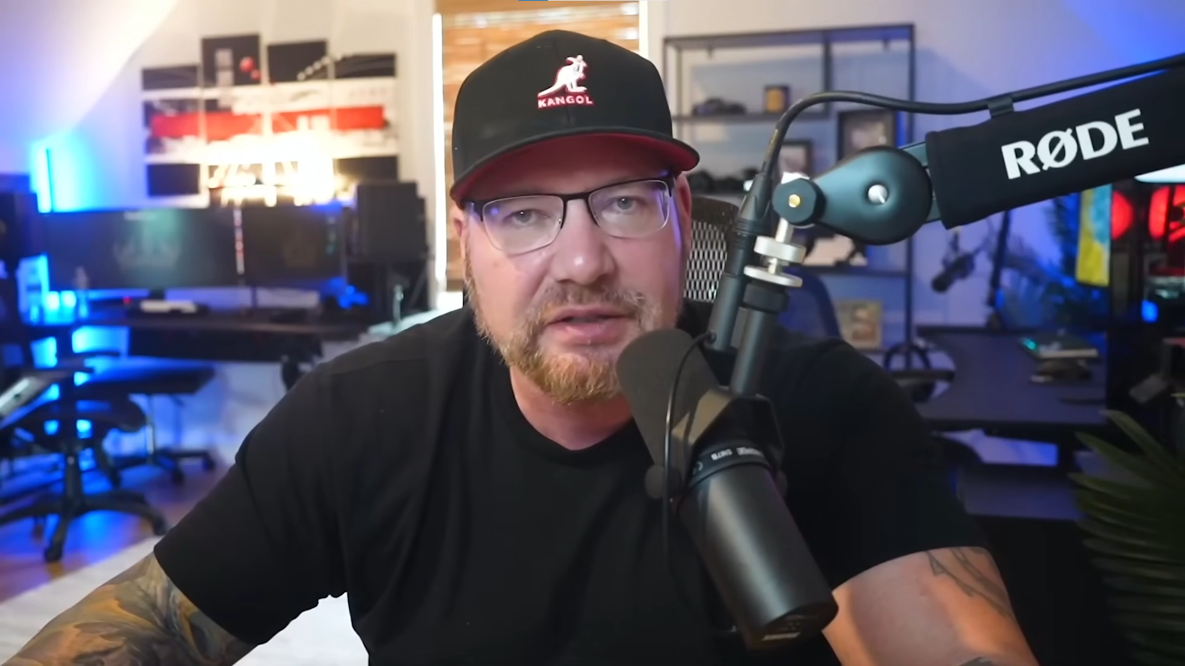
Claude Code Crash Course for Developers
Brad Traversy - Traversy Media
YouTube video
Prompt Snippets

Slide 2
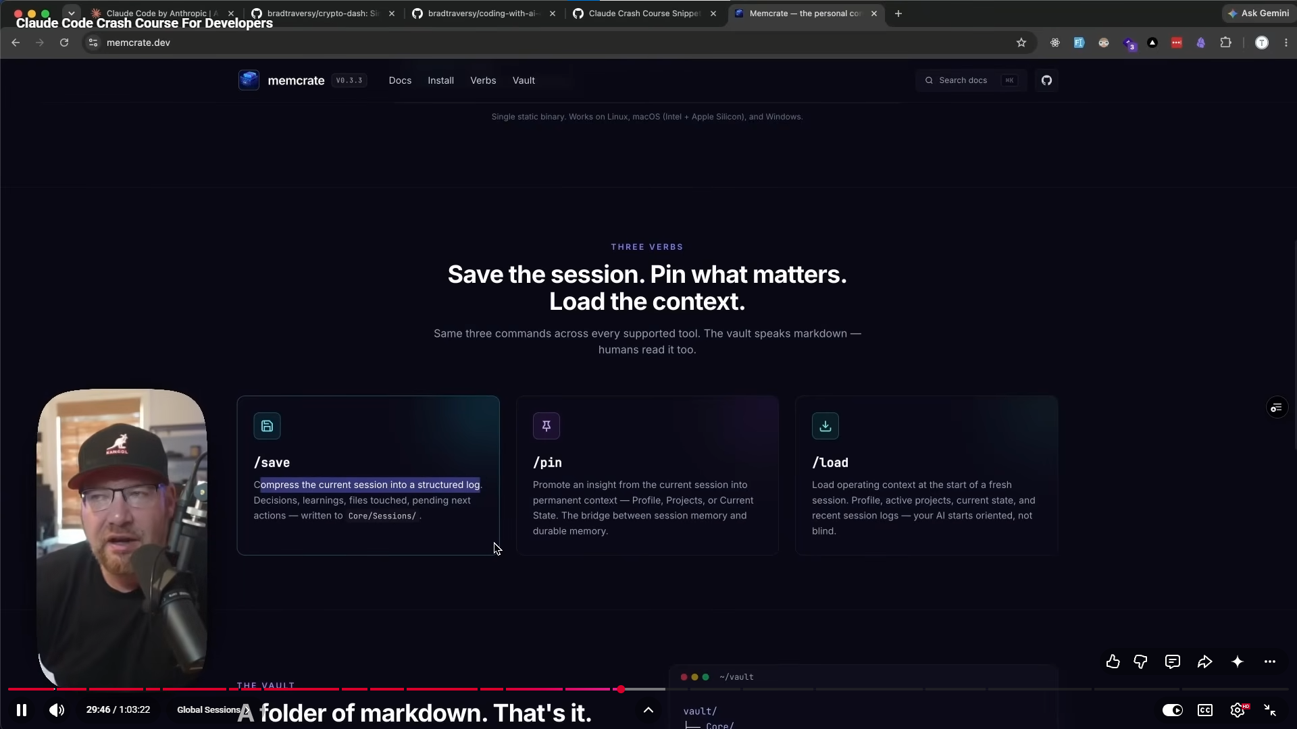

Slide 3
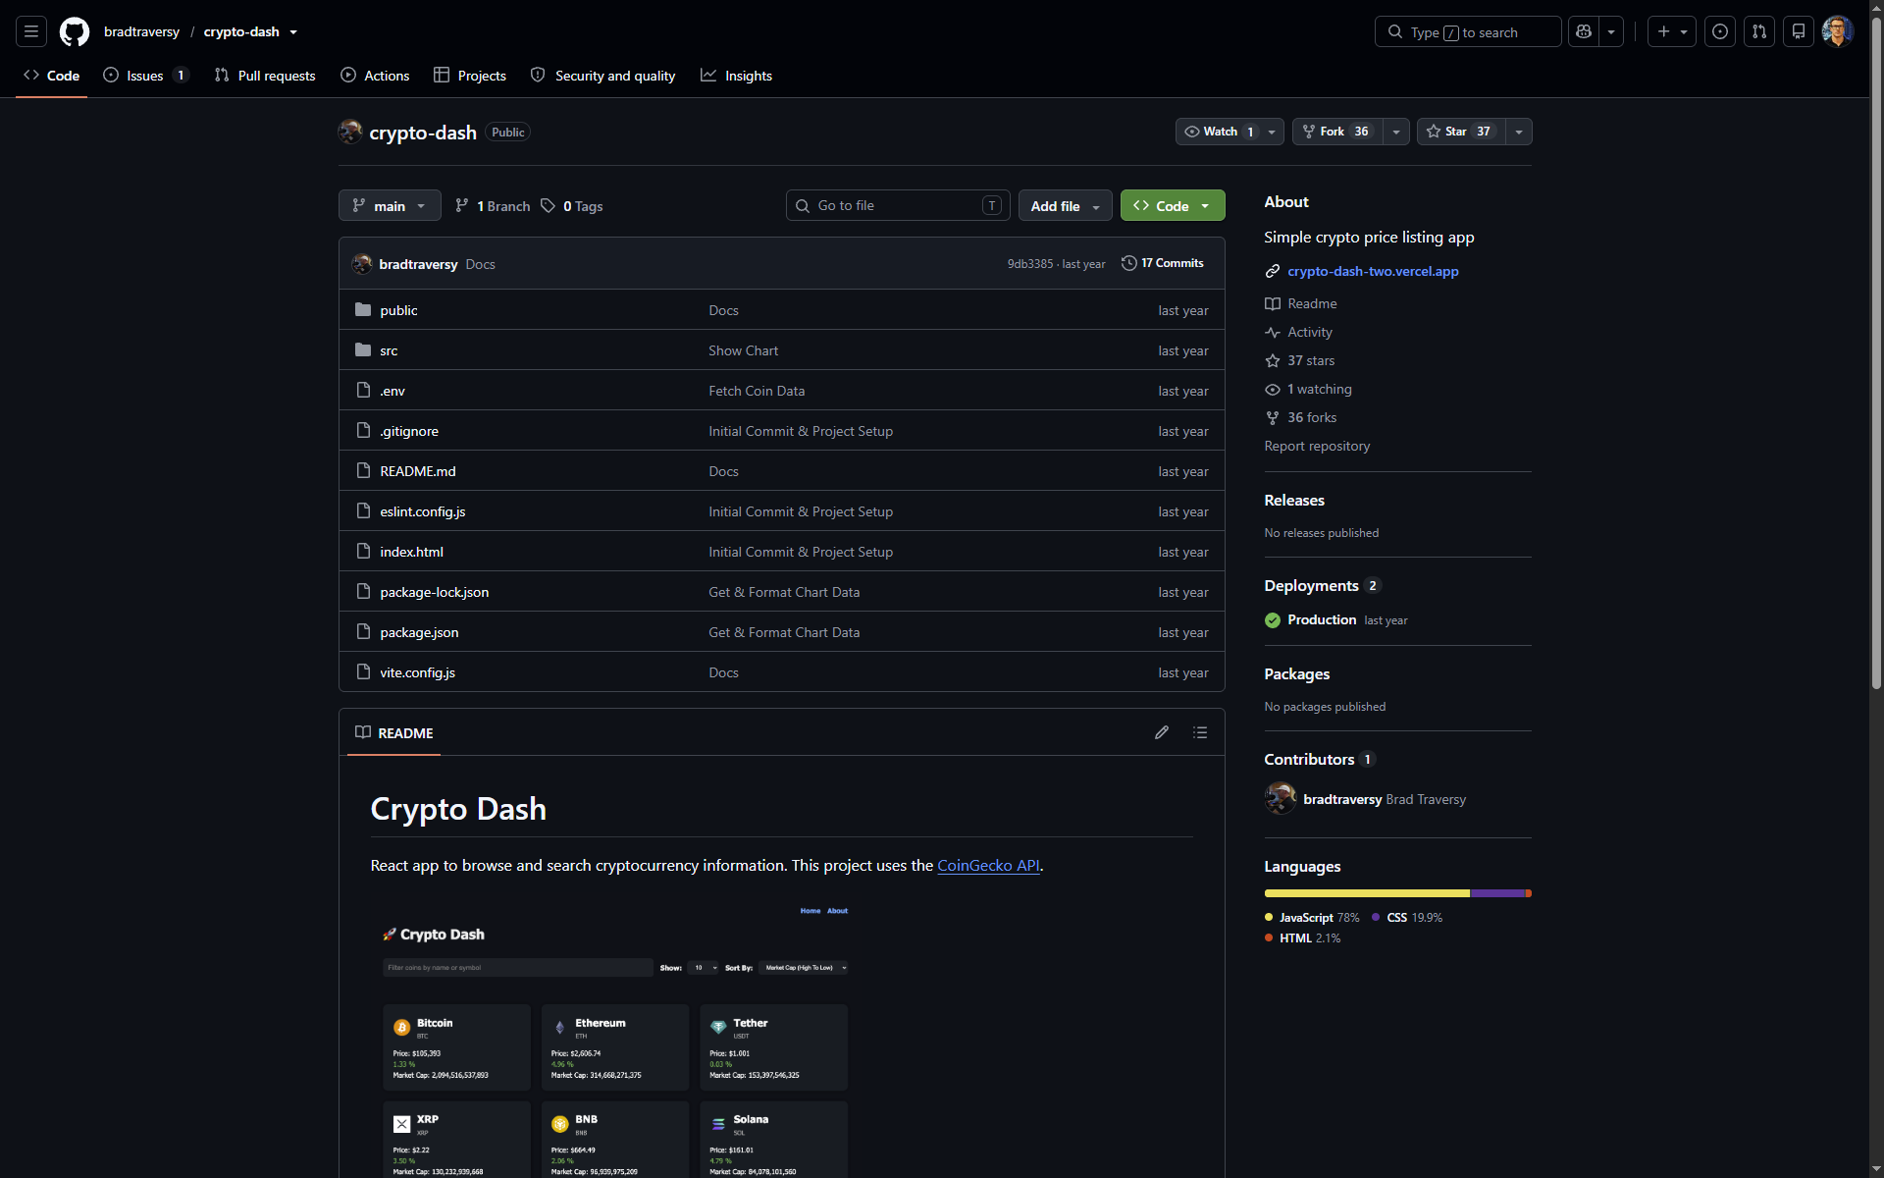
https://github.com/bradtraversy/crypto-dash
Notes:
Starter repo for part 2 of the course:
- https://github.com/bradtraversy/crypto-dash

