Slide 1
React Advanced
Untertitel
xx.xx.2024
Von: Tim Fehrmann & Leon Schwarzenberger

Slide 2
Agenda
Css-modules vs styled-components
Api-Generierung
Global State
React Hooks
Ausblick

Slide 3
Css-Modules vs Styled-Components
By Leon

Slide 4
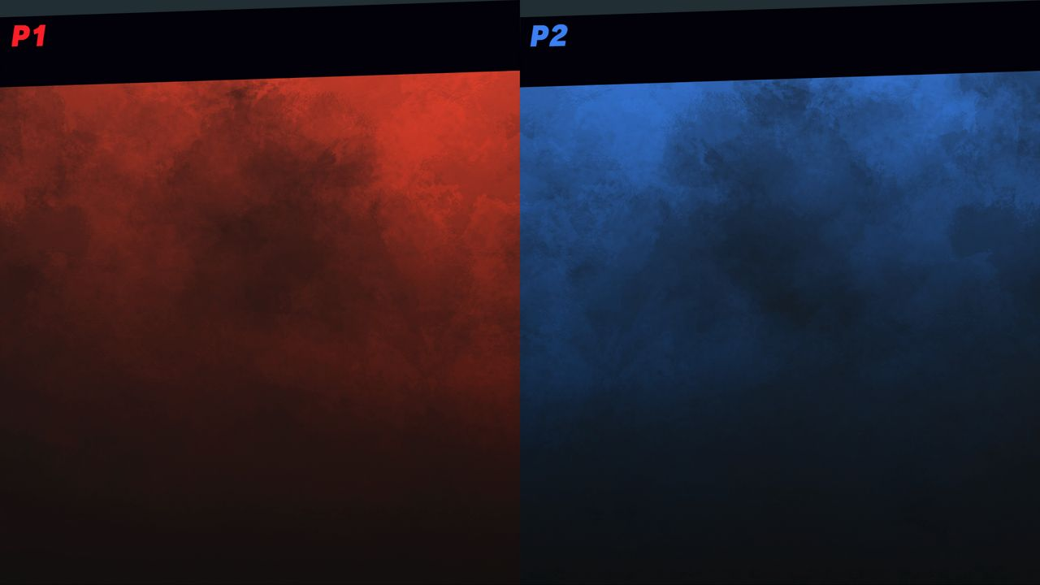

Css-Modules
Styled-Components
Todo research differences of:
Styled components, scss, sass, etc.
Vs.
ToDo
z.B. Material Ui

Slide 5
Api-Generierung
By Tim

Slide 6

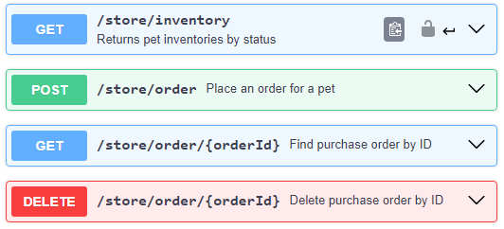



Was ist eine Api?
Application Programming Interface:
An API facilitates communication and interaction between different software applications.
https://editor.swagger.io/
Client
Api
Server

Slide 7

Rule of
„Jede Api Definition ist besser als keine Api Definition“
- Tim Fehrmann, 08.04.2024

Slide 8



Wie wird eine Api erstellt?
Speed:
By Hand
From Annotations
From Code + Annotation
openapi: 3.0.0 info: title: Pokemon API version: 1.0.0 paths: /pokemon: get: responses: '200': description: Get all Pokemon content: application/json: schema: type: array items: type: string
/** @openapi * /pokemon: * get: * summary: Get all Pokemon * responses: * 200: * content: * application/json: * schema: * type: array * items: * type: string */
[HttpGet] [SwaggerOperationSummary("Get all Pokemon")] public ActionResult<List<string>> GetPokemon() { var pokemon = pokemonService.GetAll();
return Ok(pokemon); }
openapi.yaml

Slide 9




Wie wird unsere Api generiert?
Backend
Code
Swagger
Swagger.json
Rtk-query
Swagger.json
Http-Client Api

Slide 10


Api-Generierung mit
Config (Boilerplate)
Console Command
export const emptyApi = createApi({ reducerPath: ‘pokemonApi’, baseQuery: fetchBaseQuery({
baseUrl: 'http://localhost:3000/’;
}), endpoints: () => ({}), });
"codegen": "npx @rtk-query/codegen-openapi ./config.ts
package.json
\frontend> yarn codegen
generate
terminal
Generated Api
emptyApi.ts
const injectedRtkApi = api.injectEndpoints({ endpoints: (build) => ({ getPokemon: build.query<string[], void>({ query: () => ({ url: '/pokemon' }), }), }), });
export const { useGetPokemonQuery } = injectedRtkApi;
const config: ConfigFile = { schemaFile: 'http://localhost:3000/swagger.json’; apiFile: './emptyApi.ts', apiImport: 'emptyApi', outputFile: './rawApi.ts', exportName: 'rawApi', };
config.ts
rawApi.ts

Slide 11
Global State
By Leon

Slide 12
Global State
Sektion A
1
Sektion B
1

Slide 13
React Hooks
By Tim

Slide 14
React Hooks
Sektion A
1
Sektion B
1

Slide 15
Ausblick

Slide 16
Ausblick
A
B

