Slide 1
React Advanced
Untertitel
xx.xx.2024
Tim Fehrmann & Leon Schwarzenberger

Slide 2
Loading…

Slide 3
Agenda
Projektvorstellung
Css-modules vs styled-components
Api-Generierung
Global State
React Hooks
Ausblick

Slide 4

Projektvorstellung
By Tim

Slide 5
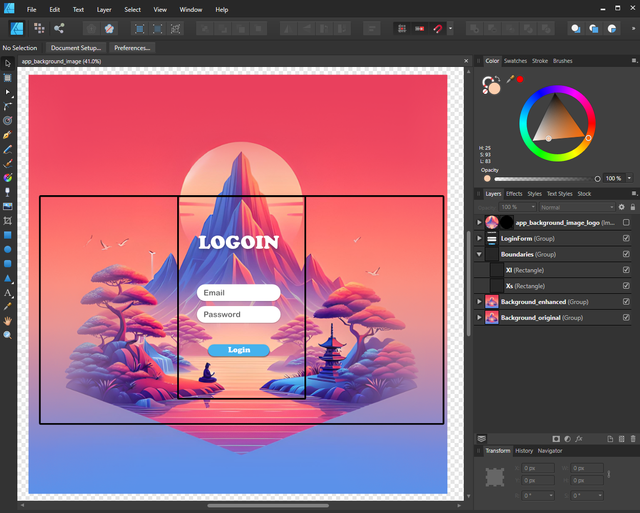


Design

Slide 6
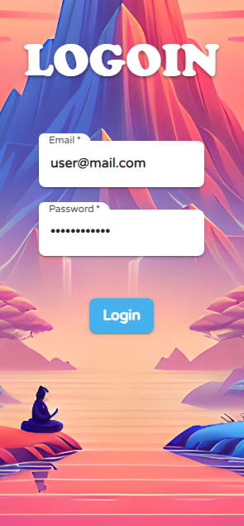
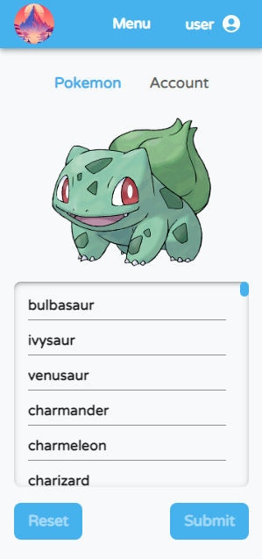
Web App
Login Page
Pokemon Page
Redirect

Slide 7
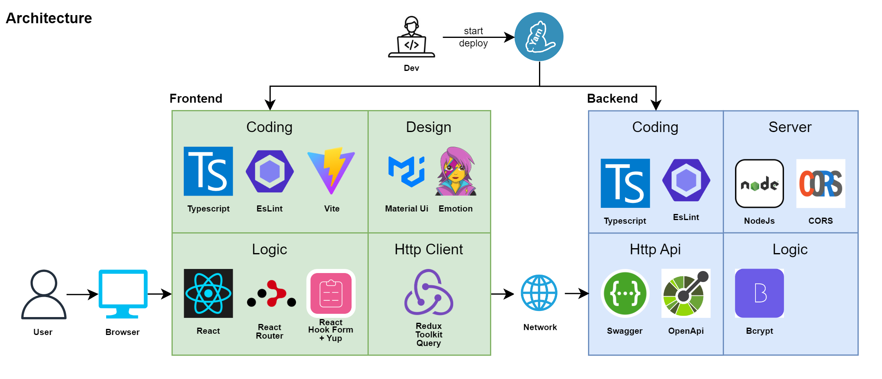
Architecture

Slide 8
Css-Modules vs Styled-Components
By Leon

Slide 9
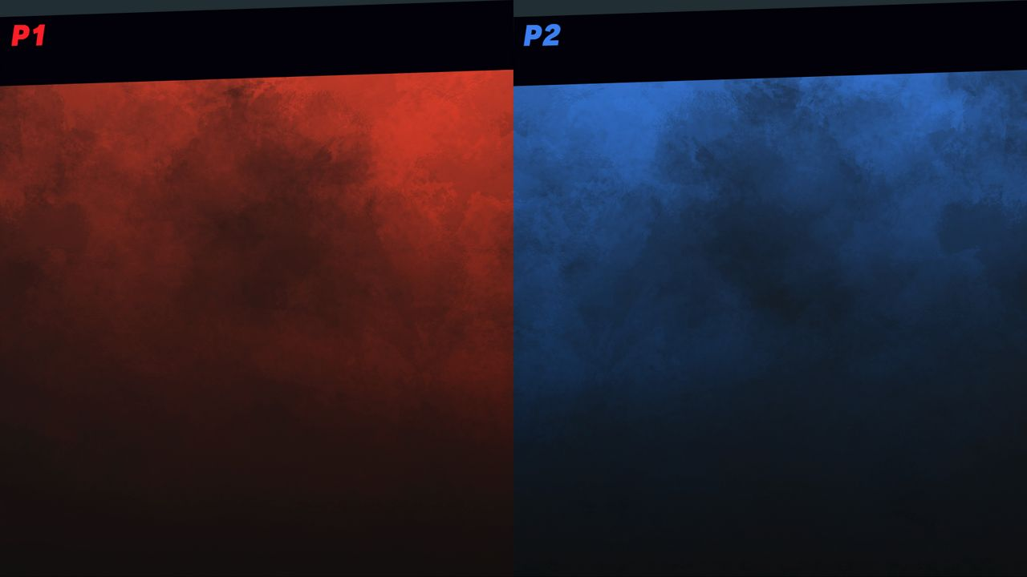

Css-Modules
Styled-Components
Todo research differences of:
Styled components, scss, sass, etc.
Vs.
ToDo
z.B. Material Ui

Slide 10
Api-Generierung
By Tim

Slide 11

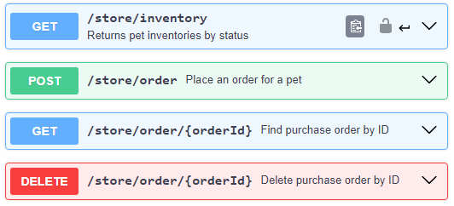



Was ist eine Api?
Application Programming Interface
Client
Api
Server
https://editor.swagger.io/

Slide 12

Rule of
„Jede Api Definition ist besser als keine Api Definition“
- Tim Fehrmann, 08.04.2024

Slide 13



Wie wird eine Api erstellt?
Speed:
von Hand
aus Annotations
aus Code & Annotations
openapi: 3.0.0 info: title: Pokemon API version: 1.0.0 paths: /pokemon: get: responses: '200': description: Get all Pokemon content: application/json: schema: type: array items: type: string
/** @openapi * /pokemon: * get: * summary: Get all Pokemon * responses: * 200: * content: * application/json: * schema: * type: array * items: * type: string */
[HttpGet] [SwaggerOperationSummary("Get all Pokemon")] public ActionResult<List<string>> GetPokemon() { var pokemon = pokemonService.GetAll();
return Ok(pokemon); }
openapi.yaml

Slide 14




Wie wird unsere Api generiert?
Backend
Code
Swagger
Swagger.json
Rtk-query
Swagger.json
Http-Client Api

Slide 15


Api-Generierung mit
Config (Boilerplate)
Console Command
export const emptyApi = createApi({ reducerPath: ‘pokemonApi’, baseQuery: fetchBaseQuery({
baseUrl: 'http://localhost:3000/’;
}), endpoints: () => ({}), });
"codegen": "npx @rtk-query/codegen-openapi ./config.ts
package.json
\frontend> yarn codegen
generate
terminal
Generated Api
emptyPokemonApi.ts
const injectedRtkApi = api.injectEndpoints({ endpoints: (build) => ({ getPokemon: build.query<string[], void>({ query: () => ({ url: '/pokemon' }), }), }), });
export const { useGetPokemonQuery } = injectedRtkApi;
const config: ConfigFile = { schemaFile: 'http://localhost:3000/swagger.json’; apiFile: './emptyApi.ts', apiImport: 'emptyApi', outputFile: './rawApi.ts', exportName: 'rawApi', };
config.ts
pokemonApi.ts

Slide 16
Aufgaben
"ToDo 1.1": "Run command below",
package.json
// ToDo 1.2 Import and use login-mutation from generated pokemonApi
LoginPage.tsx
{/* ToDo 1.3 Add ResponsiveLoadingBackdrop when login-mutation isLoading */}
LoginPage.tsx
// ToDo 1.4 Run login-mutation with credentials in body
LoginPage.tsx

Slide 17
Lösungen
techlabor_trainings_react_advanced\frontend> yarn codegen
ToDo 1.1
Click to Show Solution
// ToDo 1.2 Import and use Login Mutation from generated pokemonApi const [login, { data: loginData, isLoading: loginIsLoading}] = usePostLoginMutation();
ToDo 1.2
Click to Show Solution
{/* ToDo 1.3 Add ResponsiveLoadingBackdrop when login-mutation isLoading */} {loginIsLoading ? <ResponsiveLoadingBackdrop /> : null}
ToDo 1.3
Click to Show Solutions
ToDo 1.4
Click to Show Solution
// ToDo 1.4 Run login-mutation with credentials in body login({ body: { email, password } });

Slide 18
Global State
By Leon

Slide 19
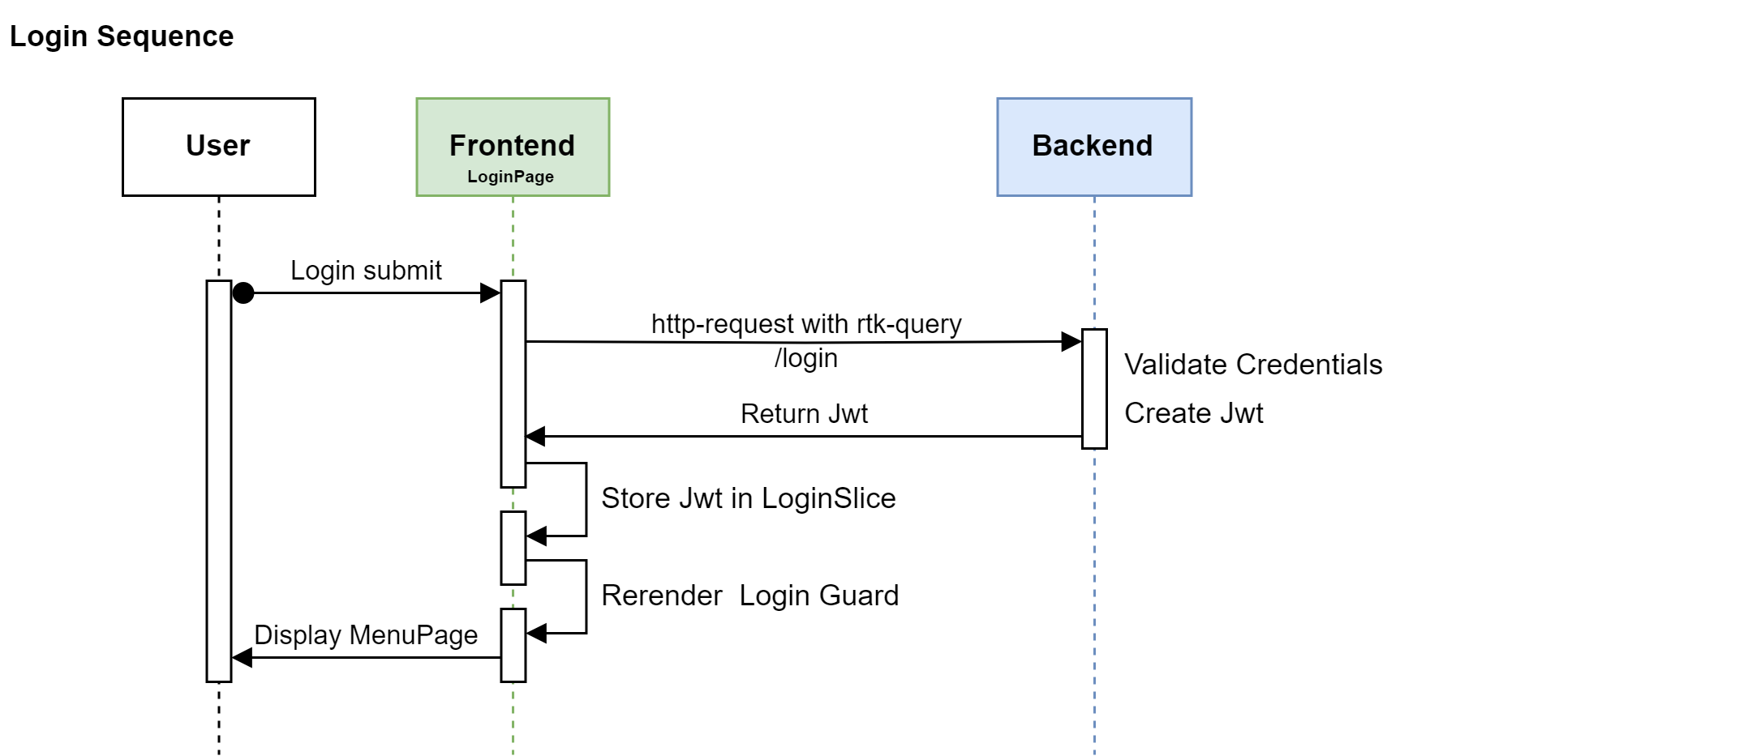
Login Request & Jwt Storage

Slide 20
Persisting State - Local Storage
ToDo 2.1: Dispatch Jwt to LoginSlice
LoginPage.tsx
ToDo 2.2: Save Jwt to LocalStorage
LoginSlice.ts
ToDo 2.3: Load Jwt from LocalStorage
LoginSlice.ts
ToDo 2.4: Use Jwt from LoginSlice to redirect to MenuPage
LoginRoute.ts

Slide 21
React Hooks
By Tim

Slide 22
React Hooks
useMemo:
kapselt eine Funktion, die einen memoisierten Wert zurückgibt
Ähnlich zu useEffect durch abhängige States gesteuert, wann der Wert neu berechnet wird
yes
Recompute & Update Cache
Render
useMemo()
Dependencies Changed
no
Use Cached
Cached Components

Slide 23
Component Caching
const trainItems = trains.map((train) => ( <ListItem key={train.id}>{train.name}</ListItem> ) ;
Render: 400 ms
Re-Render: 400 ms
Mit useMemo:
const cachedTrainItems = useMemo(() => trains.map((train) => ( <ListItem key={train.id}>{train.name}</ListItem> )), [trains]);
Render: 400 ms
Re-Render: ~ 7 ms
Dependencies
Aufgabe:
// ToDo 3.1 use useMemo to cache the pokemonItems

Slide 24
Lösungen
ToDo 3.1
Click to Show Solution
const cachedPokemonItems = useMemo(() => (
pokemons.map((pokemon) => <ListItem id="PokemonListItem" key={pokemon.id} . . . />
)), [pokemons]);

Slide 25
React Hooks
useRef:
Persistiert Werte zwischen Renderings
Ähnlich zu useState aber löst keine Renderings aus
const trainMap = useRef<Record<number, ITrain>>({});
const handleUpdatePokemon = (pokemon: IPokemon) => { trainMap.current[train.id] = train; };

Slide 26
Aufgaben useRef
// ToDo 3.2.1 use useRef to store edited pokemons in an editedPokemonsMap
// ToDo 3.2.2 update the pokemon in the editedPokemonsMap
PokemonTabContent.tsx
// ToDo 3.3.1 use useState to enable/disable the reset & submit button
// ToDo 3.3.2 update the state that tracks whether pokemons have been edited
PokemonTabContent.tsx
// ToDo 3.4.1 use useRef to store reset Callbacks from child components in a resetMap
// ToDo 3.4.2 Pass a reset-callback function to EditableTextField
PokemonTabContent.tsx

Slide 27
Lösungen useRef
// ToDo 3.2.1 use useRef to store edited pokemons in an editedPokemonsMap
const editedPokemonsMap = useRef<Record<number, IPokemon>>({});
ToDo 3.2.1
Click to Show Solution
ToDo 3.2.2
Click to Show Solution
// ToDo 3.2.2 update the pokemon in the editedPokemonsMap
editedPokemonsMap.current[pokemon.id] = pokemon;
// ToDo 3.3.1 use useState to enable/disable the reset & submit button
const [hasEditedPokemons, setHasEditedPokemons] = useState(false);
ToDo 3.3.1
Click to Show Solution
ToDo 3.3.2
Click to Show Solution
// ToDo 3.3.2 update the state that tracks whether pokemons have been edited
setHasEditedPokemons(false);
ToDo 3.4.1
Click to Show Solution
// ToDo 3.4.1 use useRef to store reset Callbacks from child components in a resetMap
const resetMap = useRef<Record<number, () => void>>({});
// ToDo 3.4.2 Pass a reset-callback function to EditableTextField
registerReset={(reset) => { resetMap.current[pokemon.id] = reset }}
ToDo 3.4.2
Click to Show Solution

Slide 28
Invalidation Tags
Query Caches können durch die Ausführung von Mutations invalidiert werden.
Hierzu werden Query & Mutation mit dem Gleichen tag ‘Pokemon’ versehen.
const enhancedPokemonApi = pokemonApi.enhanceEndpoints({ addTagTypes: ['Pokemon'], endpoints: { getPokemon: { providesTags: ['Pokemon'], }, postPokemon: { invalidatesTags: ['Pokemon'], }, }, });
const { data: getPokemonData} = useGetPokemonQuery();
invalidate
const [postPokemonData] = usePostPokemonMutation();
const handleSubmit = () => { postPokemonData({ body: updatedPokemonData }); };
invalidate
PokemonTabContent.tsx
enhancedPokemonApi.ts

Slide 29
Pitfall –Nested Object in useState
Deep Nesting wenn möglich vermeiden
Aber oftmals notwendig z.B. formData
// No Nesting
const [color, setColor] = useState('red'); setColor('blue');
// Shallow Nesting
const [colorObject, setColorObject] = useState({ slot: 1, color: 'red' }); setColorObject({ ...colorObject, color: 'blue' });
Use Object spreading to recreate object

Slide 30
Pitfall –Nested Object in useState
State-Objekte dürfen nicht direkt editiert werden
Erst kopieren, dann editieren
Color
Object
// Deep Nesting const [colorObjects, setColorObjects] =
useState([{ slot: 1, color: 'red' }, { slot: 2, color: 'green' }]);
const newColorObjects = [...colorObjects]; newColorObjects[0] = { ...newColorObjects[0], color: 'blue’ }
setColorObjects(newColorObjects);
[0]
[1]
slot:
1
color: red
slot:
1
color: blue
Use Object spreading to recreate objects
Wird ‚red‘ auf ‚blue‘ abgeändert so müssen alle Objekte darüber kopiert werden.

Slide 31
Pitfall – Object in Dependencies
Nur Änderungen am Objekt lösen useEffect aus
Unterobjekte haben keinen Einfluss
// Not Triggered pokemons.push({ id: 1, name: 'Bulbasaur' }) useEffect(handleSomething, [pokemons]);
// Not Triggered pokemons[0].name = 'Ivysaur' useEffect(handleSomething, [pokemons.length]);
// Triggered pokemons.push({ id: 1, name: 'Bulbasaur' }) useEffect(handleSomething, [pokemons.length]);
// Triggered pokemons = [...pokemons]; useEffect(handleSomething, [pokemons]);

Slide 32
Ausblick
Virtualized List
React 19

Slide 33
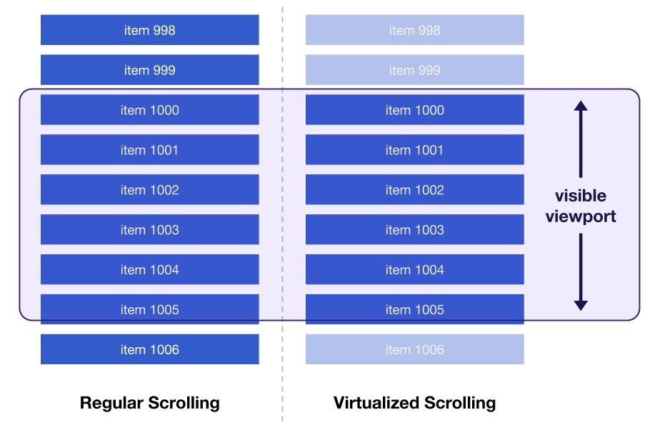
Virtualized List
Nur rendern was wirklich sichtbar ist
Performanter und flexibler als useMemo

Slide 34
React 19
Weniger Boilerplate
Schneller durch React-Compiler
useMemo & useCallback entfallen
Aber Wissen bleibt relevant

