Slide 1
React Advanced
Untertitel
xx.xx.2024
Tim Fehrmann & Leon Schwarzenberger

Slide 2
Loading…

Slide 3
Agenda
Projektvorstellung
Css-modules vs styled-components
Api-Generierung
Global State
React Hooks
Ausblick

Slide 4

Projektvorstellung
By Tim

Slide 5
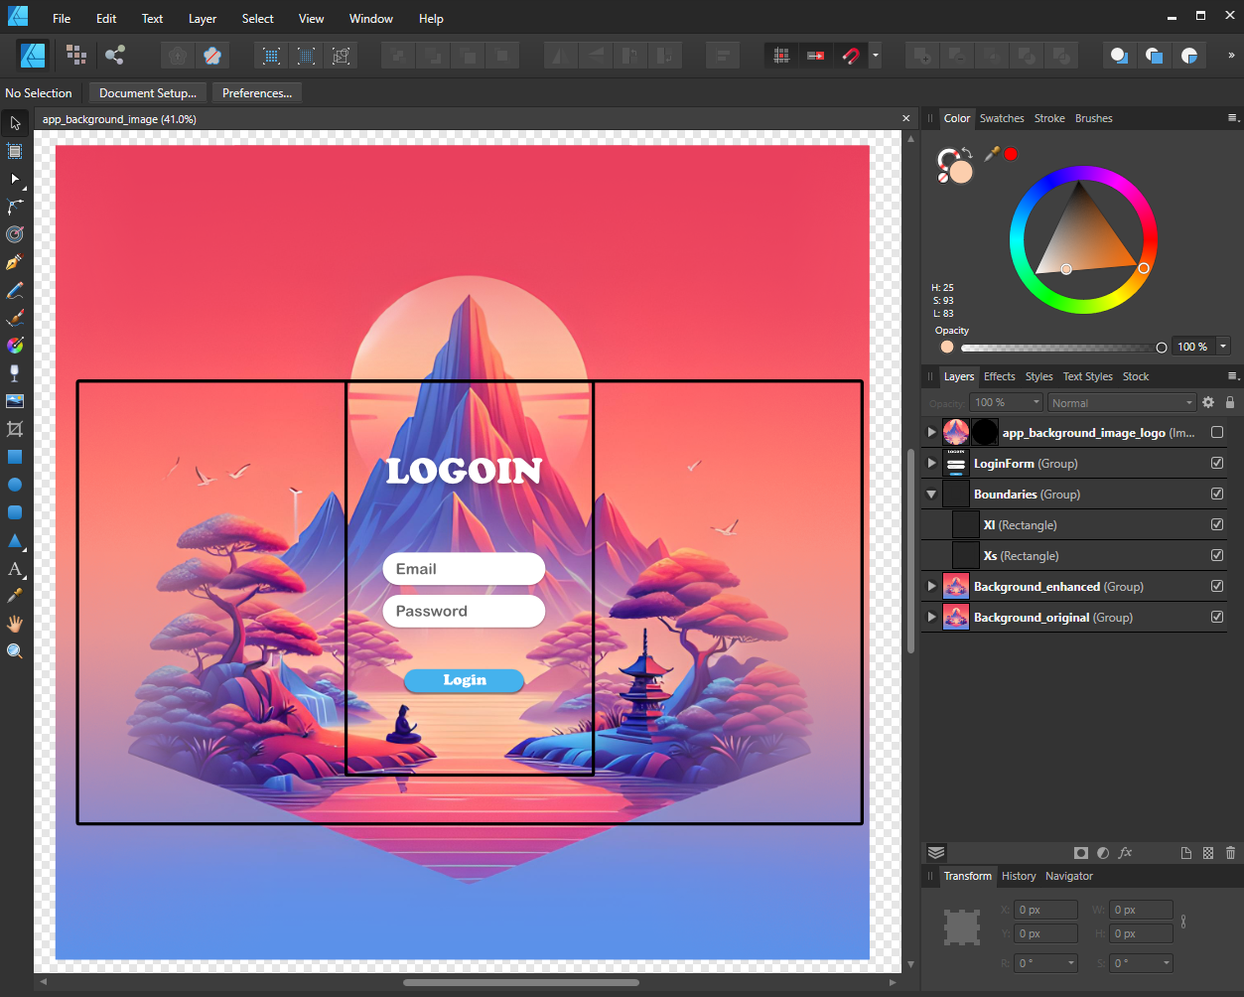


Design

Slide 6
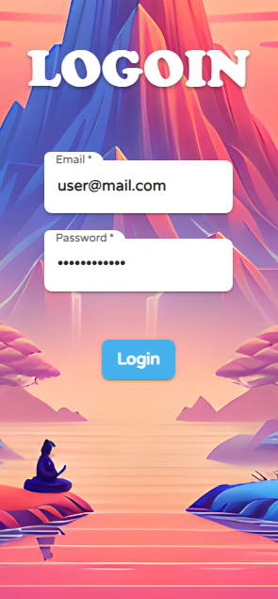
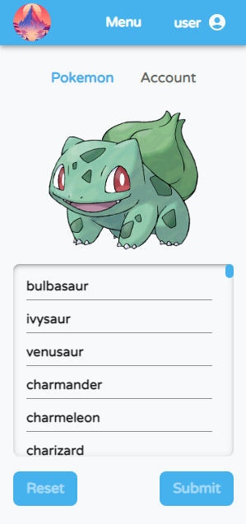
Web App
Login Page
Pokemon Page
Redirect

Slide 7
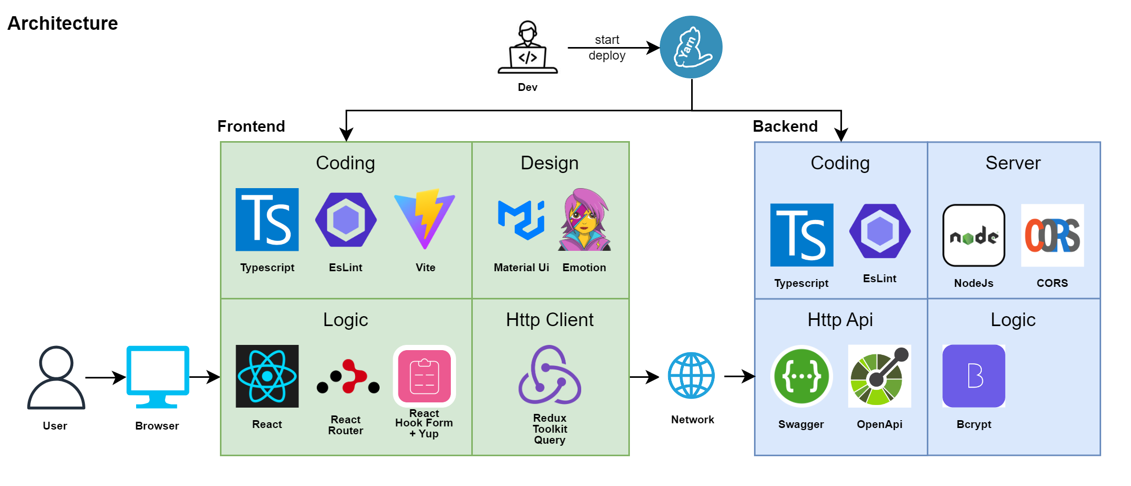
Architecture

Slide 8
Css-Modules vs Styled-Components
By Leon

Slide 9
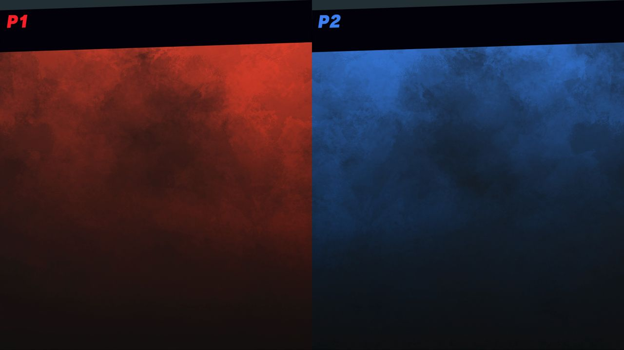

Css-Modules
Styled-Components
Todo research differences of:
Styled components, scss, sass, etc.
Vs.
ToDo
z.B. Material Ui

Slide 10
Api-Generierung
By Tim

Slide 11

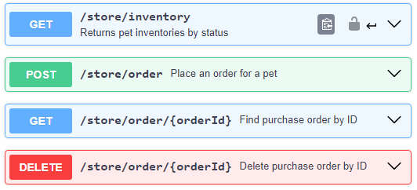



Was ist eine Api?
Application Programming Interface
Client
Api
Server
https://editor.swagger.io/

Slide 12

Rule of
„Jede Api Definition ist besser als keine Api Definition“
- Tim Fehrmann, 08.04.2024

Slide 13



Wie wird eine Api erstellt?
Speed:
von Hand
aus Annotations
aus Code & Annotations
openapi: 3.0.0 info: title: Pokemon API version: 1.0.0 paths: /pokemon: get: responses: '200': description: Get all Pokemon content: application/json: schema: type: array items: type: string
/** @openapi * /pokemon: * get: * summary: Get all Pokemon * responses: * 200: * content: * application/json: * schema: * type: array * items: * type: string */
[HttpGet] [SwaggerOperationSummary("Get all Pokemon")] public ActionResult<List<string>> GetPokemon() { var pokemon = pokemonService.GetAll();
return Ok(pokemon); }
openapi.yaml

Slide 14




Wie wird unsere Api generiert?
Backend
Code
Swagger
Swagger.json
Rtk-query
Swagger.json
Http-Client Api

Slide 15


Api-Generierung mit
Config (Boilerplate)
Console Command
export const emptyApi = createApi({ reducerPath: ‘pokemonApi’, baseQuery: fetchBaseQuery({
baseUrl: 'http://localhost:3000/’;
}), endpoints: () => ({}), });
"codegen": "npx @rtk-query/codegen-openapi ./config.ts
package.json
\frontend> yarn codegen
generate
terminal
Generated Api
emptyPokemonApi.ts
const injectedRtkApi = api.injectEndpoints({ endpoints: (build) => ({ getPokemon: build.query<string[], void>({ query: () => ({ url: '/pokemon' }), }), }), });
export const { useGetPokemonQuery } = injectedRtkApi;
const config: ConfigFile = { schemaFile: 'http://localhost:3000/swagger.json’; apiFile: './emptyApi.ts', apiImport: 'emptyApi', outputFile: './rawApi.ts', exportName: 'rawApi', };
config.ts
pokemonApi.ts

Slide 16
Api-Generierung mit
ToDo 1.1: Generate Client Api
package.json
ToDo 1.2: Import and use Login Mutation
LoginPage

Slide 17
Global State
By Leon

Slide 18
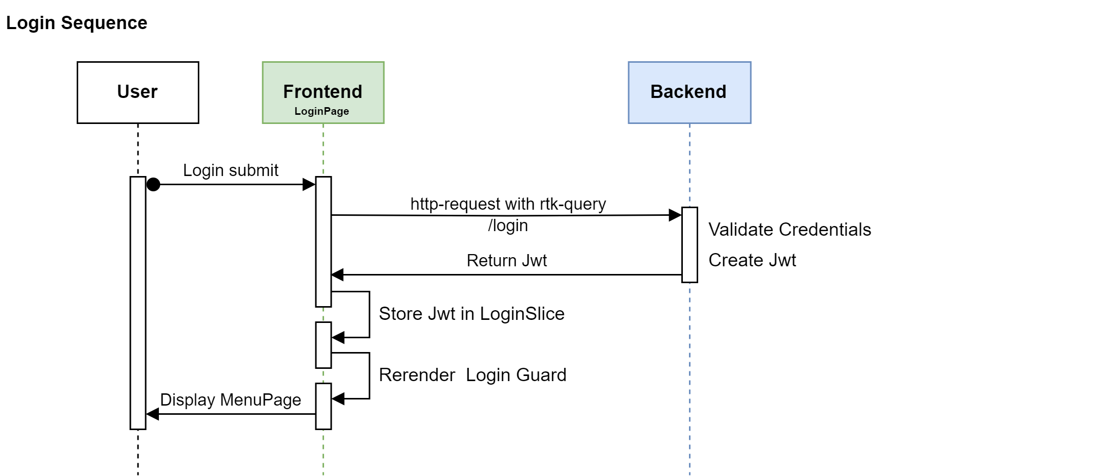
Login Request & Jwt Storage

Slide 19
Persisting State - Local Storage
ToDo 2.1: Dispatch Jwt to LoginSlice
LoginPage.tsx
ToDo 2.2: Save Jwt to LocalStorage
LoginSlice.ts
ToDo 2.3: Load Jwt from LocalStorage
LoginSlice.ts
ToDo 2.4: Use Jwt from LoginSlice to redirect to MenuPage
LoginRoute.ts

Slide 20
Persisting State - Local Storage
ToDo 2.1: Dispatch Jwt to LoginSlice
LoginPage.tsx
ToDo 2.2: Save Jwt to LocalStorage
LoginSlice.ts
ToDo 2.3: Load Jwt from LocalStorage
LoginSlice.ts
ToDo 2.4: Use Jwt from LoginSlice to redirect to MenuPage
LoginRoute.ts

Slide 21
React Hooks
By Tim

Slide 22
React Hooks
useMemo:
kapselt eine Funktion, die einen memoisierten Wert zurückgibt
Ähnlich zu useEffect durch abhängige States gesteuert, wann der Wert neu berechnet wird
yes
Recompute & Update Cache
Render
useMemo()
Dependencies Changed
no
Use Cached
Cached Components

Slide 23
Rendering 1000 Pokemon
const pokemonItems = pokemons.map((pokemon) => ( <ListItem key={pokemon.id}>{ /* Any Component */}</ListItem> ) ;
1. Render: 1473 ms
2. Render: 1473 ms
Mit useMemo:
const cachedPokemonItems = useMemo(() => pokemons.map((pokemon) => ( <ListItem key={pokemon.id}>{ /* Any Component */}</ListItem> )), [pokemons]);
1. Render: 1473 ms
2. Render: ~ 1 ms
Dependencies

Slide 24
useMemo
ToDo 3.1: use useMemo on pokemons
PokemonTabContent.tsx

Slide 25
React Hooks
useRef:
Persistiert Werte zwischen Renderings
Ähnlich zu useState aber löst keine Renderings aus
const editedPokemonsMap = useRef<Record<number, IPokemon>>({});
const handleUpdatePokemon = (pokemon: IPokemon) => { editedPokemonsMap.current[pokemon.id] = pokemon; };

Slide 26
React Hooks
ToDo 3.2: use useRef to store edited pokemons
PokemonTabContent.tsx
ToDo 3.3: use useState to enable/disable buttons (reset/submit)
PokemonTabContent.tsx
ToDo 3.4: use useRef store reset Callbacks of EditableTextField
PokemonTabContent.tsx

Slide 27
Invalidation Tags
Query Caches können durch die Ausführung von Mutations invalidiert werden.
Hierzu werden Query & Mutation mit dem Gleichen tag ‘Pokemon’ versehen.
const enhancedPokemonApi = pokemonApi.enhanceEndpoints({ addTagTypes: ['Pokemon'], endpoints: { getPokemon: { providesTags: ['Pokemon'], }, postPokemon: { invalidatesTags: ['Pokemon'], }, }, });
const { data: getPokemonData} = useGetPokemonQuery();
invalidate
const [postPokemonData] = usePostPokemonMutation();
const handleSubmit = () => { postPokemonData({ body: updatedPokemonData }); };
invalidate
PokemonTabContent.tsx
enhancedPokemonApi.ts

Slide 28
Pitfalls
Nested Objects

Slide 29
Ausblick
Virtualized List
React 19
Signals

