Slide 1


From Discovery to Person-Centered Outcomes and Plans Putting It All Together for Lives of Growth and Change
Marlene McCollum and Rachael Newkirk
In Collaboration with Sheila Keys and Bill Allen

Slide 2

Purpose of Our Time Together
Learn how to move Discovery Information into a plan with person-centered outcomes
Apply the Discovery skills through every day practice
Work in teams to assess plans using person-centered criteria
Integrate community-based exploration and individual interest into person-centered outcomes and support plans

Slide 3

Meeting Agenda and Working Agreements
Agenda
Welcome and large group opening round
Team formation and team opening round
Simulation One-Important to/for sort
Simulation Two-Developing Person-Centered outcomes
Simulation Three-Developing person-centered support plans and assessing risk
Closing and Questions
Working Agreements
Respectful listening
Come back from breaks and lunch on time
Encouragement and engagement all around
Time at the end for questions
Other agreements?

Slide 4
Before we start, here is what we want you to know:
All are welcome
Please share only what you feel comfortable sharing
Meet your needs at any time
We will break for ________ (insert lunch/break details)
We will make time for your questions at the end

Slide 5
A little bit about this training and trainers.
Choice Powers Change Consulting is a consulting business owned by Marlene McCollum and Rachael Newkirk. Their business opened in 2017 to support all people to develop deep and fulfilling connections with their community and achieve individual empowerment through strength based goals, supports and choices.
This training builds on concepts from The Learning Community’s 2-day Person Centered Thinking Skills Training as well as the Pathfinders Person Centered Planning process developed Dr. Beth Mount and John O’Brien.
Insert your own information here.

Slide 6

The Final Rule
Centers for Medicare & Medicaid Services (CMS) issued final regulations that revise and strengthen existing Medicaid managed care rules.
The rule states that individuals served must receive services in the most integrated settings of their choosing and also have full access to the benefits of community living to the same degree as others who do not receive Home and Community Based Services (HCBS)
The intent of the rule is to ensure that States receiving Federal Medicaid funds meet the needs of individuals in the community rather than institutions or institution-like settings
Notes:
The final rule is an expansion of CMS’ regulations for HCBS programs. The purpose of the rule is to further deinstitutionalize care.

Slide 7
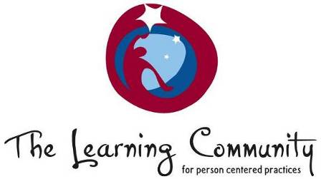
Moving from Service Life to Community Life
Service
Life
A Good Paid
Life
Community Life
‘Important to’ recognized
Focus on connecting,
building relationships
and natural supports
‘Important to’ present
‘To’ and ‘for’ present
Closest people are
paid or family
Few real connections
‘Important for’ addressed
No organized effort to address ‘important to’
‘To’ and ‘for’ present
Active circle of support
Included in community life
Wkbk pg 6
Notes:
PURPOSE:
Part 1 -To give people a way of thinking about what the training will help them accomplish – to move toward community life (Note that if you are doing training with groups that support older people, people with mental health or substance abuse issues – there is another arrow for you to use.)
SCRIPT:
Use the script below to talk people thru the descriptions of Service Life Good Paid Life and Community Life.
The required minimum standard is “service life”: issues of health and safety are adequately addressed. The presence of what is “important to” depends on who supports you, on how much they care about you – it is random and unpredictable.
How many of you have done direct support? (raise hands) How many of you have worked with someone you deeply cared about? You knew what made that person really happy, and you made those things happen. But eventually you moved on and were no longer in that person’s life.
How many of you have worked with someone who rubbed your fur the wrong way? You weren’t happy and they weren’t happy. You did what it took to keep that person healthy and safe.
But truly achieving the balance of happy and safe requires a relationship.
A good but Paid Life is not a bad place to be. Most (maybe 80%) of what is important to you is present, you are healthy and safe. But if we look at who is close to you; they are either family, other people who use services, or people who are paid. You go to places in the community where you are welcomed, you have some community presence. But real community connections are lacking. What you have is fragile in that you are dependent on the ongoing commitment of the organization that supports you.
Community Life has been our goal for the past 20 years. Community Life is defined by relationships. When you are here you may still have people who are paid in key roles, but those who watch out for you and plan with you are mostly unpaid. You are not just present but participating. Your gifts are recognized and there are opportunities for you to make a contribution.
Have you seen the “mother duck tour” of Wal Mart? The van pulls up and a group follows the staff up and down the aisles. People don’t approach groups of people. You’ve probably seen the groups of people who show up at the McDonalds and sit in the corner while the staff goes up to the counter to order for everyone. This is presence but not participation, this isn’t community life.
If we think about where people are on this continuum our goal is to help them move toward community life. We know how to do it one person at a time, but not how to do it for large numbers of people. This training will help. But we also need to look at the right hand side of the arrow – we know how to help everyone have a good paid life. A Good Paid Life should be the new place we start from. This training will give you some of the key components to accomplish this.
Where are the people you support? If you work with a few people make an X for each. IF you work with a lot of people think about it as a distribution curve and make an X where the middle would be.
TIPS:
This can take 5 minutes as a demonstration or 20+ minutes with discussion. With a small group you can draw the arrow on the wall and then give them dots or stickers or use markers to indicate where the people that they support are. Take a digital picture and this will give the group a baseline of where they are.
With a larger group – have participants discuss at their tables – “where are the people you support on this continuum?”
TIME: 5 Minutes
NOTES:

Slide 8
This is :
Story here

Slide 9
Important To Important For
What is important to a person includes those things in life which help us to be satisfied, content, comforted, fulfilled, and happy.
People to be with/relationships
Status and control
Things to do and places to go
Rituals or routines
Rhythm and pace of life
Things to have
Issues of health:
Prevention of illness
Treatment of illness / medical conditions
Promotion of wellness (e.g.: diet, exercise)
Issues of safety:
Environment
Well being ---- physical and emotional
Free from fear
Be valued
Be a contributing member of their community
Important To/Important For copyright TLC-PCP 2012 www.learningcommunity.us

Slide 10

Balancing Important To and Important For
Outcomes start with a well developed understanding of what is important to and for a person.
Before writing an outcome statement, ask yourself…
What is Important to this person?
What is Important for this person?
Work with your team to talk and think about the following:
1. What needs to change/what needs to stay the same?
2. How does this relate to what is important to/and what is important for?

Slide 11
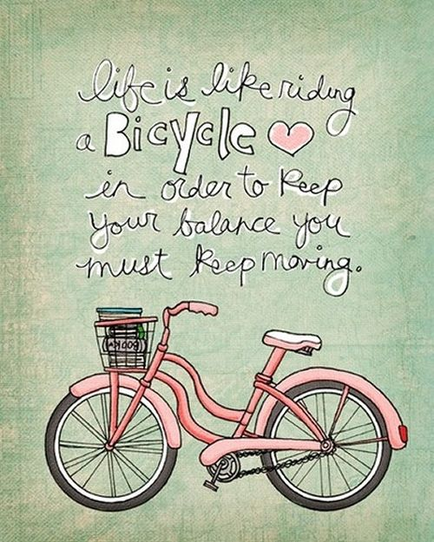
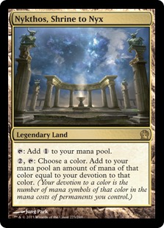

What did we come up with?
Insert illustrations to highlight the story person’s Important to on this page

Slide 12
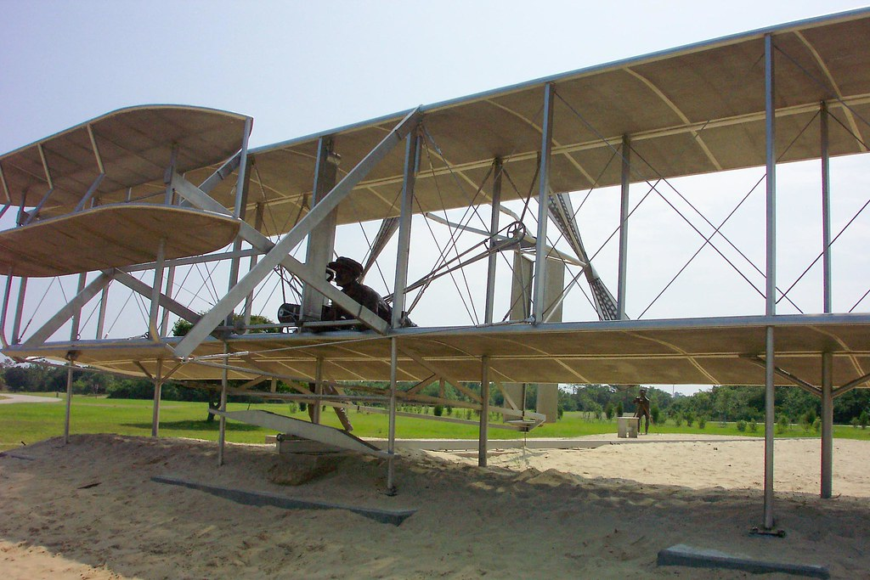

Keep in mind, if you start with Important For
Assume capability. Document capability.
…you’re never going to get to Important To

Slide 13
Pay Attention to Strengths and Preferences Identify Potential and Existing Connections
Strategies for connecting a person with their community:
Where do they already feel welcomed?
Is there meaning and participation for them there or elsewhere?
Are there people with shared interests who might act as connectors?
How can we supporting family/friends/staff to be connectors?
What can we do to foster greater independence right now?

Slide 14
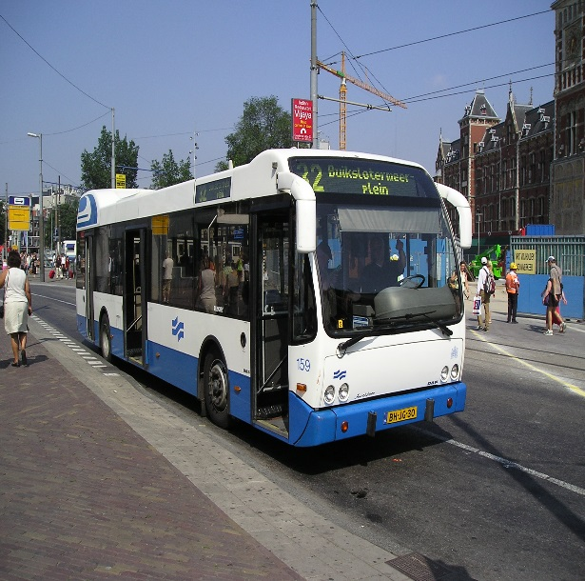
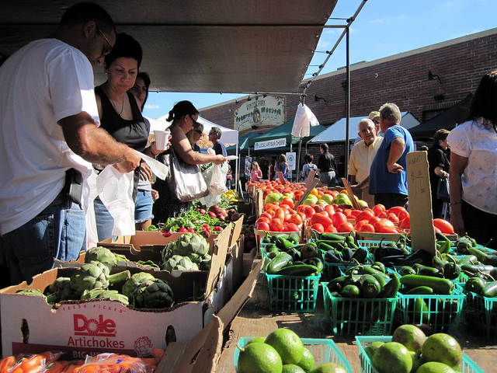
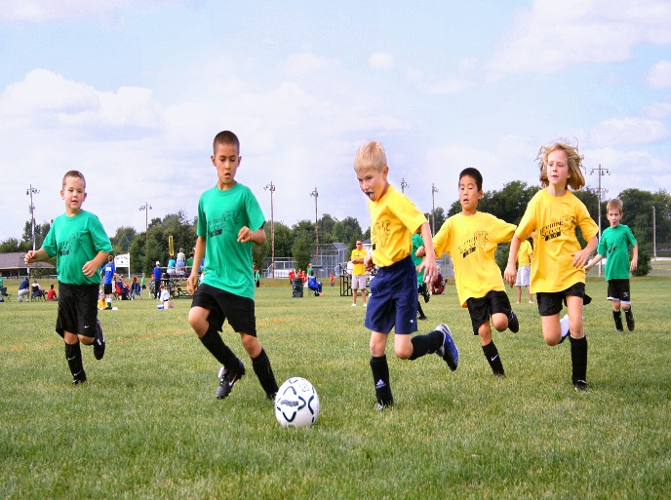
Understanding a person’s Important To helps them to build stronger community connections, and community engagement.

Slide 15

Where can you find community resources?
Ask your Service Coordinator and/or Independent Facilitator
Ask other people who help you like your IHSS worker, counselor, music teacher or boss
Visit your town’s recreation district
Ask employees at businesses you frequent
Ask the Student Association at your local university/community college
Watch the news, listen to the radio
Go to local fairs and community events and visit the tables and booths
Be willing to try new things!
Talk to the people who know you--- your family, friends, church pastor, teachers, …
Go on-line
Read local weekly and daily newspapers
Visit your local library and bookstores
Call 211

Slide 16
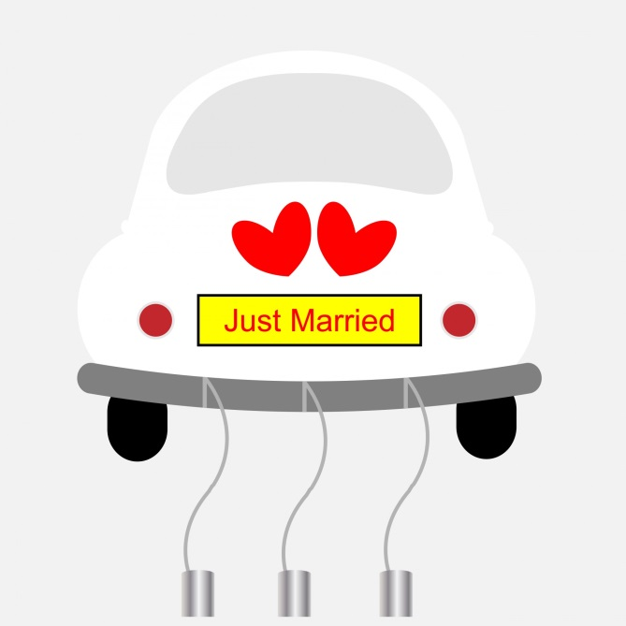
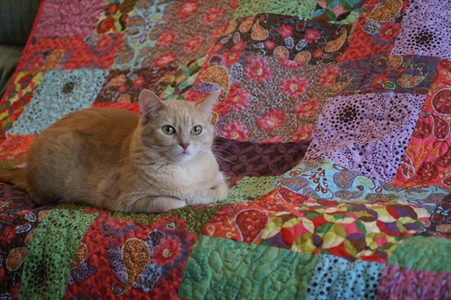

What did we come up with?
Insert illustrations to highlight some of the obvious ideas for things to do on this page

Slide 17
Defining Outcomes
An outcome statement identifies how a person’s life will be different when the plan is successful by identifying:
The ultimate results or impact of an action
Changes a person or their team/family would like to achieve
What a person aims to do or hopes to accomplish by implementing different practices.
Tim continues with archery lessons and will join the Silverado Archery Club.
Justin registers for welding classes at Napa Valley College so he receives a certificate to work in that field.
Liz has “walking around” money so she can easily buy things at Game Stop and get her Pepsi.

Slide 18
Being person-centered means helping people retain control over their own life so they have the life they choose and the support to be safe.
This is NOT person-centered:
Defining by disability
Thinking people can’t learn or change
Doing things FOR people instead of WITH them
Using substitutes to make choices
Planning for safety needs only
Planning for fun things only
This IS person-centered:
Seeing a person by looking at their gifts, capacities and interests
Trusting that all people change and learn when given the opportunity
Supporting people so they can try new things and choose for themselves
Putting a person at the center of their own planning process so that their health and safety needs are balanced with their need for fun and independence

Slide 19
Language: Let Respectful Interest Be Your Guide
How does the person identify themselves with their words? A few examples to consider:
Gender-what pronouns do they prefer?
Age- “75 years young” or “family matriarch”, “in his 30s” or “Millennial”
Cultural/Nationality- ‘Cuban” or “Hispanic”, “East coaster” or “Southerner”, “As” or “Giants”
Sexual Orientation- Is this a big or a small part of how they self-identify? If yes, what words do they use to do so?
Ethnicity/Race: “Irish” or “Irish Catholic”, “African-American” or “Black”, “Native American” or “Maidu”
Disability- “Autistic” or “ASD”, “dyslexic” or “learning disability”
Religion- Is this a big or small part of how they self-identify? If yes, what words do they use to do so?

Slide 20
Language: When it changes, you will too…
Take care to avoid:
“The Nons” Non-verbal (say instead how the person communicates) Non-ambulatory (say instead how the person moves around) Non-compliant (she won’t go out if it’s raining)
Clinical language when the everyday will do “woman” vs. “female” “when she’s on her period” vs. “during her menstrual cycle”
Talking about people in a way you don’t talk about yourself (toileting/using the bathroom, outing/going bowling, caregiver/his best friend, feeding/eating, aggressing/yelling)
Skipping the uncomfortable stuff (be honest, if you need to say “290 Registrant” or “in drug rehab.”) have a discussion about what needs to be written down and why. Balance respect with honesty.
Age biased phrasing, “flakey teen,” “senior moment”, “age-equivalent of”
Adding unnecessary downgrades “able to attend to all her own personal care” vs. “she has a vibrant style full of color and polka dots-she spends a lot of time and attention on her hair and make-up.”

Slide 21
Writing Person Centered Outcomes …that are clear, results-oriented and action-oriented…
A person centered outcome is specific, it identifies what you want to achieve in the future and who will be impacted.
Use present or near-future tense. Only use first-person when you are using a direct quote.
Link what is Important to with what is Important for.
Jada takes a Cooking class with Julie so she meets new people and learns how to make meals that support weight loss and taste good.
Maria is a member of Sing Napa Valley and performs on stage with her choir buddies.
Lelani will be with someone that she trusts at all times so that she can continue living in her own home with her dogs and fruit trees.

Slide 22
Writing Person Centered Outcomes …to get person-centered results…
Lisa’s long time goal, “I am going to be married by the time I’m 50,” is happening this year, she and Letty are saving for a huge wedding in July 2021.
Maria sings with Sing Napa Valley and performs on stage with her choir buddies.
Lelani will be with someone that she trusts at all times so that she can continue living in her own home with her dogs and fruit trees.
Use present or near-future tense. Only use first-person when you are using a direct quote, make sure the person is in support of the quote, “can I write that?”
Begin with the aim of the outcome.
Use the person’s name followed by an action verb.
If it is helpful complete the statement with how it will make a difference, using “so that/in order to.”
Link what is Important to with what is Important for.

Slide 23
The Building Blocks of a Person-centered Outcome
Be specific, action/results oriented
Use the person’s name, followed by an action
Link what is important to a person with what is important for a person
Identify how a person’s life will be different when the plan is successful
Work with your team to develop two person-centered outcomes. Consider:
1. An outcome to address living situation.
2. An outcome to address hopes and dreams
3. An outcome addressing employment or recreation.

Slide 24
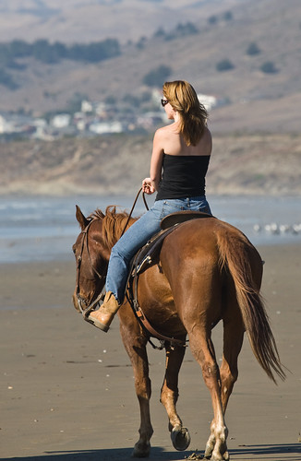
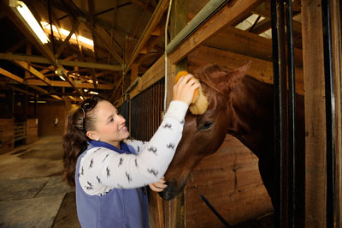
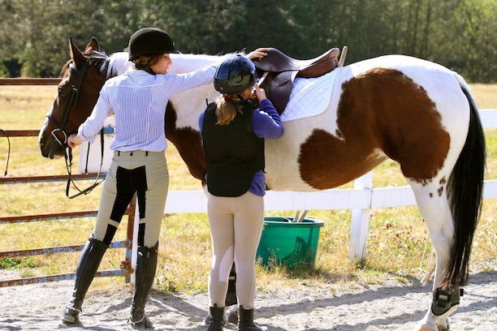
Writing Plans to Support Person-Centered Outcomes We achieve our hopes and dreams: 1. By building on strengths and skills 2. By identifying natural supports 3. By addressing barriers to success with the necessary supports
Insert illustrations to highlight some of the common outcome ideas on this page

Slide 25
Risk Assessment Example
What do I want? | Is there a perceived risk or an actual risk? | What are the possible safeguards? | What safeguard options make sense to pursue?
Go to the movies by myself. | Taking the bus home at 9:30 at night, walking from the bus stop to home. Being alone on the streets at night, possible robbery or assault. | Have a cell phone and know how to call 911. Call my parents when leaving the movies and arriving home. Invite a neighbor to go to the movies. | Right now I need to do all three things, but within a month I want to feel OK with just having my cell phone.

Slide 26

Assessing for risk and identifying possible safeguards.
Look at the outcome you’ve created.
Identify possible risks or barriers that might keep a person from safely meeting their goal.
Identify safeguards which can be put in place to support a person in reaching their outcome.

Slide 27
Developing an Action Plan to Support Your Outcome …identify the steps to help the person achieve their desired outcome…
…save $40 per month to have $480 by December 1st
…will provide in-home nursing so Tabitha can leave rehab and move back home
Jose’s brother Miguel will drive him to Pitch and Putt on Sundays so he can practice his swing.
A plan describes the measurable steps that will be taken to meet specific outcomes
Defines what will happen to impact positive change in the person’s life
Get specific about who will do what and when, use names, days or dates

Slide 28
Developing an Action Plan to Support Your Outcome …provides the information necessary to support independence and engagement…
Addresses identified barriers and/or risks that may be getting in the way of people having a reasonable balance of between that they want and what they need to be successful.
Takes what’s already working into account.
Considers the things that the team/family does for a person that they might learn to do for themselves, or with less help.
When Rocky goes to Mass with Tran on Wednesdays, Tran will look to see if Rocky has his sound-canceling headphones. If the organ is too loud, or if the incense is too strong, Tran will walk outside with Rocky during that part of Mass.
Trina’s mom Angie will keep filling her med box every week At Trina’s psychiatrist appointment on 12/21 it will be a year since her last hospitalization so they will ask if Trina can start filling her own med box again.

Slide 29
Step 7: Putting it all together:
Outcome Statement:
Actions Participant has agreed to take to so that he/she meet his/her outcome:
1)
2)
Actions Participant plans to continue doing so that he/she meets his/her outcome:
1)
2)
Actions family, friends and Participant’s network have agreed to do to support Participant’s success in meeting his/her Outcome:
1)
2)

Slide 30
Step 7: Putting it all together:
Actions Provider has agreed to take to assist Participant in meeting his/her outcome.:
1)
2)
3) The following risks have been identified by Participant and his/her team:
The following safeguards have been considered:
The following safeguards will be used to support Participant in meeting this outcome:

Slide 31
Writing A Support Plan:
Identifies steps to achieve the outcome
Steps to be taken are measurable
Addresses barriers and risk
Allows for growth and increased independence
Work with your team to develop a plan for one of your outcomes. WRITE:
1. Choose one of your outcomes
2. Write a comprehensive plan for achieving that outcome
3. ID supports and services, resources and natural supports

Slide 32
Questions to ask to see if your plan is on target
Can we identify what is important to the person?
If an outcome is related to health and safety/Important For, is it addressed within the context of what is Important To?
Will the plan help the person achieve their desired outcome?
Can you measure if the outcome is present in the person’s life?
What supports/services are needed to help a person achieve this outcome

Slide 33
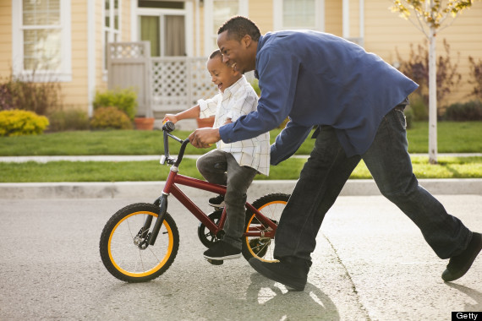
Remember, Planning is a Promises Person-centered planning is a promise to pay attention and act on learning. If we want to be trusted we need to do what we say, and to be there to support.
Everyone should have the chance to take risks and try new things.
Everyone should have the chance to do as much as they can on their own.

Slide 34
Things that are true for all people, including people with and without a developmental disability:
Being a welcomed member of your community recognized for your talents and gifts makes us proud of who we are and where we live.
Being able to go places, and join community groups is how we meet or friends, neighbors and spouses.
Having a variety of people we can talk to and who we trust is what helps us stay happy, healthy and safe.
Having a job or going to college is how we earn respect, money and self-confidence. It’s how we afford to live as we choose.

Slide 35
An Easy Test To Determine Success When People Experience Change, They Experience Life
Change is constant.
Outcomes Should Often Change
Our lives are fluid, these are the two things that usually drive change:
We try new things
We stop doing something we used to do
Plans change and people change over time
Change can be big or small, fast or slow.
Everyone’s life changes.

Slide 36

Thank You!
Insert your names/agency contact information here
For more information on similar trainings, email:
choicepowerschange.com

