Slide 1
Aktorik und Sensorik mit intelligenten Materialsystemen 4
Computer Lecture: Numerical Linearization of a SMA-Spring Actuator in Matlab
Gianluca Rizzello
gianluca.rizzello@mmsl.uni-saarland.de Saarland University

Slide 2
Computer Lecture Overview
GOALS:
Obtain a linearized model describing the response of a SMA-spring actuator around an equilibrium state via a numerical identification method
Identification of Joule heating – displacement linearized dynamics
Identification of environmental temperature – displacement linearized dynamics
Identification of load force – displacement linearized dynamics

Slide 3
System Identification Toolbox
Numerical linearization: obtain a linearized model describing relationship between input deviations an output deviations from an equilibrium point
This operation can be performed in Matlab via System Identification Toolbox
To open the System Identification Toolbox GUI, type the following command in Matlab:
systemIdentification
Original
system
Linearized
system

Slide 4
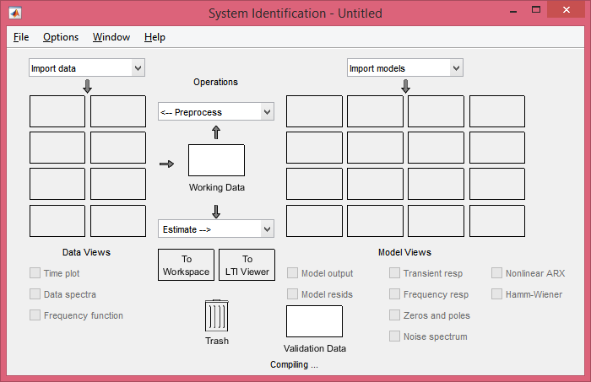
System Identification Toolbox
System Identification Toolbox GUI

Slide 5
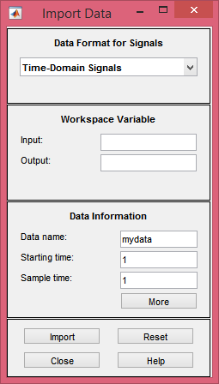
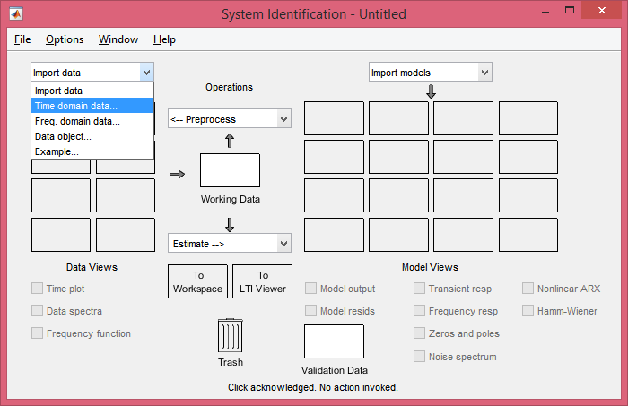
System Identification Toolbox
System Identification Toolbox GUI
Import input/output data
Specify here all the required information, then select ‘Import’

Slide 6
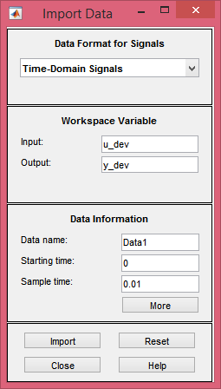
System Identification Toolbox
System Identification Toolbox GUI
Input and output must me column vectors with same size, sampled with uniform sampling time

Slide 7
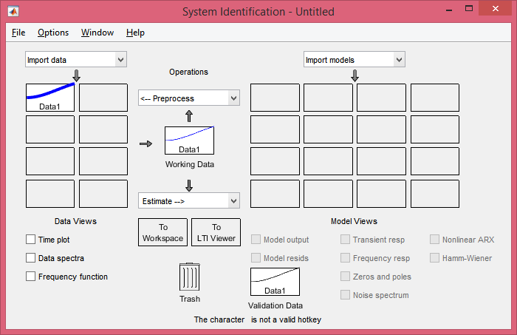
System Identification Toolbox
System Identification Toolbox GUI
Data have now been imported

Slide 8
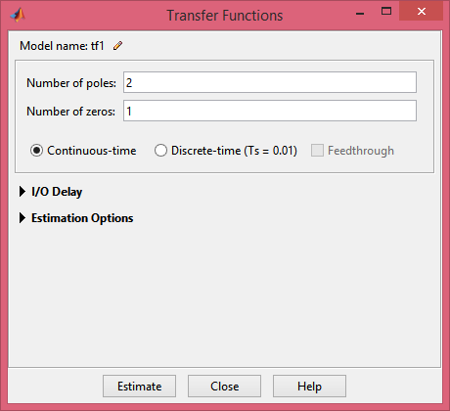
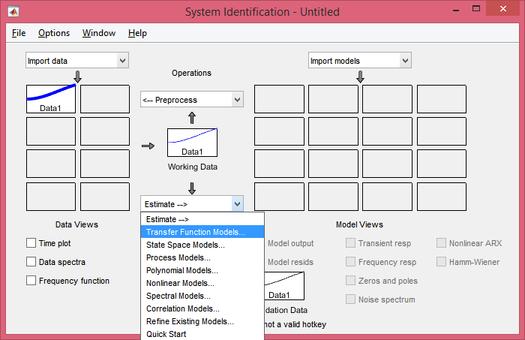
System Identification Toolbox
System Identification Toolbox GUI
From the new window, choose number of zeros and poles for the optimal model, then select ‘Estimate’

Slide 9
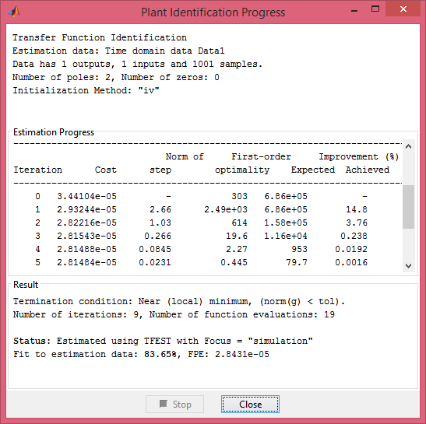
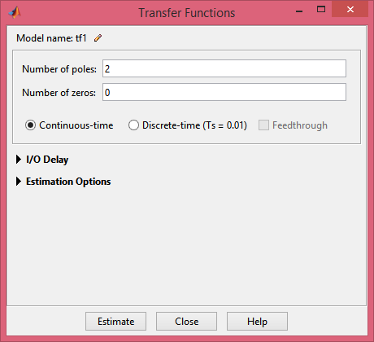
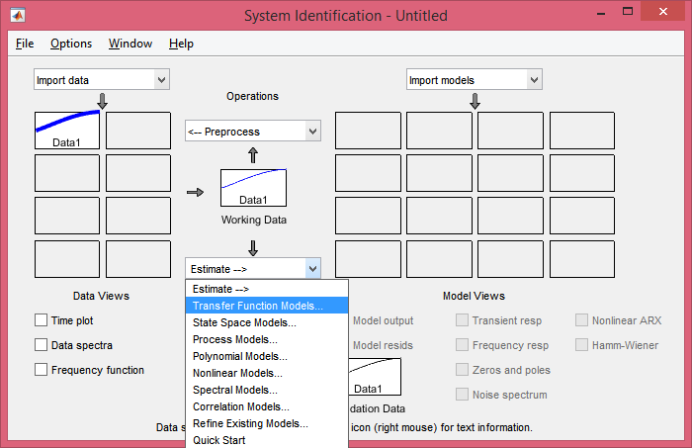
System Identification Toolbox
System Identification Toolbox GUI
FIT of the resulting model

Slide 10
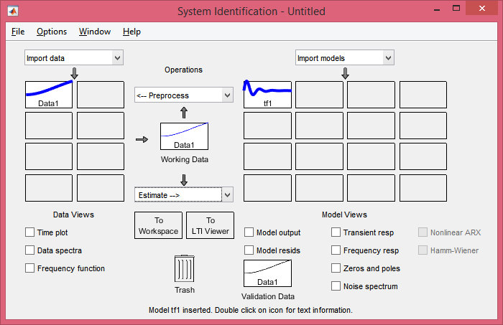
System Identification Toolbox
System Identification Toolbox GUI
The resulting model is saved here

Slide 11
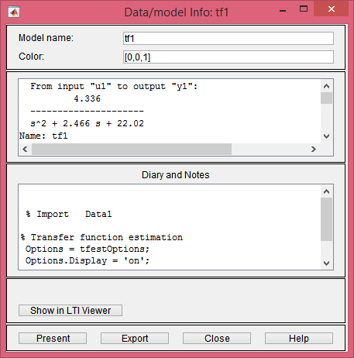
System Identification Toolbox
System Identification Toolbox GUI
Right-click to show the identified transfer function model, which can be eventually exported in Matlab as a transfer function object

Slide 12
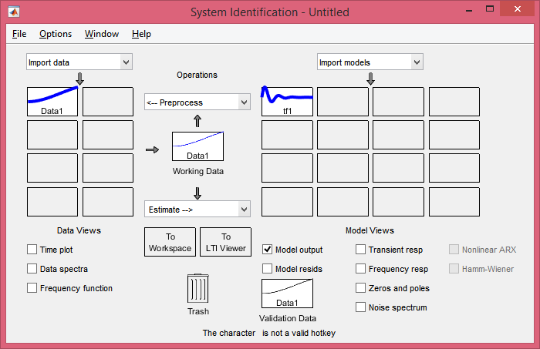
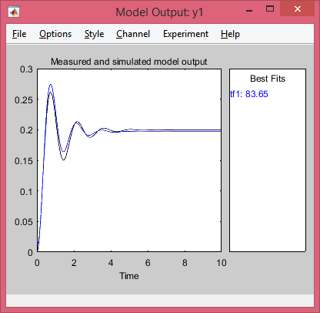
System Identification Toolbox
System Identification Toolbox GUI
To show time-domain response, select ‘Model output’

Slide 13
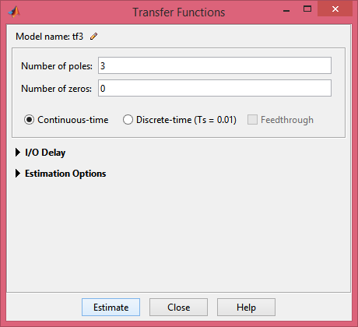
System Identification Toolbox
System Identification Toolbox GUI
To improve the accuracy, we can increase the complexity of the model, e.g., by increasing the number of zeros and poles

Slide 14
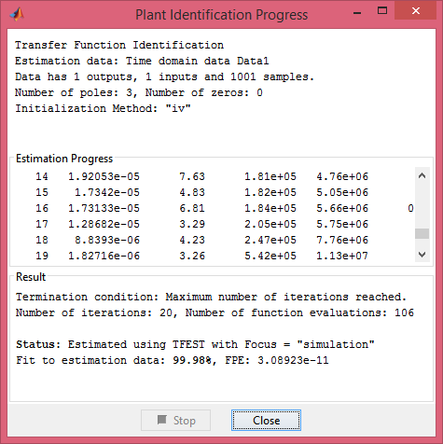
System Identification Toolbox
System Identification Toolbox GUI
In this particular case, we get an almost perfect FIT

Slide 15
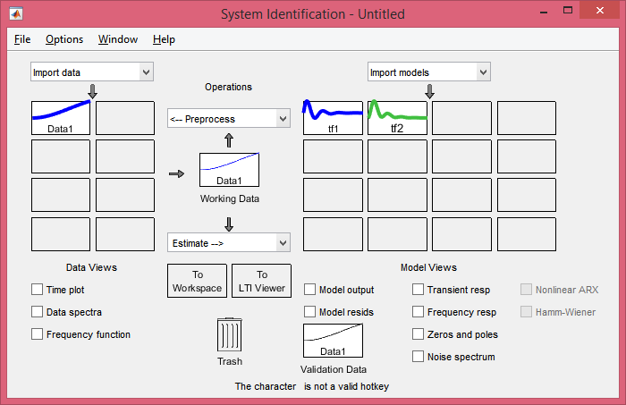
System Identification Toolbox
System Identification Toolbox GUI
In this particular case, we get an almost perfect FIT

Slide 16
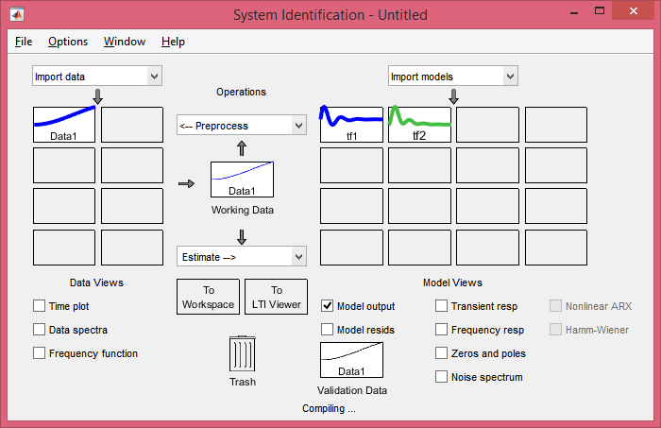
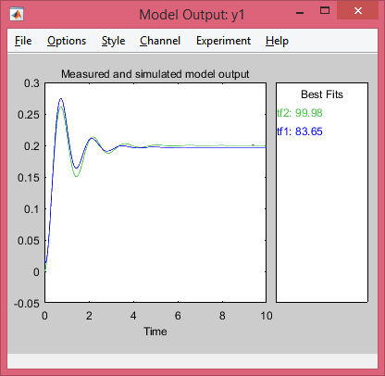
System Identification Toolbox
System Identification Toolbox GUI
In this particular case, we get an almost perfect FIT

Slide 17
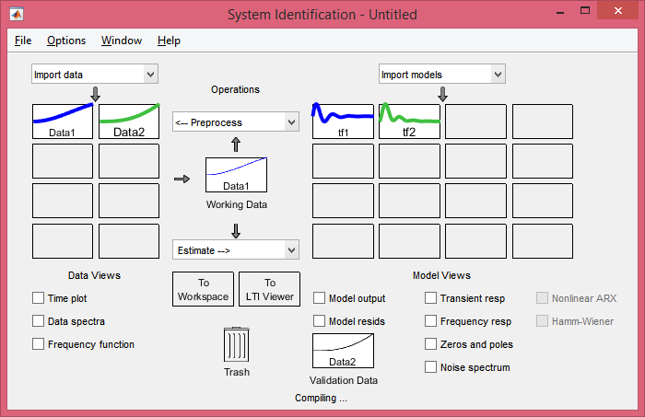
System Identification Toolbox
System Identification Toolbox GUI
New data can be eventually imported and used to perform validation of the model

Slide 18
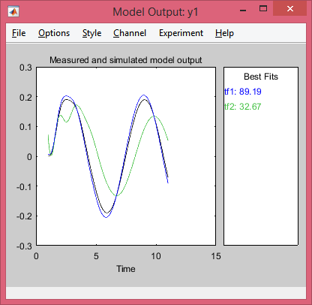
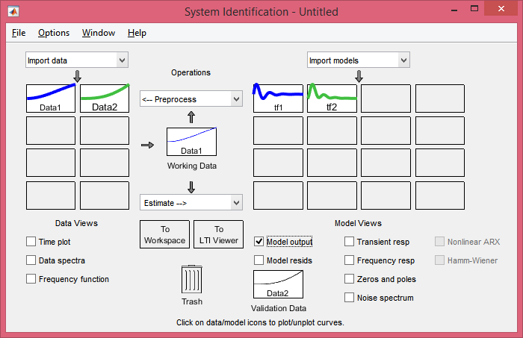
System Identification Toolbox
System Identification Toolbox GUI
New data can be eventually imported and used to perform validation of the model

Slide 19
Transfer functions in Matlab
To represent a transfer function object in Matlab, one can use the command
G = tf(num,den)
where num and den are arrays containing coefficients of numerator and denominator polynomials, respectively, while G is the transfer function object
Example 1: to represent the following transfer function
we use the following command
G = tf([2 1],[1 4 4 2])
Example 2: to represent products between factors, such as in
one can use the command conv
G = tf(2*[1 3],conv([1 2 2],[1 5]))

Slide 20
Transfer functions in Matlab
Useful commands on transfer functions:
step(G) – shows step response of G
impulse(G) – shows impulse response of G
lsim(G,u,t) – computes response of G to input u with respect to time t
pzmap(G) – shows poles x and zeros o of G on the complex plane
bode(G) – shows Bode plots of G
nyquist(G) – shows Nyquist plot of G
zpk(G) – factors zeros and poles of G
G3 = G1+G2 – computes G3 as the sum of G1 and G2, i.e., parallel connection
G3 = G1*G2 – computes G3 as the product of G1 and G2, i.e., series connection
T = G/(1+G) – computes T as the negative feedback connection of G
All of these functions are also valid for state-space objects as well
Transfer function objects can be also converted to state-space and vice-versa
S = tf2ss(G) – converts transfer function G into state-space object S
G = ss2tf(S) – converts state-space object S into transfer function G

Slide 21
Assignment
Given the SMA-spring model, consider the equilibrium state corresponding to the following constant inputs:
J = 0.125 W
T_{E} = 293 K
F_{L} = 0 N
By using the Simulink model, bring the system to the desired equilibrium point.
Apply a very small variations of J, and measure the corresponding small variation of output displacement. By using the System Identification Toolbox GUI, identify a suitable transfer function model which relates the two deviations from equilibrium. HINT: for generating the small input deviation you can use different signals, including steps, bipolar square waves, or sinewaves.
Repeat the previous step by progressively increasing the amount of variation of J from the equilibrium, and compare the resulting transfer functions obtained.
Repeat the previous identification by only producing variations on T_{E}.
Repeat the previous identification by only producing variations on F_{L}.

