Slide 1
Aktorik und Sensorik mit intelligenten Materialsystemen 4
Computer Lecture: Analytical Linearization of a DE-Mass-Spring Actuator in Matlab
Gianluca Rizzello
gianluca.rizzello@mmsl.uni-saarland.de Saarland University

Slide 2
Computer Lecture Overview
GOALS:
Obtain a linearized model describing the response of a DE-mass-spring actuator around an equilibrium state via the Taylor expansion method
Comparison between voltage-displacement response of nonlinear and linearized systems
Comparison between load force-displacement response of nonlinear and linearized systems

Slide 3
Analytical linearization
Analyrical linearization: obtain a linearized model describing relationship between input deviations an output deviations from an equilibrium point, based on a Taylor expansion of model equations
The analytical linearization requires:
Identification of an equilibrium state
Computation of partial derivatives of system functions
These operations can be performed systematically in Matlab via Symbolic Toolbox
Original
system
Linearized
system

Slide 4
State-space modeling: DE mass spring
State-space representation of the overall DE mass spring model, by considering the special case of a second order viscoelastic model
Control input u = v
Disturbance input d = F_{L}
Output y = l₁
State x = [x₁ x₂ x₃ x₄]^{T}

Slide 5
Symbolic Toolbox
The symbolic toolbox offers a powerful framework to solve complex problems in an analytical way, such as computation of gradients of functions or the solution of nonlinear systems of equations
The following steps need to be implemented:
Definition of equilibrium control input u_{eq} and disturbance input d_{eq};
Definition of symbolic variables for system states x = [x₁ x₂ x₃ x₄]^{T}, control input u, and disturbance input d;
Definition of system state functions f = [f₁ f₂ f₃ f₄]^{T} as well as output function h = h₁;
Find an equilibrium state x_{eq} by solving f(x_{eq},u_{eq},d_{eq}) = 0, for the given values of u_{eq} and d_{eq};
Compute the linearized model matrices by differentiating f and h and compute the corresponding gradient matrices on the obtained values for x_{eq}, u_{eq}, and d_{eq}.
All these steps have been implemented in the Matlab script Model_linearization.m

Slide 6
Symbolic Toolbox
Useful commands of the Symbolic Toolbox:
x = sym('x') – define symbolic variable x
x = sym('x','real') – define symbolic real variable x
f = 2*x^2 + 3 – define f as a symbolic function of the symbolic variable x
g = subs(f,x,2) – given a symbolic function f of argument x, obtain a new symbolic function g by substituting x = 2 in f
g = subs(f,{x,y},{2,3}) – given a symbolic function f of arguments x and y, obtain a new symbolic function g by substituting x = 2 and y = 3 in f
xnum = double(f) – given a symbolic function f which, after a substitution, does not depend on any symbolic variable, convert it into the corresponding numerical value xnum which can be manipulated as a double
sol = vpasolve(f == 0,x) – given a symbolic function f of argument x, obtain sol as the x which solves the equation f == 0
sol = vpasolve(f == 0,x,[-1 2]) – given a symbolic function f of argument x, obtain sol as the x which solves the equation f == 0, with x constrained in [-1, 2]
sol = vpasolve(f == 0,[x y],[-1 2;0 inf]) – given a symbolic function f of arguments x and y, obtain sol as the [x; y] which solves f == 0, with x constrained in [-1, 2] and y constrained in [0, inf]
g = diff(f,x) – given a symbolic function f having x among its argument, obtain a new symbolic function g given by the partial derivative of f over x

Slide 7
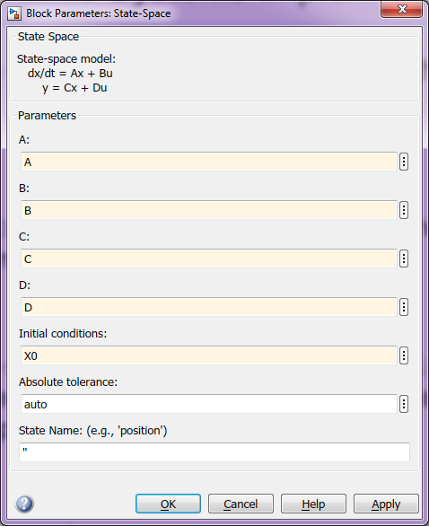
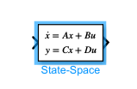
Linear Systems Implementation
Representations of linear state-space models in the form
In Matlab: S = ss(A,B,C,D) – creates object S representing the linear state-space model defined by matrix variables A, B, C, D
In Simulink: The block state-space located in Simulink/Continuous can be used to implement a linear state-space model, once matrices A, B, C, D and initial condition X0 are specified

Slide 8
Assignment
Given the DE-mass-spring model, perform the corresponding studies in Simulink:
Consider the equilibrium corresponding to u = 2500 V and d = 0 N, compare the output displacement of both nonlinear and linearized models when applying a voltage square wave perturbation from the equilibrium given by a square wave with period of 10 s, duty cycle of 50%, and amplitude equal to -10 V, -100 V, and -1000 V
Consider the equilibrium corresponding to u = 1250 V and d = 0 N, repeat the study of case 1 by considering voltage square waves with amplitude 10 V, 100 V, and 1000, -10 V, -100 V, and -1000 V
Consider the equilibrium corresponding to u = 0 V and d = 0 N, repeat the study of case 1 by considering voltage square waves with amplitude 10 V, 100 V, and 1000 V
Consider the equilibrium corresponding to u = 0 V and d = 0 N, repeat the study of case 1 by considering force square waves with amplitude 0.01 N, 0.1 N, and 1 N
Repeat one of the above simulations by combining arbitrary equilibrium perturbations in both voltage and force inputs

