Slide 1

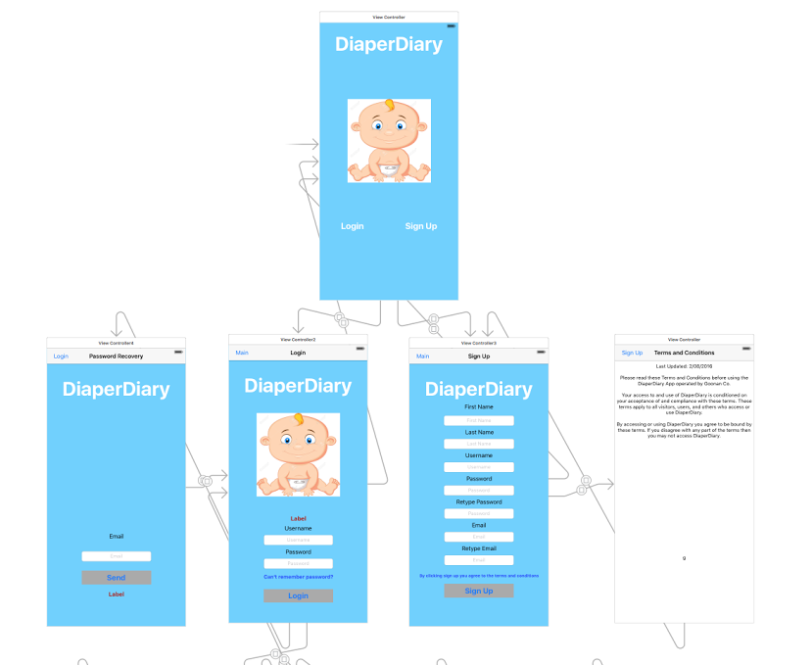

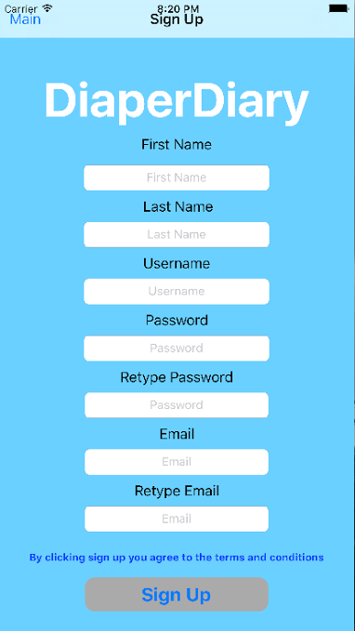
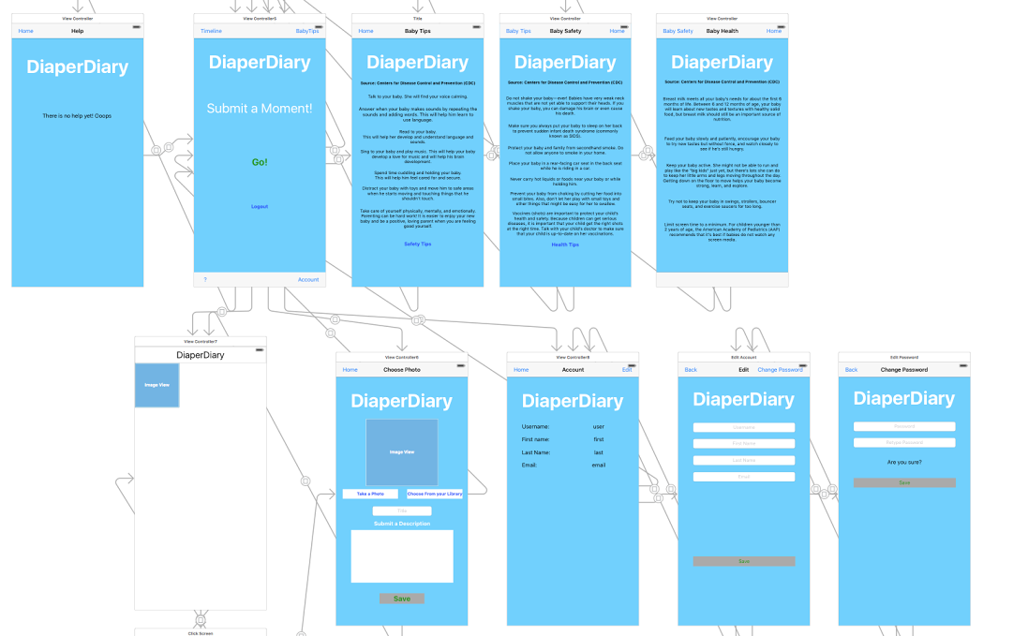
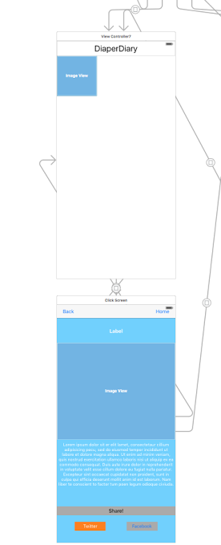


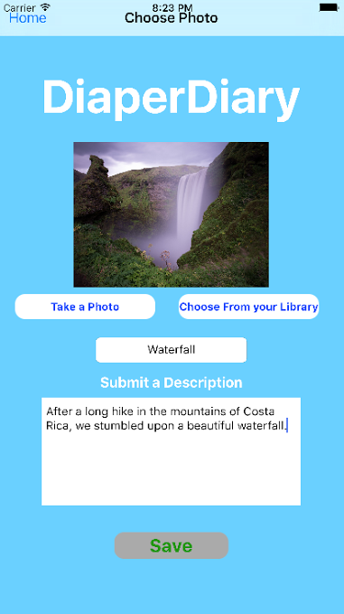


DiaperDiary
Timothy Goonan
Professor Daniel Canas
Department of Computer Science
Wake Forest University
Storyboard
Problem:
Parents need to be able to document pictures and journal entries of their children and the special moments that happen as they grow up with ease and efficiency. They should also be able to then submit a moment onto social media outlets so that their friends and family stay up to date with their new family.
DiaperDiary provides an answer to this problem and even goes beyond what is needed. The app is login and password secured, so only the user can submit and delete entries. You can also edit your account and change the password after you create the account.
The app has view controllers with tips on health, safety, and general words of advice for taking care of a new born baby. All of the tips come from the CDC (Centers for Disease Control and Prevention), an established government agency on the public’s well being.
There is a view where you can submit a picture with a title and a description of the event. The picture then gets posted to a timeline and if you click the picture it enlarges and also displays the title and description. There it has two buttons to share to either Facebook or Twitter.

