Slide 1
PRESENTATION TITLE
Mirjam Nilsson

Slide 2
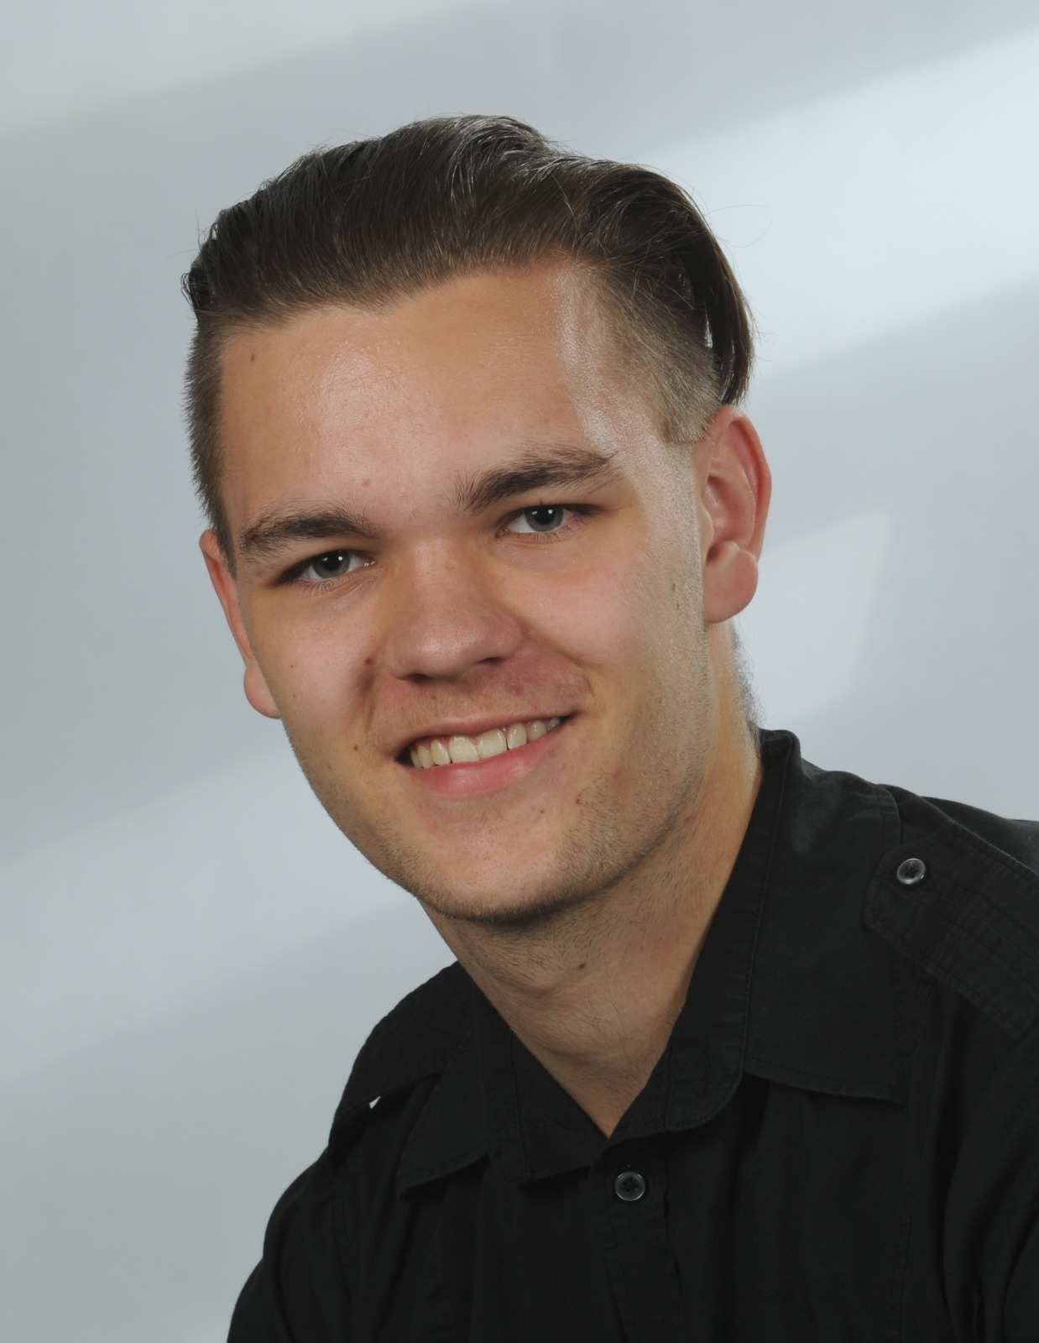
INTRODUCTION
At Contoso, we empower organizations to foster collaborative thinking to further drive workplace innovation. By closing the loop and leveraging agile frameworks, we help business grow organically and foster a consumer-first mindset.​

Slide 3
INTRODUCTION
At Contoso, we empower organizations to foster collaborative thinking to further drive workplace innovation. By closing the loop and leveraging agile frameworks, we help business grow organically and foster a consumer-first mindset.​

Slide 4
INTRODUCTION
At Contoso, we empower organizations to foster collaborative thinking to further drive workplace innovation. By closing the loop and leveraging agile frameworks, we help business grow organically and foster a consumer-first mindset.​

