Slide 1
Medizinische Bildverarbeitung
Jonas Köllner, Tim Grosch

Slide 2
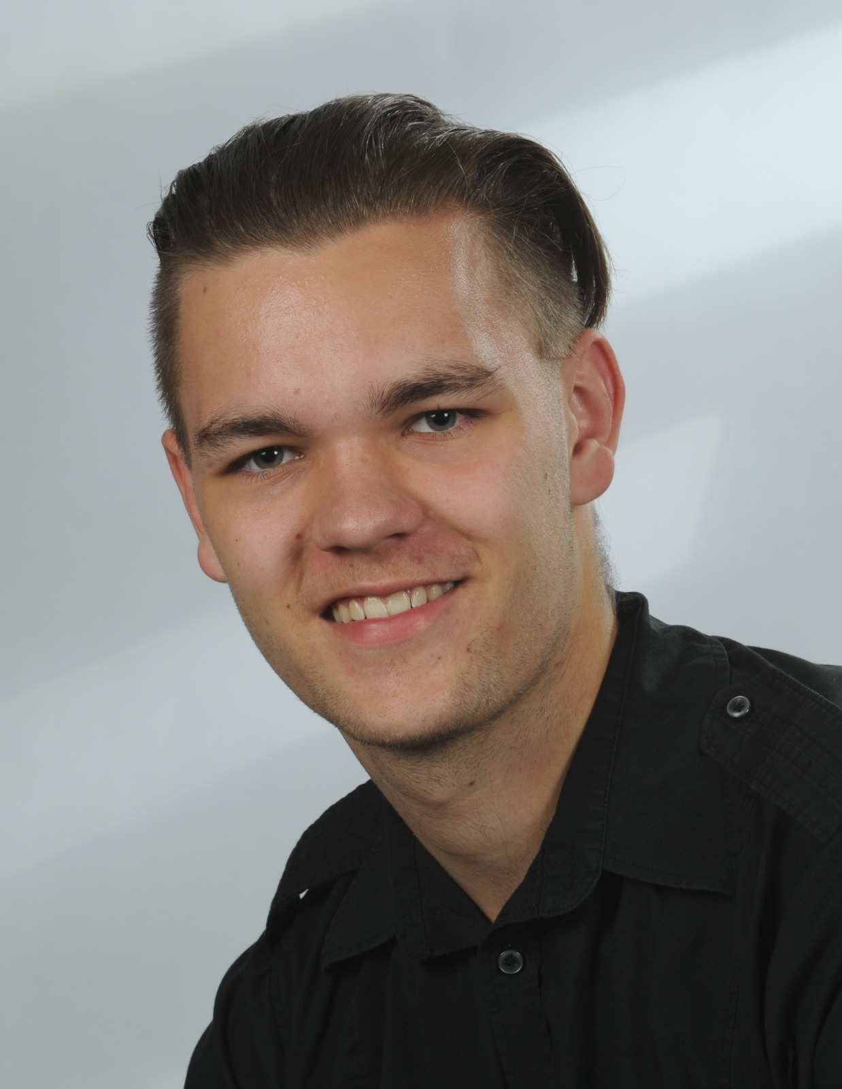
INTRODUCTION
At Contoso, we empower organizations to foster collaborative thinking to further drive workplace innovation. By closing the loop and leveraging agile frameworks, we help business grow organically and foster a consumer-first mindset.​

Slide 3
INTRODUCTION
At Contoso, we empower organizations to foster collaborative thinking to further drive workplace innovation. By closing the loop and leveraging agile frameworks, we help business grow organically and foster a consumer-first mindset.​

Slide 4
INTRODUCTION
At Contoso, we empower organizations to foster collaborative thinking to further drive workplace innovation. By closing the loop and leveraging agile frameworks, we help business grow organically and foster a consumer-first mindset.​

