Slide 1







I.R.I.S. AI Driven Architecture
3. Relevant data pulled from Dataverse
7. Log case notes
1. request
2. request
4. Prompt with necessary data and question to GPT-3
6. response
Investigator
Embedded Canvas App
Azure Function App (API)
5. Response returned

Slide 2

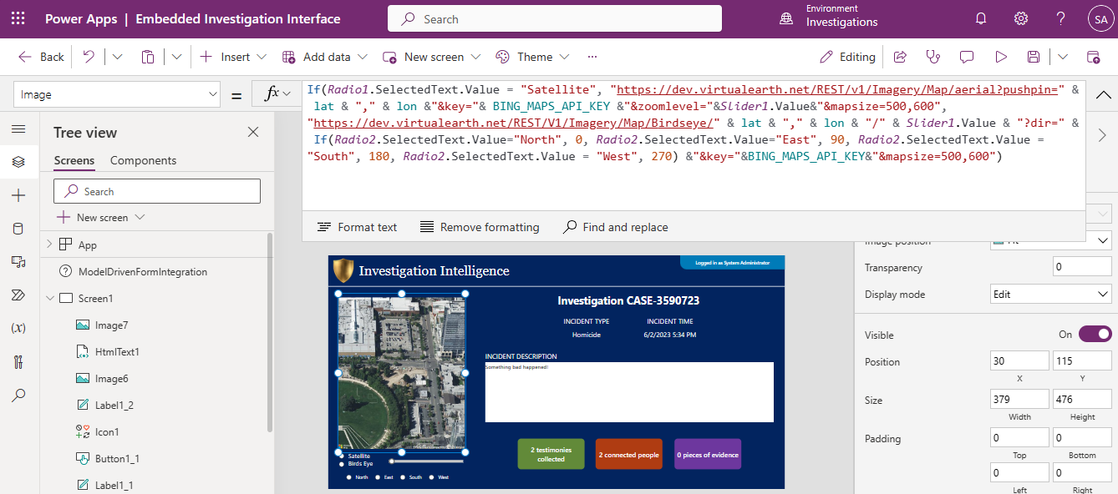
Request for imagery with:
Imagery type
Latitude & Longitude
Magnification level
Orientation (if bird’s eye)
Map size (static)
API Key
HTTP GET Request
HTTP GET Request
I.R.I.S.
image
image
Bing Maps

