Slide 1













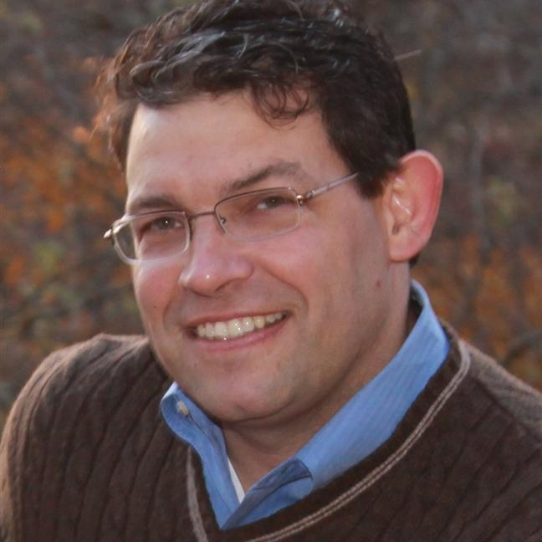
State seal
State of ________
Power Platform Roundtable
Power Apps Fundamentals
Thursday, March XX – 9:30 AM to 12:00 PM EST
You’re invited to a Power Platform workshop, designed to familiarize you with the capabilities of Microsoft’s Power Platform and how it’s driving impact with public sector digital transformation.
Power Apps
Power Automate
Power BI
Dataverse
In this session we will explore:
Canvas Apps
POWER PLATFORM ADMIN CENTER (PPAC)
CANVAS APPS
MODEL-DRIVEN APPS
DATAVERSE
POWER AUTOMATE
CHATBOTS (PVA)
CUSTOMER VOICE
POWER BI & REPORTING
Presented By
David Bandler
Technical Specialist
David Walsh
Solution Specialist

