Slide 1
Conduct

Slide 2
Jimmy,
It has been a long time and it is time to represent again. The crew is ready to help you bust out of there. Break night on November 2. No more kites until then. You will not hear from me. Meet me and the gang at the south end of the rec yard at 2:35 PM.
See you then!
You blood friend, Roman.

Slide 3
Drug

Slide 4
Don – do you need any ganja? I have plenty of it and can shoot the breeze. Is anybody dirty in there? We have it locked. All the square you need. Let me know and I will send it in the envelope!
-Dustin

Slide 5
Violence

Slide 6
You let me know what puppy you need and I will get one in for you. Time these guys get whacked. No slap. A real beef. Let’s fight these crips! Take him out! And don’t drop a dime…
-Bobby

Slide 7
Innocent

Slide 8
Jose,
We miss you! The baby is doing well and we miss you a lot! We are looking forward to seeing you when you get out in a month. Please behave until then! I have been so busy taking care of the baby. I also do yoga now. Yoga is fun, have you tried it yet Take care!
-Rose

Slide 9
Spanish

Slide 10
¡A por estos muchachos! ¡Crea una brigada! No más crips. Y sin cometas. ¿Tienes un cachorro? ¡Representar!

Slide 11
Multi-Page

Slide 12
Joe,
How are things going? We look forward to your release in 30 days. Be careful, be safe, and be wise. When you get out, we are planning on

Slide 13
throwing you a big party. A celebration! Please don’t get into any fights.
PS: I’ve recorded all of your favorite shows. They’re ready for you!
-Your Brother, Frank

Slide 14
Hand Written

Slide 15
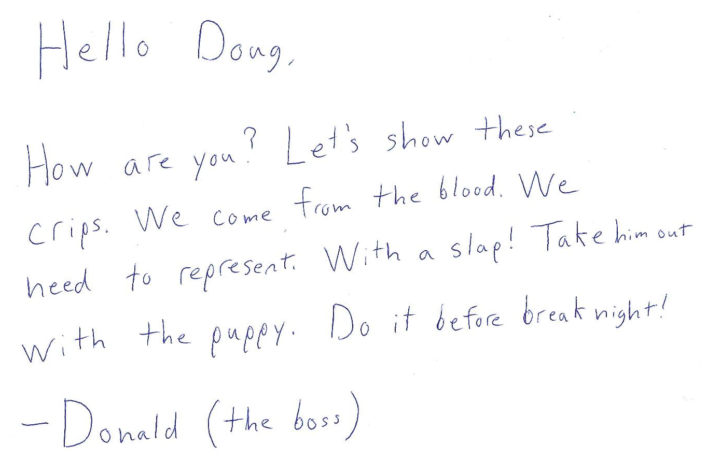

Slide 16
