Slide 1
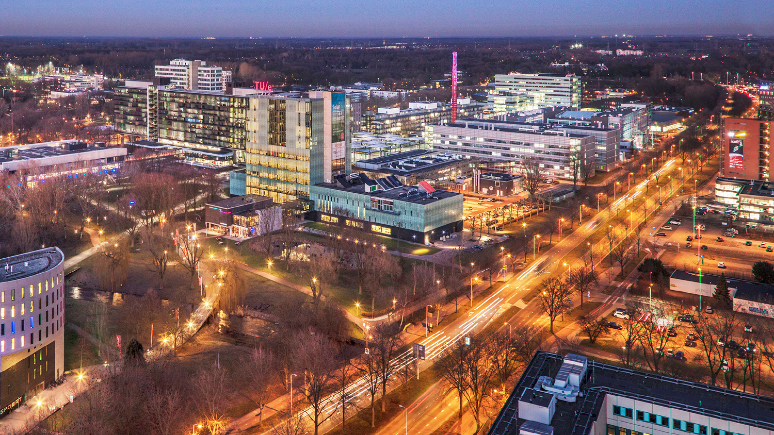
Design of a toy model database for predicting potential energy surfaces with neural nets
July 9th 2020
Tim Heiszwolf
Supervisor: dr.ir J.M.V.A. Koelman
TU/e Physics and CCER
Notes:
Welcome everybody. I am Tim Heiszwolf and while sadly I wasn’t able to see any of you in DIFFER due to Corona I still would like to tell you what I have been doing together with mr Koelman these past few months.
0:15m -> 00:15m

Slide 2
Content
Problem
Potential energy surfaces
Goal and requirements
Background information
Solution
Potential energy
Program
Preparations for machine learning
Results
Speed
Databases
Machine learning
Future
Notes:
First I am going to explain you what the problem is and which goals and requirements I had. Next I am going to give some background information on potential energy surfaces.
Then I will tell you about the solution that was made including the toy model itself, some of the extra features of the program that makes the database has and how the database can be prepared for machine learning.
After this the results of this toy model will be discussed. Things like the speed of the algorithm, the quality of the databases and a bit about machine learning.
Finally I would like to tell you about the future of this project.
0:30m ->00:45m

Slide 3
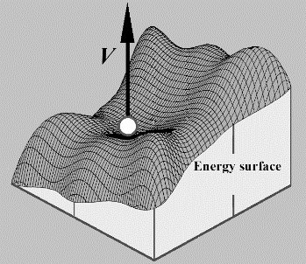
Problem: Potential energy surfaces
Potential energy surface (PES)
Properties of materials
Calculations cost much time
Potential energy surface of a ball on a high.
Source: Dynamical integrity: three decades of progress from macro to nano mechanics by John Michal Thompson
Notes:
This entire project is about potential energy surfaces. A potential energy surface describes what the potential energy is as the different degrees of freedom change. The classic example is the energy of a ball as it rolls across a hilly surfaces. Here the position are the degrees of freedom and the height directly corresponds to the amount of potential energy. Since this is such a nice way of representing it these kind of graphs are often used for visualization of such a potential energy surface.
But what are they used for? In the fields of physics and chemistry potential energy surfaces are used to calculated properties and applications of certain materials. The potential energy surface is crucial when developing new batteries or solar panels, but also when designing new television screens. When investigating the properties of materials but also designing new materials the potential energy surface is crucial. These properties are often difficult (and expensive) to test and thus are more often investigated using computational methods.
But sadly the calculation of these potential energy surfaces (or their associated forces) takes a very long time. With machine learning a bit of accuracy can be sacrificed to make these calculations significantly faster. In this presentation a framework for rapid generation of training data using a toy model will be presented and a small investigation into machine learning will be done. These databases can then be used to find the optimal hyper parameters for a neural net after which training on reality based data can be done.
1:30m -> 02:15m

Slide 4
Problem: Goals and requirements
Toy model
Database generation
Neural network (NN)
Requirements PES:
Depend on position
Periodic boundary conditions
Complex
Hardwired symmetries
Continuously differentiable
Physical behavior but general
Faster and more flexible than DFT simulations
Notes:
So the goal is to make a fast testing framework for using machine learning on potential energy surfaces as a alternative to real simulations. This consists of three parts first the toy model for the potential energy, next the software that generates the database and finally neural network should be made to test if the framework is useable.
The potential energy surface has several requirements:
First the energy should only depend on position and take into account the infinitely repeating boundary conditions
But it should also be somewhat complex and non trivial for a machine learning algorithm to learn.
It should also be symmetric. Both translational symmetry and permutational symmetry is wanted. So we should for example be able to move a square of particles and the energy should stay the same but we should also be able to swap the position of two particles and that also shouldn’t change the energy.
The energy should be continuous and continuously differentiable because other wise it cannot be used for the calculations we want to use it for.
It should thus also display physical behavior like for example that two particles who come close to each other should repel each other but at a larger distance they should attract each other. It should also be quite general and abstract such that it can easily be modified.
And finally calculating the energy with this toy model should be faster, easier and more flexible than using DFT simulations
1:15m ->03:30m

Slide 5
Problem: Goals and requirements
Requirements database:
Reasonable range of energies
Inputs are symmetric
Inputs are continuous
Inputs are continuously differentiable
Requirements neural network:
Be accurate
Have a well behaved derivative
Notes:
Next the database is generated which of course also have some requirements:
First and most importantly it should contain reasonable energies. So the energies have a good spread but extremely high energies should also not be common or not occur at all.
The inputs should also behave well since the database is going to be used to train a neural network. This means:
The should be symmetric just like the potential energy.
The inputs should also be continuous and continuously differentiable. This is because the output of the neural network should be continuous and continuously differentiable and that can only be if the inputs are also continuous and continuously differentiable.
Finally a neural network should be trained and inspected. Its requirements that it should be:
Accurate
And have a well behaved derivative since those two things are ultimately what this is all about.
0:50m ->04:20

Slide 6
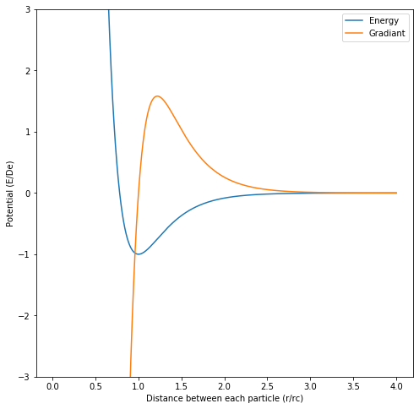
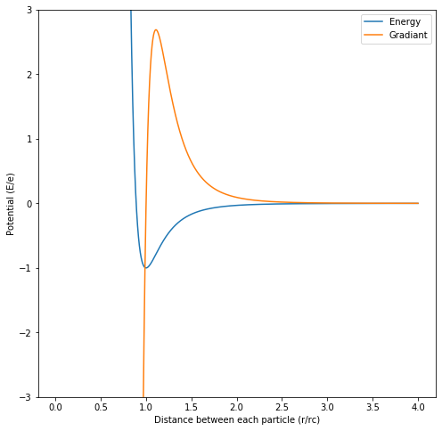
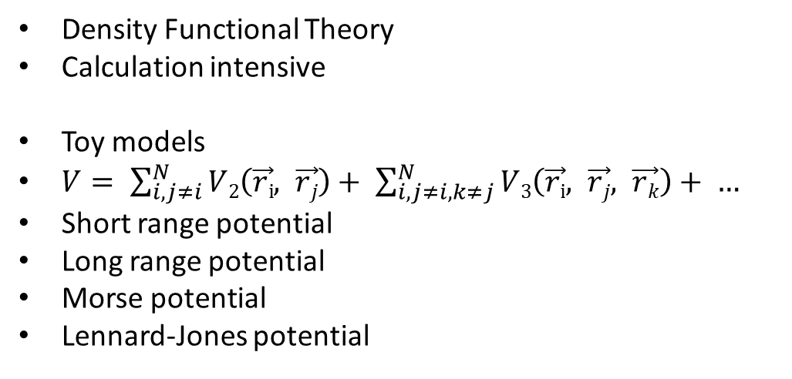
Background information
Density Functional Theory
Calculation intensive
Toy models
$V= \sum_{i,j≠i}^{N}{V2\left(\vec{ri}, \vec{rj}\right)+ \sum_{i, j≠i, k≠j}^{N}{V3\left(\vec{ri}, \vec{rj}, \vec{rk}\right)+ …}}$
Short range potential
Long range potential
Morse potential
Lennard-Jones potential
The Morse potential
The Lennard-Jones potential
Notes:
There are two major methods for calculating the potential energy surface from a configuration.
First are Density Functional Theory simulations or DFT. This method uses quantum mechanics. These calculations are good since they can be accurate and can be very generally applied to many types of systems and different types of atoms. But sadly these methods are quite slow and require many calculation before they are accurate.
Another method are toy models and that is what we are going to be using today so it can be very useful to investigate how these work. These work by taking the sum of all interatomic potentials of pairs, triplets, quartets, etcetera. Using only pair potentials is good enough for a lot of applications. But some applications with metals or covalent solids sometimes a higher term is needed such as the triplet interaction.
Two well known pair actions are the Morse potential and the Lennard-Jones potential. These depend only on the distance between the atoms and thus is symmetric, it also is continuous and easy to compute. These potentials can be seen here. They consists of a positive short range part which dominates when the particles are very close and then asymptoticly approaches zero. And the long range part which is negative but dominates when the particles are far away from each other. When added they form the inter atomic potential.
The Morse potential consists of two exponential functions with a minimum at a certain characteristic distance with a characteristic energy. Due to the way it is constructed the width of the minimum can also be adjusted. This minimum can also be approximated as a harmonic potential.
The Lennard-Jones potential has a similar construction but it uses a 1 over r construction.
2:00m -> 06:20m

Slide 7
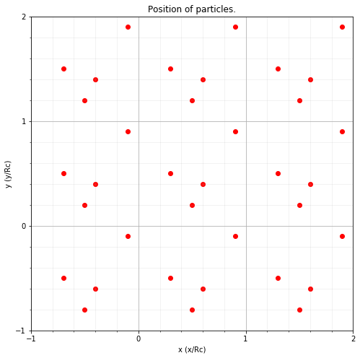
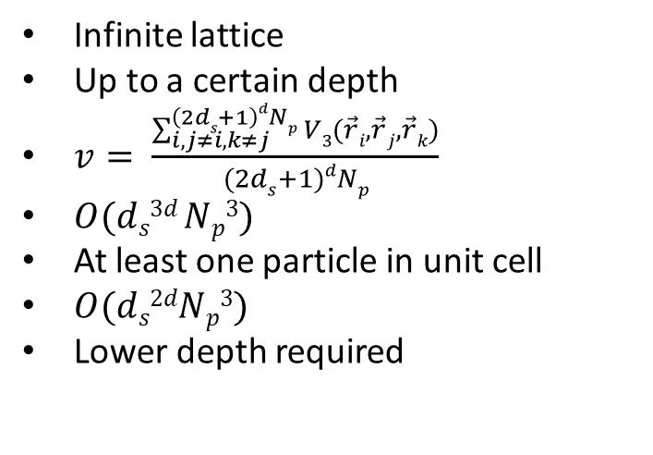
Solution: Potential energy
Infinite lattice
Up to a certain depth
$v= \frac{\sum_{i, j≠i,k≠j}^{\left(2ds+1\right)dNp}{V3(\vec{r}i, \vec{r}j,\vec{r}k)}}{(2ds+1)dNp}$
$O(ds3d Np3)$
At least one particle in unit cell
$O(ds2dNp3)$
Lower depth required
A example of the lattice with a depth of 1.
Notes:
Next we are going to design the potential energy. For the lattice we choose a structure composed of square unit cells of with a certain width. Each unit cell contains certain amount of particles. The lattice has infinite repeating boundary conditions. But to make sure the computation can finish only a certain depth of surrounding cells ds is taken into account. For example here you can see a lattice with a depth of 1. Of course the depth needs to be large enough such that the potential energy has converged, but a larger depth also means that more particles need to be taken into account and thus more calculations have to be done.
When then calculating the potential energy we will take into account only the triangle interactions since the pair interactions are not very complex. Higher could also be done but that will greatly increase computational requirements. Also the potential energy per particle is going to be calculated since otherwise it won’t converge nicely.
When then calculating the potential energy per particle one method that can be used is taking the sum of every possible triangle in the entire lattice. But this is computationally sub-optimal since the algorithm scales with the depth to the power 3 times the dimension and the number of particles per cell to the power 3. For this method the depth of the surrounding cells also need to be quite large since otherwise the edge effects will be significant which makes the problem worse.
A better approach would be to calculate the amount of energy per particle in the unit cell. This can be done by only counting a triangle if at least one of the particles is in the central unit cell. This has the advantage that the calculation scales much better but also that the depth of surrounding cells that is needed for a good convergence is significantly lower since the edge effects only come from the central unit cell.
1:50m -> 08:10m

Slide 8
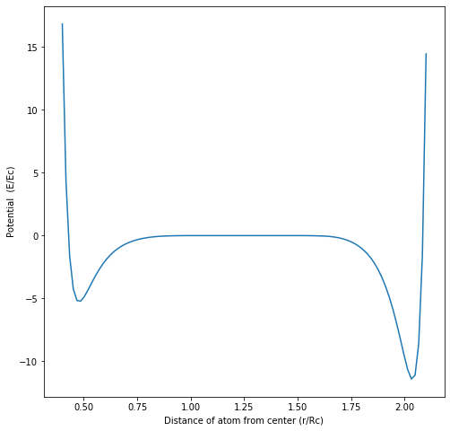
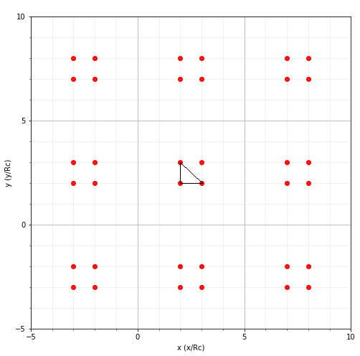
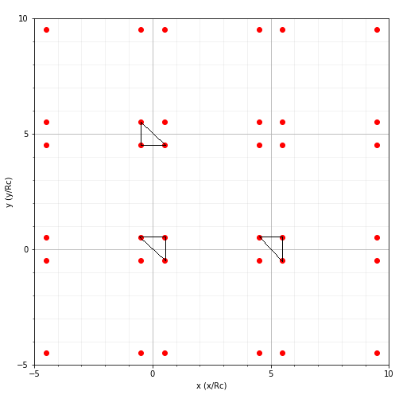
Solution: Potential energy
Triangles are counted multiple times
The energy of a moving square configuration.
A lattice with the square in the center of the cell.
A lattice with the square at the edge of the cell.
Notes:
You might think that the amount of computations can be reduced even further by not counting each triangle multiple times but sadly only counting each triangle one time will not work very well.
This is because that will result in a energy that is not symmetric. For example here is the potential energy per particle from a square configuration which is made larger until it reached the corners of the cell. Since at the edge the configuration is equivalent to a translation of the original configuration the energy should be the same. But is clearly not the case here.
The reason is because a triangle that would only be counted once in the original configuration is counted three times in the equivalent translated situation thus resulting in a energy three times large.
This method does work if you take into account each and every triangle in the lattice but as said before the extra computational requirements for that are much larger.
1:00m -> 09:10m

Slide 9
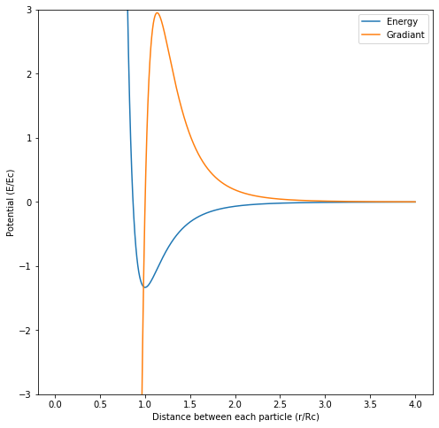
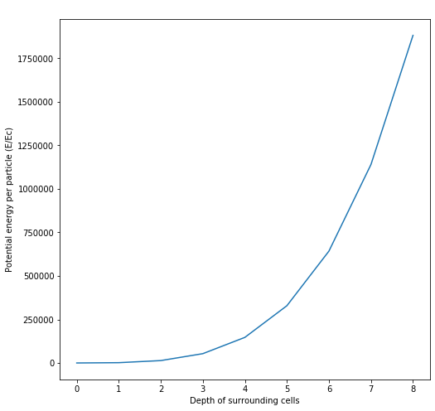
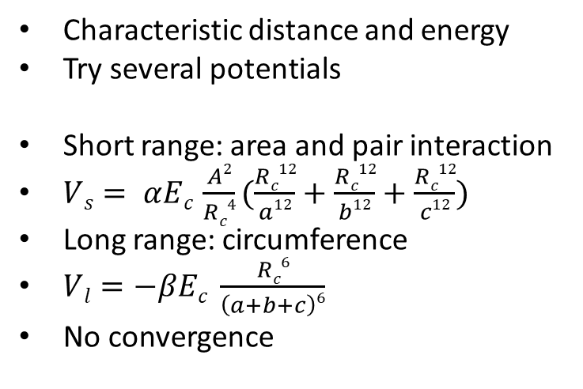
Solution: Potential energy
Characteristic distance and energy
Try several potentials
Short range: area and pair interaction
$Vs= αEc \frac{A2}{Rc4}(\frac{Rc12}{a12}+\frac{Rc12}{b12}+\frac{Rc12}{c12})$
Long range: circumference
$Vl=−βEc \frac{Rc6}{\left(a+b+c\right)6}$
No convergence
The potential energy function of a equilateral triangle.
The convergence of the potential as the depths of surrounding cells increase
Notes:
So now only a potential energy function for a triangle is needed and the toy model is done. We want this potential energy function to have a characteristic distance Rc and a characteristic energy Ec. This makes the equation more easily adjustable. For this the energy the minimum energy of a equilateral triangle was choses. The characteristic distance was defined as the lengths of the sides of the triangles at the minimum. Several potential were tried to find the best one.
The first potential that was tried has a short range potential that depends on pair interactions but was made complex by multiplying by the area squared of the triangle. The long range energy was based on the circumference of the triangle. But sadly this function did converge very well as can be seen in this picture.
This is because if two particles are close together but a third particle is far away the pair interaction term will still be large and the area even larger. Thus this results in the energy increasing with the depth of the surrounding cells.
1:10m -> 10:20m

Slide 10
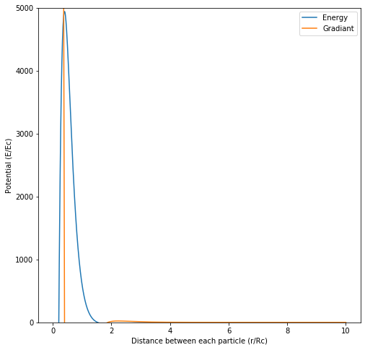
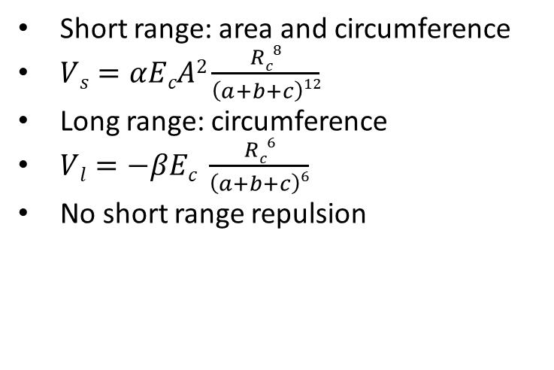
Solution: Potential energy
Short range: area and circumference
$Vs=αEcA2\frac{Rc8}{\left(a+b+c\right)12}$
Long range: circumference
$Vl=−βEc \frac{Rc6}{\left(a+b+c\right)6}$
No short range repulsion
The energy of a configuration with two particles close to each other and the third moving away.
The potential energy function of a equilateral triangle.
Notes:
Next a function in which the short range also depended on the circumference was tried but sadly this also didn’t work. This is because it doesn’t properly display repulsion when two particles are close to each other. A test was done in which two particles are placed at 0.5Rc from each other and a third particle moves away from those. As can be seen in the results at long range this becomes nearly zero because the circumference becomes very large and on the short range it sometimes even becomes negative since the area becomes very small while the circumference stays at least one times the characteristic distance.
0:40m -> 11:00m

Slide 11
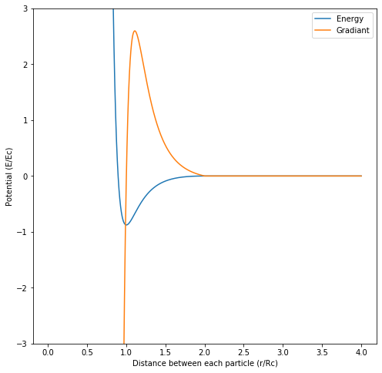

Solution: Potential energy
Added pair interactions
Average distance between particles
Modified Lennard-Jones potential
$Vs=\frac{Rc2n}{S2n}−\frac{Rc2n}{R02n}$
$Vl=−2\left(\frac{Rcn}{Sn}−\frac{Rcn}{R0n}\right)$
$Vc=−\frac{2n}{{R0}^{n+1}}(1−\frac{Rcn}{R0n})(\frac{s}{Rc}−\frac{R0}{Rc})$
$V=Vs +Vl +Vc$ for $s<R0$
$R0n≫Rcn$
The modified Lennard-Jones energy of a triangle. R₀=2R_{c} and n=6.
Notes:
So it was decided to add pair interactions back in since otherwise repulsion or convergence couldn’t be achieved. To make a single equation applicable to both pair and triplet interactions the average relative distance between the particle was chosen as inputs. So for a triangle that is the circumference divided by three and for a pair it was just the distance between them.
For the equation itself the Lennard-Jones potential was modified in such a way that it converged after a certain distance called R0. Due to this a correction term was needed to make sure the gradient remained continuous. The result can be seen here. The characteristic distance and energy are not exactly in the correct place due to these modifications but as long a R0 to the power n is much larger than Rc to the power n than the characteristic distance and energy are approximately in the right position.
n=6 was choses to make it look like the original Lennard-Jones potential and a R0 of 2Rc was choses to ensure relatively fast convergence.
1:00m -> 12:00m

Slide 12
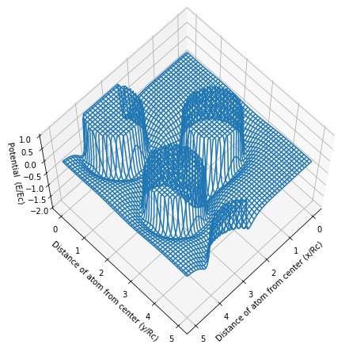
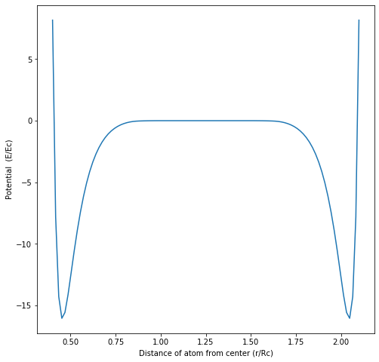
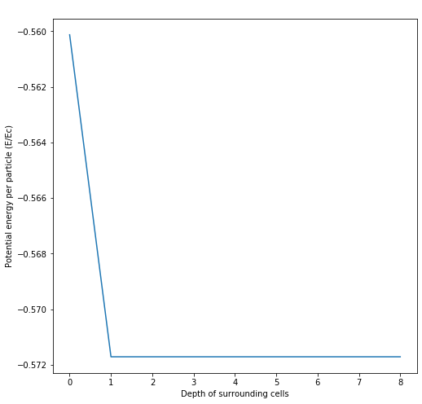
Solution: Potential energy
The potential energy surface.
The (symmetric) energy of the expanding square.
The convergence of a with a cell width of 5R_{c}.
Notes:
And as can be seen the other properties are also good. The potential energy surface looks nice and displays clear minima and maxima. The test with the expanding square also yields good results and the convergence is also very fast due to the build in convergence.
0:15m -> 12:15m

Slide 13
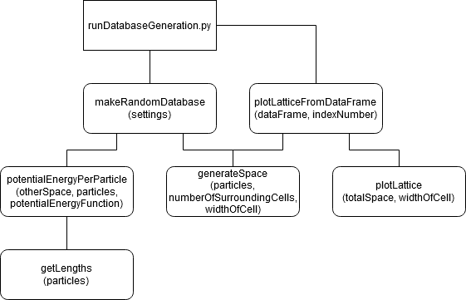
Solution: Program
Python
Generates a database
Many settings
Methods to adjust distribution
A diagram of the structure of the code.
Notes:
So next the software to generate the database was written. This was done on Python because of the easy of development, popularity and my own experience in it.
For generating a database there are many settings which can be adjusted. For example how many particles are in each cell, what the depth of the surrounding cells is, the number of dimensions, what the range of cell widths is and in how many parts the widths are divided.
It also contains methods that can be used to adjusted the distribution. For example the top percentage of energies can be cut-off. But there also a method that can be used to lower the energies of the distribution. This is done by a sort of gradient decent like relaxation method. The particles start in their randomly assigned location but during each scan of the relaxation process they have the opportunity to move in a random direction with a semi-random magnitude. If this results in a lower total energy the change is accepted and if not the particle doesn’t move. Depending on how many scans this is done for this allows the particles to come closer to their local minimum or away from their local maximum and thus lower the energies and make the distribution more representative of real energies.
1:20m ->13:35m

Slide 14
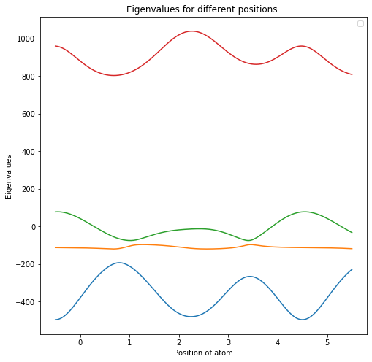

Solution: Preparations for machine learning
What input?
Positional data?
Relative distances?
Eigenvalues!
$Poij= \sum_{k}^{\left(2dsp+1\right)d}{{(\frac{R0p}{rijk}−\frac{rijk}{R0p})}^{−o}}$ for $rijk<Rop$
Build in convergence
Eigenvalues of order -2 for a particle dragged trough the unit cell.
Notes:
Alright so now we have a database, we can begin training a neural network right? No but nearly!
The inputs of the neural network still need to be picked. The obvious choice is just positional data but this is not a good solution. Because this is not symmetric and thus such a network will have to learn that itself which is inefficient.
One of the other possibilities is just using the relative distance of each particle since that is also what the potential energy function uses. We only need to sort it to make sure it is symmetric and then it will be good. But sadly this will also not work very well. This is because while it is symmetric it will result in inputs and thus also outputs that are not continuously differentiable. Imagine three particles on a line the middle particle is closer to one particle than another. Now the middle particles moves to the other particle and we can see a problem. As soon as the particle is halfway the relative distances will cross and thus since their derivates are different there will be a discontinuity in the derivative of the inputs.
But what can be used? Well, ordered eigenvalues of a matrix are continuous and will never cross if the values in the matrix are continuous. This is the no crossing theorem. But what should the elements of the matrix be?
This is the answer. The calculate the proximity of order o for particle i and particle j. You calculate their relative distance and enter it into this function. It looks nearly like a 1 over r to the power o function but it has build in convergence at R0p. You then repeat this for each equivalent of j in each other cell of the lattice and take the sum. The reason these equivalent particles are taken into account is so that neural network also can get a feeling of how the neighboring particles in other cells effect the particle in the central cell. To calculate the entire matrix you calculate this for every combination i and j and thus it will result in a matrix that has the same size as the number of particles squared.
Because of course that only produces the amount of input equivalent to the number of particles you need to make the same about of these proximity matrices as there are dimensions because otherwise the system will be underdetermined.
2:30m -> 15:05m

Slide 15
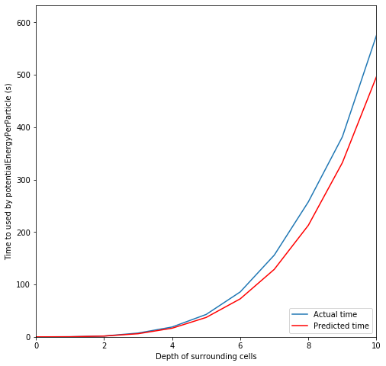
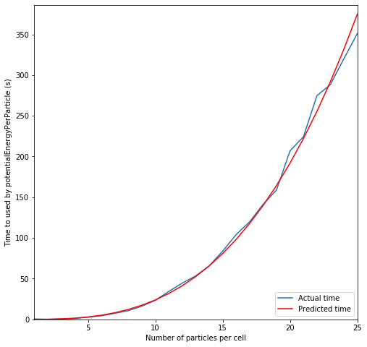

Results: Speed
Very fast
$O\left(dsd Np2\right)+O\left(ds2d Np3\right)$
The calculation time for a increasing depth of surrounding cells with N_{p}=4.
The calculation time for a increasing number of particles with d_{s}=2.
Notes:
So now that we can generate our database how does it perform? Quite well in fact!
It scales equivalent or worse than DFT simulations (depending on which algorithm is used) but the pre-factor is much smaller since this is just a simple analytical calculation.
As you can see in these images especially for low numbers of particles and a low depth of surrounding cells the algorithm performs very good.
0:30m -> 15:30m

Slide 16

Results: Speed
Preperations
$O\left(dspd Np2\right)+O(Np3)$
0.5 seconds for 20 particles
Notes:
The speed at which the preparations of the database can be done is also important since that ultimately decides how much faster the calculations with the trained neural network are compared to DFT simulations. The construction of the proximity matrix scales like this and the calculation of the eigenvalues scales like O(Np^3) although depending on the method used this can be slightly lower. But here we just used a general numpy algorithm. This of course needs to be done for each dimension so another factor d is added to each of these terms.
Again a test using real computations was also done and it took around 0.5 seconds per data point to prepare a database for 20 particles which is very fast.
0:45m -> 16:15m

Slide 17
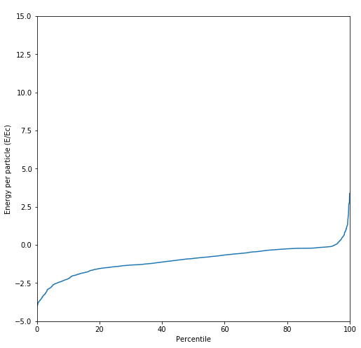
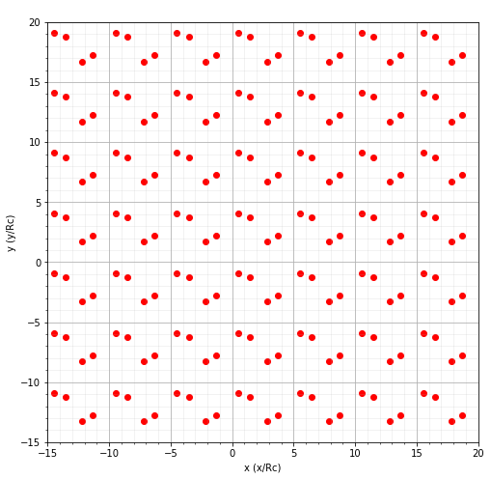
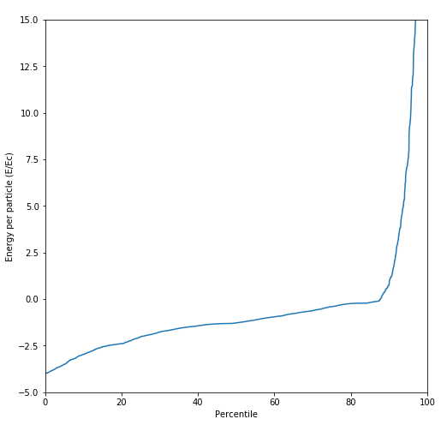
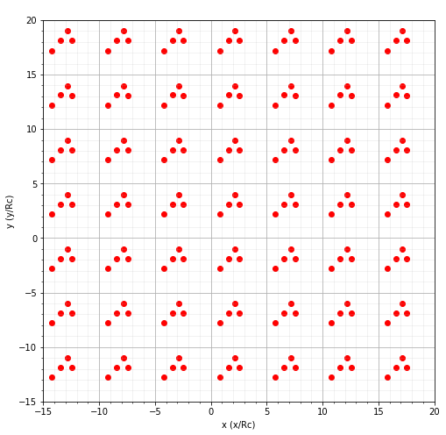
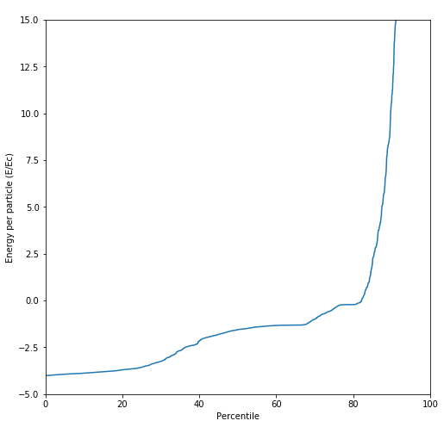
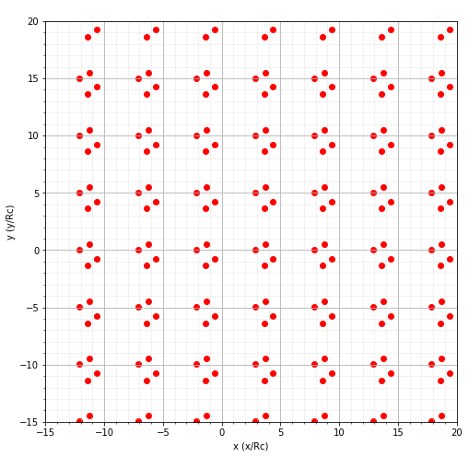
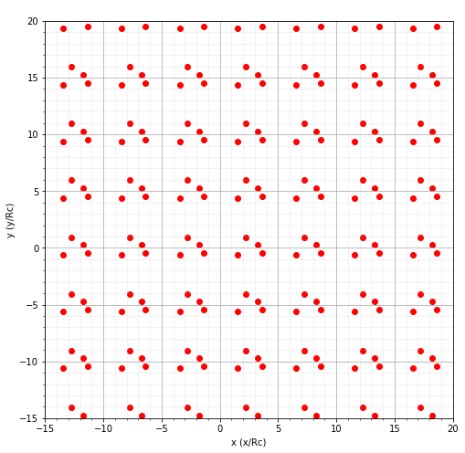
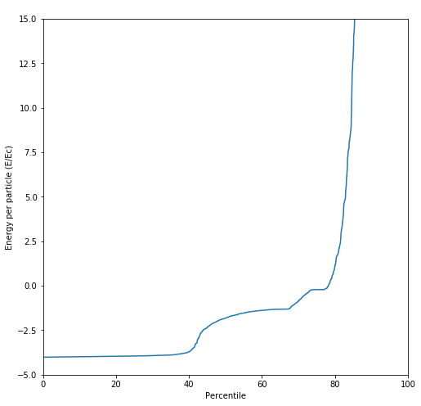
Results: Databases
Amount of scans
Prevalent configurations
Acceptance rate
20% -> 30 to 40 scans
Depends on cell width
Pair forming.
Distribution for with 30 scans of relaxation.
Distribution for with 50 scans of relaxation.
Triangle forming.
Distribution for with 200 scans of relaxation.
Distribution for with 100 scans of relaxation.
No clear shapes (yet).
Square forming.
Notes:
One of the questions with generating a database is how much the relaxation process should be applied. To test this I made a couple of databases with a cell width of 5Rc and 4 particles and did different amounts of relaxation. The results can be seen here. As you can see as the amount of particle scans becomes larger the bottom part of the distribution all tends towards the same value. It is unknown why for higher amount of scans the highest energies also seem to be higher and more common but luckily that is not a problem since we can cut those values off. But we do know why the lower energies seem to do this.
It is because when you inspect the lattices themselves you can see that for a higher number of scans certain configurations seem to become more prevalent. The particles seem to form either pairs, triangles or squares. This is of course bad for the database since we want the training data to posses many different kinds of configurations and these are nearly identical.
One of the ways to quantify this is the average acceptance rate of the last few scans. The acceptance rate is the percentage of particle movements which are accepted. While certainly not scientifically determined I found that a acceptance rate of around 20% seems to be optimal. This corresponds to around 30 to 40 scans and in such a database these kinds of configurations are common. There is no real pattern here but you can see they are close together and are in fact about to form a square.
It is important to note that the amount of scans needed varies with the size of the cell. In general the amount of scans needed scales directly proportional to the size of the cell. But this has the disadvantage that it takes a long time to calculate. Another option is to make the maximum step size allowed larger. But this has the disadvantage that it becomes harder for the particle to find the local minima since it is more likely to overshoot such a place. Also due to the build in convergence of the potential energy function for large cells this might not work well at all since the acceptance rate will be very high due to the change in potential always being zero since the potential is always zero.
2:30m -> 18:45m

Slide 18
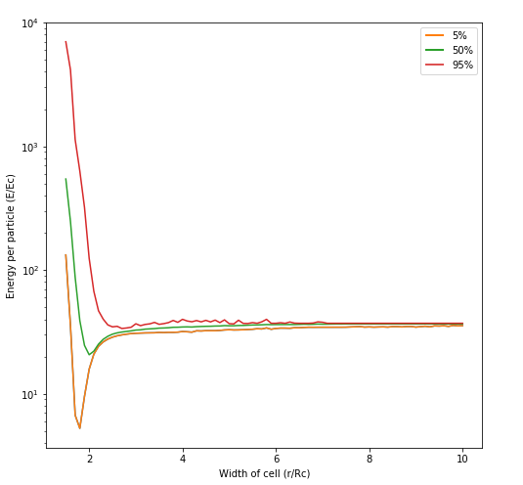
Results: Databases
Range of cell widths
Minimum and maximum
A plot of the different energies in the database. It is a log plot with a offset of -37.1E_{c}.
Notes:
Next a database with a cell size ranging from 1.5Rc up to 10Rc was created and inspected and this also looks quite good.
You can see a clear minimum in energy at the size of the cell at around two which is what we would expect. You can also see a nice and high peak for lower cell widths and as you can see that the energies start becoming way less extreme as the width of the cell becomes larger.
0:30m -> 19:15m

Slide 19
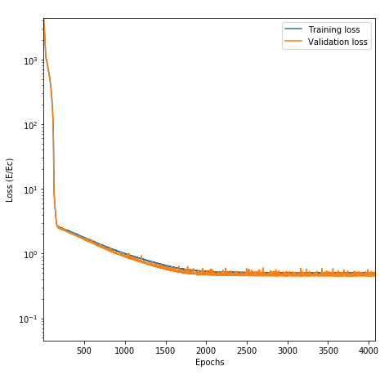
Results: Machine learning
Cell width 5R_{c}
25000 datapoints
3 trainings per network
Simple networks
Mean absolute error
ADAM optimizer
Low learning rate
The loss of a linear network with ADAM and a learning rate of 10⁻⁵.
Notes:
Finally to test how good the databases were some machine learning was also done. This was first tried on a database containing a range of cell widths but little results were achieved with this so it was then tried on only a since cell width. This did have success. The size of the database used was 25 thousand of which 20% was used as validation data. Each network was trained at least 3 times to make sure the amount of luck was minimal.
The design of the networks was kept quite simple. The most successful networks were linear networks but networks with a single hidden layer about the size as the number of inputs were also tried.
As a error metric the mean absolute error was chosen. This was done because for example root mean square error places more emphasis on outliers which is not what we want. A relative error also wasn’t chosen because the energy can easily have a offset added and that won’t change anything physically and thus a relative error didn’t make sense.
Finally a couple of optimizers were tried and except for Stochastic gradient decent all seemed to work fine so ADAM was chosen since it is a popular versatile and modern optimizer. It was also discovered that a lower learning rate always resulted in a significantly better error. A learning rate up to 10^-5 was tried and even then a lower learning rate still seemed to improve the result but this learning rate was picked since otherwise the training took way to long.
1:30m -> 20:45m

Slide 20
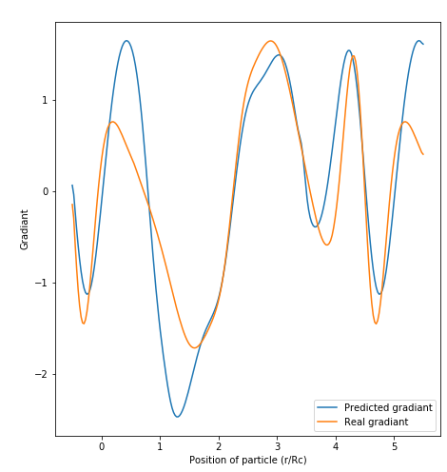
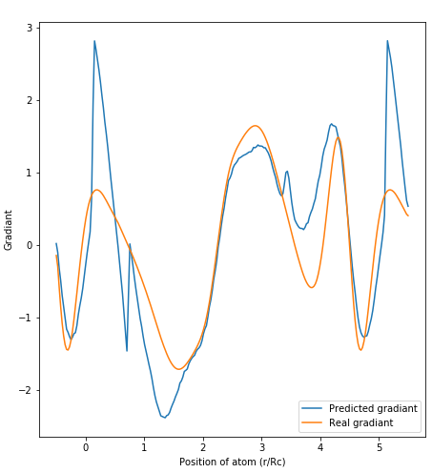
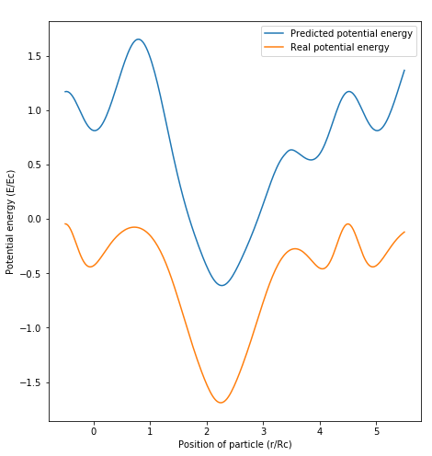
Results: Machine learning
Amount of inputs
Order of proximity matrices
Hidden layers
The potential energy per particle as the particle is moved trough the cell.
The gradient of the potential energy per particle as at the particle is moved trough the cell.
The gradient of the potential energy per particle as the particle is moved trough the cell for a network with a hidden layer.
Notes:
One of the interesting question is what kind of inputs should be used. At a minimum the same amount of proximity matrices (and their associated eigenvalues) should be generated as there are dimensions but can perhaps more inputs (and thus having a over determined system) can result in a better trained network?
The answer sadly is no. Using more inputs usually resulted in a more inaccurate network. Both for linear and non-linear networks. This might be because the overdetermination results in a network that is slightly confused as to what inputs are more important. The networks thus also seem to be unable to learn to ignore one set of the inputs. For example network with inputs of order -2 and -3 had a error of 0.5Ec but a network with inputs -2, -3 and -4 had a error of 1.6Ec.
The optimal order of the proximity matrices was also investigated. Generally a higher order of proximity matrices resulted in worse results. For example a network with inputs of order -3 and -4 had a loss of 1.4Ec which is worse than the 0.5Ec of order -2 and -3.
In this image the results of a test where a particle was dragged trough the unit cell is displayed. It is from a linear network with order -2 and -3. The energy itself has a large offset but this is not a disaster since the shape is nearly correct. As you can see the predicted gradient matches the real gradient quite well.
When we add multiple layers the error metric often stays nearly the same but especially for a network with a hidden layer the width of 4 times the input size weird discontinuity like shapes were seen. This couldn’t have been caused by the activation layer since those were softplus which are continuously differentiable and were determined to be the optimal activation layer in a previous paper.
So the best results remained to be the linear networks. And while they were not perfect they were surprisingly good.
2:00m -> 22:45m

Slide 21
Future
More focus on machine learning
Other networks
Adaptive learning rate
A faster programming language
Rewrite
Compile
Better relaxation
Conclusion
Notes:
So now a bit about the future. The scope of the project initially was more on machine learning but figuring out the potential energy turned out to be more difficult that anticipated. So this project could hopefully be the basis for a project for another BEP student which is more focused on machine learning. In such a project better networks and networks that work on multiple cell widths could be designed. A adaptive learning rate could also be implemented such that it starts with a high learning rate but becomes lower as the decline in error stagnates.
With hindsight the choice to use Python as the programming language also was a mistake. Since Python is not a fast programming language. This doesn’t have to be solved since it currently does fine but if it was reimplemented in another language is would be faster. A easier option is to look into a Python to machine code compiler because then the existing code can be used.
The current relaxation process also works poorly on large open spaces due to the way the potential energy function is defined. This can also be improved by for example using a different potential energy function when relaxing the system then when calculating the eventual potential energy.
But to conclude this project was largely a success. A potential energy function and surrounding framework was designed that is able to produces nice databases for machine learning and it does so in a way that is significantly faster and easier than using DFT simulations.
I hope that whoever is the next BEP student of mr Koelman that they will find my work useful and finally I would like to thank you all for listening.
1:45m -> 24:30m

