Slide 1

Micro Frontend Workshop
A Webpack 5 approach
November 11th, 2022

Slide 2
Introduction
Workshop is based on my experiences within the Rabobank
Assignments focus on the Angular framework (and React for the last assignment)
Interactive presentation, interrupt me whenever you have questions
Many illustrations/diagrams to illustrate concepts and problems
Reach out if there is something you are interested in but haven’t seen

Slide 3
Table of contents
Reasons to split up your frontend application (5 sheets)
Domain-Driven Design (DDD) (6 sheets)
Implementing DDD with NX (10 sheets)
Assignment 1: Implement Domain-Driven Design
** Lunch break **
Architectural choices (9 sheets)
Multiple repositories vs. mono repositories (2 sheets)
What is Module Federation? (5 sheets)
Sharing dependencies with Module Federation (12 sheets)
Applying Module Federation (13 sheets)
Assignments 2-4: Implement a Micro Frontend architecture with Static (2), Dynamic (3) and Multi-framework (4) Module Federation

Slide 4
Reasons to split up your frontend application

Slide 5
1) Subpar developer experience
You notice:
Cold boots of your project take very long
The project structure is difficult to work with
You are losing the overview of how everything is interconnected

Slide 6
2) Slow / unstable pipelines
You notice:
The project takes a long time to build, slowing down the CI pipeline
A rapid increase of integration tests that need to be run, slowing down the CD pipeline
A rapid increase of load on infrastructure due to long-running parallel pipeline jobs
Risk of infrastructure instability causing flaky integration test results
An increasing number of failed pipeline jobs

Slide 7
3) Refactoring is hard
You notice:
Refactoring parts of the project gets more and more challenging
More and more teams need to be involved with changes
Migrations within the project take longer than they should
Quality / structure of the project is getting worse

Slide 8
4) Tight coupling
You notice:
More and more teams need to be involved with changes
Tight coupling between features or the main app
You will notice the level of coupling when you try to split off a feature into a stand-alone app
More occasions where simple changes caused something seemingly unrelated to break

Slide 9
Goals of splitting up the app
Forces you to design a decoupled project structure, improving overview for developers
Tight coupling between features or the main app can be identified and decoupled
Better developer experience: smaller apps will start and reload faster
Pipelines build and test smaller apps, decreasing load, increasing throughput and stability
Less interdependencies = fewer teams need to be involved with changes
Migrations are easier to do in smaller apps
But how do you start to split up the application?

Slide 10
Domain-Driven Design (DDD)

Slide 11
Improve maintainability
Subdivide your application into small, less complex decoupled parts
First goal: identify so-called sub-domains

Slide 12

Identify sub-domains
Employee
Expert
Manager
Buying Agent
Request Product
Specify Order
Approve Order
Send Order
Take a look at your automated processes. Indicators of sub-domains:
Organizational: Different roles responsible for specific processes
Vocabulary: Terms are used differently depending on the context
Pivotal events: Completion of significant tasks. Process likely proceeds in another sub-domain

Slide 13




Identify sub-domains
Employee
Expert
Manager
Buying Agent
Request Product
Specify Order
Approve Order
Send Order
Product
Order
Budget
Hierarchy
Request Budget
Approve Budget
Manager
Manager

Slide 14
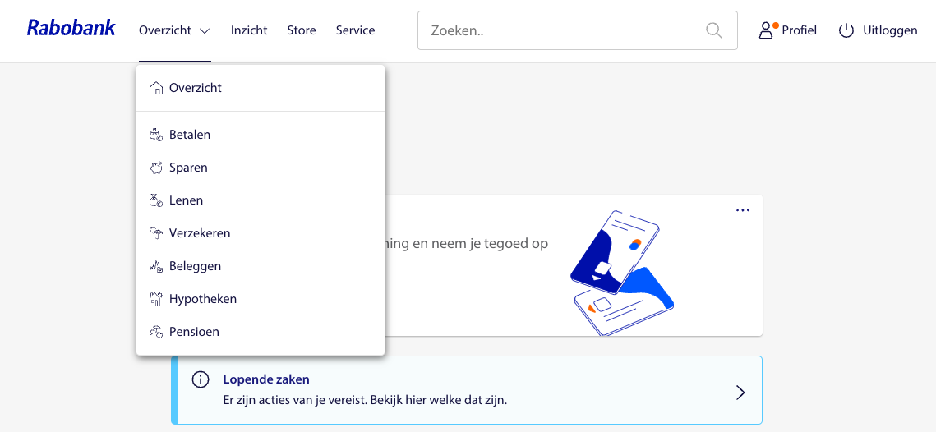
Identify sub-domains: menu items

Slide 15
Domains are modelled separately
Catalog
Approval
Product
Id
Title
Description
Product
Id
Title
Price
Price
Picture
Q&A
Budget
No redudancy: Each domain has an unique perspective to its entities
For instance: Catalog process needs many details, Approval does not

Slide 16

Context-Mapping
Catalog
Catalog
API
Order
Order
Left: Domains aren’t decoupled anymore
Right: Prevents tight coupling with an API

Slide 17
Implementing DDD with NX

Slide 18
NX architecture matrix
Catalog
Order
Shared
Feature
API
Feature
Feature
Feature
Feature
UI
UI
UI
UI
UI
UI
UI
UI
UI
Domain
Domain
Domain
Util
Util
Util
Util
Util
Util

Slide 19
My recommended architecture matrix
Catalog
Order
Shared
Page
Page
Page
Page
Page
Page
Page
Page
Page
Feature
API
Feature
Feature
Feature
Feature
UI
UI
UI
Domain
Domain
Domain
Util
Util
Util

Slide 20
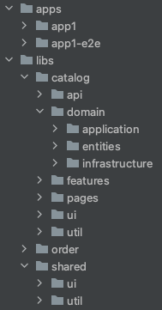
Project categories
App: provides the entry point for a domain
Api: provides functionality exposed to other domains
Domain: domain logic like models, interfaces, data, services, facades, state management
Feature: use case implementation with smart components
Page: page components that use features
Ui: use case-agnostic reusable dumb components
Util: reusable helper functions

Slide 21
Project categories
Shared folder only contains ui and util
It should never expose domain-specific functionality, use the api projects instead!

Slide 22
Restricting imports
app
catalog-page
order-page
catalog-feature
order-feature
order-page-2
Project type import violation
catalog-domain-logic
Domain import boundary violation

Slide 23
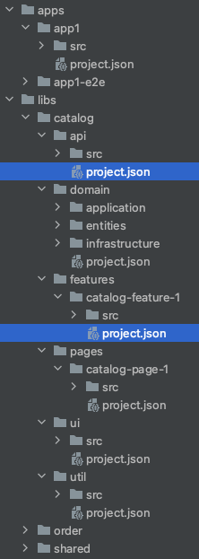
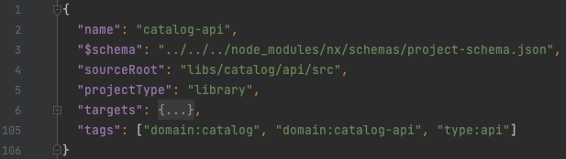
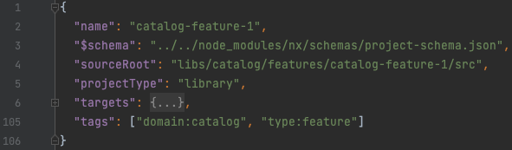
Restricting imports – project tags
NX enables tags option in project configuration

Slide 24
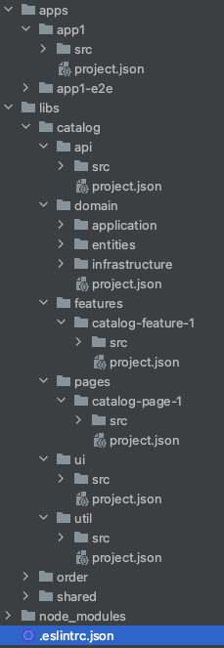
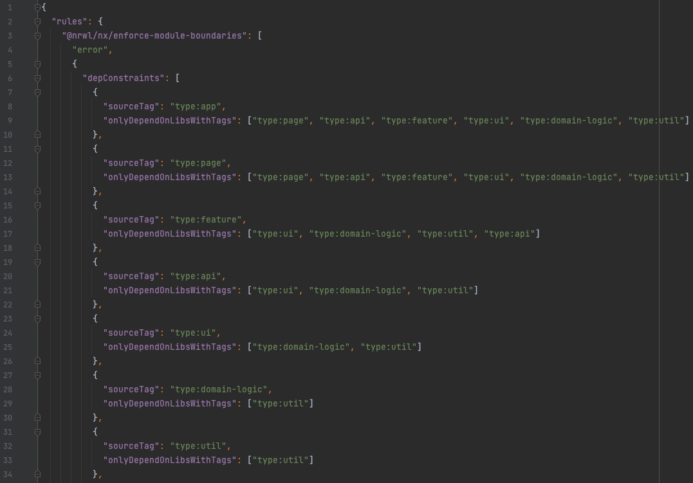

Slide 25
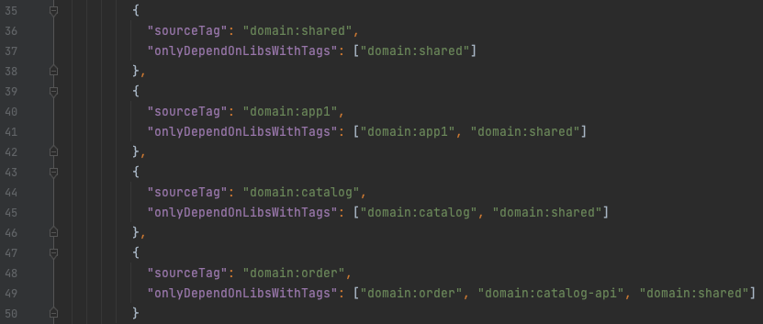

Slide 26
Restricting imports
app
domain:catalog
domain:order
type:page
type:page
catalog-page
order-page
domain:catalog
domain:order
domain:order
type:feature
type:feature
type:page
catalog-feature
order-feature
order-page-2
domain:catalog
type:domain-logic
“type:feature” may not import “type:page”
catalog-domain-logic
“domain:order” may not import “domain:catalog”

Slide 27
Modular Monolith = Modulith
app
domain:catalog
domain:order
domain:order
type:page
type:page
type:page
catalog-page
order-page
order-page-2
domain:catalog
domain:order
type:feature
type:feature
catalog-feature
order-feature
domain:catalog
domain:catalog
domain:catalog-api
type:domain-logic
type:api
catalog-domain-logic
catalog-api

Slide 28
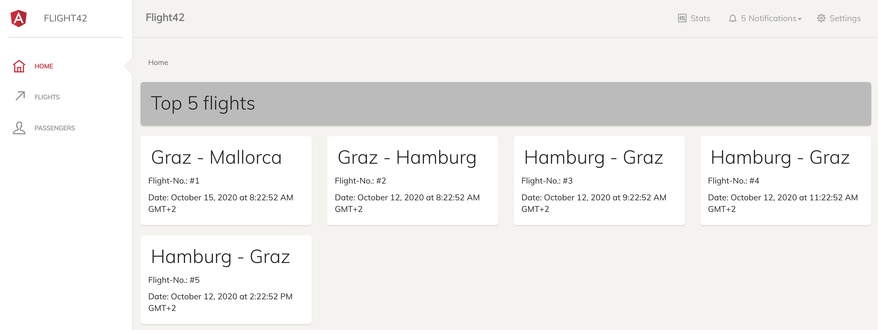
Assignment 1: Implement a DDD
Goal: Transform the monolith flight-app to a modulith app
Go to https://github.com/HybrIT-dev/mfe-workshop. Read the readme.
Checkout main branch and create your own unique branch to work on

Slide 29
Architectural choices

Slide 30
A decoupled modulith
The Domain-Driven Design resulted in a decoupled Modulith app
Improved dependency graph
Improved project structure
Smaller, less complex modules
Restricted imports limit interdependencies: less tests need to run
You may no longer need to split up the app

Slide 31
Architectural choices
Deploy Modulith as one artifact
Further decouple Modulith into several smaller micro applications
UI Composition with Hyperlinks
UI Composition with a Shell
Module Federation (Micro Frontends)

Slide 32
Deploy Modulith as one artifact
Consistent UI
Optimized bundles by compiling everything together
Slow builds due to big app
Much coordination required between teams of other sub-domains
Policy required for updating dependencies
Tempting to work around domain boundaries and reuse other domain features

Slide 33
Micro apps
Teams can choose their architecture and technology stack
Use “the best technology” for the requirements within the sub-domain
Complete isolation
Smaller apps = faster builds
If you choose to isolate the app in individual repositories, you have to deal with shipping shared libraries via npm
User experience impact when navigating between micro apps
Session state complexity

Slide 34
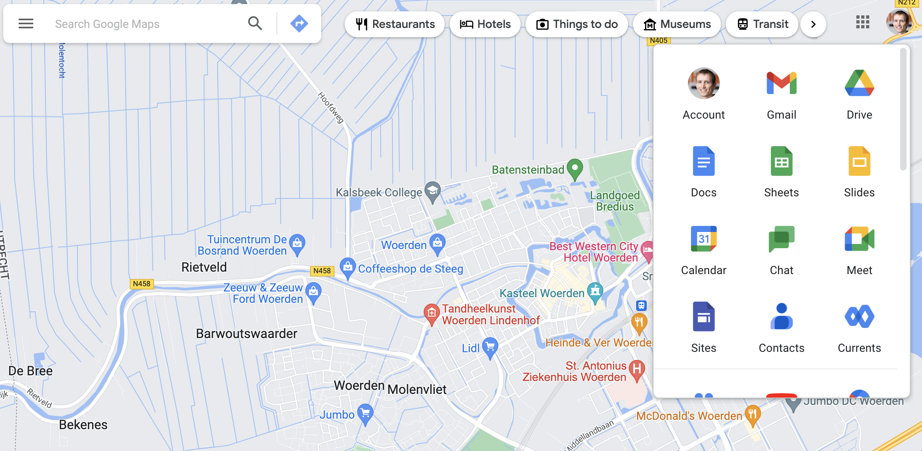
UI composition with Hyperlinks

Slide 35
UI composition with Hyperlinks
Easy to implement
Uses simple SPA frameworks as they were intended
Optimized bundles per domain
Requires an universal design system to get a standard look-and-feel
User experience impact when navigating between applications
Session state complexity

Slide 36
UI composition with a Shell
A shell application loads an app into an element at run-time: e.g. iframes
Complete isolation: iframes cannot influence apps in another iframe
Allows the integration of legacy systems
Session state is preserved
Requires an universal design system to get a standard look-and-feel
Much performance overhead when loading a micro app at run-time
Requires infrastructure code to load a micro app

Slide 37
Module Federation
A shell-based architecture that loads and renders code from separately deployed remote javascript modules at run-time
Complete isolation of domains
All functionality is loaded within a shell: session context never changes
Opportunity to combine multiple frameworks, excellent for migrations
Incredible flexibility to load any Javascript-based module at run-time
Requires Webpack 5 or later
Tricky to deploy/manage many Module Federated applications
Better suited for large applications

Slide 38
Decision tree
UI composition with Hyperlinks
little
How much shared state and navigation?
iframes
Need to support a legacy app or a very strong isolated app?
yes
Monolith
no
much
Module Federation
Need smaller apps with separate deployments?
yes
no
Support or migrate multi frameworks in big apps?
Module Federation
yes
yes
Webpack 5+ support?
no
Micro app
no

Slide 39
Multiple repositories vs. Mono repositories

Slide 40
Micro frontends in a mono repo??
Sounds like a contradiction, but there are many advantages:
No version conflicts by design
Easy code sharing
Optimized bundles
Also able to deploy Micro Frontends separately thanks to NX
Micro Frontends can be isolated from each other with import boundaries
Project structure can be gigantic and harder to navigate
Teams need to align on architectural and tech stack decisions

Slide 41
Micro frontends in multiple repositories
Complete isolation by design
Teams can fully concentrate within a narrowly scoped repo
Teams have the maximum amount of freedom: architecture, tech stacks
Separate deployments without needing NX
Version management is required
Distribute shared dependencies via NPM
Using different tech stacks and frameworks might lead to version conflicts in the browser and increased bundle sizes

Slide 42
What is Module Federation?

Slide 43
A simple application
Application
{1}
{2}
1.1
1.2
1.3
2.1
2.2
2.3
A
Shared dependency

Slide 44

Separating a domain
Application
{1}
{2}
1.1
1.2
1.3
2.1
2.2
2.3
A
Shared dependency

Slide 45
Isolated / federated module
Application
Federated Module
{1}
{2}
1.1
1.2
1.3
2.1
2.2
2.3
A
Shared dependency

Slide 46

Shell / Host and remote
Application (shell / host)
Federated Module (remote)
App routing
import remote entry module
build
exposes
Remote entry module
remoteEntry.mjs
webpack config
{1}
{2}
exports
1.1
1.2
1.3
A
2.1
2.2
2.3
Shared dependency

Slide 47



Shell with imported remote module
Application (shell)
App routing
Remote entry module
{1}
{2}
1.1
1.2
1.3
A
2.1
2.2
2.3
Shared dependency

Slide 48
Sharing dependencies with Module Federation

Slide 49
Shared dependencies
Application (shell)
Federated Module (remote)
App routing
Remote entry module
webpack config
webpack config
{1}
{2}
1.1
1.2
1.3
A
2.1
2.2
2.3
Shared dependency

Slide 50

Shared dependencies - Properties
webpack config
shared : { “< importPathToModule >”: {…} }
version
requiredVersion
strictVersion
singleton
eager + pinned
The version of the shared module
The required version of the shared module
Throws an error if the shared module version is not valid
Only allow a single version of the shared module
Preload a shared module in the main bundle

Slide 51
version & requiredVersion
shared : {
“@angular/core”: { “version”: “12.1.3”, “requiredVersion”: ”^12.0.0”}
}
version
requiredVersion
The version of the shared module
The required version of the shared module

Slide 52
version & requiredVersion
shared : {
“@angular/core”: { “version”: “12.1.3”, “requiredVersion”: ”^12.0.0”}
}
Inferred from package.json
version
requiredVersion
The version of the shared module
The required version of the shared module

Slide 53
version & requiredVersion
shared : {
“@angular/core”: { “requiredVersion”: ”^12.0.0”}
}
Shell
Remote
@angular/core: ^12.1.0
@angular/core: 12.1.0
@angular/core: 12.1.0
@angular/core: ^12.1.0
@angular/core: ^12.1.0
@angular/core: 12.1.0
@angular/core: 12.1.0
@angular/core: ^12.0.0
@angular/core: ^12.0.0
@angular/core: 12.0.0
@angular/core: 12.1.0
fallback
@angular/core: ^12.1.0
@angular/core: ^12.0.0
@angular/core: 12.0.0
@angular/core: 11.0.0
triggers warning
@angular/core: ^11.0.0

Slide 54
strictVersion & singleton
shared : {
“@angular/core”: { “requiredVersion”: ”^12.0.0”, “strictVersion”: true, “singleton”: true}
}
requiredVersion
strictVersion
singleton
The required version of the shared module
Throws an error if the shared module version is not valid
Only allow a single version of the shared module

Slide 55
strictVersion & singleton
shared : {
“@angular/core”: { “requiredVersion”: ”^12.0.0”, “strictVersion”: true, “singleton”: true}
}
Shell
Remote
@angular/core: ^12.1.0
@angular/core: 12.1.0
@angular/core: ^12.1.0
@angular/core: ^12.1.0
@angular/core: 12.1.0
@angular/core: ^12.0.0
@angular/core: ^12.0.0
@angular/core: 12.1.0
@angular/core: ^12.1.0
@angular/core: ^12.0.0
Webpack throws error
@angular/core: ^11.0.0

Slide 56
Singleton shared dependency
Application (shell)
Federated Module (remote)
App routing
Remote entry module
“@senses/A” : { singleton : true }
webpack config
webpack config
{1}
{2}
1.1
1.2
1.3
A
2.1
2.2
2.3
Shared dependency

Slide 57
Singleton shared dependency
Application (shell)
App routing
Remote entry module
{1}
{2}
1) Hey Webpack , I need a shared dependency “A” from source “@senses/A”
1.1
1.2
1.3
A
2.1
2.2
2.3
“@senses/A” : { singleton : true }

Slide 58
Singleton shared dependency
Application (shell)
App routing
2) No shared dependency “A” from source “@senses/A” has been registered yet
Remote entry module
{1}
3) Registering
{2}
4) Here is the shared dependency instance
1.1
1.2
1.3
A
2.1
2.2
2.3
“@senses/A” : { singleton : true }

Slide 59
Singleton shared dependency
Application (shell)
App routing
Remote entry module
6) Here is the shared dependency instance
{1}
{2}
5) Hey Webpack , I need a shared dependency “A” from source “@senses/A”
1.1
1.2
1.3
A
2.1
2.2
2.3
“@senses/A” : { singleton : true }

Slide 60
eager & pinned
shared : {
“@angular/core”: { “requiredVersion”: ”^12.0.0”, “eager”: true, “pinned”: true}
}
Improves startup time by eliminating asynchronous import requests
Improves load time of a remote module by preloading its dependencies
eager
pinned
Preload a shared module in the main bundle
Preload an unused shared module in the main bundle
Increases build time and bundle size
Increases build time and bundle size

Slide 61
Applying Module Federation
A.K.A. the fun part ☺

Slide 62
Steps to apply module federation
For each of your domains:
Add a new stand-alone remote app
Add webpack config with the ModuleFederationPlugin
Support Module Federation’s eager consumption of dependencies
Transform your main app to a host
Extend webpack config with the ModuleFederationPlugin to transform your main app into a host
Support Module Federation’s eager consumption of dependencies
Tell Webpack where to find the remote apps
Replace entry page imports with imports of the federated remote module

Slide 63
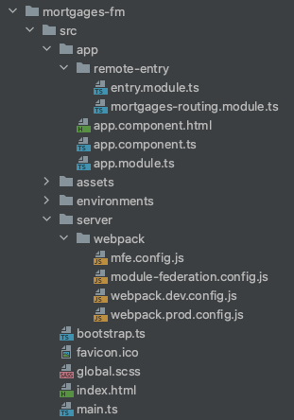
Remote app example

Slide 64
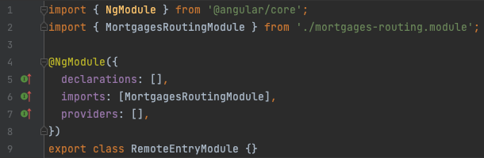
Remote app example

Slide 65
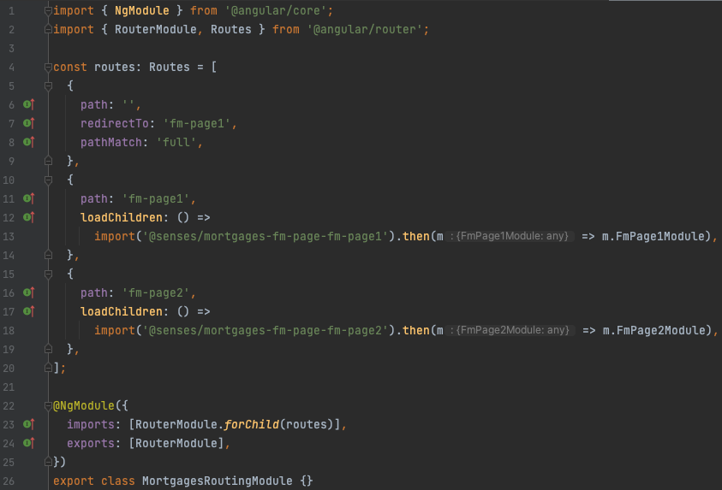
Remote app example

Slide 66
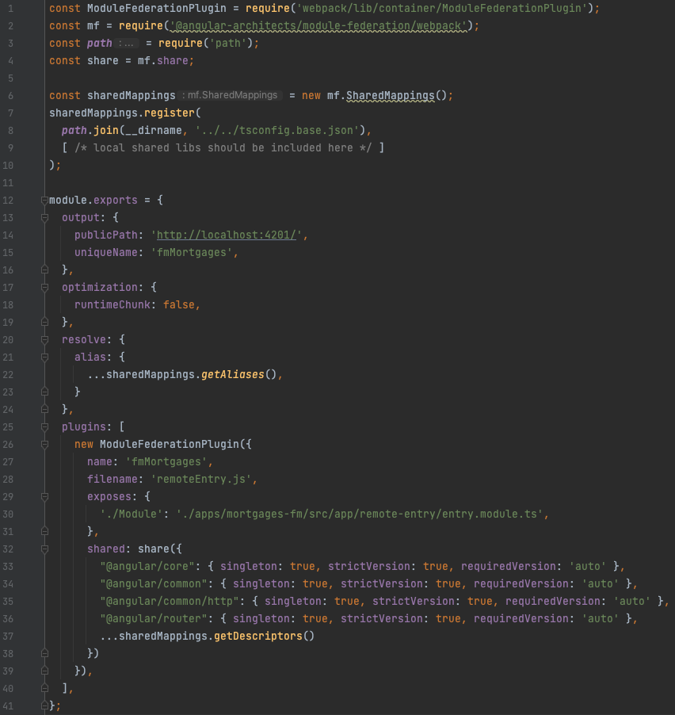

Slide 67
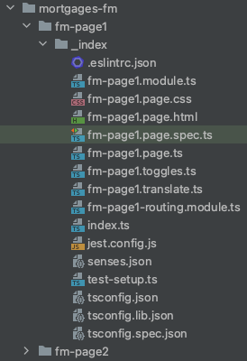
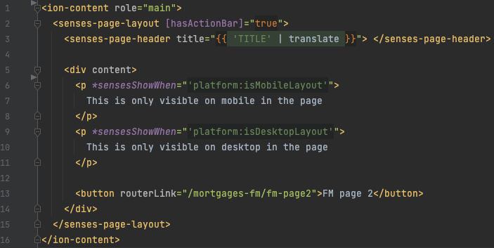
Remote app example
Not rendered because
this depends on state in a stateful library that is not shared yet

Slide 68
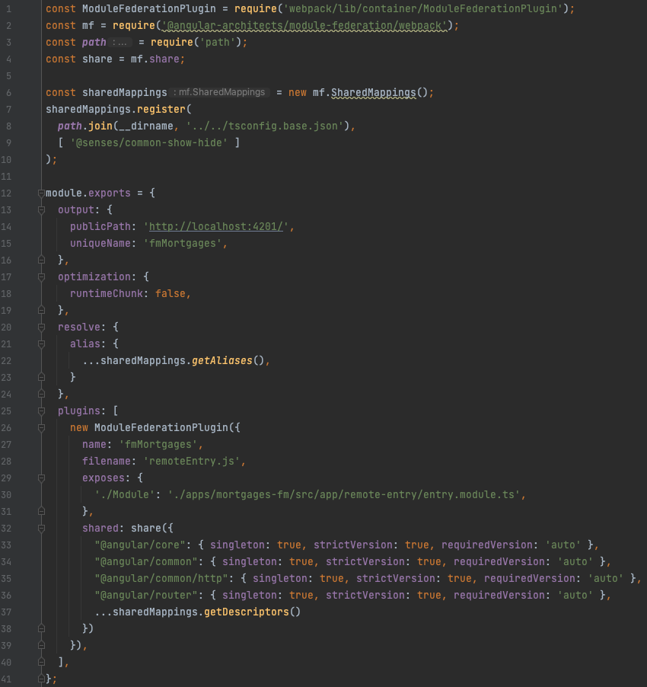

Slide 69
Error: Cannot find module 'ramda'
at webpackMissingModule (consumes:134:162)
at consumes:134:270
at __webpack_require__.m.<computed> (consumes:164:1)
at __webpack_require__ (bootstrap:19:1)
at 5256 (app.module.ts:24:28)
at Function.__webpack_require__ (bootstrap:19:1)
at _ZoneDelegate.invoke (zone.js:372:26)
at Zone.run (zone.js:134:43)
at zone.js:1275:36
at _ZoneDelegate.invokeTask (zone.js:406:31)

Slide 70
What is going on?
Host app
Remote app
Host
import bundle 412.js
fm-page-1
webpack config
common-show-hide
webpack config
register as shared bundle 412.js
register as shared bundle 412.js
import bundle 562.js
ramda
register as bundle 562.js
register as bundle 783.js

Slide 71
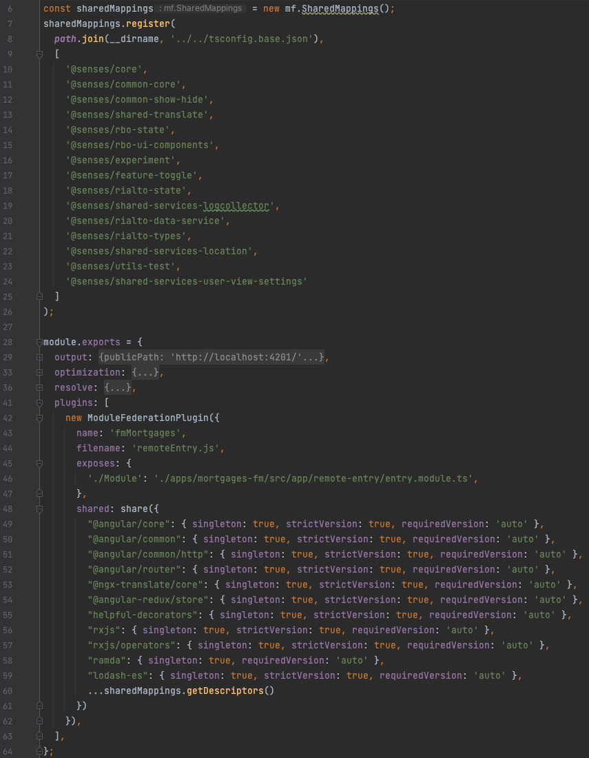

Slide 72
Transition to NX module federation
It is already used as our toolset
It simplifies and automates the webpack configuration
It automatically scans your local NX workspaces and finds shared npm packages and local libraries
It is easy to configure what npm packages and local libraries you want to share or exclude between the host and remotes
It includes schematics that provide a well-thought-out project structure for your remotes and host apps
The NX CLI has the capability to boost up serving your remote and host apps locally by leveraging cache

Slide 73

Transition to NX module federation

Slide 74
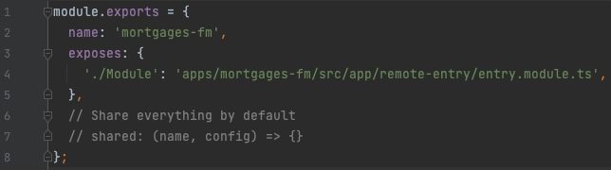
Transition to NX module federation

Slide 75
Assignments 2-4: Module Federation
Goal: Implement a Micro Frontend architecture with Module Federation for the modulith flight-app
Read the docs for the instructions

