Slide 1
HLS Streaming_free_running_k2k
Tim Hsu
Notes:
Kernel to kernel streaming example consisting of three compute
units in a linear hardware pipeline.
1) Memory read
This Kernel reads the input vector from Global Memory and streams its
output.
2) Increment
This Kernel reads stream input, increments the value and streams to
output.
3) Memory write
This Kernel reads from its input stream and writes into Global Memory.

Slide 2
Outline
Streaming_free_running_k2k
Memory Read
Increment
Memory Write
Vitis_analyzer
Streaming_k2k_mm
Read/Write Stream
Vitis_analyzer
Notes:
描述：
Kernel到Kernel streaming example 由linear hardware pipeline 中的三個計算單元組成。
Memory read
該Kernel從Global Memory中讀取輸入向量並stream傳輸其輸出。
2) Increment
這個Kernel讀取stream輸入，增加值和stream輸出。
3) Memory write
該Kernel從其stream輸入讀取並寫入Global Memory。

Slide 3
Streaming_free_running_k2k
Notes:
描述：
Kernel到Kernel streaming example 由linear hardware pipeline 中的三個計算單元組成。
Memory read
該Kernel從Global Memory中讀取輸入向量並stream傳輸其輸出。
2) Increment
這個Kernel讀取stream輸入，增加值和stream輸出。
3) Memory write
該Kernel從其stream輸入讀取並寫入Global Memory。

Slide 4
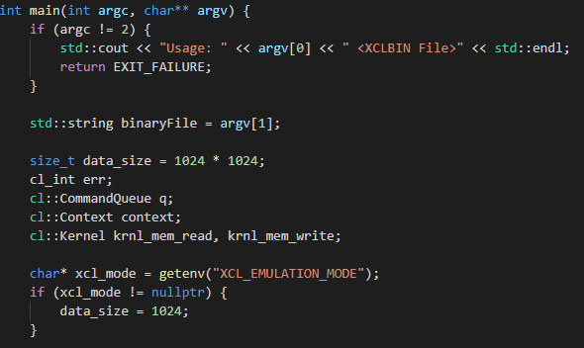
Streaming_free_running_k2k Memory Read
Notes:
// 減少 emulation mode的 data size
char* xcl_mode = getenv("XCL_EMULATION_MODE");

Slide 5
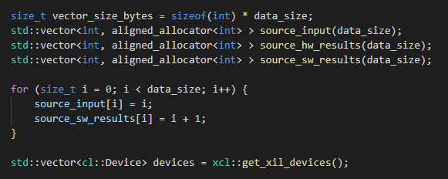
Streaming_free_running_k2k Increment
Notes:
// 分配 Memory in Host Memory
size_t vector_size_bytes = sizeof(int) * data_size;
// Create the test data and Software Result
for (size_t i = 0; i < data_size; i++) {
// OPEN CL HOST CODE AREA START
get_xil_devices() 是一個實用 API，它將查找 Xilinx 平台並返回連接到 Xilinx 平台的設備列表
std::vector<cl::Device> devices = xcl::get_xil_devices();

Slide 6
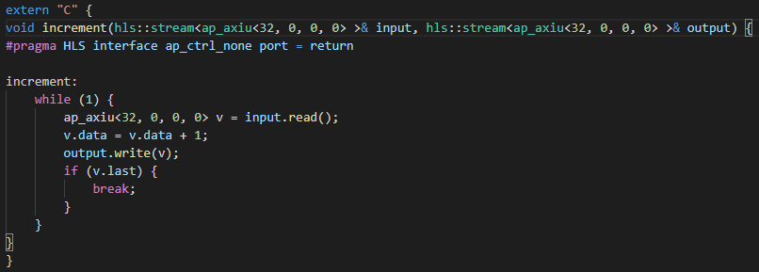
Streaming_free_running_k2k Increment
Notes:
// For free running kernel, user needs to specify ap_ctrl_none for return port.
// This will create the kernel without AXI lite interface. Kernel will always be in running states.
#pragma HLS interface ap_ctrl_none port = return

Slide 7
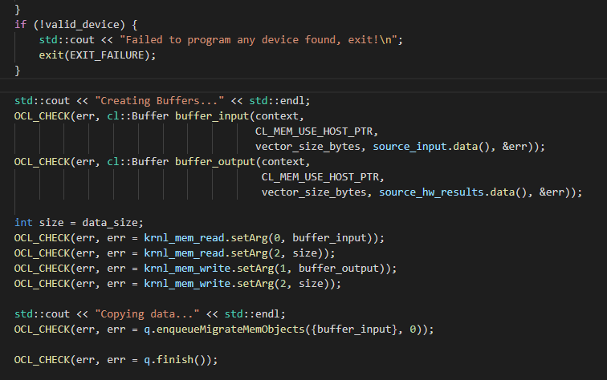
Streaming_free_running_k2k Memory Write
Notes:
// Allocate Buffer in Global Memory
//Buffers 被分配使用CL_MEM_USE_HOST_PTR for 有效的 memory and Device-to-host communication
std::cout << "Creating Buffers..." << std::endl;
// Set the Kernel Arguments
int size = data_size;
// Copy input data to device global memory
std::cout << "Copying data..." << std::endl;

Slide 8
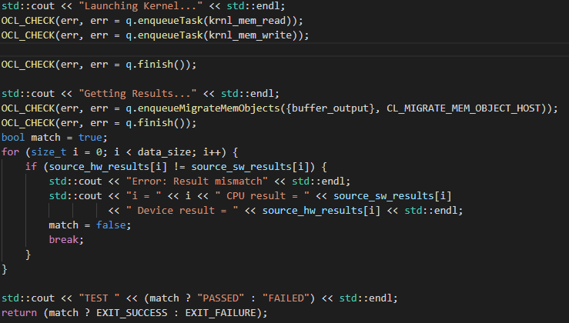
Streaming_free_running_k2k Memory Write
Notes:
// wait for all kernels to finish their operations
OCL_CHECK(err, err = q.finish());
// Copy Result from Device Global Memory to Host Local Memory
std::cout << "Getting Results..." << std::endl;
// OPENCL HOST CODE AREA END
// Compare the results of the Device to the simulation
bool match = true;

Slide 9
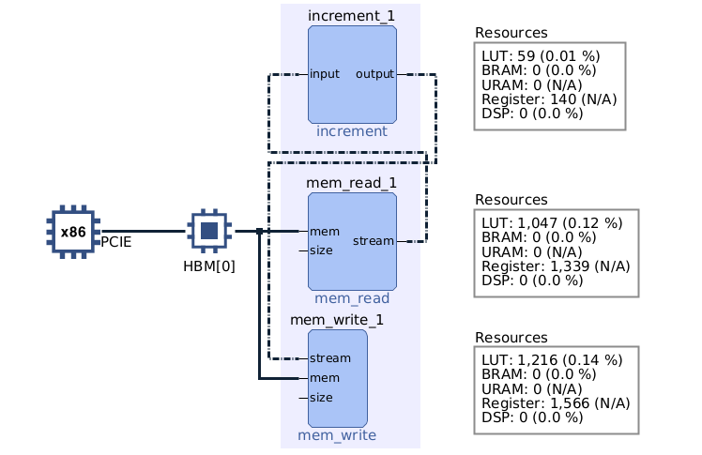
Streaming_free_running_k2k Vitis_analyzer
Notes:
System Diagram

Slide 10
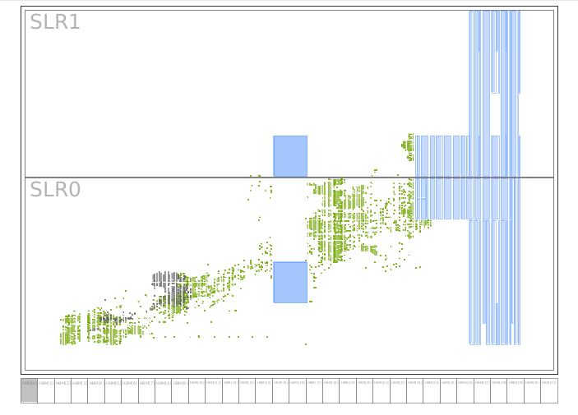
Streaming_free_running_k2k Vitis_analyzer
Notes:
Device Map

Slide 11
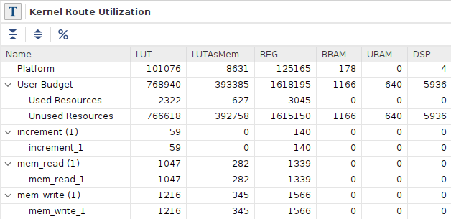
Streaming_free_running_k2k Vitis_analyzer

Slide 12
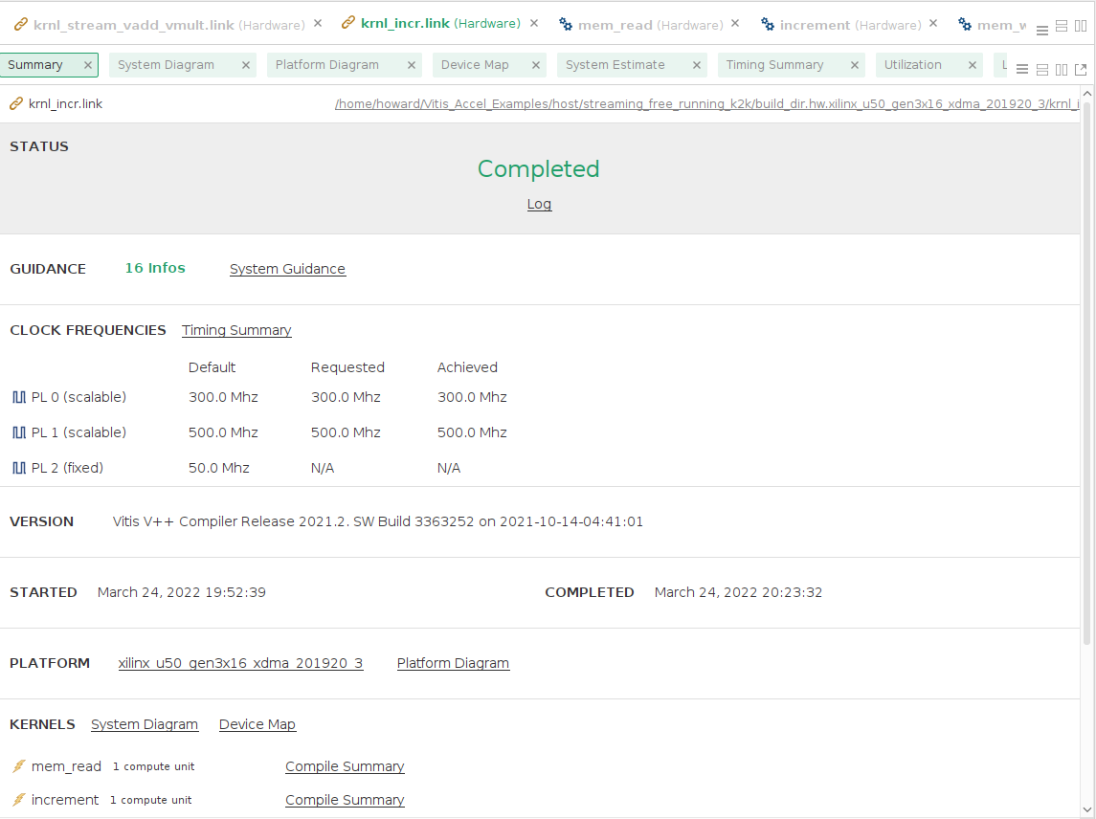
Streaming_free_running_k2k Vitis_analyzer

Slide 13
Streaming_free_k2k_mm
Notes:
描述：
Kernel到Kernel streaming example 由linear hardware pipeline 中的三個計算單元組成。
Memory read
該Kernel從Global Memory中讀取輸入向量並stream傳輸其輸出。
2) Increment
這個Kernel讀取stream輸入，增加值和stream輸出。
3) Memory write
該Kernel從其stream輸入讀取並寫入Global Memory。

Slide 14
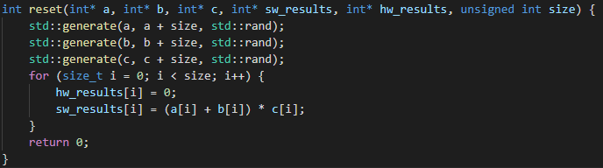
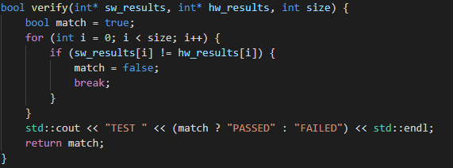
Streaming_k2k_mm Read/Write Stream
Notes:
//RESET FUNCTION//
// Fill the input vectors with data
//VERIFY FUNCTION//

Slide 15
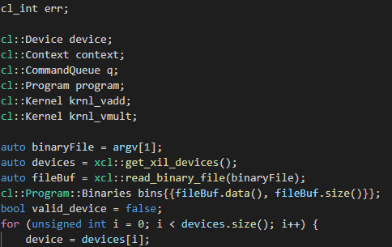
Streaming_k2k_mm Read/Write Stream
Notes:
// OpenCL Host Code Begins.
//get_xil_devices() 是一個實用 API，它將查找 Xilinx 平台並返回連接到 Xilinx 平台的設備列表

Slide 16
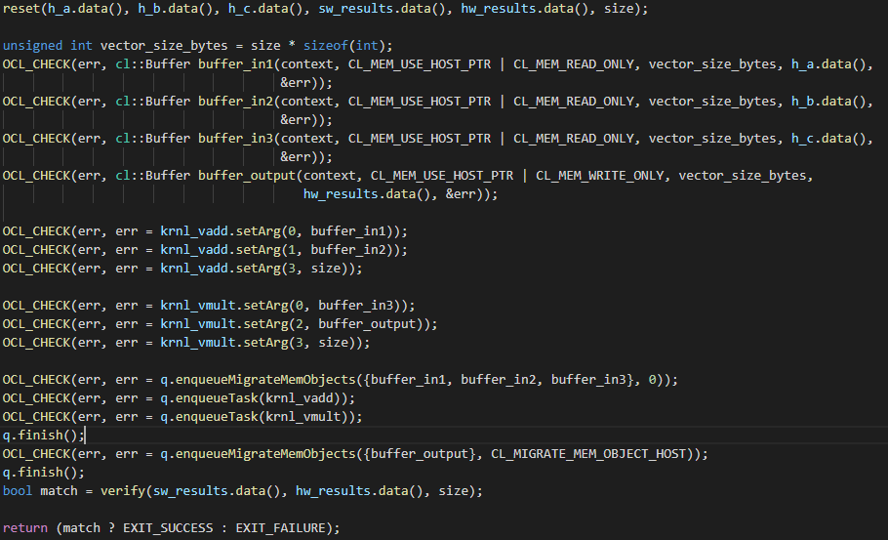
Streaming_k2k_mm Read/Write Stream
Notes:
// Reset the data vectors
reset(h_a.data(), h_b.data(), h_c.data(), sw_results.data(), hw_results.data(), size);
// Running the kernel
unsigned int vector_size_bytes = size * sizeof(int);
// Allocate Buffer in Global Memory
//Buffers 被分配使用CL_MEM_USE_HOST_PTR for 有效的 memory and Device-to-host communication
OCL_CHECK(err, cl::Buffer buffer_in1(context, CL_MEM_USE_HOST_PTR | CL_MEM_READ_ONLY, vector_size_bytes, h_a.data(),
// Setting Kernel Arguments
OCL_CHECK(err, err = krnl_vadd.setArg(0, buffer_in1));
// Copy input data to device global memory
OCL_CHECK(err, err = q.enqueueMigrateMemObjects({buffer_in1, buffer_in2, buffer_in3}, 0 /* 0 means from host*/)); // Launch the Kernel
OCL_CHECK(err, err = q.enqueueTask(krnl_vadd));
OCL_CHECK(err, err = q.enqueueTask(krnl_vmult)); q.finish(); // Copy Result from Device Global Memory to Host Local Memory
OCL_CHECK(err, err = q.enqueueMigrateMemObjects({buffer_output}, CL_MIGRATE_MEM_OBJECT_HOST));q.finish();
// OpenCL Host Code Ends // Compare the device results with software results
bool match = verify(sw_results.data(), hw_results.data(), size);

Slide 17
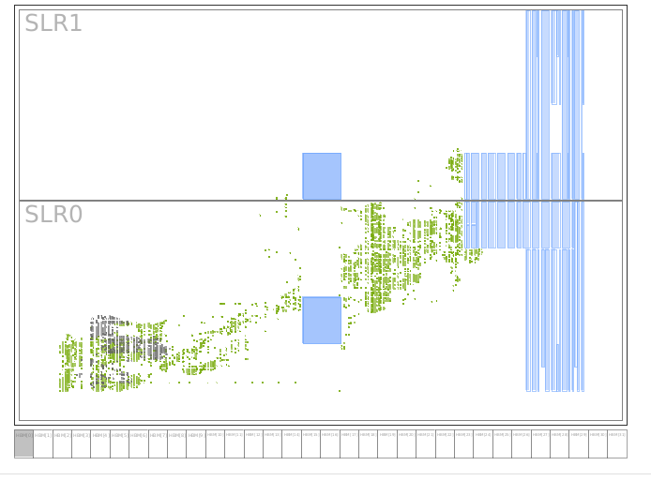
Streaming_k2k_mm Vitis_analyzer

Slide 18
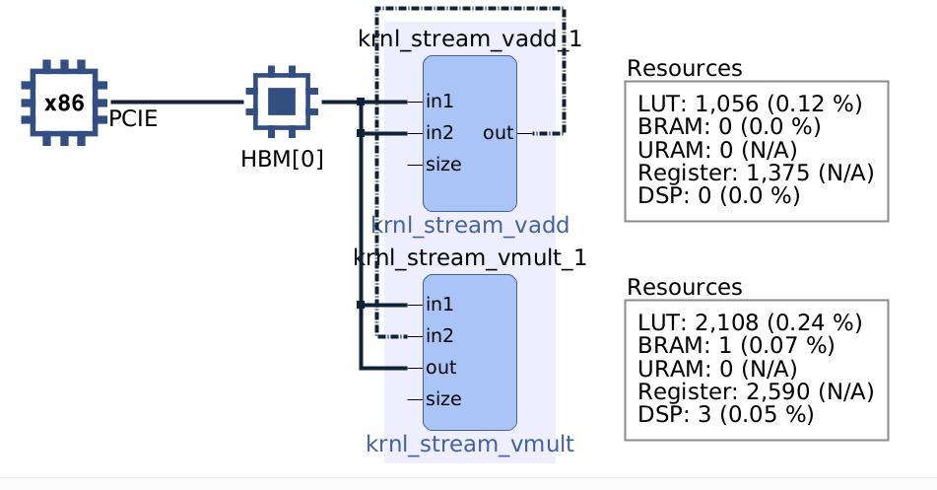
Streaming_k2k_mm Vitis_analyzer
Notes:
System Diagram

Slide 19
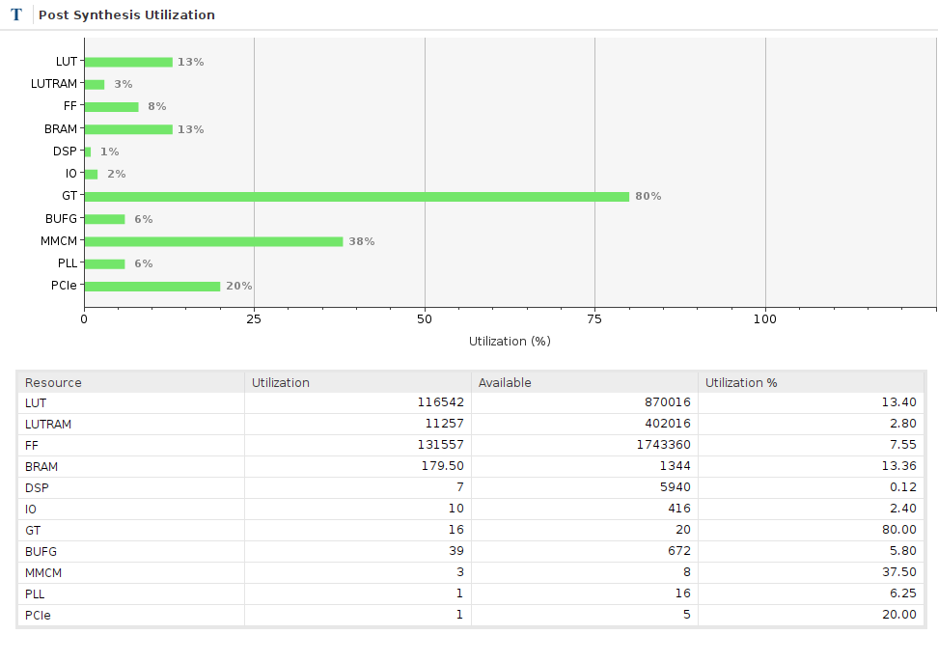
Streaming_k2k_mm Vitis_analyzer
Notes:
Utilization

Slide 20
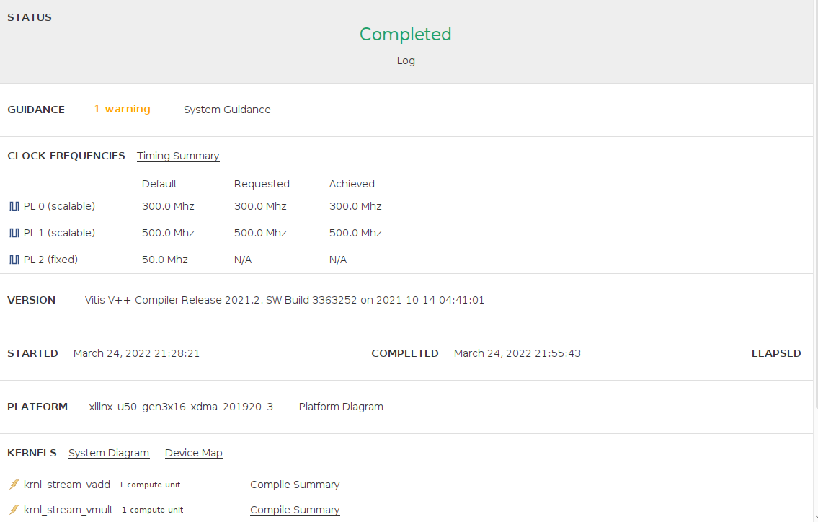
Streaming_k2k_mm Vitis_analyzer

