Slide 1
Enter Complete Paper Title Here
Paper No. XX-XX-XX
Your Name
Graduate Research Assistant
Your Email
Álvaro Romero Calvo
Assistant Professor
alvaro.romerocalvo@gatech.edu
Conference Name, Location, and Date

Slide 2
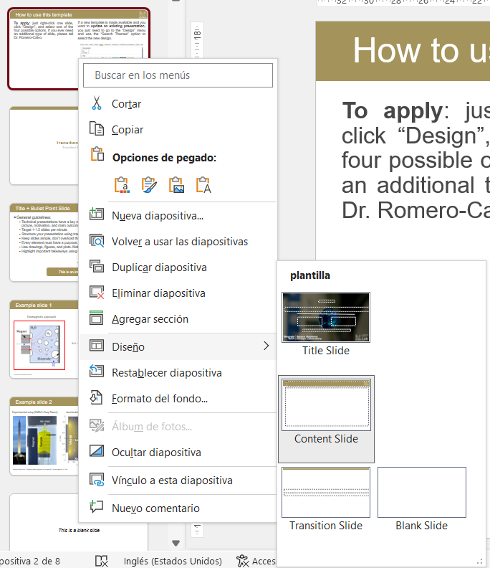
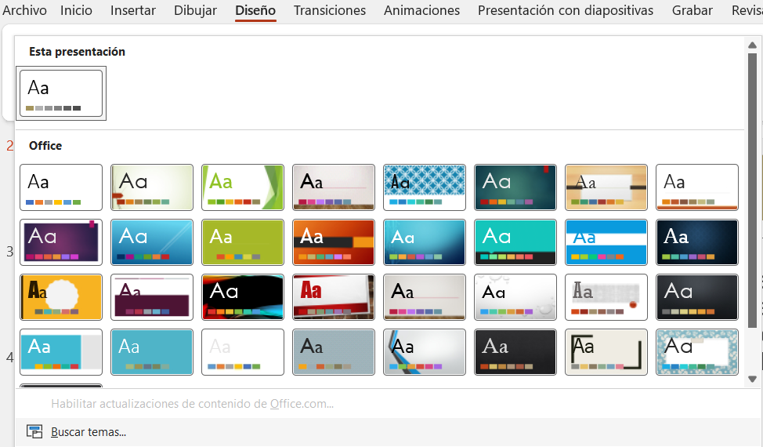
How to use this template
To apply: just right-click one slide, click “Design”, and select one of the four possible options. If you ever need an additional type of slide, please tell Dr. Romero-Calvo.
To update: If a new template is made available and you want to update an existing presentation, you just need to go to the “Design” menu and use the “Search Themes” option to select the new design.

Slide 3
Transition Slide Title
Transition Slide Subtitle

Slide 4
Title + Bullet Point Slide
General guidelines:
Technical presentations have a key networking function. Focus on the high-level picture, motivation, and main outcomes, not on the math
Target 1-1.5 slides per minute
Structure your presentation using transition slides
Keep slides simple, don’t overload them
Every element must have a purpose, avoid unnecessary content
Use drawings, figures, and plots. Make sure everything is well aligned
Highlight important takeaways using boxes (see below)
This is an important message

Slide 5
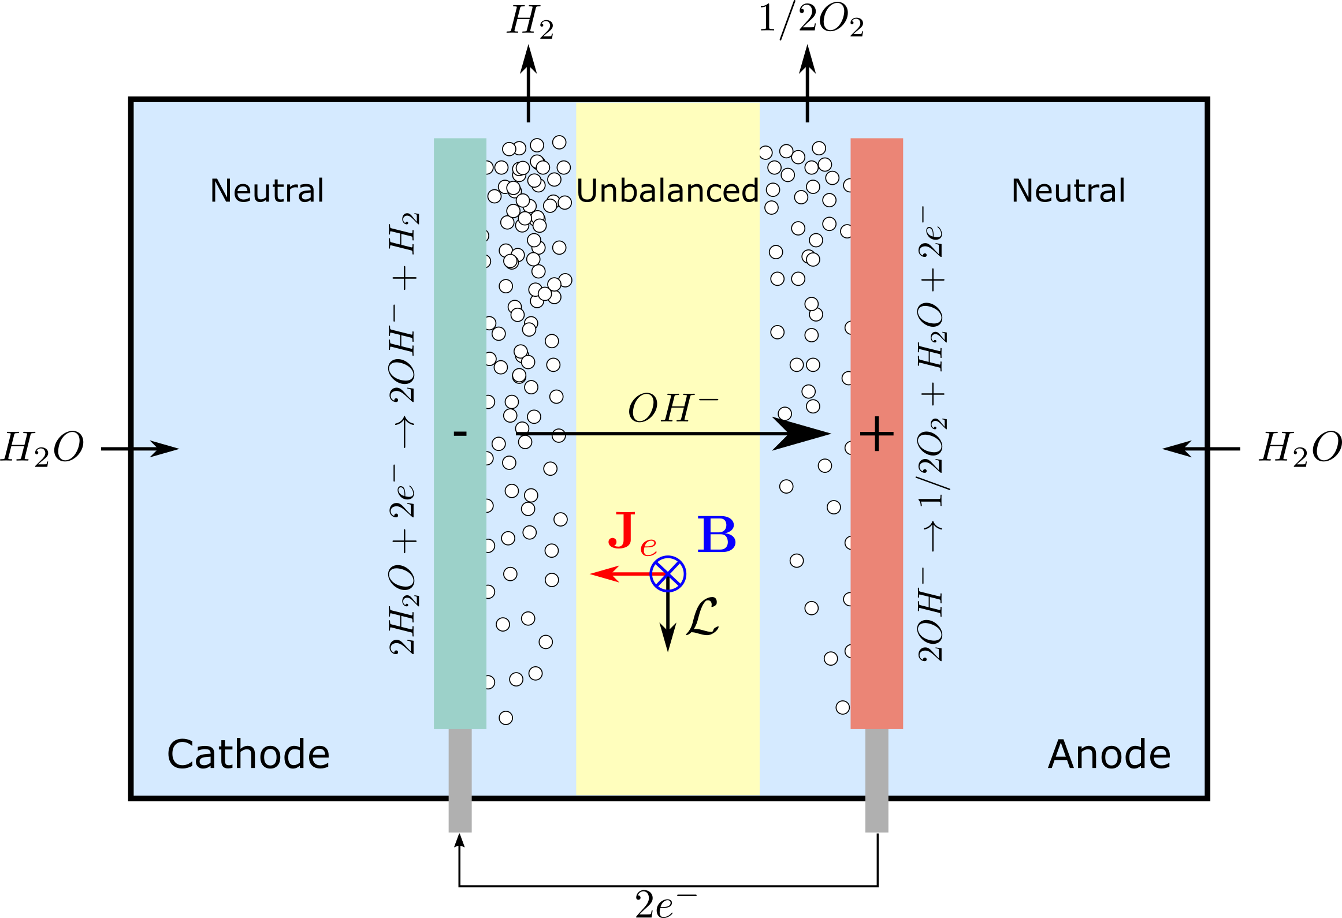
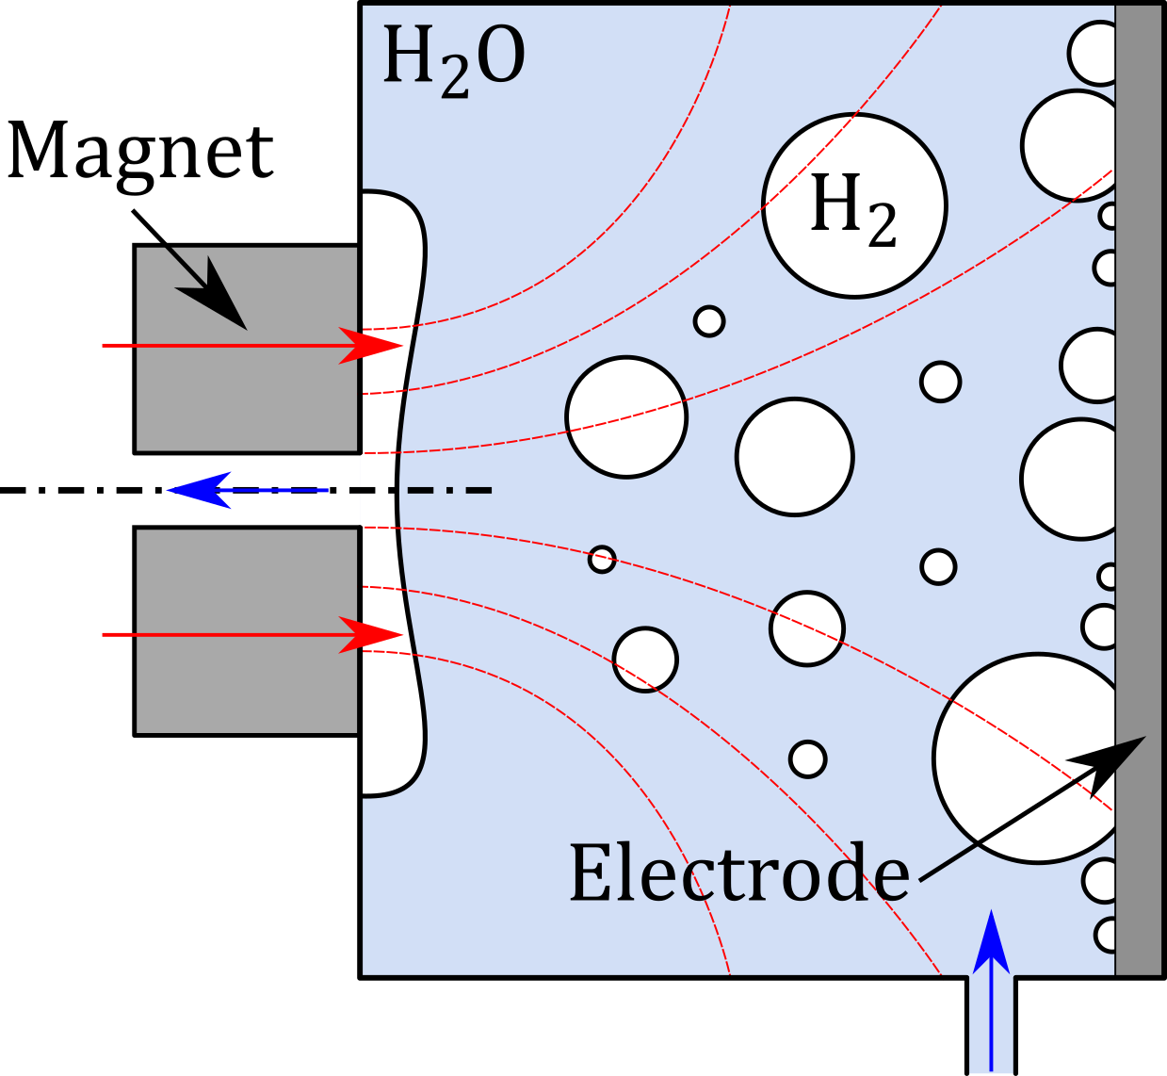

Example slide 1
Diamagnetic approach
Magnetohydrodynamic approach
Preliminary Patent issued

Slide 6
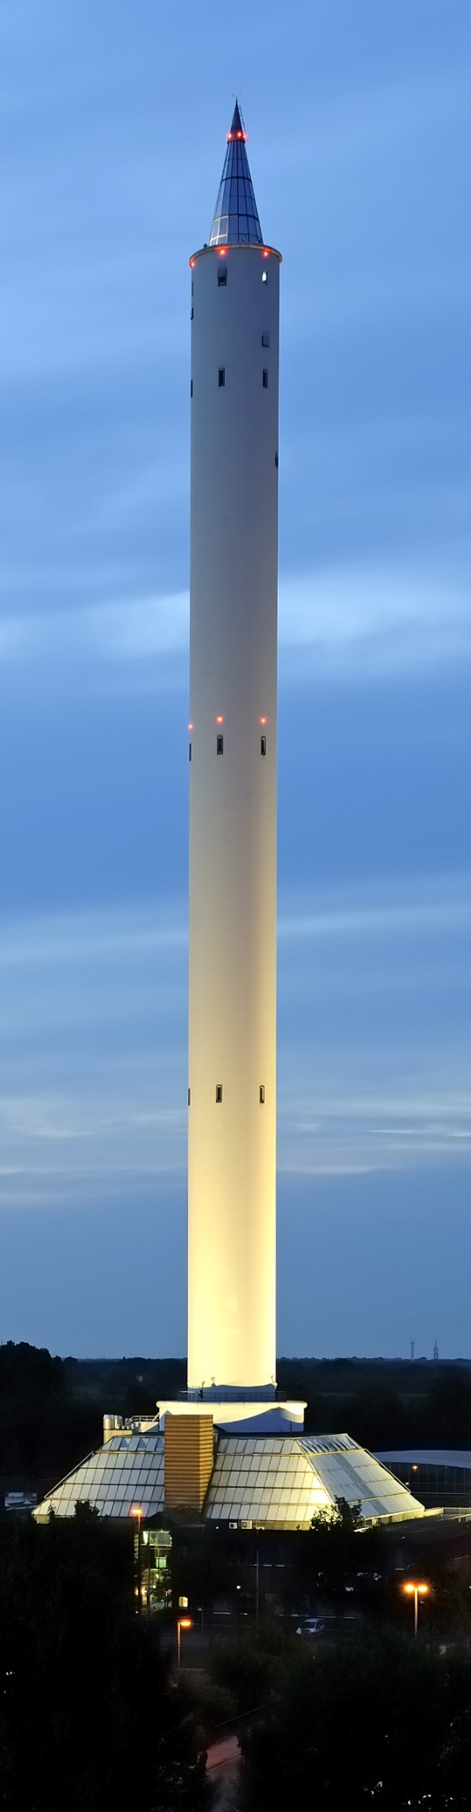
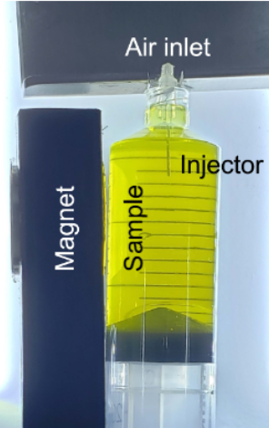
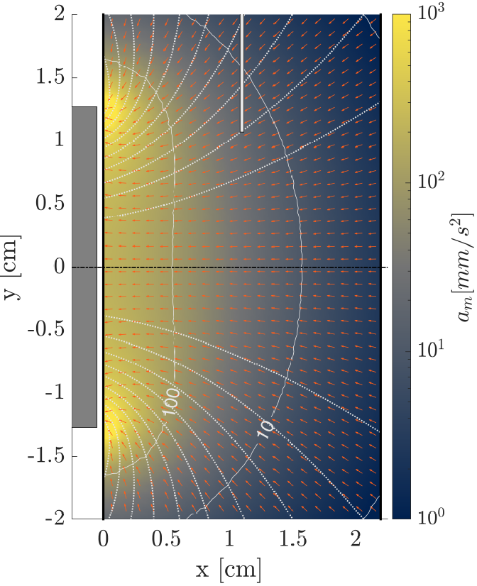
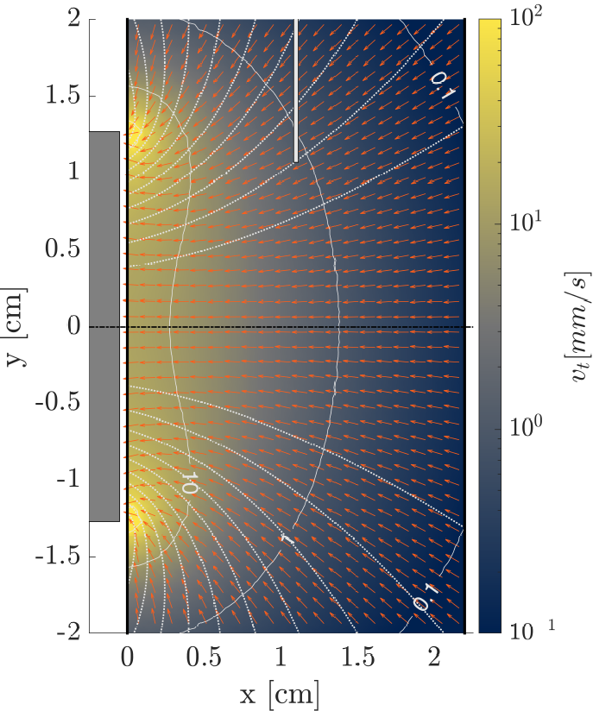
Example slide 2
Experimental setup (ZARM’s Drop Tower)
Acceleration (DI water)
Terminal bubble velocity
Injector
Liquid
1 mm
diameter
Magnet
Syringe
Romero-Calvo Á et al., “Magnetic phase separation in microgravity”, npj Microgravity, 32, 2022

Slide 7
This is a blank slide

Slide 8
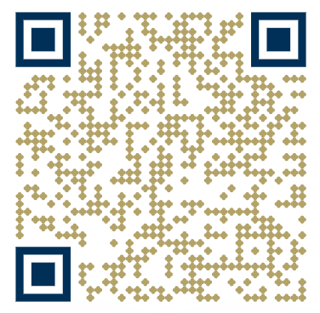




The conclusion slide is key:
Use an image, background video, or graphical element that highlights your coolest result. Show your creativity and captivate your audience during the Q&A turn!
Include contact information (use the elements left at the bottom of the slide)
Don’t thank the audience for listening. Instead, ask if they have any questions
Your email
Your Linkedin
Your ResearchGate
More information available at lowgravitylab.ae.gatech.edu

