Slide 1
Writing a Research Proposal
Linda A. Hershey, MD, PhD
Professor of Neurology, UB
Chief of Neurology, VAMC

Slide 2
Topics for Discussion
Finding a mentor
Choosing a project
Developing research questions
Writing the proposal

Slide 3
Finding a Mentor
Get ideas from your department chair r.e. potential mentors and their areas of research.
Meet with the mentor to discuss their previous work & their resident research projects.
Ask about time availability and collaborators.
Review some background papers together.

Slide 4
Choosing a Project
Establish a good rationale for the project (scholarship).
Build on your mentor’s previous publications (experience).
Make sure the key variables are in the chart (if a chart review).
Be sure there is time for reviewing the literature, getting IRB approval, abstracting charts, analyzing data and preparing a manuscript (with accompanying powerpoint presentation).
If the project involves making phone calls or mailing out
questionnaires, be sure several months are available.

Slide 5
Developing Research Questions
Are the research objectives feasible?
(Time? Sample size? Technical expertise?)
Are the questions novel? Interesting? Useful?
(Will the answers open up new areas of research?)
Is the scope of the study well focused?
(Collecting too much data wastes time and money)
Is it ethical to ask these research questions?
(Unacceptable physical risks or invasion of privacy?)

Slide 6
Writing the Proposal
Background
Objectives (research questions)
Research Plan (inclusion/exclusion)
Methodology
Risk/Benefit Analysis
Confidentiality

Slide 7
Use of TCD in Men to Identify Vascular Causes of Headache
Why TCD? We have technical expertise &
research experience with TCD.
Why Men? Little is known r.e. HA in men,
especially those from OEF & OIF.
Why HA? We have research experience
studying migraine with PET/TCD.

Slide 8
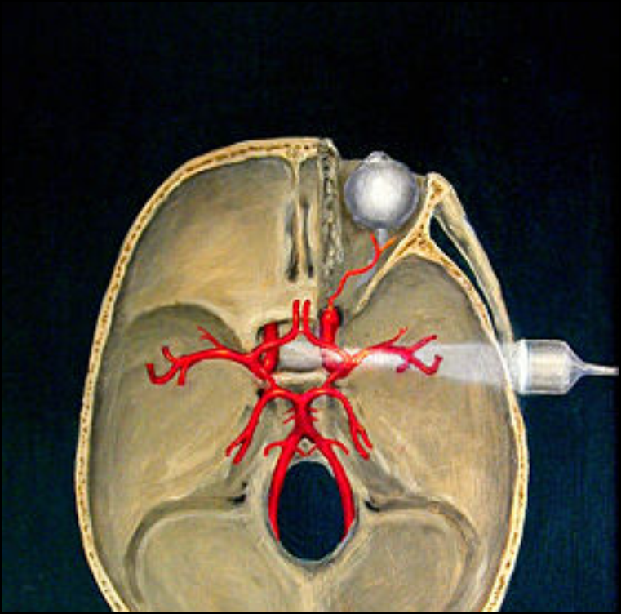
TCD Study: Methods

Slide 9
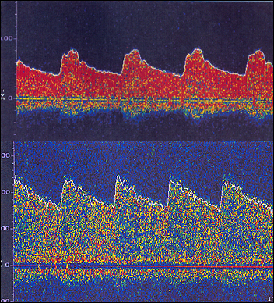
TCD Study: Methods

Slide 10
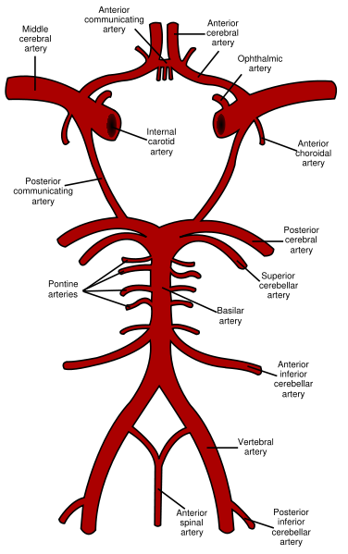
Circle of Willis = 11 vessels

Slide 11
TCD Study: Role of Collaborators
Dr. Choudary (resident)…..literature search, study design, data abstraction, data analysis and manuscript preparation.
Mohammad Hussain (research assistant)…….literature search,
study design, data abstraction and data analysis.
Dr. Bednarczyk (headache expert)…..study design, data analysis and manuscript preparation.
Vicky Olson (laboratory technician).......data collection and
manuscript preparation.
Dr. Hershey (PI)……literature search, study design, IRB approval, data analysis and manuscript preparation.

Slide 12
TCD Study: Establishing a
Good Rationale
We know that migraineurs have low posterior perfusion on PET and low posterior velocities on TCD, even when not having HAs.
We know that migraineurs are more likely to have side-to-side velocity differences and lower pulsatility indices.
We performed a small validation study in 2002, demonstrating the usefulness of these TCD criteria for the diagnosis of migraine:
a) low velocities in 2 or more posterior vessels, or
b) side-to-side differences in ICA velocities >10cm/sec, or
c) side-to-side differences in MCA velocities >10cm/sec, or
d) low pulsatility indices in 3 or more vessels.

Slide 13
TCD Study: Research Questions
What are the most common vascular causes of headache in men (migraine, VBI, or C.A.)?
How do age, head injury, smoking, diabetes and HTN influence these prevalence figures?
In those with negative TCDs, how many pts are on drugs that could be causing headache?

Slide 14
Power
Type I error (alpha): False-positive result.
Type II error (beta): False-negative result.
Power = 1- beta.
Effect size: The magnitude of the effect . The
larger the effect, the smaller the sample size needed to show a significant difference.

Slide 15
Statistical Tests
Aim #1: Proportion of HAs in three groups (migraine, VBI and arteriosclerosis) will be compared with chi-square test.
Aim #2: Prevalence of migraine vs age: Wilcoxon rank sum (outcome is dichotomous; predictor variable is continuous).
Aim #2: Prevalence of migraine vs trauma: Chi-square test
(outcome and predictor variables are both dichotomous).
Aim #3: This will be a proportion (per cent of pts with normal
TCDs who are on drugs that could potentially cause HAs).

Slide 16
Research Plan
Population to be studied: All pts referred to the TCD laboratory between Jan 1, 2007 and Dec 31, 2007 with the CC of HA.
Inclusion criteria: Age and sex of the patient must be available in the chart (only men aged 20-70 yrs will be included).
Exclusion criteria: Patients who have brain tumors, strokes or other mass lesions on brain imaging studies will be excluded. Patients who happen to be VA employees will be excluded.

Slide 17
Methodology
This is a retrospective chart review.
Data collected from the chart will include:
age, sex, head injury (+/-), smoking (+/-),
diabetes (+/-), HTN (+/-), medications that could potentially cause HA (+/-) and the results of the TCD (migraine, VBI, C.A., or no vascular cause of HA).

Slide 18
Risks and Benefits
This is a retrospective chart review.
It meets the “no more than minimal risk” criteria.
Five investigators will have data access.
We should benefit by learning how age, head injury and vascular risk factors contribute to headaches in men. We will learn how many men have HAs that are drug-induced.

Slide 19
Writing a Research Proposal
Find a mentor EARLY.
Choose a project EARLY.
Develop 3 interesting research questions.
Write & submit the proposal EARLY!!!

