Slide 1

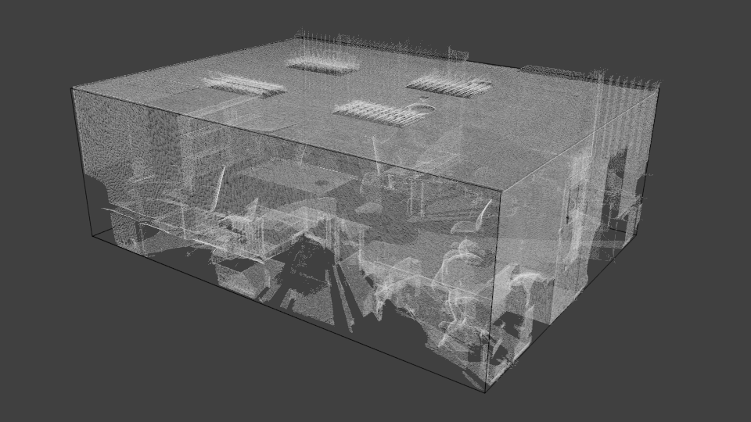
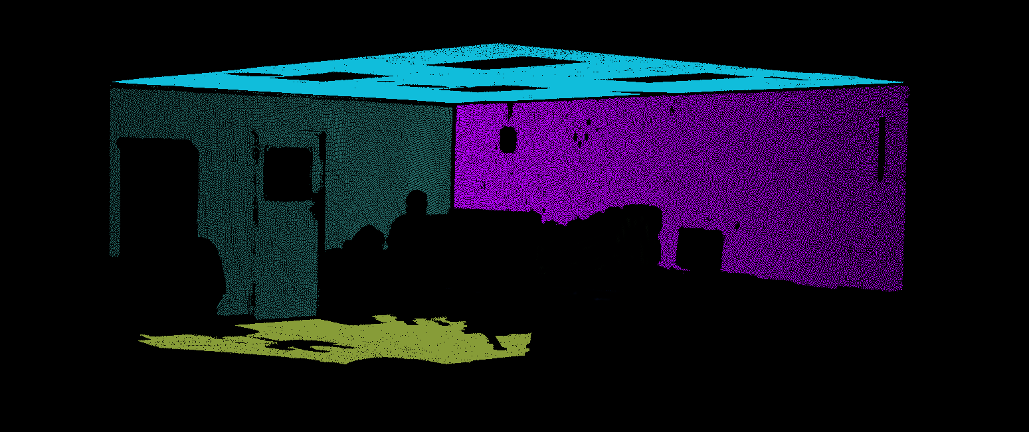
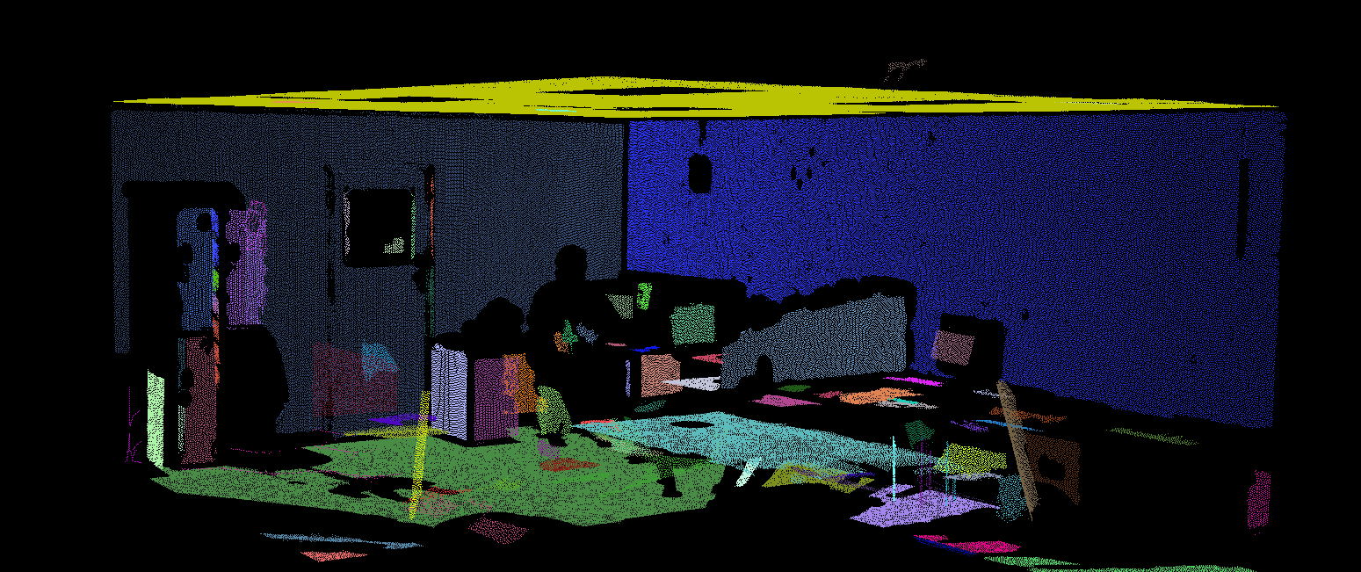
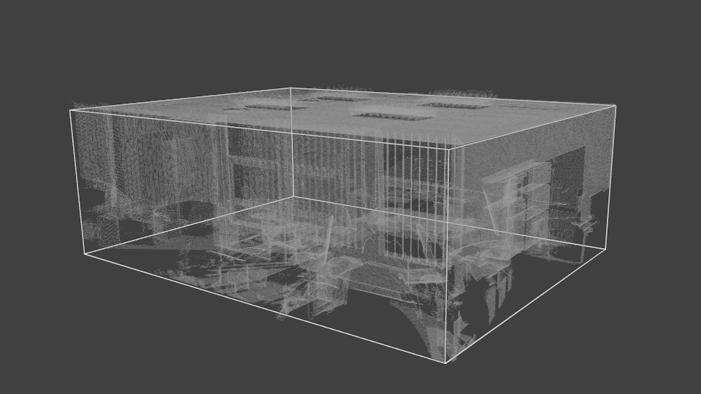
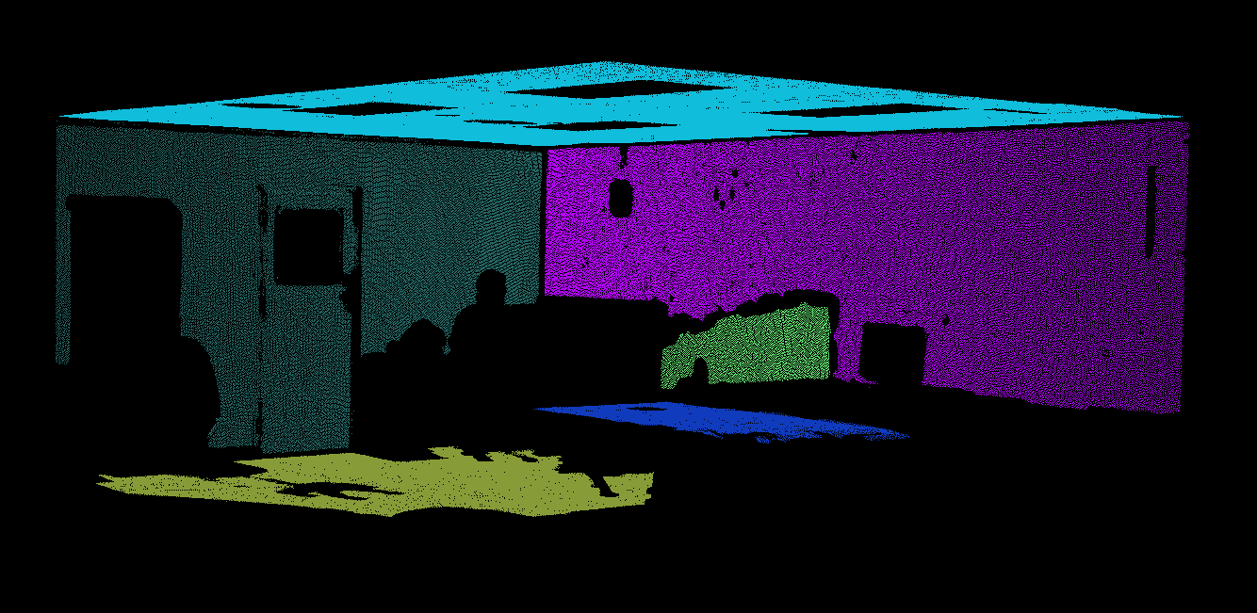
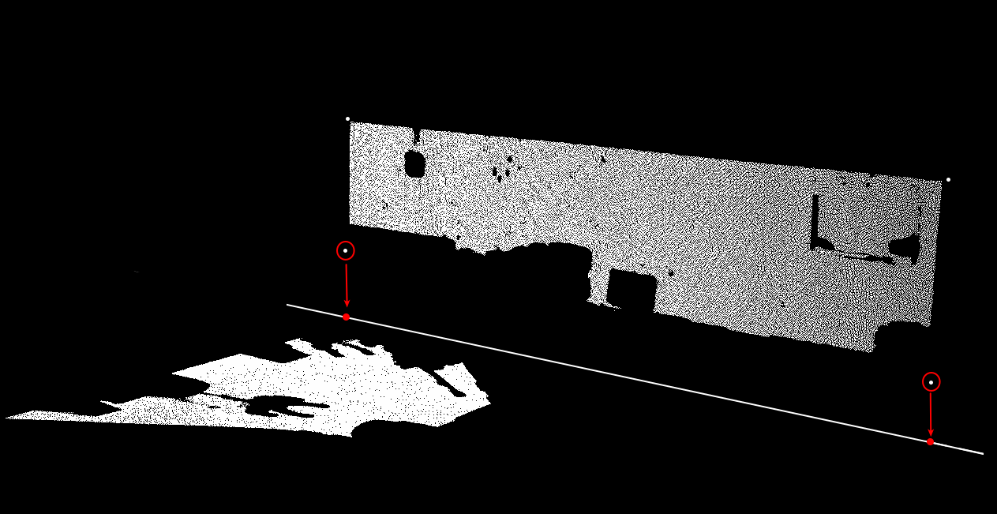
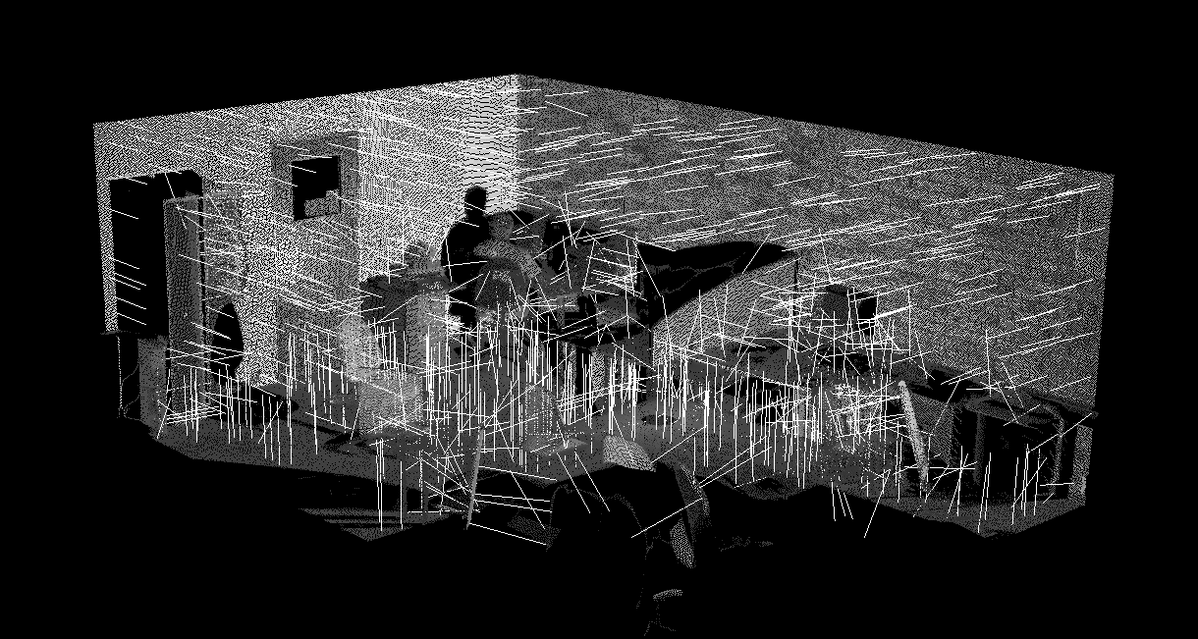
Creating a Boundary Representation Model from Indoor Laser Scans
__________________________________________________________________________________
Author: Tim Marsh Supervised by: Dr. G Sithole
Introduction
Method Cont.
Method Cont.
Results
With laser scanning becoming more prominent as a form of surveying, it becomes increasingly important for us to be able to process the resulting point clouds and make use of them. This project aims to takes indoor laser scans and create boundary representations of these laser scans using machine learning processes and algorithms.
This is done on uncleaned point clouds with a few specific techniques:
Normal computation using Principal Components Analysis
Segmentation using Region Growing
Plane Fitting using RANSAC
Segment filtering based on bounding boxes
Extrusion of segment corner points
A boundary representation model is a method for representing solids by surface elements. That is representing each wall the floor and roof as single surface elements.
Segmentation
The Segmentation of the point cloud is one of the most important steps. The point cloud is segmented up into different planar sections. From these sections walls and floors are detected and extracted. To do this the segmentation parameters need to be correct.
Below is an undesirable result from segmentation. There are too many small unnecessary segments that could cause problems later.
With the correct parameters the segmentation result should look as follows:
Segment Selection
Segments are selected based on their vertical size and orientation. Segments with a vertical extent less that 1m are removed and segments that are not perfectly vertical or horizontal are also removed. This leaves just the extents of the room.
Segment Selection Cont.
After the segment selection is left the scan will look as follows:
Note how objects within the room have been removed.
Extrusion of Boundary points
Boundary points of each segments are created by creating a object oriented bounding box (OBB) and extruded outwards to establish the full extent of what that segments represents.
Each segments is compare to all other segments are lines of intersection are created. The boundary points created with the OBB are then projected onto the lines of intersection. This projection is represented by the red arrows below.
This is done for every segment against every other segments. The boundary points can then be said to estimate the corners of the room. These points are then used to create the boundary representation model.
The resulting Boundary Representation models will look as follows:
Conclusion
This system is currently limited by the complexity of the rooms that have been scanned. Future versions will look into extending this system into more complex rooms and into multi room situations.
Method
Normal Computation
Normals Are calculated using a Principal Components Analysis and in the case of ambiguous normal directions the normal are orientated towards the scan center, which will have to be within the room resulting in all normal pointing inwards. The image below shows the normals of an indoor scene.
Contact Information
Tim Marsh
TimIainMarsh@gmail.com
Dr. George Sithole
george.sithole@uct.ac.za

