Slide 1
TOKENIZATOIN
Timothy J. Naudet

Slide 2
Tokenization Techniques
Accessing only the “errors-*.json” files in the “spack-monitor-nlp” repository, 6 different tokenization techniques were used, in combination with regex, to attain tokens from the error text.
The techniques were:
Spacy
NLTK
BagOWords
Doc2Vec
Keras
Stokenization.py from a paper (linked below)
https://arxiv.org/pdf/2005.01634.pdf

Slide 3
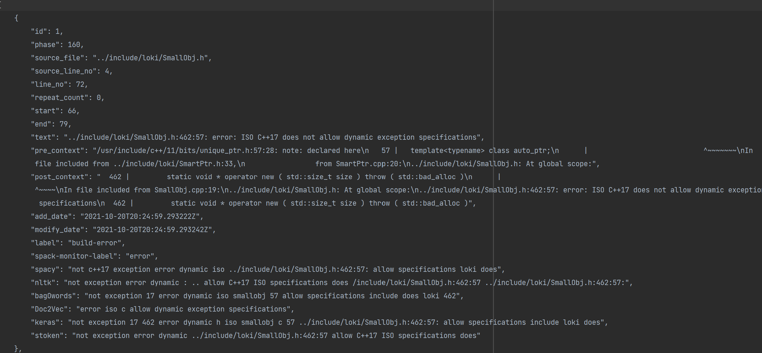
Tokenization Examples
The generated tokens are presented here:

Slide 4
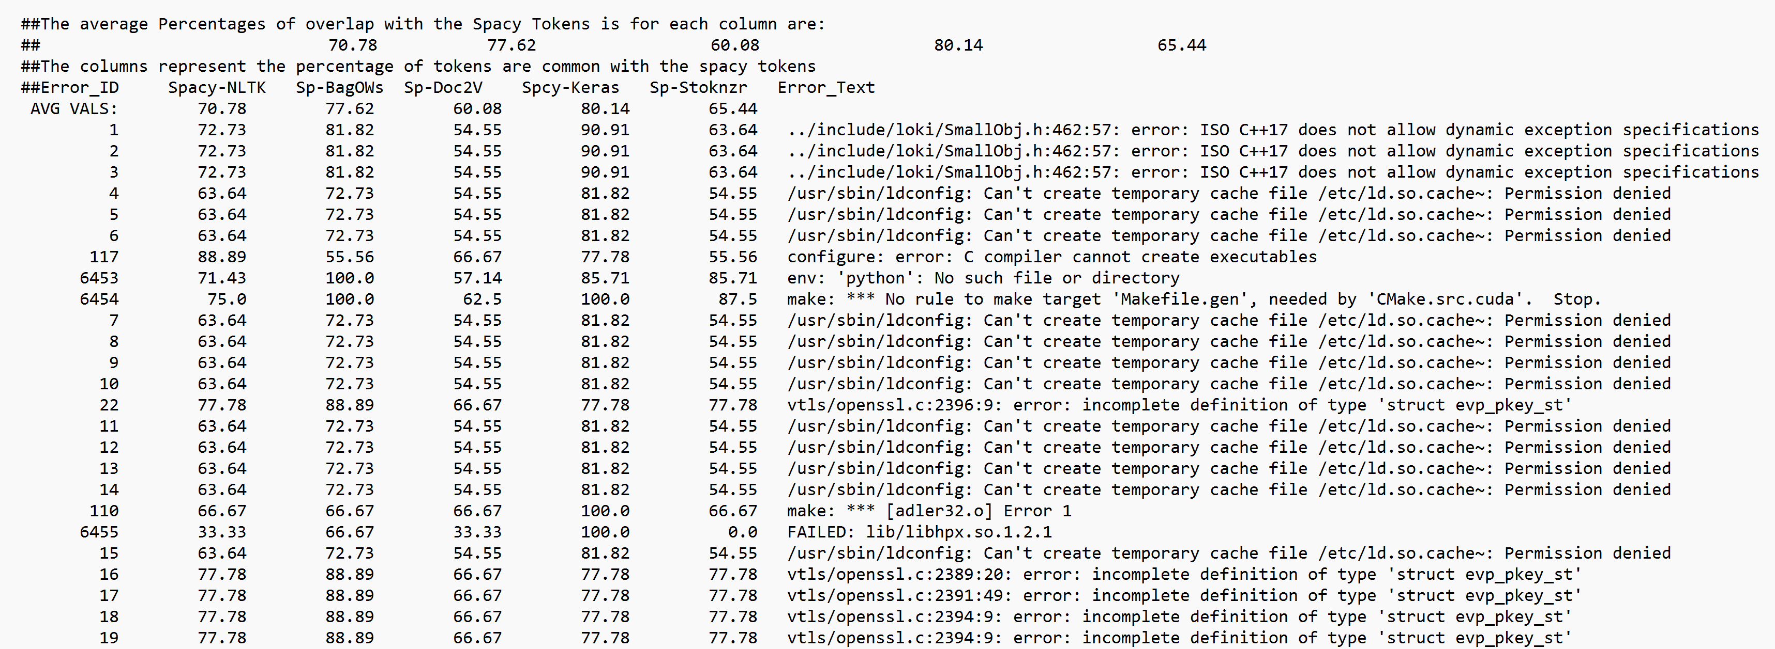
Outcome Metrics
An example of the created outcome is presented below. These metrics, and the averages by column, are provided in the first row and saved in the _presenting_json.json file:

Slide 5
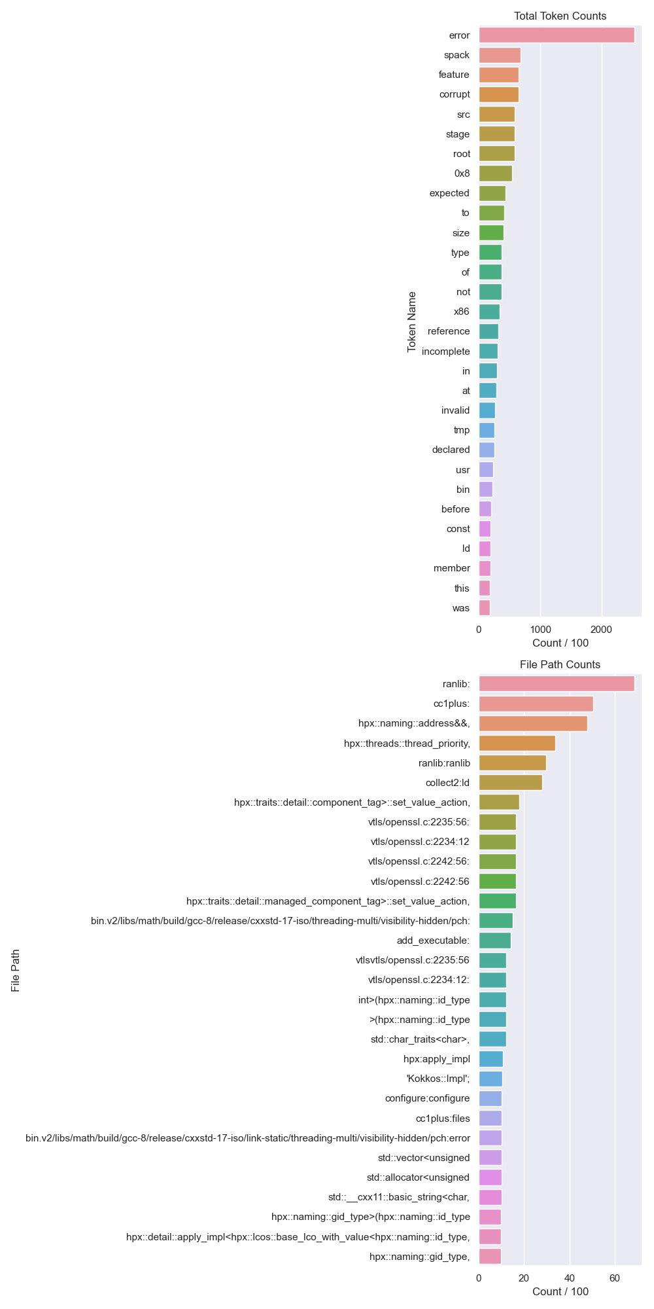
MOST COMMONly Produced Tokens

Slide 6
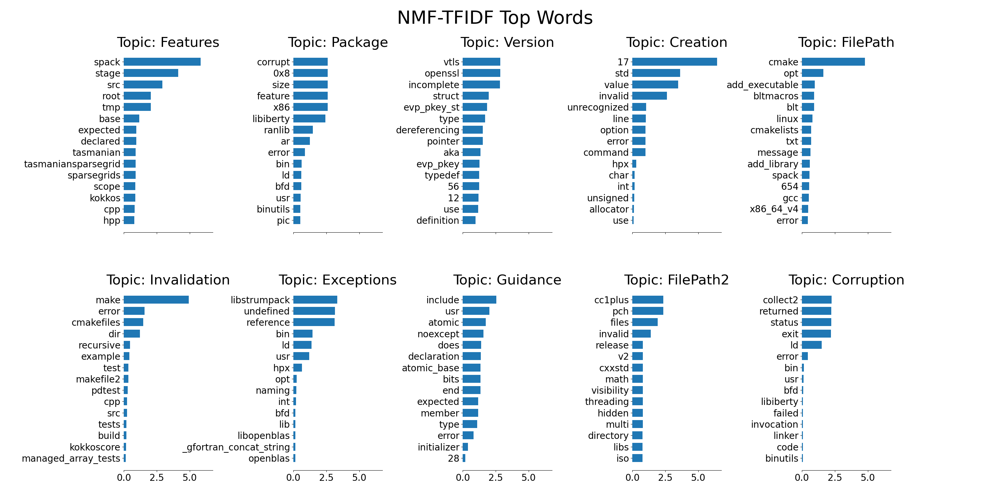
TF-IDF – NNMF Top words

Slide 7
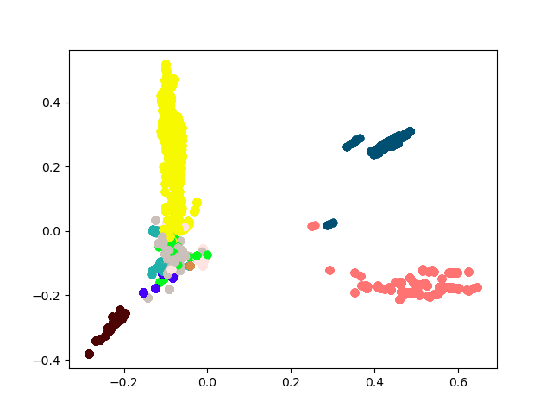
TF-IFD and PCA Plot
This plot illustrates the PCA reduced dimensions of the TF-IDF vectorized data of all the text contained in the error messages.
This plot indicates a dichotomy of correlated and uncorrelated words. Few words tend to stay aligned in the normalized axis of the reduced dimensions of the text.

Slide 8
Appendix: keras
Keras has the options import. text_to_word_sequence(“text”) or to make a Tokenizer object and call tokenizer. text_to_word_sequence(“text”).
The former was selected for brevity.
https://www.tensorflow.org/api_docs/python/tf/keras/preprocessing/text/Tokenizer
https://www.tensorflow.org/api_docs/python/tf/keras/preprocessing/text/text_to_word_sequence

