Slide 1
TOKENIZATOIN

Slide 2
Tokenization Techniques
Accessing only the “errors-*.json” files in the “spack-monitor-nlp” repository, 6 different tokenization techniques were used, in combination with regex, to attain tokens from the error text.
The techniques were:
Spacy
NLTK
BagOWords
Doc2Vec
Keras
Stokenization.py from a paper (linked below)
https://arxiv.org/pdf/2005.01634.pdf

Slide 3
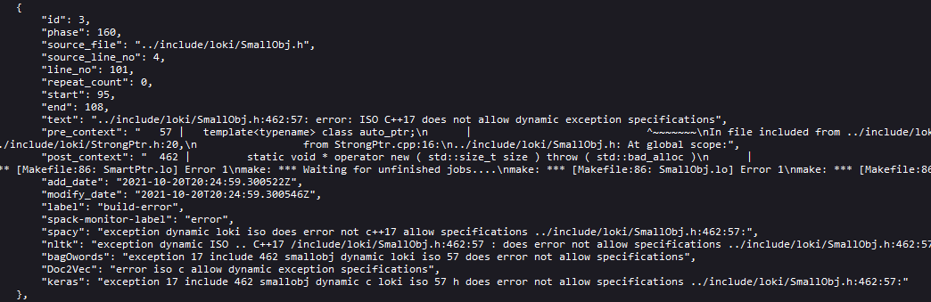
Tokenization Examples
The generated tokens are presented here:

Slide 4
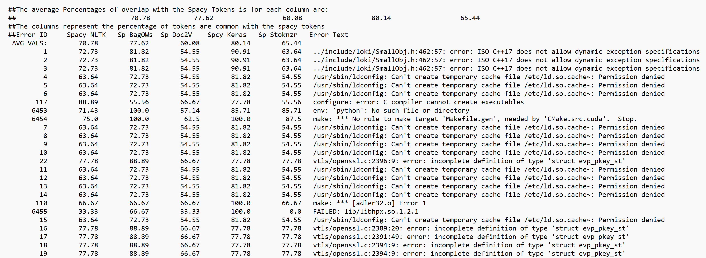
Outcome Metrics
An example of the created outcome is presented here:

Slide 5
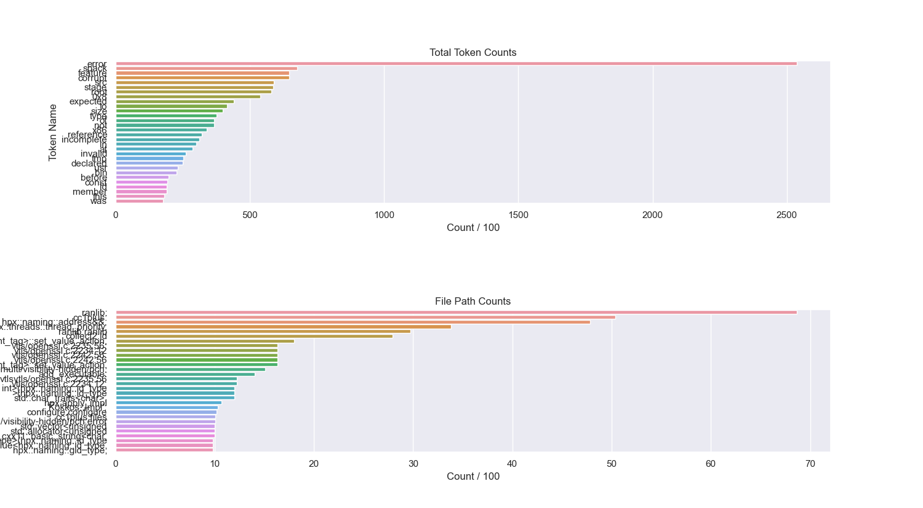
Produced Tokens

Slide 6
Appendix: keras
Keras has the options import. text_to_word_sequence(“text”) or to make a Tokenizer object and call tokenizer. text_to_word_sequence(“text”).
The former was selected for brevity.
https://www.tensorflow.org/api_docs/python/tf/keras/preprocessing/text/Tokenizer
https://www.tensorflow.org/api_docs/python/tf/keras/preprocessing/text/text_to_word_sequence

